Slide 1
Association Rule Mining
Dr Syed Ali Raza
Assistant Professor
FAST, Karachi Campus
Notes:
Working on Machine Learning for 8 years now and feel that Machine Learning is one of the most exciting field in Computer Science. So I decided to give a lecture on Machine Learning.

Slide 2
Association Rule Mining
Given a set of transactions, find rules that will predict the occurrence of an item based on the occurrences of other items in the transaction
Market-Basket transactions
Example of Association Rules
{Diaper} → {Beer}, {Milk, Bread} → {Eggs,Coke}, {Beer, Bread} → {Milk},
Implication means co-occurrence, not causality!

Slide 3
Definition: Association Rule
Association Rule
An implication expression of the form X → Y, where X and Y are itemsets
Example: {Milk, Diaper} → {Beer}
Rule Evaluation Metrics
Support (s)
Fraction of transactions that contain both X and Y
Confidence (c)
Measures how often items in Y appear in transactions that contain X
Example:

Slide 4
Support
Support is an important measure because a rule that has very low support may occur simply by chance
Support is often used to eliminate uninteresting rules

Slide 5
Confidence
Confidence measures the reliability of the inference made by a rule
For a given rule X → Y , the higher the confidence, the more likely it is for Y to be present in transactions that contain X.
Confidence also provides an estimate of the conditional probability of Y given X.

Slide 6
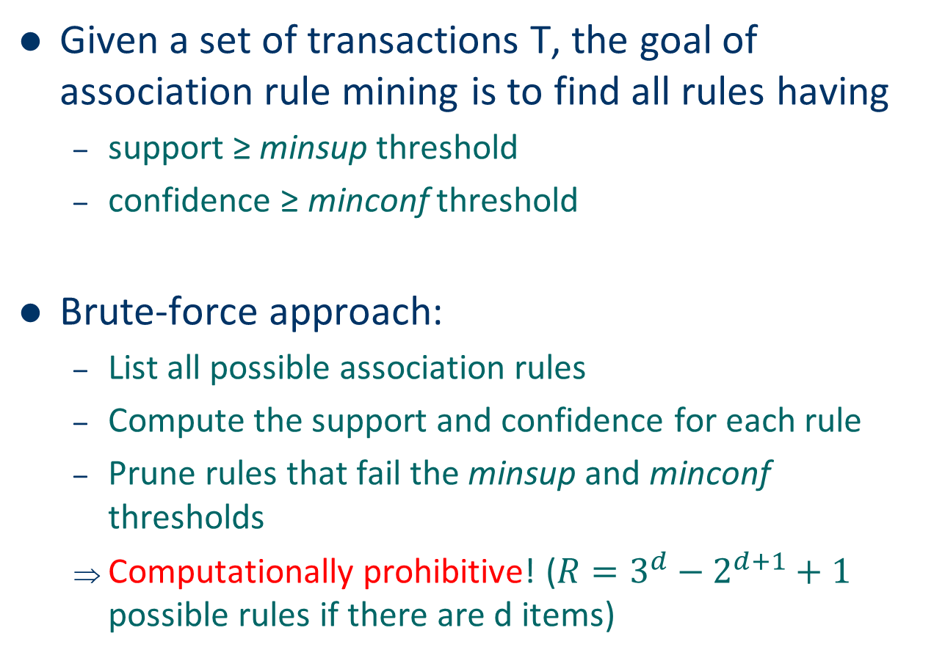
Association Rule Mining Task
Given a set of transactions T, the goal of association rule mining is to find all rules having
support ≥ minsup threshold
confidence ≥ minconf threshold
Brute-force approach:
List all possible association rules
Compute the support and confidence for each rule
Prune rules that fail the minsup and minconf thresholds
Computationally prohibitive! ($R=3^{d}−2^{d+1}+1$ possible rules if there are d items)

Slide 7
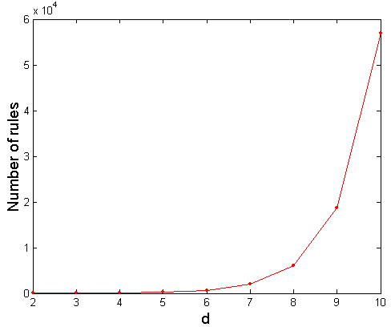
Computational Complexity
Given d unique items:
Total number of itemsets = 2^{d}
Total number of possible association rules:
If d=6, R = 602 rules

Slide 8
Mining Association Rules
Example of Rules:
{Milk,Diaper} → {Beer} (s=0.4, c=0.67) {Milk,Beer} → {Diaper} (s=0.4, c=1.0)
{Diaper,Beer} → {Milk} (s=0.4, c=0.67)
{Beer} → {Milk,Diaper} (s=0.4, c=0.67) {Diaper} → {Milk,Beer} (s=0.4, c=0.5)
{Milk} → {Diaper,Beer} (s=0.4, c=0.5)
Observations:
All the above rules are binary partitions of the same itemset: {Milk, Diaper, Beer}
Rules originating from the same itemset have identical support but can have different confidence
Thus, we may decouple the support and confidence requirements

Slide 9
Mining Association Rules
Two-step approach:
Frequent Itemset Generation
Generate all itemsets whose support ≥ minsup
Rule Generation
Generate high confidence rules from each frequent itemset, where each rule is a binary partitioning of a frequent itemset
Frequent itemset generation is still computationally expensive

Slide 10
Frequent Itemset Generation
Brute-force approach:
Each itemset in the lattice is a candidate frequent itemset
Count the support of each candidate by scanning the database
Match each transaction against every candidate
Complexity ~ O(NMw) => Expensive since M = 2^{d} !!!

Slide 11
Frequent Itemset Generation Strategies
Reduce the number of candidates (M)
Complete search: M=2^{d}
Use pruning techniques to reduce M
Apriori principle
Reduce the number of transactions (N)
Reduce size of N as the size of itemset increases
Reduce the number of comparisons (NM)
Use efficient data structures to store the candidates or transactions
No need to match every candidate against every transaction
FP Tree Generation

Slide 12
Apriori Principle
Apriori Principle: If an itemset is frequent, then all of its subsets must also be frequent
Suppose {c, d, e} is a frequent itemset as shown in the next Figure
Clearly, any transaction that contains {c, d, e} must also contain its subsets, {c, d}, {c, e}, {d, e}, {c}, {d}, and {e}. As a result, if {c, d, e} is frequent, then all subsets of {c, d, e} (i.e., the shaded itemsets in this figure) must also be frequent

Slide 13
Apriori Principle
Conversely, if an itemset such as {a, b} is infrequent, then all of its supersets must be infrequent too. As illustrated in the next Figure, the entire subgraph containing the supersets of {a, b} can be pruned immediately once {a, b} is found to be infrequent. This strategy of trimming the exponential search space based on the support measure is known as support-based pruning.
It follows a property of the support measure, namely, that the support for an itemset never exceeds the support for its subsets, also known as the anti-monotone property of the support measure.

Slide 14
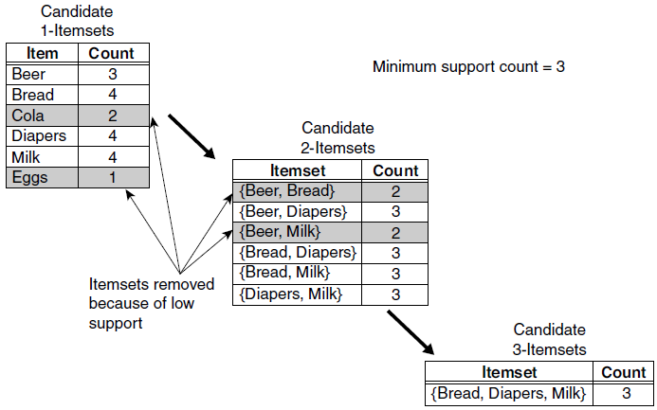
Example of Frequent Itemset Generation Using Apriori Algorithm
Assume that the support threshold is 60% (3/5) ( i.e. a minimum support count equal to 3)
Here the Apriori principle is applied
Notes:
https://www.youtube.com/watch?v=ToswH_dA7KU

Slide 15
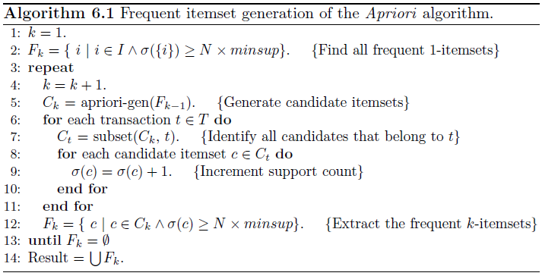
Algorithm for Frequent Itemset Generation Using Apriori Principle

Slide 16
Algorithm for Frequent Itemset Generation Using Apriori Principle
The algorithm initially makes a single pass over the data set to determine the support of each item. Upon completion of this step, the set of all frequent 1-itemsets, F1, will be known (steps 1 and 2)
Next, the algorithm will iteratively generate new candidate k-itemsets using the frequent (k − 1)-itemsets found in the previous iteration (step 5)

Slide 17
Algorithm for Frequent Itemset Generation Using Apriori Principle
To count the support of the candidates, the algorithm needs to make an additional pass over the data set (steps 6–10). The subset function is used to determine all the candidate itemsets in Ck that are contained in each transaction t
After counting their supports, the algorithm eliminates all candidate itemsets whose support counts are less than minsup
The algorithm terminates when there are no new frequent itemsets generated, i.e., Fk = ∅

Slide 18
References
Lecture Notes for Chapter 6, Introduction to Data Mining, by Tan, Steinbach, Kumar

