Slide 1

Work Breakdown Structure

Slide 2
SW
Project
Scope and planning involves defining a project's deliverables, goals, tasks, deadlines, and cost and how to develop the software product.
SCOPE
Planning
Requirements
Design
Development
Testing
Built
Release

Slide 3

Project Management
Planning
Estimating
Scheduling
Define activities & deliverables
Time, Cost in terms of resource usage
Define sequence of tasks occurrence

Slide 4
What is WBS?
a work breakdown structure is:
“A hierarchical decomposition
of the total scope of work
to be carried out by the project team
to accomplish the project objectives
and create the required deliverables.”

Slide 5
WBS
Dividing complex projects to simpler and manageable tasks.
Stops till the tasks no longer remains decomposable.
Work packages: the smallest unit of work that a project can be broken down into.
A WBS element may be a product, data, a service, or any combination.
5

Slide 6
Why is it needed?
For activities identification
For correct estimation
Identify related activities using PERT
Creating schedules
Project failure risk minimized

Slide 7
When should we develop WBS?
After finalizing project scope and before project estimation

Slide 8
How to create WBS?
Done by project managers mostly
describe the project statement
Highlight all necessary phases in the project
Create deliverables
Validate for completeness
8

Slide 9
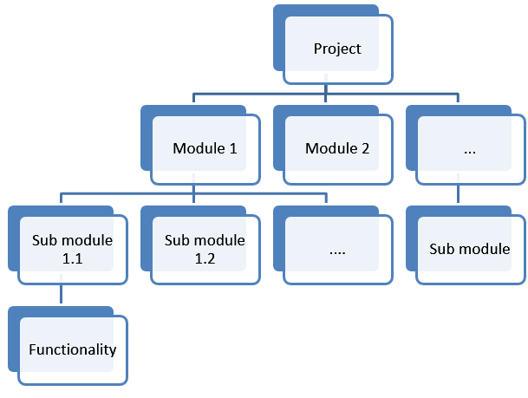
WBS

Slide 10
Reasons to use WBS
correct project organization.
depicts whole project work.
Helpful for describing the project scope to stakeholders.
Helpful in cost estimation, resource allocation, and time management improvements.
Minimize unnecessary work that leads to missed deadlines and out-of-scope work.

Slide 11
Levels in WBS
Starts with level 0 i.e. project title
Then make level 1, highest level breakdown of about 4-7 nodes depending on your project. Termed as control accounts
Then make level 2, they are work packages.
Level 3 are the tasks/activities to be performed
Follow the standard numbering scheme
11

Slide 12
WBS Formats
Outline (Indented Format)
Graphical Tree (Organizational Chart)

Slide 13
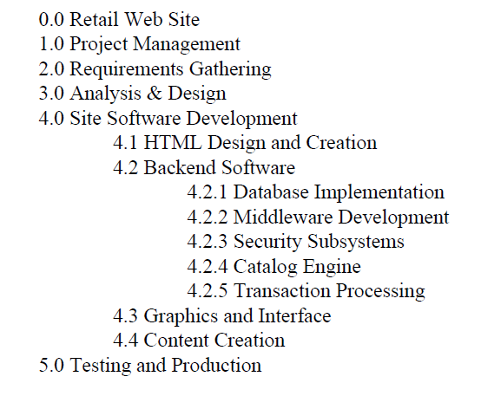
Displaying the WBS Example of outlined WBS.
13

Slide 14
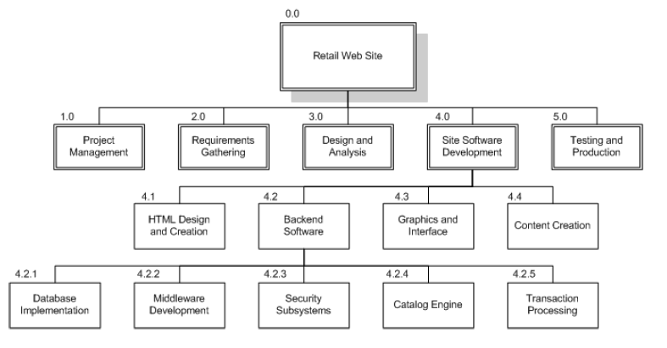
Displaying the WBS Example of Graphical Tree WBS
14

Slide 15
Challenges
Must have concrete knowledge of project
All tasks/ deliverables properly identified and quoted
Each task should be broken down into legit activities
15

Slide 16
WBS Guidelines
Must be easy to understand
Covers all objectives
Each element corresponds to a deliverable
Breakdown until you get accurate time and cost estimates
Should not be much detailed as project plan
Can evolve over time
Each level have no more than 7 items
Can be drawn using Gantt Pro, Word, Excel, MS Project, Visio etc. May use a template if you have
16

Slide 17
Example WBS
Redecorate Room
Prepare materials
Buy paint
Buy a ladder
Buy brushes/rollers
Buy wallpaper remover
Prepare room
Remove old wallpaper
Remove detachable decorations
Cover floor with old newspapers
Cover electrical outlets/switches with tape
Cover furniture with sheets
Paint the room
Clean up the room
Dispose or store left over paint
Clean brushes/rollers
Dispose of old newspapers
Remove covers
WBS

Slide 18
Professional Tools used
https://www.projectmanager.com/
https://www.atlassian.com/software/jira
https://ganttpro.com/

