Slide 1
APRIORI ALGORITHM KINZA 23K-0842
Step-by-step formulas, worked examples, pseudocode, and interpretations (Beginner friendly)

Slide 2
Agenda
Introduction & Key Concepts
Apriori principle & Pseudocode
Worked Example — full iteration tables and arithmetic
Rule generation: confidence & lift with calculations
Second example (Tea & Biscuits) + interpretation
Real-world supermarket example + suggested actions
Parameters, complexity & optimizations
Advantages & limitations
Conclusion & references

Slide 3
Introduction
Apriori finds frequent itemsets in a transaction database and derives association rules.
Typical use: Market basket analysis (what customers buy together).
Inputs: Transaction set T, minimum support min_sup, minimum confidence min_conf.
Outputs: Frequent itemsets and high-confidence association rules.

Slide 4
Key Concepts & Formulas
Transaction: e.g., T1 = {Milk, Bread, Butter}.
Itemset: any set of items (1-itemset, 2-itemset, ...).
Support(X) = |{t ∈ T : X ⊆ t}| / |T|
→ Example: If X appears in 3 of 10 transactions, support(X) = 3/10 = 0.3
Confidence(A→B) = support(A∪B) / support(A)
→ Interprets as P(B | A)
Lift(A→B) = support(A∪B) / (support(A) × support(B))
→ Lift > 1: positive association
→ Lift ≈ 1: independent
→ Lift < 1: negative association

Slide 5
Apriori Principle (Intuition)
If an itemset is frequent, all of its subsets must be frequent.
Example: If {A,B,C} is frequent, then {A,B}, {A,C}, {B,C}, {A}, {B}, {C} are all frequent.
Use this to prune: when a candidate has any infrequent subset, drop it.

Slide 6
Detailed Pseudocode
Apriori(T, min_sup):
# T: list of transactions (sets)
# min_sup: fraction (e.g., 0.4 for 40%)
L1 = find_frequent_1_itemsets(T, min_sup)
k = 2
L = {1: L1}
while L[k-1] is not empty:
Ck = apriori_gen(L[k-1]) # join + prune step
for each transaction t in T:
for each candidate c in Ck:
if c subset of t:
count[c] += 1
Lk = { c in Ck | count[c] / |T| >= min_sup }
L[k] = Lk
k += 1
return union of all L[k]
apriori_gen(Lk_minus_1):
# join step: join pairs in Lk_minus_1 with first k-2 items equal
# prune step: remove candidate if any (k-1)-subset is not in Lk_minus_1
return candidate set Ck

Slide 7
How the Algorithm Executes (Step-by-Step)
1. Scan DB once to count all single items ⇒ produce L1 (frequent 1-itemsets).
2. From L1 generate candidate pairs C2 (all combinations of L1 items).
3. Scan DB and count C2 occurrences ⇒ filter by min_sup ⇒ L2.
4. From L2 generate C3 (join L2 items that share prefix), prune using Apriori, count and filter ⇒ L3, etc.
5. Continue until no Lk is produced.
6. Generate rules from frequent itemsets by computing confidence and filtering by min_conf.

Slide 8
Worked Example: Dataset (Setup)
Dataset (5 transactions):
T1: {A, B, C}
T2: {A, B}
T3: {A, C}
T4: {B, C}
T5: {A, B, C}
Total transactions |T| = 5
Set min_sup = 40% = 0.4
That means an itemset must appear in at least 0.4 × 5 = 2 transactions.
So required count ≥ 2.

Slide 9
L1 Calculation
Count every single item across T1..T5:
Count(A) = appears in T1, T2, T3, T5 → 4
Support(A) = 4/5 = 0.8
Count(B) = T1, T2, T4, T5 → 4
Support(B) = 4/5 = 0.8
Count(C) = T1, T3, T4, T5 → 4
Support(C) = 4/5 = 0.8
All supports ≥ 0.4 → L1 = {A, B, C}.

Slide 10
L1 Calculation Table
Item | Count | Support
A | 4 | 4/5 = 0.8
B | 4 | 4/5 = 0.8
C | 4 | 4/5 = 0.8

Slide 11
Generate C2 (Candidates) — Explain Join & Prune
From L1 = {A,B,C}, all 2-combinations: {AB, AC, BC}.
No pruning necessary (all 1-subsets are frequent).
Count each by scanning transactions:
AB appears in T1, T2, T5 ⇒ count = 3 → support = 3/5 = 0.6
AC appears in T1, T3, T5 ⇒ count = 3 → support = 0.6
BC appears in T1, T4, T5 ⇒ count = 3 → support = 0.6
All ≥ 0.4 → L2 = {AB, AC, BC}.

Slide 12
C2 Calculation Table
Itemset | Count | Support
AB | 3 | 3/5 = 0.6
AC | 3 | 3/5 = 0.6
BC | 3 | 3/5 = 0.6

Slide 13
Generate C3 and L3
From L2, make C3 candidate by joining AB & AC → ABC (since AB and AC share prefix A).
Count ABC across transactions:
ABC appears in T1 and T5 → count = 2 → support = 2/5 = 0.4
Because support(ABC) = 0.4 ≥ min_sup, L3 = {ABC}.

Slide 14
C3 Calculation Table
Itemset | Count | Support
ABC | 2 | 2/5 = 0.4

Slide 15
Summary of Frequent Itemsets
L1: A (0.8), B (0.8), C (0.8)
L2: AB (0.6), AC (0.6), BC (0.6)
L3: ABC (0.4)
Algorithm stops after L3 because next candidates would be size 4 but there are only 3 items.

Slide 16
Rule Generation: Method, Formulas & Examples
Method: For each frequent itemset X, for every non-empty proper subset A ⊂ X, form rule A → X/A.
Accept rule if confidence(A → X/A) ≥ min_conf.
Example (let min_conf = 0.6):
From AB (support 0.6): rules A→B and B→A.
• confidence(A→B) = support(AB)/support(A) = 0.6 / 0.8 = 0.75 → accepted
• confidence(B→A) = 0.6 / 0.8 = 0.75 → accepted
From ABC (support 0.4): rules like AB→C, A→BC, etc.
• AB→C: confidence = support(ABC)/support(AB) = 0.4 / 0.6 ≈ 0.6667 → accepted if min_conf ≤ 0.6667
Lift example:
• lift(A→B) = support(AB)/(support(A)×support(B)) = 0.6 / (0.8 × 0.8) = 0.6 / 0.64 = 0.9375
• Lift < 1: items slightly negatively associated relative to expectation from independence.

Slide 17
Detailed Arithmetic: A → B
Show calculations step-by-step:
support(A) = 4/5 = 0.8
support(AB) = 3/5 = 0.6
confidence(A→B) = support(AB)/support(A) = 0.6 / 0.8 = 0.75 → 75%
Interpretation: if a transaction contains A, 75% of time it also contains B.

Slide 18
Second Worked Example (Tea & Biscuits)
Dataset (5 transactions):
T1: {Tea, Sugar}
T2: {Tea, Biscuits}
T3: {Sugar, Biscuits}
T4: {Tea, Sugar, Biscuits}
T5: {Tea, Biscuits}
|T| = 5. Choose min_sup = 50% = 0.5 ⇒ required count ≥ 3.
L1 counts:
• Tea: appears in T1,T2,T4,T5 ⇒ 4 → support = 4/5 = 0.8
• Biscuits: T2,T3,T4,T5 ⇒ 4 → support = 0.8
• Sugar: T1, T3, T4 ⇒ 3 → support = 3/5 = 0.6
C2 counts (pairs):
• Tea-Biscuits: appears in T2, T4, T5 → count = 3 → support = 0.6
• Tea-Sugar: T1, T4 → count = 2 → support = 0.4
• Biscuits-Sugar: T3, T4 → count = 2 → support = 0.4
For min_sup 0.5, only Tea-Biscuits (0.6) is frequent.
Rule: Tea → Biscuits: confidence = support(Tea,Biscuits)/support(Tea) = 0.6 / 0.8 = 0.75
Interpretation: 75% of transactions with Tea also include Biscuits — good for bundling tea & biscuits.

Slide 19
Practical Supermarket Mini-Dataset (Realistic Demo)
Transactions (10 example):
T1: {Bread, Milk}
T2: {Bread, Diapers, Beer, Eggs}
T3: {Milk, Diapers, Beer, Cola}
T4: {Bread, Milk, Diapers, Beer}
T5: {Bread, Milk, Diapers, Cola}
T6: {Bread, Milk}
T7: {Diapers, Beer}
T8: {Bread, Cola}
T9: {Milk, Eggs}
T10: {Bread, Milk, Diapers}
Choose min_sup = 30% (0.3) → threshold count ≥ 3 (since 0.3×10=3).

Slide 20
Supermarket Frequent Itemsets & Actions
Itemset | Example Support | Action/Interpretation
Bread | 6/10 = 0.6 | High demand — prioritize shelf space
Milk | 5/10 = 0.5 | Staple — maintain stock
Diapers | 5/10 = 0.5 | Promote with related products (beer/cola)
Beer, Diapers | 4/10 = 0.4 | Suggest bundle or targeted marketing

Slide 21
Business Actions from Supermarket Analysis
Business Actions:
• Place diapers near beer/cola promotions for adults
• Create cross-sell offers
• Plan inventory based on frequent patterns

Slide 22
How to Choose min_sup & min_conf
Start with domain knowledge: staples (bread, milk) need higher thresholds.
min_sup too high → few patterns (may miss less-frequent but useful combos).
min_sup too low → explosion of candidates; heavy computation.
Common practical approach: start with moderate min_sup (e.g., 0.01–0.05 for very large datasets) and raise/lower depending on output count.
min_conf typically 50%–80% depending on how conservative you want rules to be.

Slide 23
Complexity & Common Optimizations
Complexity: multiple DB scans, candidate explosion; worst-case exponential in number of distinct items.
Optimizations:
• Hash-based counting to reduce candidate generation
• Partition algorithm: find local frequent itemsets per partition and combine
• Sampling: approximate frequent itemsets from a sample
• Use FP-Growth (no candidate generation) for dense datasets

Slide 24
Advantages & Limitations
Advantages:
• Simple and intuitive
• Uses pruning (Apriori principle) to reduce search
Limitations:
• Many DB scans, slow on large datasets
• Generates a large number of candidates in dense datasets
• Not memory-efficient for huge numbers of items

Slide 25
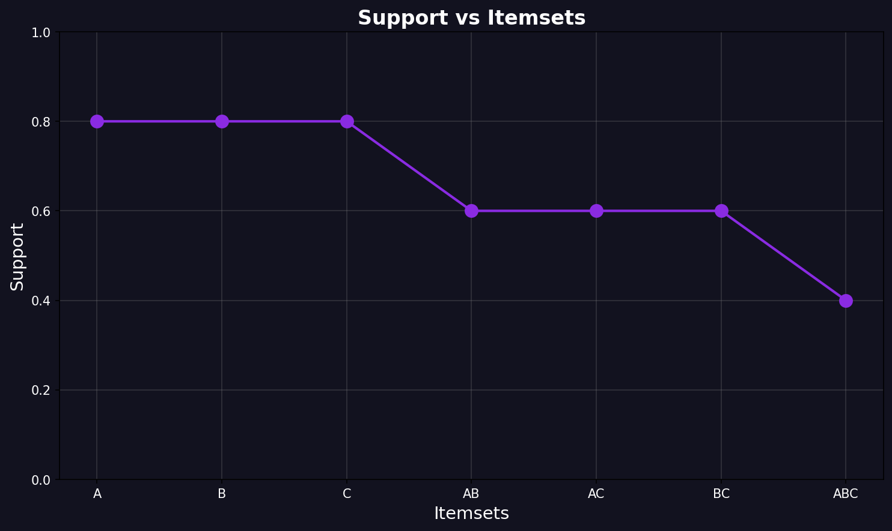
Support vs Itemsets Graph

Slide 26
Conclusion & References
Apriori is foundational for association mining and demonstrates pruning via downward closure.
For large or dense datasets, consider FP-Growth or other optimized algorithms.
References:
• Agrawal & Srikant (1994) — Fast Algorithms for Mining Association Rules
• Han et al. — Data Mining: Concepts and Techniques

