Slide 1
Principal Component Analysis (PCA)
Dimensionality reduction, step-by-step calculations, examples, and interpretation
Kinza 23K-0842

Slide 2
Agenda
Introduction to PCA
Mathematical foundation & optimization theory
Detailed covariance & correlation mathematics
Matrix operations in PCA
Eigenvalues & eigenvectors (detailed linear algebra)
Step-by-step numerical example with full calculations
Complete matrix representations
Applications, advantages & limitations
Key mathematical formulas summary

Slide 3
Introduction
PCA reduces dimensionality while preserving variance
Transforms correlated features into uncorrelated principal components
Useful for:
• Visualization
• Noise reduction
• Feature extraction

Slide 4
Mathematical Foundation
Mathematical Foundation:
Given data matrix X ∈ ℝⁿˣᵖ with n observations and p features
Goal: Find projection matrix W ∈ ℝᵖˣᵏ (k < p) such that:
• Y = XW captures maximum variance
• Columns of W are orthonormal (W^T W = I)
Optimization Problem:
maximize: Var(W^T X) = W^T Σ W
subject to: ||W|| = 1 (unit vector)
Solution: Use Lagrange multipliers
L = W^T Σ W - λ(W^T W - 1)
Taking derivative: ∂L/∂W = 2ΣW - 2λW = 0
This gives: ΣW = λW (eigenvalue equation!)

Slide 5
Covariance & Correlation (Mathematical Details)
Covariance: Measures joint variability of two variables
Definition:
Cov(X,Y) = E[(X - E[X])(Y - E[Y])]
= (1/(n-1)) × Σᵢ₌₁ⁿ (Xᵢ - X̄)(Yᵢ - Ȳ)
Sample Covariance Matrix Σ:
Σᵢⱼ = Cov(Xᵢ, Xⱼ) for features i and j
Properties:
• Cov(X,X) = Var(X) ≥ 0 (diagonal elements)
• Cov(X,Y) = Cov(Y,X) (symmetric matrix)
• |Cov(X,Y)| ≤ √(Var(X)Var(Y)) (Cauchy-Schwarz)
Correlation Coefficient:
ρ(X,Y) = Cov(X,Y) / (σₓσᵧ) ∈ [-1, 1]
Matrix Form:
Σ = (1/(n-1)) × (X - 1ₙX̄^T)^T (X - 1ₙX̄^T)

Slide 6
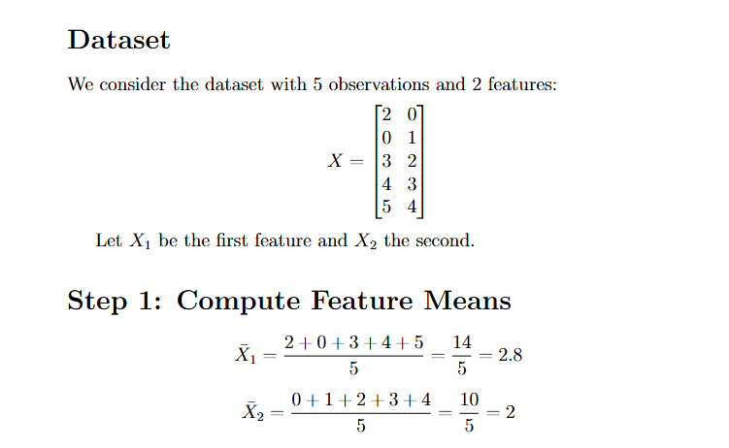
Mathematical Formulation (Solved Example)

Slide 7
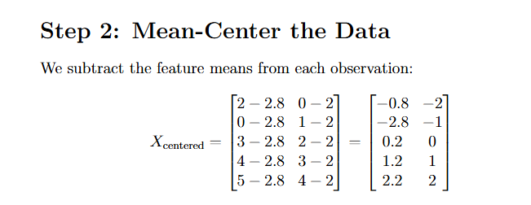
Mathematical Formulation (Solved Example)

Slide 8
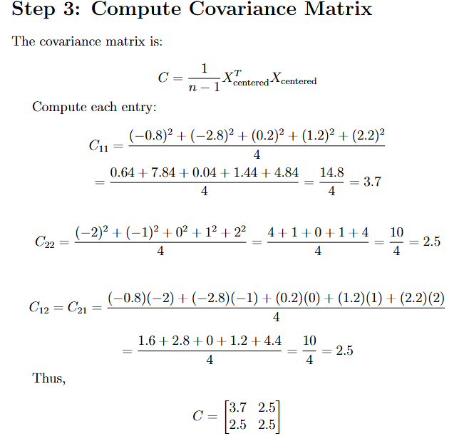
Mathematical Formulation (Solved Example)

Slide 9
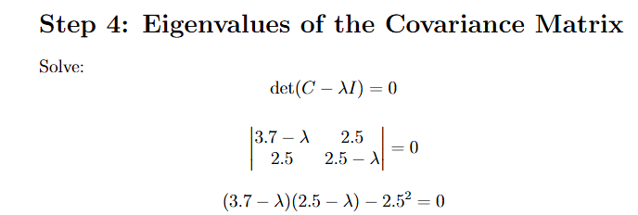
Mathematical Formulation (Solved Example)

Slide 10
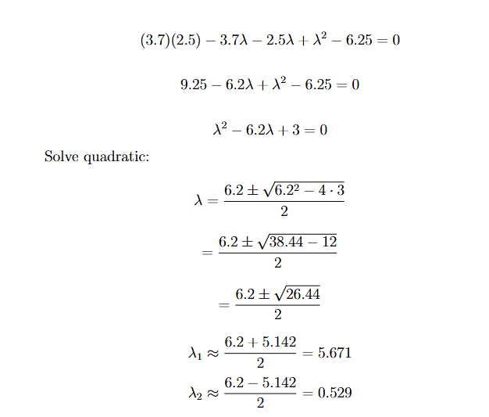
Mathematical Formulation (Solved Example)

Slide 11
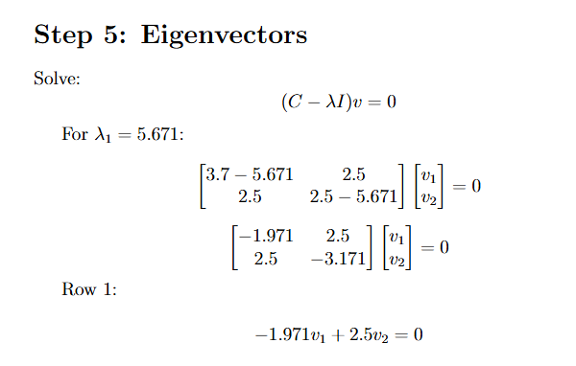
Mathematical Formulation (Solved Example)

Slide 12
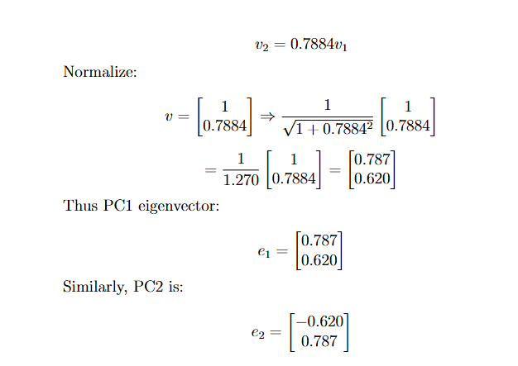
Mathematical Formulation (Solved Example)

Slide 13
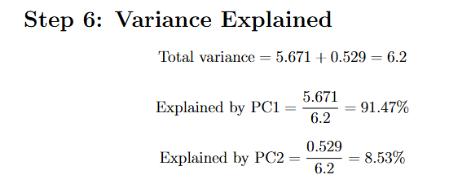
Mathematical Formulation (Solved Example)

Slide 14
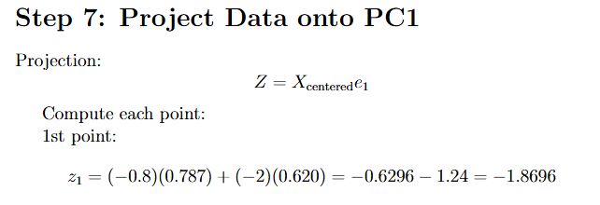
Mathematical Formulation (Solved Example)

Slide 15
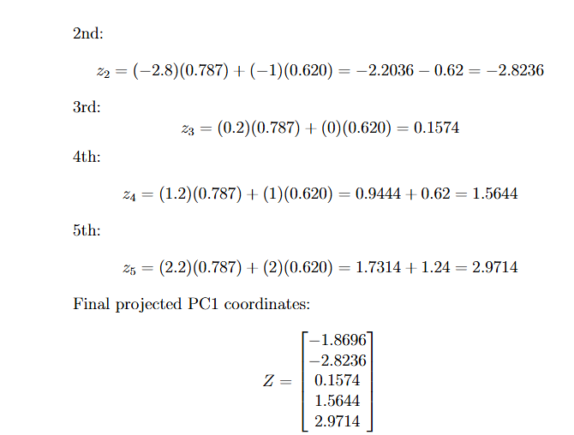
Mathematical Formulation (Solved Example)

Slide 16
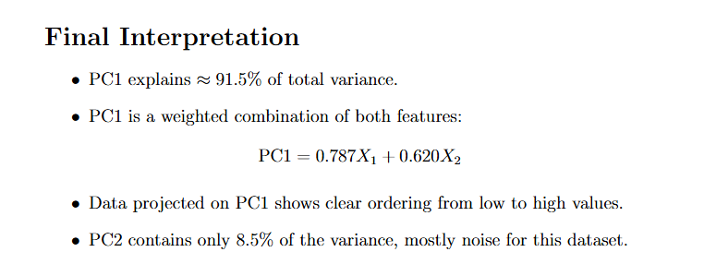
Mathematical Formulation (Solved Example)

Slide 17
Applications of PCA
Applications of PCA:
1. Dimensionality reduction for high-dimensional data
→ Reduce from 1000 features to 50 principal components
2. Visualization in 2D/3D
→ Project high-dimensional data to 2D for plotting
3. Noise reduction in datasets
→ Remove components with low variance (often noise)
4. Preprocessing for machine learning
→ Reduce features before training models
→ Remove multicollinearity
5. Feature extraction
→ Create new features that capture most information

Slide 18
Advantages & Limitations
Advantages:
• Reduces dimensionality → faster algorithms, less storage
• Removes multicollinearity → uncorrelated features
• Preserves maximum variance → minimal information loss
• No labels required → unsupervised method
Limitations:
• Linear assumptions → may miss non-linear relationships
• May lose interpretability → components are linear combinations
• Sensitive to scaling → features must be standardized
• Assumes variance = importance → may not always be true

Slide 19
Key Takeaways
Key Takeaways:
• PCA transforms correlated features into uncorrelated principal components
• Key steps: Standardize → Covariance → Eigen decomposition → Projection
• Eigenvalues indicate variance explained by each component
• Choose number of components based on explained variance (e.g., 95%)
• First PC captures maximum variance, second PC captures second maximum (orthogonal), etc.
• Useful for visualization, noise reduction, and feature extraction

