Slide 1

PlagioScan
Plagiarism Checker
For Short Text
Presented By: Kinza Ali
Safia Naseem
Fatima Nawaz

Slide 2
Introduction
Plagiarism is a major issue in academic and professional writing. Many students unintentionally copy content from online sources.
This project introduces PlagioScan, a tool that detects similarity between short texts using Natural Language Processing (NLP).
It helps users identify copied or similar content quickly and efficiently.

Slide 3
Algorithm / Approach
The system uses NLP techniques to detect plagiarism:
• Text is converted into numerical form using TF-IDF (Term Frequency–Inverse Document Frequency) • Cosine Similarity is used to compare texts • Similarity score is calculated in percentage
Result:
High similarity → Plagiarism detected
Medium similarity → Partial match
Low similarity → Original content

Slide 4
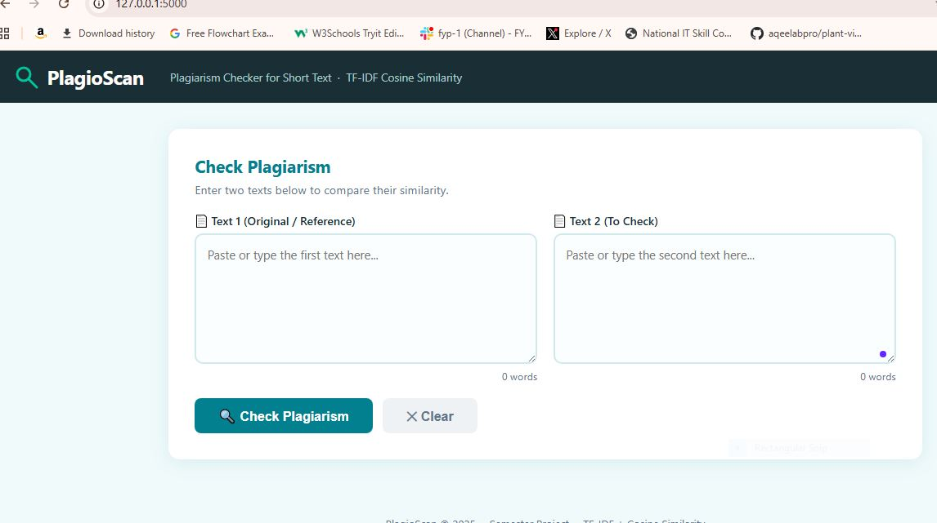

Slide 5
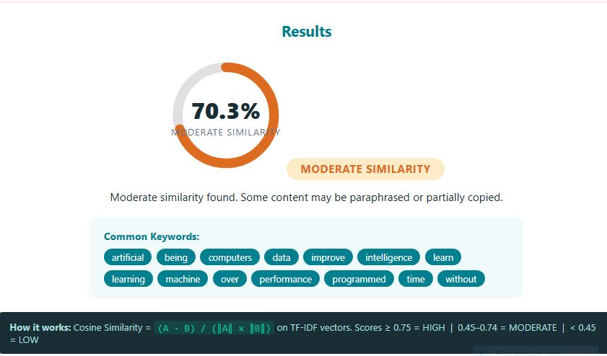

Slide 6
Target Audience
This software is useful for:
• Students • Teachers • Content writers • Bloggers
It is especially designed for quick checking of short text content.

Slide 7
Sales Perspective
Who will buy it?
• Schools and universities • Freelancers and writers • Educational platforms
Why will they purchase?
• Saves time in checking plagiarism • Easy to use • Fast and accurate results • Affordable solution

Slide 8

Thank You

