Slide 1
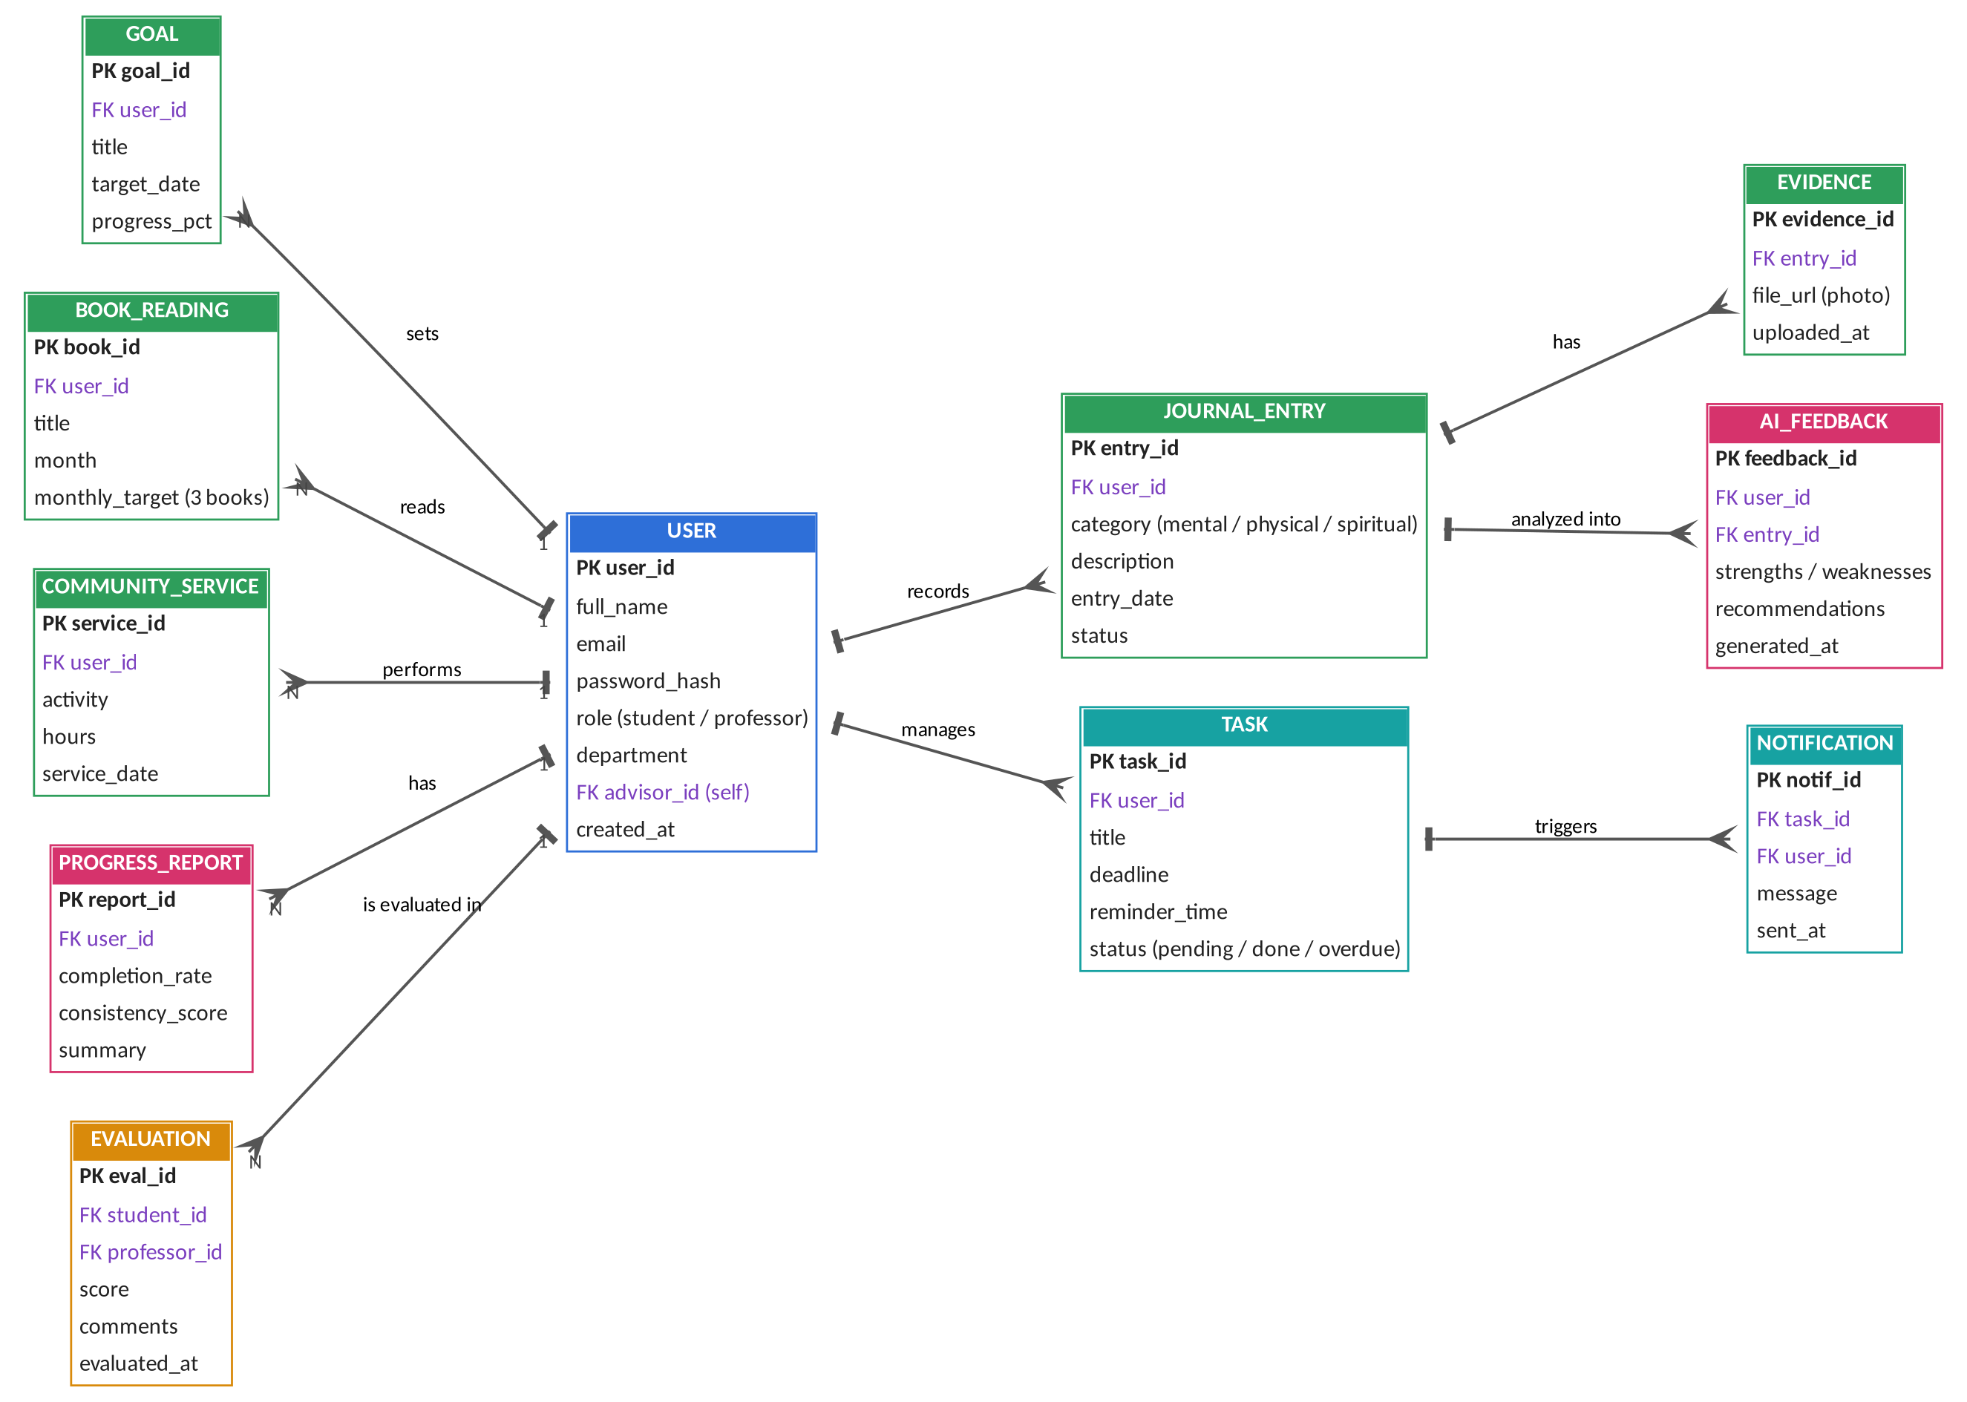
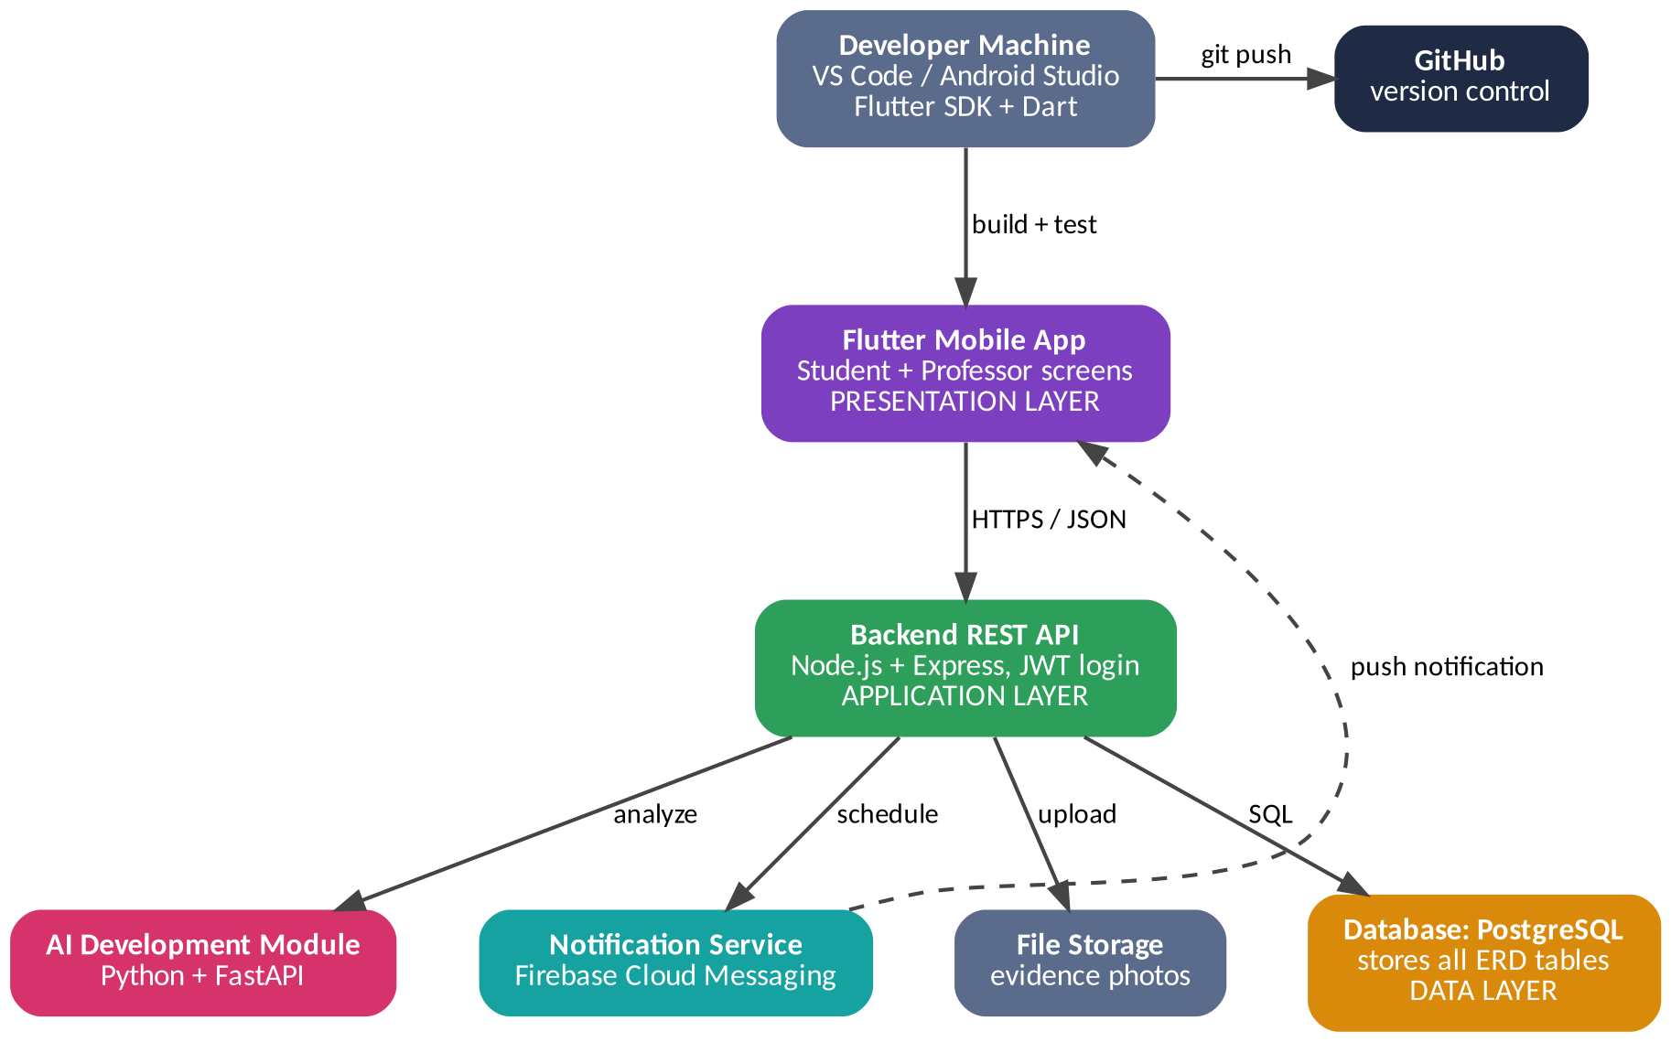
ERD & Development Environment — AI-Powered Student Leadership and Personal Growth App
Left: database tables and relationships (PK = primary key, FK = foreign key, crow’s foot = “many”, bar = “one”). Right: tools and servers that build and run the system.
ENTITY RELATIONSHIP DIAGRAM (ERD)
DEVELOPMENT / RUNTIME ENVIRONMENT
Self-link: USER.advisor_id → USER.user_id (a professor advises many students). Student and professor share one USER table, separated by role.
Colors — blue: users | green: development records | pink: AI output | orange: evaluation | teal: tasks and notifications
Kinzul Eman | ID: 232012048 | Pakistan Global Institute | Final Year Project (FYP)

