Slide 1

資 料 結 構
TA
2024/03/11

Slide 2
大綱
03/11 課程
Homework 1（ Due date: 3/17(日) ）
練習題

Slide 3
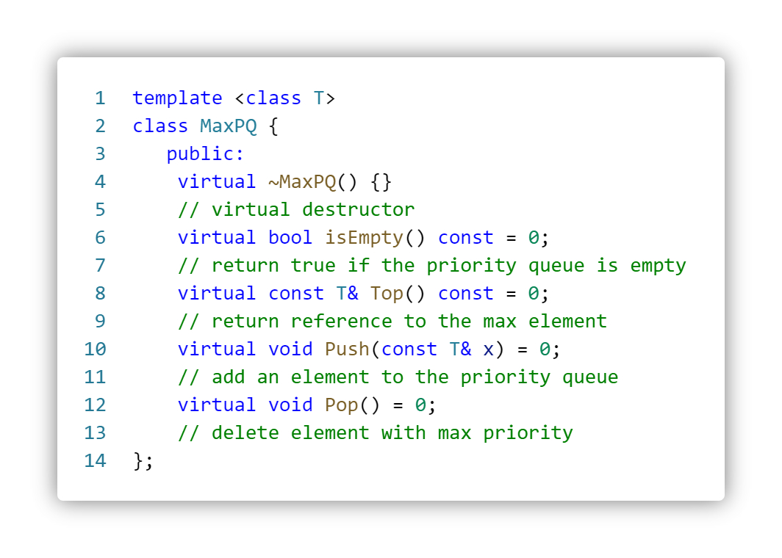
MaxPQ - ADT
Time complexity analysis (See page 281)
 | Unordered linear list | Max heap
IsEmpty | O(1) | O(1)
Top | Θ(n) | O(1)
Push | O(1) | O(log n)
Pop | Θ(n) | O(log n)
Notes:
Write a C++ abstract class similar to ADT 5.2 for the ADT MinPQ, which defines a min priority queue. Now write a C++ class MinHeap that derives from this abstract class and implements all the virtual functions of MinPQ. The complexity of each function should be the same as that for the corresponding function of MaxHeap.
虛擬繼承 (Virtual inheritance) 教學： https://openhome.cc/Gossip/CppGossip/virtualInheritance.html

Slide 4
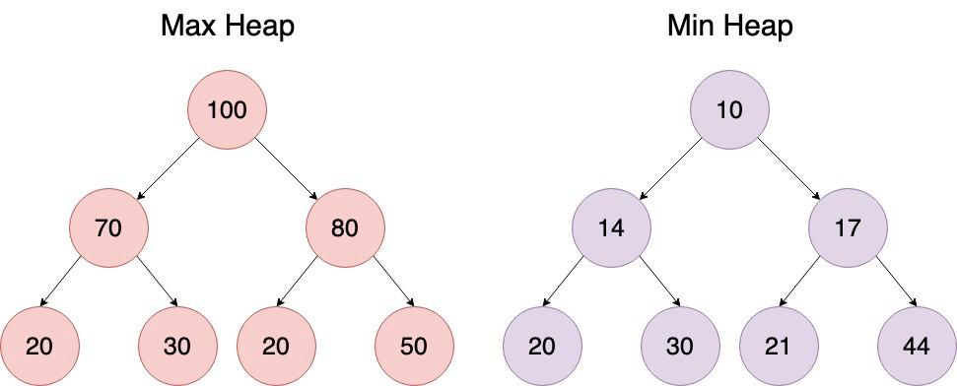
Min Heap & Max Heap
0 | 1 | 2 | 3 | 4 | 5 | 6 | 7
 | 100 | 70 | 80 | 20 | 30 | 20 | 50
0 | 1 | 2 | 3 | 4 | 5 | 6 | 7
 | 10 | 14 | 17 | 20 | 30 | 21 | 44

Slide 5
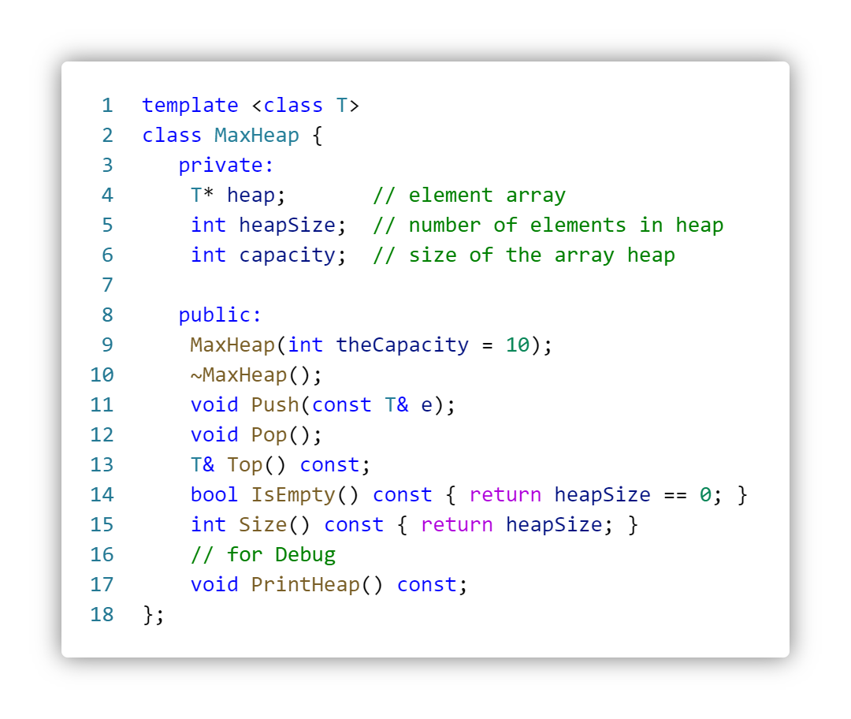
Max Heap - ADT

Slide 6
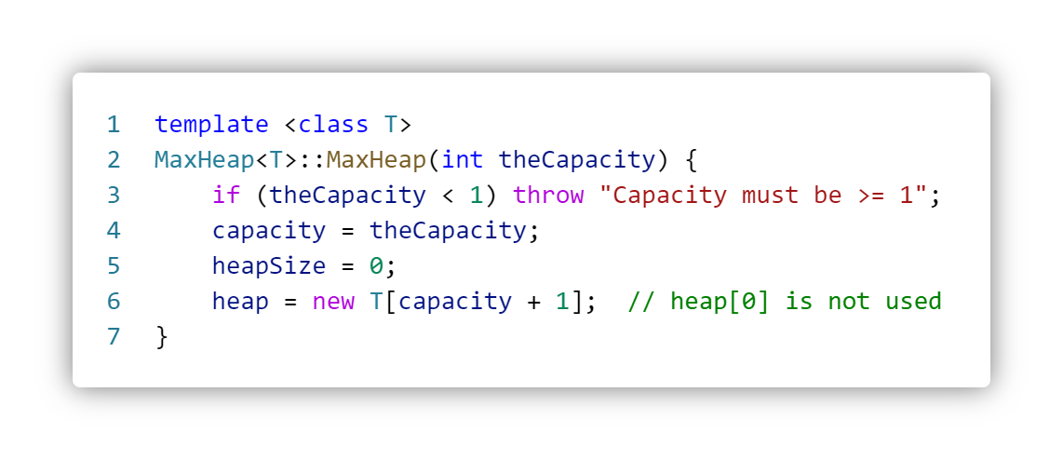
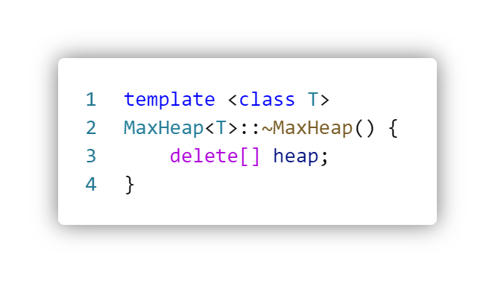
Max Heap - Constructor、Destructor
Note:
heapSize: heap 已存放多少元素
capacity: heap 最多可存多少元素
實際需花費記憶體: capacity+1 的空間 (heap[0] 不使用)

Slide 7
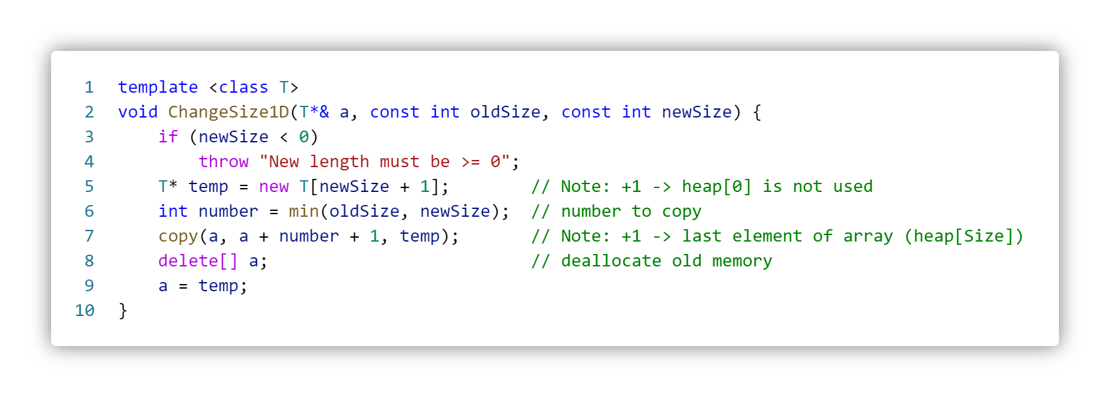
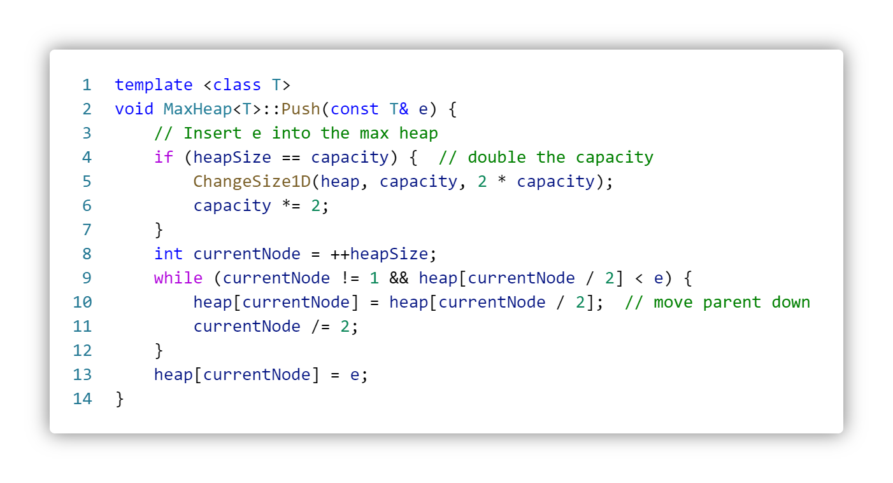
Max Heap - Push

Slide 8
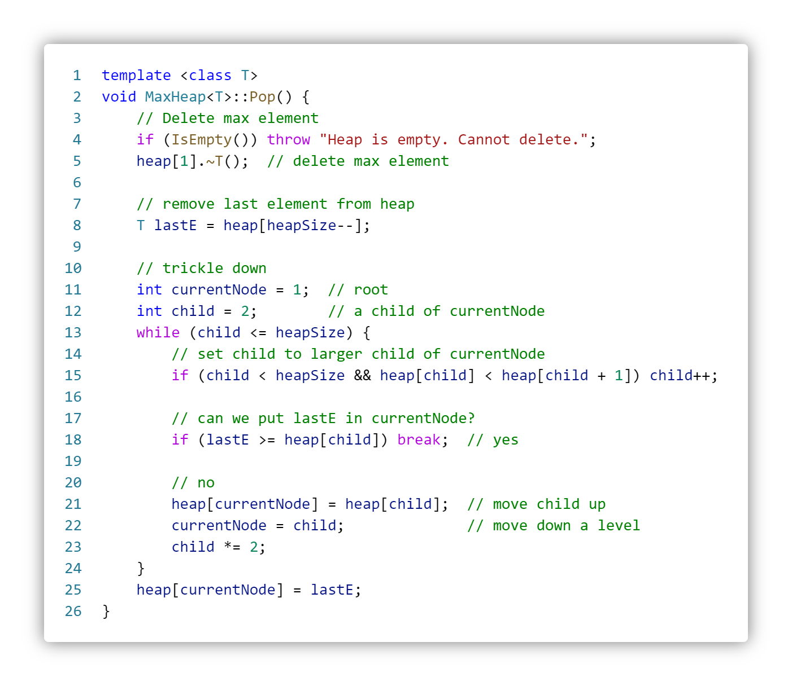
Max Heap - Pop

Slide 9
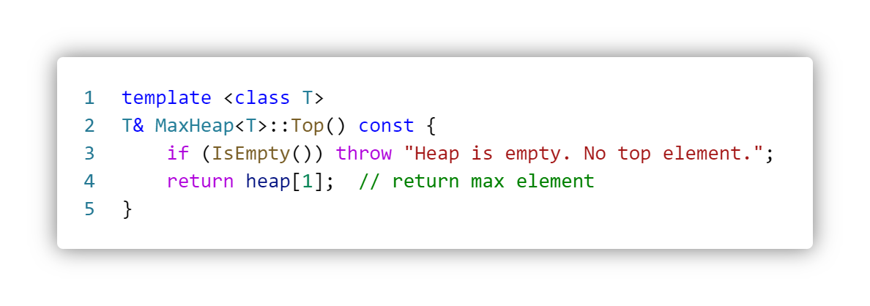
Max Heap - Top

Slide 10
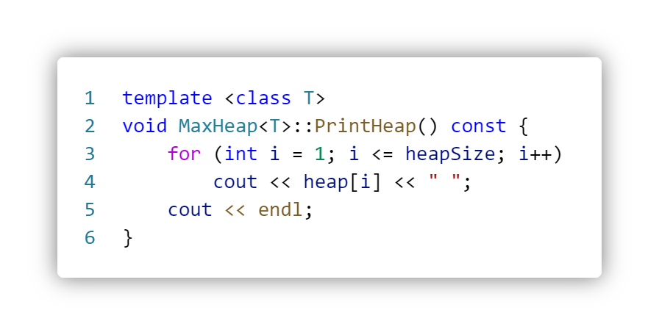
Max Heap - Print Heap Memory (For Debug)
0 | 1 | 2 | 3 | 4 | 5 | 6 | 7
 | 100 | 70 | 80 | 20 | 30 | 20 | 50
Output: 100 70 80 20 30 20 50

Slide 11
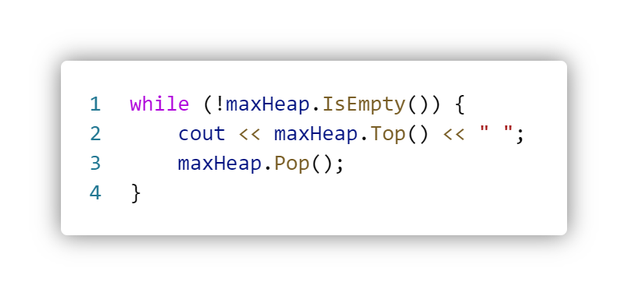
Max Heap - In descending order
0 | 1 | 2 | 3 | 4 | 5 | 6 | 7
 | 100 | 70 | 80 | 20 | 30 | 20 | 50
Output: 100 80 70 50 30 20 20

Slide 12
Binary Search Tree _{(pages. 287-296)}
0
Notes:
(a) Write a program to start with an initially empty binary search tree and make n random insertions. Use a uniform random number generator to obtain the values to be inserted. Measure the height of the resulting binary search tree and divide this height by log2n. Do this for n = 100, 500, 1000, 2000,3000, ., 10,000. Plot the ratio height/log2n as a function of n. The ratio should be approximately constant (around 2). Verify that this is SO.
(b) Write a C++ function to delete the pair with key k from a binary search tree. What is the time complexity of your function?

Slide 13
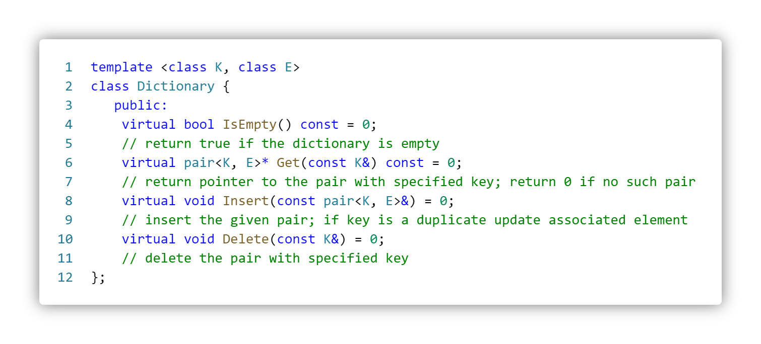
Binary Search Tree - ADT
Notes:
std::pair - cppreference.com

Slide 14
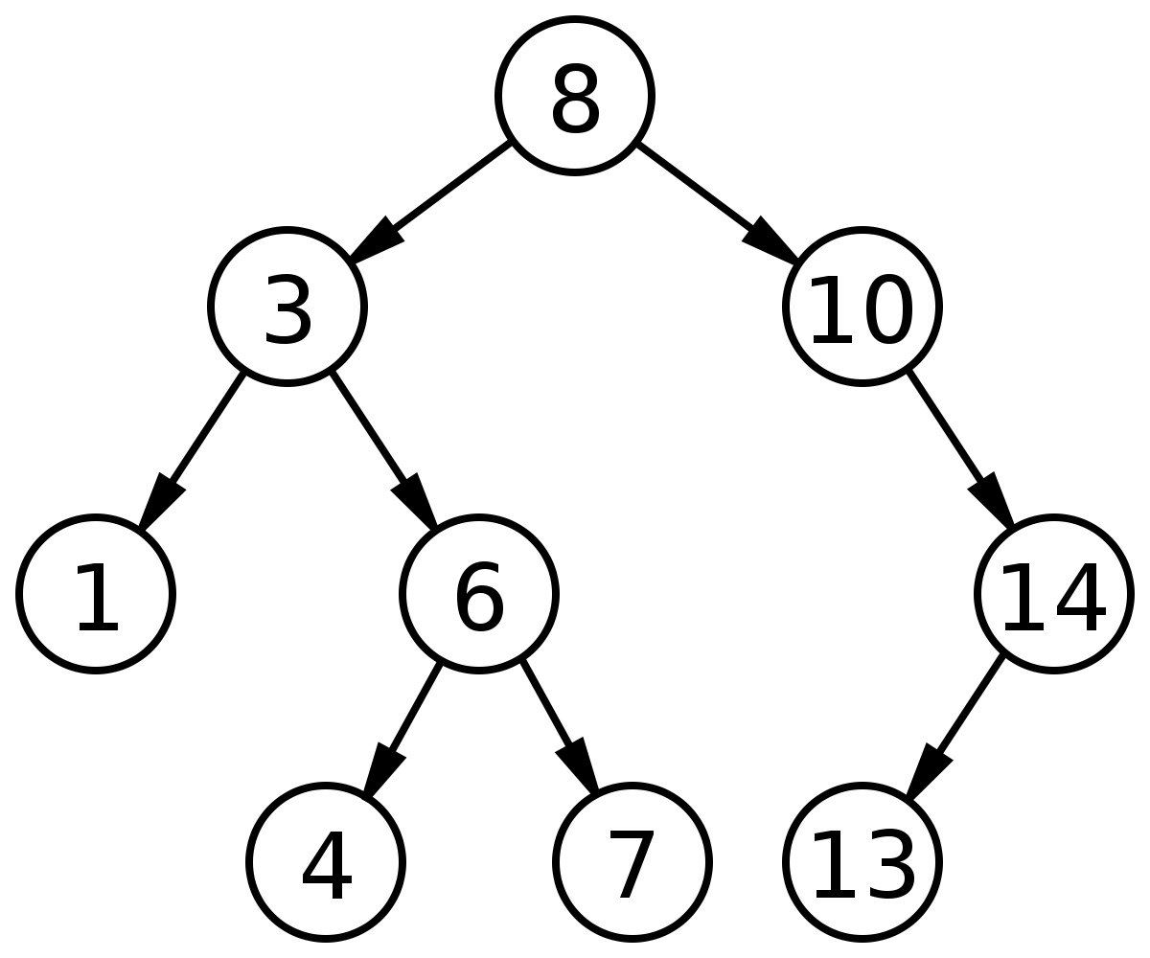
Binary Search Tree - Definition _{(page. 288)}
A binary search tree is a binary tree. It may be empty. If may be empty. If it is not empty then it satisfies the following properties:
Every element has a key and no two elements have the same key (i.e., the keys are distinct).
The keys (if any) in the left subtree are smaller than the key in the root.
The keys (if any) in the right subtree are larger than the key in the root.
The left and right subtrees are also binary search trees.

Slide 15
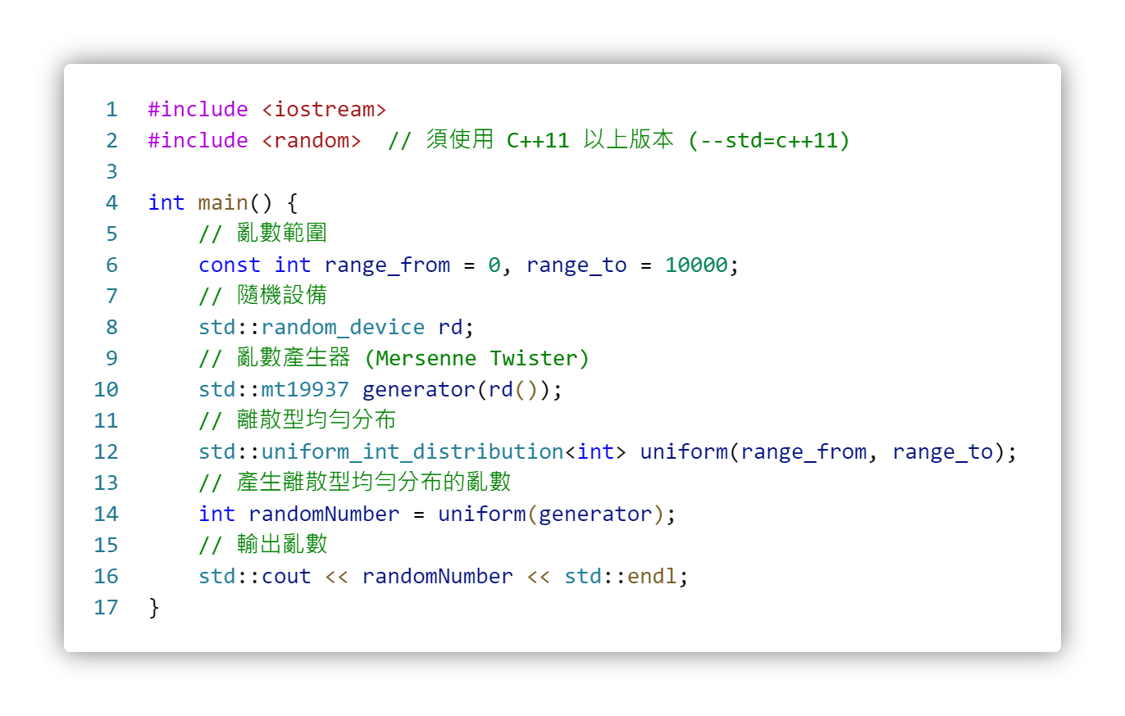
Uniform Random Number Generator
使用 C++11 內建亂數函式庫產生離散型均勻分布的亂數。
C++11 內建亂數函式庫使用教學：隨機亂數產生器與機率分布
Random - C++

Slide 16
How to compile with C++11?
讓Dev C++支援C++11 - 程式人生
Visual Studio Code 安裝 C/C++11 環境教學

Slide 17
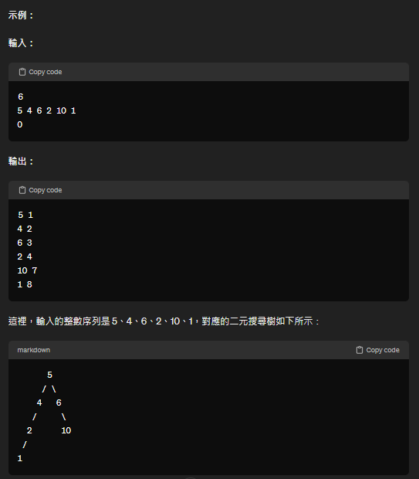
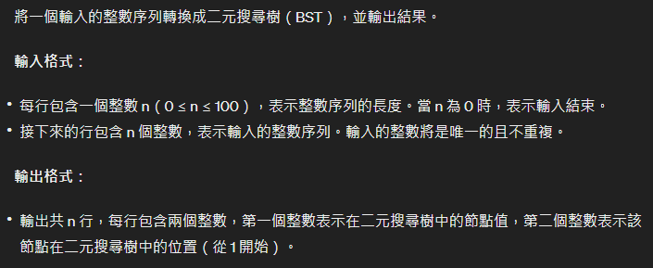
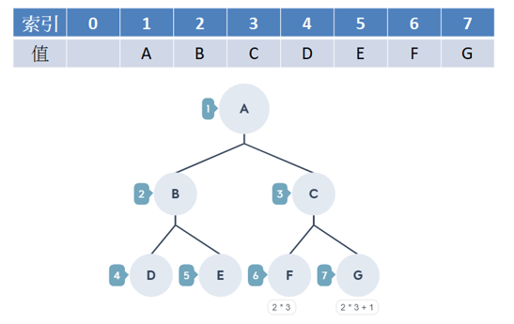
練習題

