Slide 1


INTERNET OF THINGS
12/08/14
BlackBerry Confidential

Slide 2

CONTENTS
Definition
Application to Home
Application to Business
Project Ion & BlackBerry
References
Notes:
Today I will be furthering your knowledge in the concept of The Internet of Things or IoT.
I will be providing examples and explaining to you how this emerging market will not only impact your personal life but also your professional life.
I will also be talking about BlackBerry’s recent announcment of Project Ion and what exactly the guys in waterloo are attempting here.

Slide 3
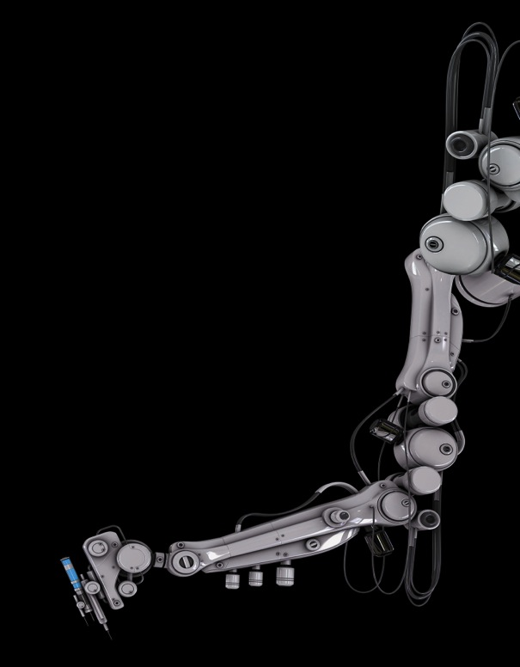
Definition
IoT is a computing concept that describes a future where everyday physical objects will be connected to the internet and be able to identify themselves to other devices.
A Thing is an entity or physical object that has a unique identifier, an embedded system and the ability to transfer data over a network.
Notes:
[Read Definition]
These include objects that exist today like smartphones, smart TV’s, smart thermostats and so on.
Its essentially an object that is connected to a network to enhance that objects capabilities from its original intention.
These devices could be:
Smartphones
Smart Watches
Smart TV’s
Fitness Bands
Any device which is connected to the internet and can transfer data.

Slide 4
IT IS PREDICTED THAT BY 2020 THERE WILL BE 50 BILLION DEVICES CONNECTED TO THE INTERNET.
Notes:
This represents a huge market opportunity to control and manage all these devices and derive useful information from all this data.

Slide 5

Application To HOME
IoT is largely considered the most radical change in information and how we manage information since the introduction of the World Wide Web.
Notes:
It is often said that IoT will eventually replace our conventional means to access the internet and discover information.

Slide 6
APPLICATION TO HOME
TITLE
HERE
Smarter Homes:
Sensors and Actuators Integrated into more devices. E.g. Coffee Machines, Heating, Showers.
Appliances will become more smarter and learn your routine and work around you.
You will have an Intelligent system that is tailored for your requirements.
Health Monitors
Use Case:
You wake up in the morning to your alarm clock that has set an alarm on its own by analysing your sleeping patterns and taking into account the time you would like to go to work, it then queries the internet on any traffic or disruptions on your way to work and adjusts itself so you have optimum sleep while still waking up on time.
Your new smart home has communicated with your alarm clock and determined that the heating should start to turn on half an hour before you wake up.
Notes:
2. While the costs of sensors and actuators go down, more and more devices will integrate them into their systems.
3.We already have appliances which are smart but IoT will take this further with for example fridges that analyse the food within it and calculate when you next need to do shopping.
4. No longer broad systems which attempts to satisfy everyone but a different version of a system to tailor to each individual.
5. Tech companies are already coming out with fitness trackers but now there is talk of smart clothing. Clothing with sensors which will track and monitor your health in a real time basis and detect if anything will go wrong before it has even happened.
6. Its better to understand IoT with a Use Case; [Read Use Case]

Slide 7
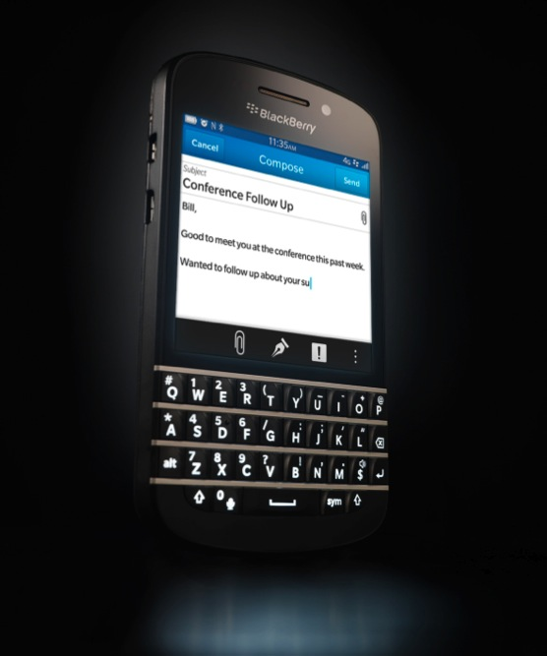
APPLICATION TO BUSINESS
IoT will revolutionise the workplace and how an organisation runs not only at your desks but also in conferences and board rooms.
Notes:
As well as domestic enhancements, IoT will also revolutionise the workplace in the same way that computers and database’s did with the old paper based systems.

Slide 8
APPLICATION TO BUSINESS
TITLE
HERE
Smarter Offices:
Integrating conference reservation systems with the smart building to have intelligent lights, projectors, blinds and air conditioning.
No need for fiddling around with controls, allowing you to be efficient and concentrate on your role. This in turn saves costs.
Use Case:
You walk into the office in the morning, the building detects your presence and begins to turn your computer on and logs you in automatically. It then checks to see your test requests and checks for you if there are any devices and SIMS of that test request. All this would be done before you even reached your desk.
Notes:
2. Here are a few examples of how it can be made applicable to an office environment.
2. Eventually we will have a building wide system that integrates with the whole building to boost efficiency and savings.
3. Business’s and the people doing their job will be allowed to focus on their job and allow the system to do the small jobs involved on a daily bases.
4. And here is a typical use case for our office here. [Read Use Case].

Slide 9
PROJECT ION
In May 2014 Blackberry unveiled a series of initiatives codenamed Project Ion.
Notes:
Project Ion is the internal name of the IoT project that was announced in May. It comes at a opportunist time as the market for IoT has just been recently growing. IoT is still in its infancy with 2014 largely being considered ‘The Year Of The Internet Of Things’.

Slide 10
PROJECT ION
The QNX platform is already running on our BlackBerry Handsets and in most In-car entertainment systems.
John Chen now envisages QNX to be extended to more devices and more devices.
Ion will provide a secure, reliable infrastructure to the Internet Of Things.
Notes:
QNX platform is on a wide range of technology already running it. John Chen now envisages the platform to extend to more and more devices to provide a secure, reliable infrastructure.
At the moment IoT doesn't really have a good infrastructure in where many different devices can be connected together and be compatible together. Ion aims to solve this problem and provide the connective tissue between devices and machine to machine processing whilst boosting BlackBerry level encryption and reliability.
This market is really just in its infancy and if BlackBerry becomes the infrastructure to support other companies just as it did with Enterprise then it could become a market leader in IoT solutions.

Slide 11
REFRENCES
http://www.businessinsider.com/75-billion-devices-will-be-connected-to-the-internet-by-2020-2013-10
https://evrythng.com/2014/01/2014-iot-predictions/
http://www.techopedia.com/definition/28247/internet-of-things-iot
http://whatis.techtarget.com/definition/thing-in-the-Internet-of-Things
http://www.cmswire.com/cms/internet-of-things/working-smart-the-internet-of-things-and-connected-offices-024457.php
http://techcrunch.com/2014/05/21/blackberry-reveals-project-ion-its-qnx-powered-effort-to-underpin-the-internet-of-things/
http://el.blackberry.com/project-ion
Notes:
I will be sending a email with this PowerPoint so if you would like to do any further reading then please refer to these links.
Any Questions?

Slide 12
THANK YOU FOR YOUR ATTENTION.

