Slide 1

Note: The data and information in this document is reflective of a hypothetical situation and client. This document is to be used for KPMG Virtual Internship purposes only.
Sprocket Central Pty Ltd
Data analytics approach
Kipkosgei - Junior Consultant

Slide 2
Note: The data and information in this document is reflective of a hypothetical situation and client. This document is to be used for KPMG Virtual Internship purposes only.
Agenda
Introduction
Data Exploration
Model Development
Interpretation

Slide 3
Note: The data and information in this document is reflective of a hypothetical situation and client. This document is to be used for KPMG Virtual Internship purposes only.
Introduction
Place headline insight or information here. This should be the most important point for this slide.
Data has a lot in it, that draws better insights in building a good marketing strategy and optimize on resource. However to archive this there is a lot to undertake from Data Exploration on the what we will do before we conducted Model Development and Interpretation
After doing the Data Quality check and from the recommendation we made. Here are the steps in preparation to get quality data for good model and right interpretation

Slide 4
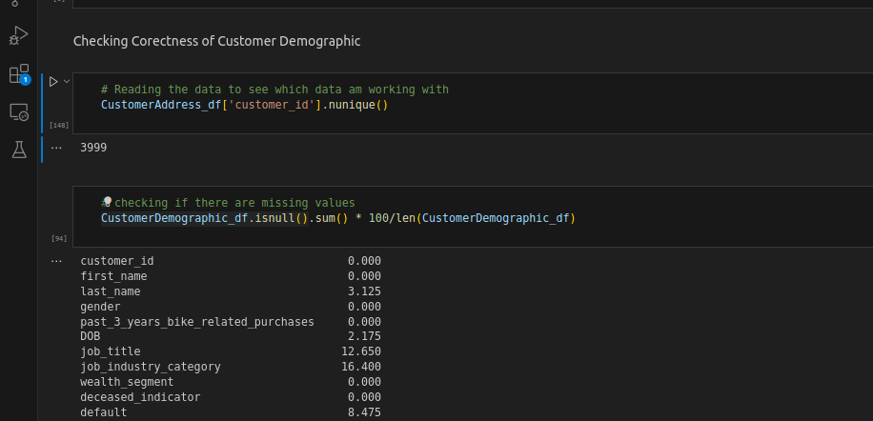
Note: The data and information in this document is reflective of a hypothetical situation and client. This document is to be used for KPMG Virtual Internship purposes only.
Data Exploration
Data exploration are the steps to undertake
Here will try to understand more about the data set,cleaning the data, this will help us for building our predictive models.
1. Missing values, outlier treatment (bias)
2. Perform feature engineering (transformation/creation)
Place any supporting images, graphs, data or extra text here.

Slide 5
Note: The data and information in this document is reflective of a hypothetical situation and client. This document is to be used for KPMG Virtual Internship purposes only.
Model Development
This is iterative process in creating the right algorithm, that model are build, hypothesis tested to be used to implement
Based on the new clean quality data, we can able to model data to build a prediction of an outcome.
We will also test the models, if it meets our expectation, check if its accurate and houses all desirable features.

Slide 6
Note: The data and information in this document is reflective of a hypothetical situation and client. This document is to be used for KPMG Virtual Internship purposes only.
Interpretation
Trying to preview data,drawing relevant conclusion using various techniques.
Interpretation will help on what decision to make, check on the trends.
Help and gain more understanding of data,processes and performance.

Slide 7
Note: The data and information in this document is reflective of a hypothetical situation and client. This document is to be used for KPMG Virtual Internship purposes only.
Appendix

Slide 8
Note: The data and information in this document is reflective of a hypothetical situation and client. This document is to be used for KPMG Virtual Internship purposes only.
Appendix
This is an optional slide where you may place any supporting items.

