Slide 1
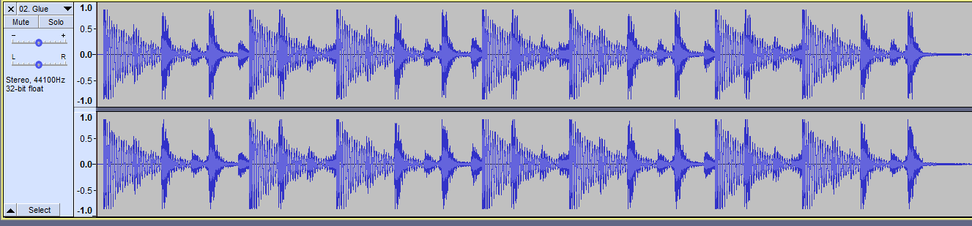
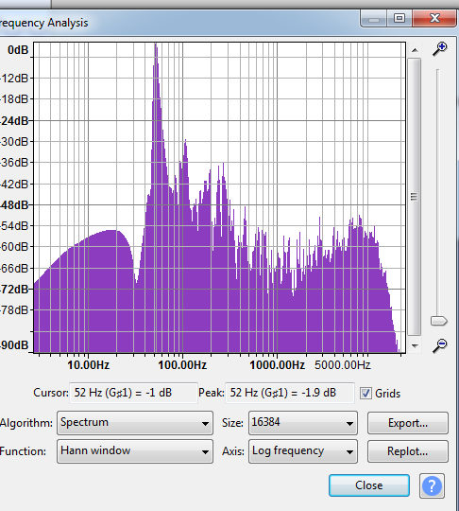
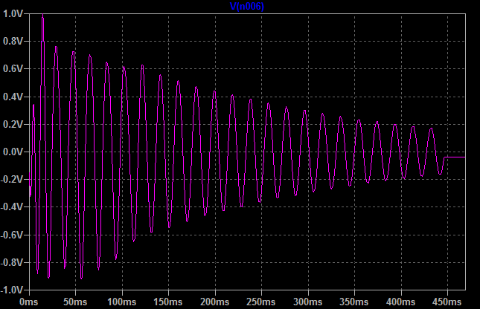
Bass drum hit in Bicep - Glue
Fundamental = 52 Hz
Minimum time between hits = 0.7s
Imported into LTSPICE after 120Hz 4th order LP filter

Slide 2
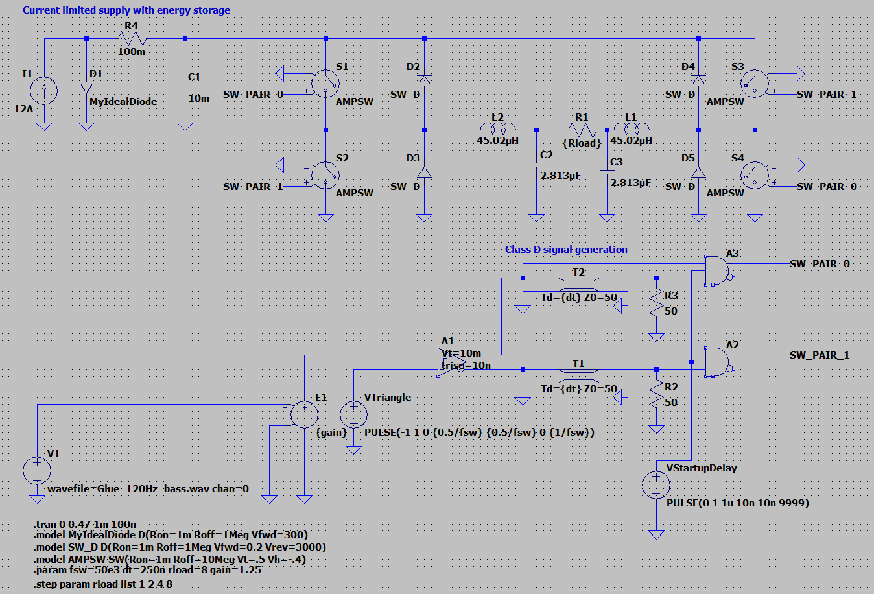
LT spice simulation of current limited supply with large capacitive storage

Slide 3
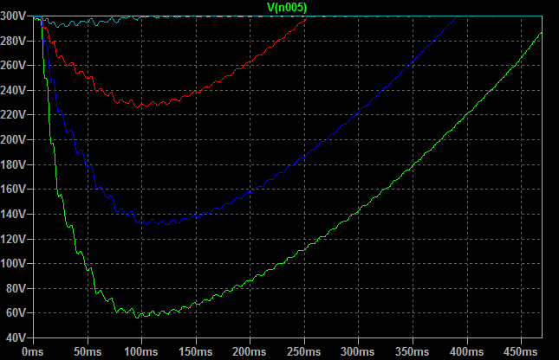
Supply voltage sag with different resistive loads (8/4/2/1Ω) @ 300V nominal bus. Peak level set to 100% modulation (clipping point).
Results indicate running with 300V bus is sane for 8/4ohm and amplifier will be essentially distortion free for 8ohm at peak output.
Load | Minimum bus voltage | Compression | Recovery time
8 | 290.8V | -0.27dB | 108mS
4 | 225V | -2.50dB | 255mS
2 | 131V | -7.20dB | NA
1 | 56V | -14.60dB | NA
Look ahead limiter will compress input signal to avoid class-D amplifier reaching 100% modulation, the minimum required compression is recorded

Slide 4
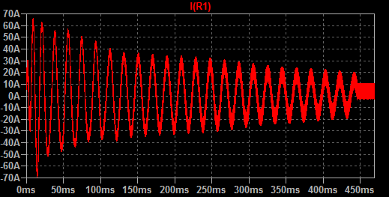
Output current into 4Ω (also approximate capacitor ripple)
RMS capacitor: 8ohms 14.365A, 4ohms 21.428A

Slide 5
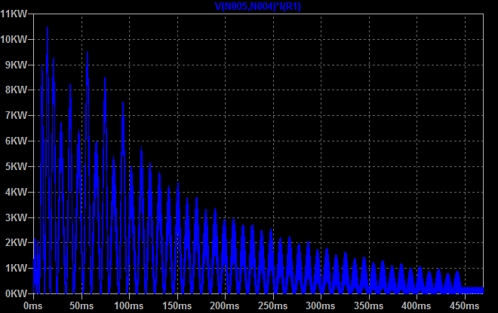
Power output into 8ohms
1.3235kW average

Slide 6
Strategies for dealing with low ohm load (IPAL etc.)
Reduced dc bus – Lowers switching loss if problematic
Restrict maximum duty cycle – lowers effective maximum output amplitude

Slide 7
Limiter
DAC drives amplifier (modulator), by monitoring rail voltage we can estimate duty cycle
Rail voltage changes slowly, LP filter rail voltage and use to estimate duty cycle and use zero attack limiter on duty cycle estimate.
Maximum duty cycle should be restricted to <0.5 for low ohm loads, depending on output device stress it may also be required to lower bus voltage.
Hold/release adjustable.
Additional user peak and long term average limiting

