Slide 1
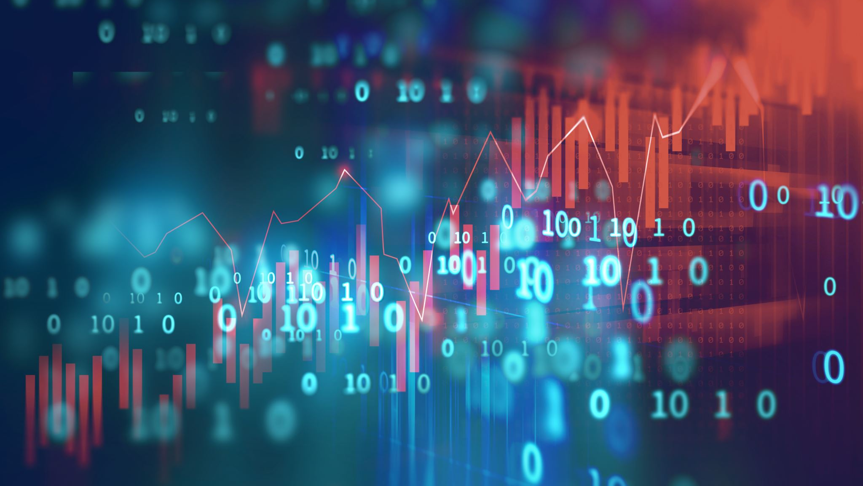
Artificial Intelligence
Past, Present, Future

Slide 2
Timeline of Artificial Intelligence (AI)
1987:
1997:
2007:
2011:
2015:
2015:
UCI Machine Learning Repository (MLR) Launched as FTP Archive
IBM’s Deep Blue defeats world chess champion Kasparov
UCI MLR Transition to Current Website
Google Brain deep neural network can discover and categorize items
Amazon AWS Machine Learning services launched
UCI MLR Notable Growth in Data Size
1986:
1992:
2006:
2010:
2012:
2015:
2016:
Parallel Distributed Processing published, advancing neural network models
Backgammon program created by Tesauro matches top human players
Hinton creates the term “deep learning”
Microsoft Kinect greatly improves motion-sensing input capability
ImageNet research paper published on model to greatly reduce error in image recognition
Microsoft’s Distributed Machine Learning Toolkit improves distribution across systems
Google DeepMind’s AlphaGo defeats renowned Go player Lee Sedol
Legend:
UCI MLR Events
Benchmarks in AI Development
Possible links to UCI MLR changes
Notes:
Sources:
Roboticsbiz. Machine Learning: The complete history in a timeline. (December 7, 2019). https://roboticsbiz.com/machine-learning-the-complete-history-in-a-timeline/. Accessed July 23, 2020.

Slide 3
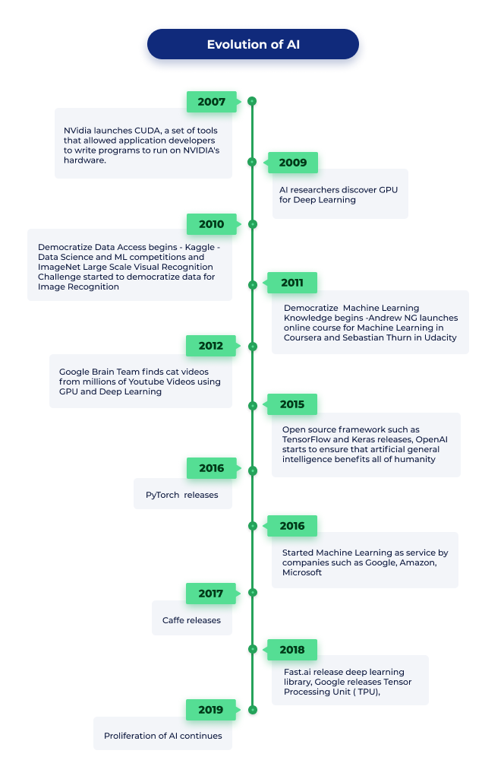
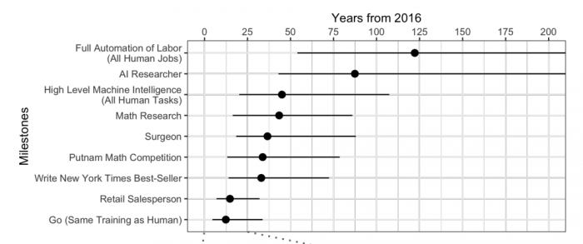
Rebirth and Future of AI
Potential Future Implications of AI Development
Catalysts to Recent Growth in AI
Democratization of AI knowledge opens doors to academia and researchers (Stanford, Udacity)
Cloud and GPU advancements make AI more accessible and affordable
Advanced open source tools and frameworks (PyTorch, OpenAI)
Web-based platforms readily available (AWS, IBM Cloud AI)
Notes:
Sources:
Leapfrog Technology. Evolution of AI. https://www.lftechnology.com/blog/ai/ai-evolution/. Accessed July 22, 2020.
MIT Technology Review. Experts Predict When Artificial Intelligence Will Exceed Human Performance. https://www.technologyreview.com/2017/05/31/151461/experts-predict-when-artificial-intelligence-will-exceed-human-performance/. Accessed July 22, 2020.

