Slide 1

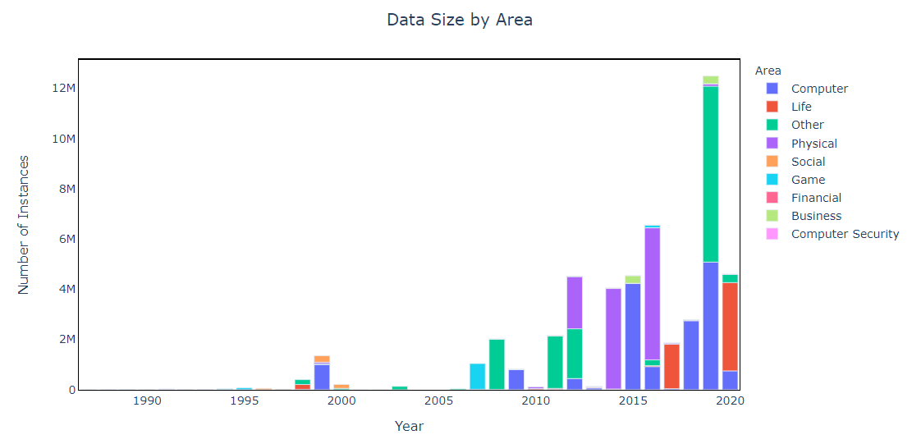
Artificial Intelligence (AI) Development Considering University of California Irvine (UCI) Machine Learning Repository (MLR)
1987: UCI MLR launched as FTP archive
2012: ImageNet research paper published on model to greatly reduce error in image recognition
2015: Amazon AWS Machine Learning services launched
2015+ : MLR increased growth in data sets – including human motion tracking
1997: IBM’s Deep Blue defeats world chess champion Kasparov
2010: Microsoft Kinect greatly improves motion-sensing input capability
1986: Parallel Distributed Processing published, advancing neural network models
2011: Google Brain deep neural network can discover and categorize items
2015: Microsoft’s Distributed Machine Learning Toolkit improves distribution across systems
2016: Google DeepMind’s AlphaGo defeats renowned Go player Lee Sedol
1992: Backgammon program created by Tesauro matches top human players
2007: UCI MLR transition to current website
2006: Hinton creates the term “deep learning”
Legend:
UCI MLR Events
Benchmarks in AI Development
Possible links to UCI MLR changes
Notes:
Sources:
Roboticsbiz. Machine Learning: The complete history in a timeline. (December 7, 2019). https://roboticsbiz.com/machine-learning-the-complete-history-in-a-timeline/. Accessed July 23, 2020.
Leapfrog Technology. Evolution of AI. https://www.lftechnology.com/blog/ai/ai-evolution/. Accessed July 22, 2020.

Slide 2
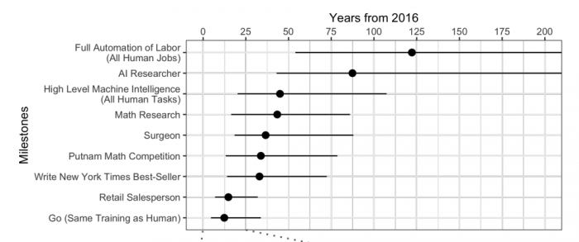
Possible Future of AI
Future Implementation:
Causal Discovery
Clustering
Classification
Regression
Graphic source: MIT Technology Review
https://www.technologyreview.com/2017/05/31/151461/experts-predict-when-artificial-intelligence-will-exceed-human-performance
Notes:
Sources:
MIT Technology Review. Experts Predict When Artificial Intelligence Will Exceed Human Performance. https://www.technologyreview.com/2017/05/31/151461/experts-predict-when-artificial-intelligence-will-exceed-human-performance/. Accessed July 22, 2020.

