Slide 1
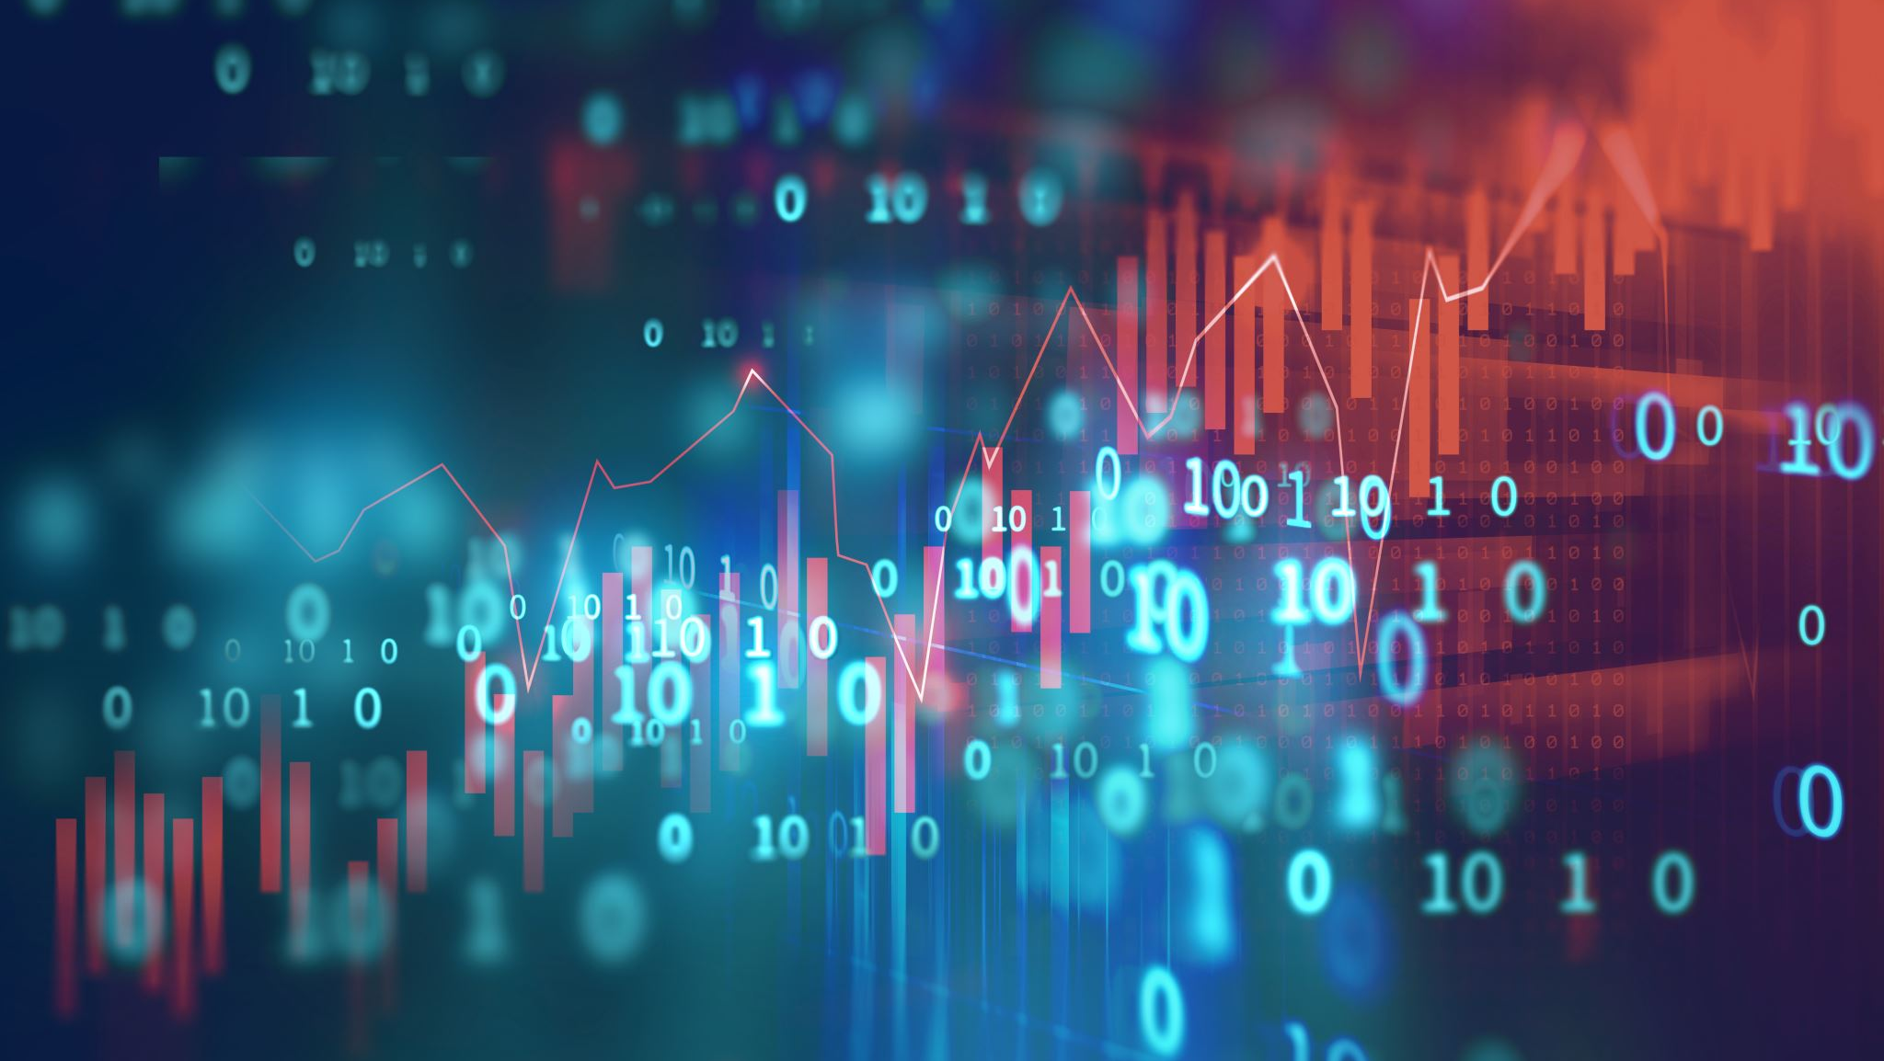
Artificial Intelligence
Past, Present, Future

Slide 2
Timeline of Artificial Intelligence (AI)
1992:
2006:
2011:
2012:
2015:
2016:
Backgammon program created by Tesauro matches top human players
Hinton creates the term “deep learning”
IBM’s Watson defeats Jeopardy champions
ImageNet research paper published on model to greatly reduce error in image recognition
Amazon AWS Machine Learning services launched
Google DeepMind’s AlphaGo defeats renowned Go player Lee Sedol
1986:
1997:
2010:
2011:
2014:
2015:
2017:
Parallel Distributed Processing published, advancing neural network models
IBM’s Deep Blue defeats world chess champion Kasparov
Microsoft Kinect greatly improves motion-sensing input capability
Google Brain deep neural network can discover and categorize items
Facebook develops DeepFace, greatly improving human facial recognition
Microsoft’s Distributed Machine Learning Toolkit improves distribution across systems
Carnegie Mellon and University of Alberta create systems to defeat top Texas Hold ‘em players
Notes:
Sources:
Roboticsbiz. Machine Learning: The complete history in a timeline. (December 7, 2019). https://roboticsbiz.com/machine-learning-the-complete-history-in-a-timeline/. Accessed July 23, 2020.

Slide 3
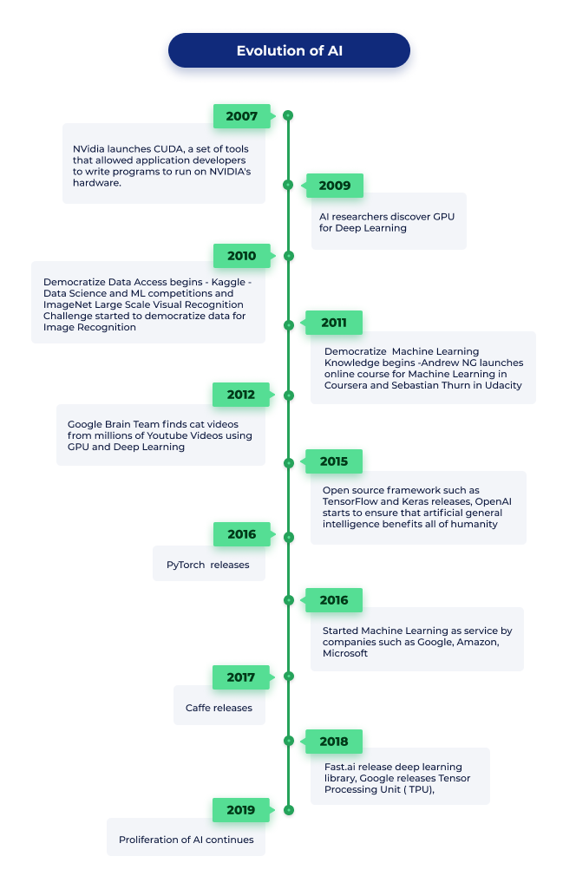
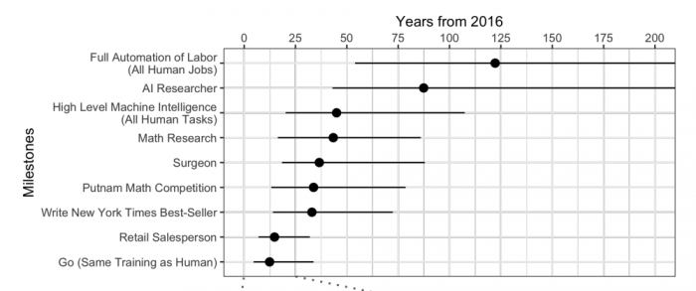
Rebirth and Future of AI
Potential Future Implications of AI Development
Catalysts to Recent Growth in AI
Democratization of AI knowledge opens doors to academia and researchers (Stanford, Udacity)
Cloud and GPU advancements make AI more accessible and affordable
Advanced open source tools and frameworks (PyTorch, OpenAI)
Web-based platforms readily available (AWS, IBM Cloud AI)
Notes:
Sources:
Leapfrog Technology. Evolution of AI. https://www.lftechnology.com/blog/ai/ai-evolution/. Accessed July 22, 2020.
MIT Technology Review. Experts Predict When Artificial Intelligence Will Exceed Human Performance. https://www.technologyreview.com/2017/05/31/151461/experts-predict-when-artificial-intelligence-will-exceed-human-performance/. Accessed July 22, 2020.

