Slide 1

Digital Transformation of SME
Supervisor: Ing. Martin Lukáš, Ph.D.
Advanced Economic Writing
Department of Information Technologies
Czech University of Life Sciences, Prague
23.10.2023
Aidyn Kudamanov

Slide 2

Introduction
Digital Transformation²
Small and Medium Enterprises (SME)^{3,4}
Enterprise architecture (EA)¹
TOGAF¹
ArchiMate¹¹

Slide 3

Objectives
Explore the digital transformation of SMEs in technology advanced European countries (case: Norway)
Define the strategies used to restructure SME
Define the digital trends for SME
Influence of digital transformation
Propose solutions/workarounds for non-digital SME challenges
Does the digital transformation of small and medium enterprises (SMEs) in specific European countries with a high development of digital technologies lead to increased competitiveness and growth for these businesses?

Slide 4

Methodology
In-depth research of scholarly and proffesional literature related to EA in digital transformation for SMEs.
The analysis of digital transformation will be prepared in SMEs case study by using TOGAF approach and ArchiMate notation language.
The findings will be interpreted, summarized, and used for formulating recommendations for SMEs.

Slide 5
Content
Introduction
Objectives
Literature review
Case of Norway
History
Trends
Conceptual Models
Theoretical frameworks
Methodology
Data collection
Problem defining
Sampling strategy
Sandbox preparation – Togaf/Archimate
Challenges and Solutions
Recommendation
Conclusion
List of references

Slide 6

Norway

Slide 7
History¹¹
1967
The National Insurance Scheme (Folketrygdloven)
1960s
70s, 80s - Participatory design (PD)
1995
Diskos
2003
Altinn
2004
BankID

Slide 8
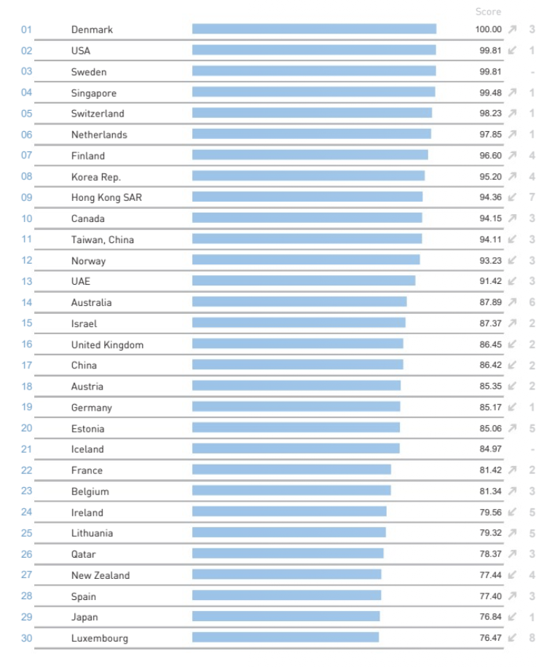
Figure 1. The 2022 IMD World Digital Competitiveness ranking (source: IMD 2022⁷)

Slide 9
Digital Trends ranking for Norway SMEs 2021 (source: OECD 2021¹⁰)
Broadband Donwload Speed 100 mb/s rank – 52.2
Social Media acceptance – 74.9
E-commerce – 20
Cloud Computing – 61.0

Slide 10
Conceptual Model of EA¹
Traditional
MIT
DYI

Slide 11
DYI (Dynamic Architecture) conceptual model¹
EA to be Developed
The Basis for EA
Responsible person
EA process
Principles, standards, diagrams, project-start architecture
Individual business initiatives
Enterprise architecture/Senior Business Manager
Informal process with project architecture
EA Time
Based on the business initiative
EA Description
Future state of particular business initiative

Slide 12
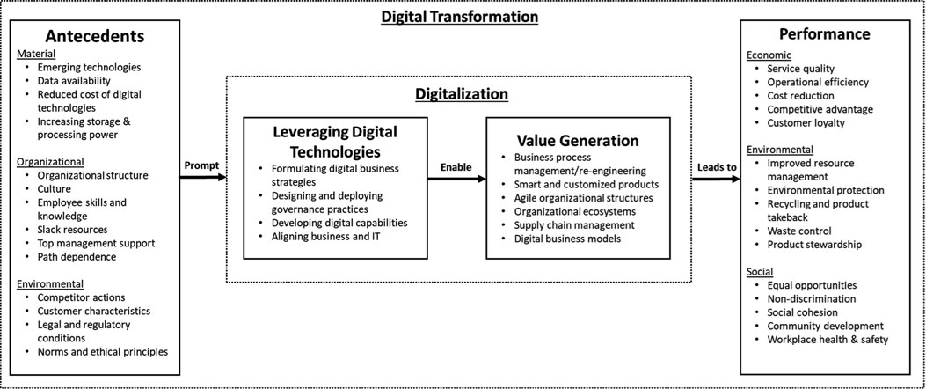
Figure 2. Conceptual Model of Digital Transformation (Source: Mikalef et al. 2022¹¹)

Slide 16
TOGAF Architecture approach Phase 4
Context
Business
Application and Data Processing
Data Space
Technologies

Slide 17
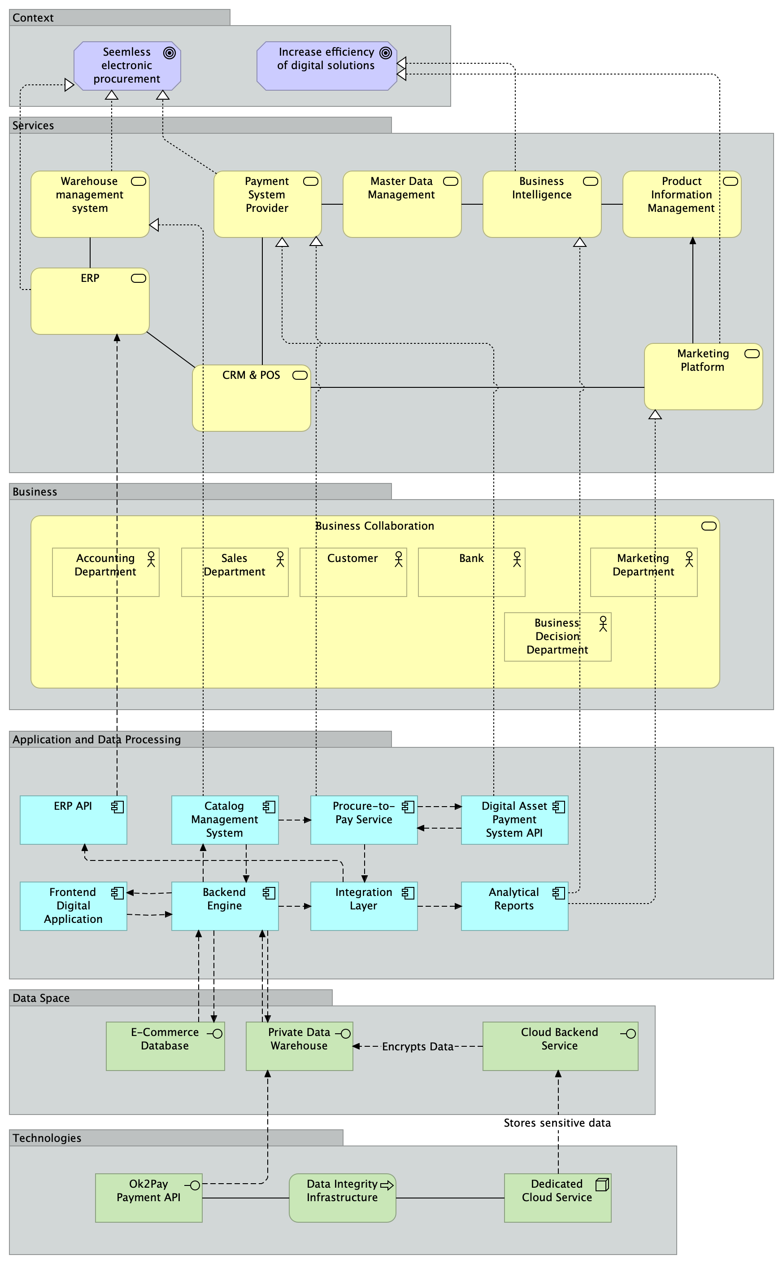
Figure 3. Meta-modeling of E-Commerce for digitization of Medium Enterprise (source: own construction)

Slide 18
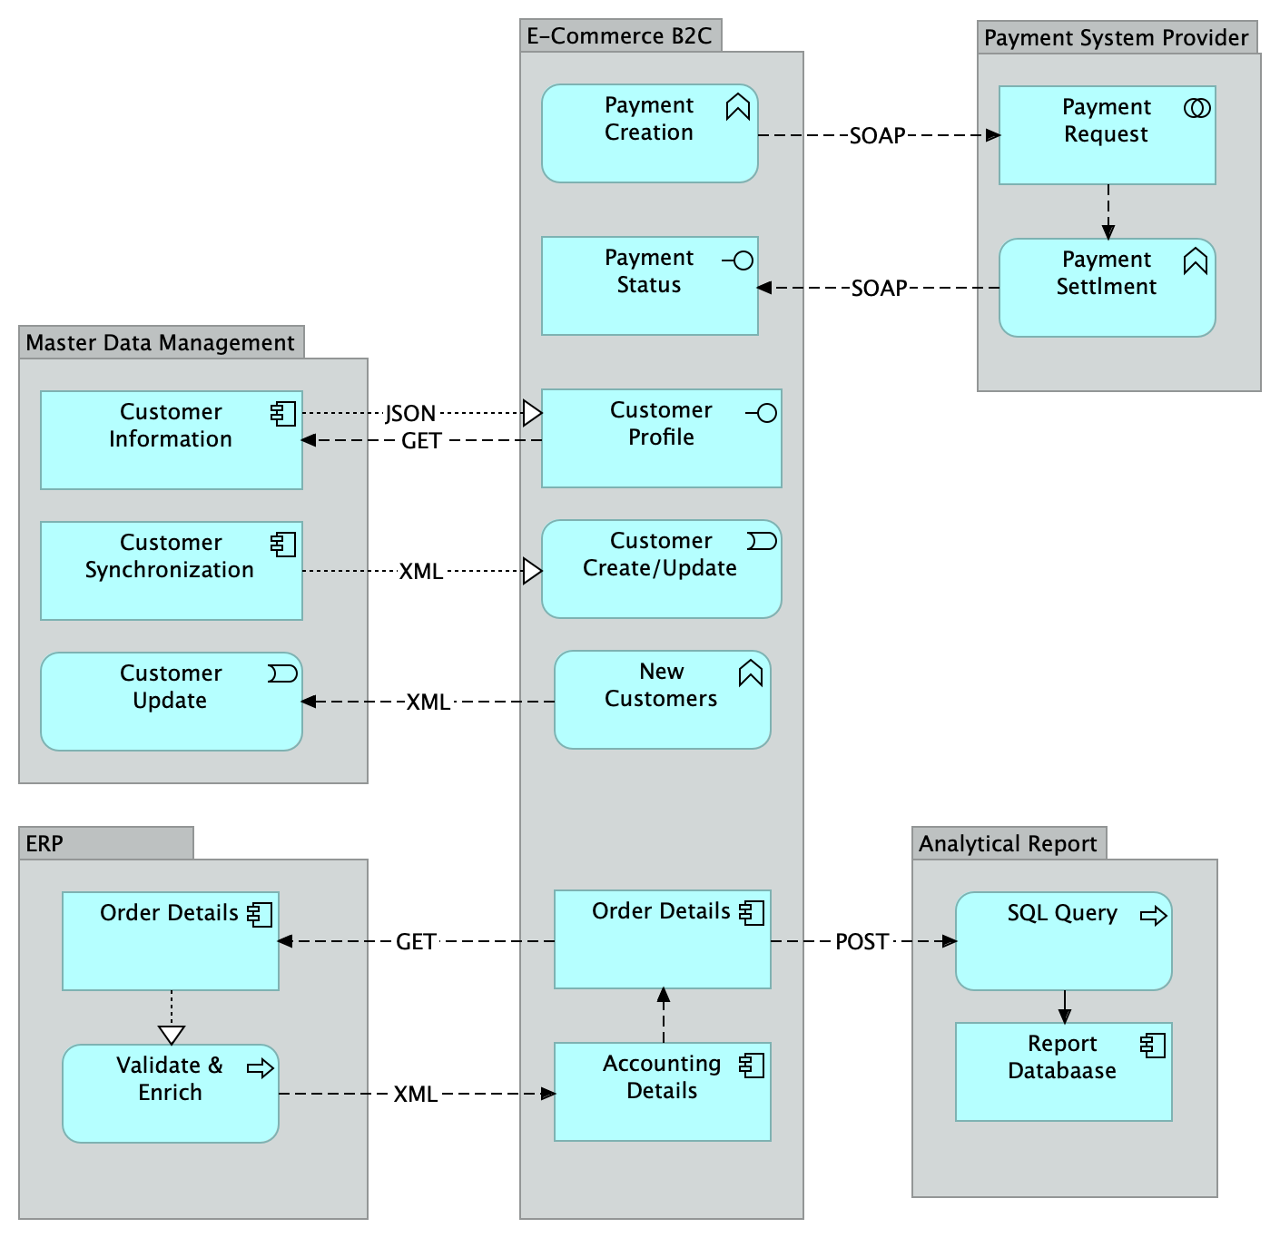
Figure 4. Data Flow Architecture (source: own construction)

Slide 19
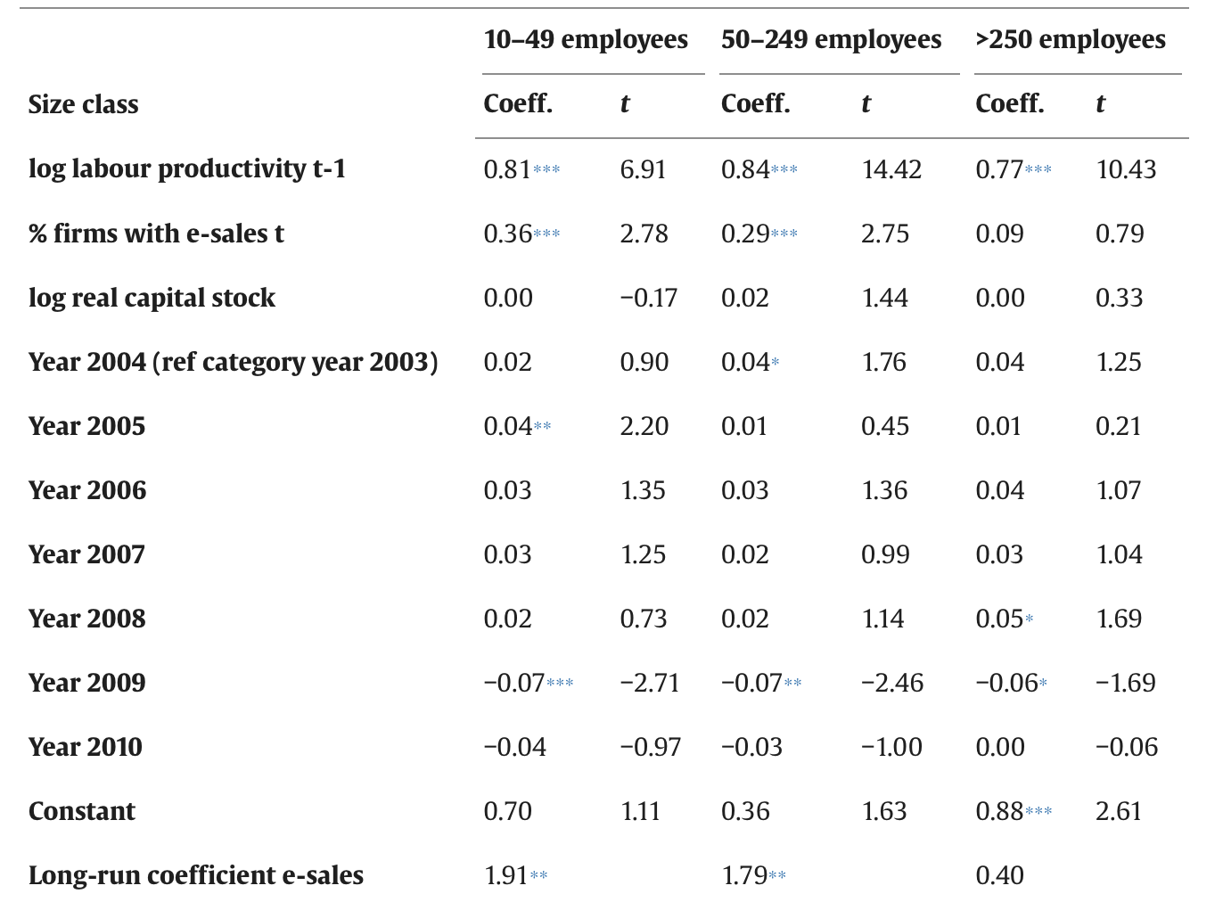
Challenges & Solutions
Figure 5. Impact on labour productivity of change in e-sales activities 2001-2010 (source: M. Falk et. al 2015⁹)

Slide 20
Norway Problem
Businesses afraid of implementing the new digital solution that may cause a damage to the company.⁹
The lack of knowledge in implementing advanced IT solutions into the business processes.⁸

Slide 21
Recommendation
Product Exploitation
Innovation Performance
Product Explore

Slide 22
Conclusion
The main digital transformation changes in Norway history
Implementation of the network connectivity, bankID, procurement/accounting solutions
Current Trends for SME in Norway
The full cover of mobile networking across the country, cloud computing integration, social media acceptance
Conceptual Model for Norway enterprises
DYI adapted for Norway enterprises
Meta model provided as a template for the digital transformation into the e-commerce for the SME in Norway according to the TOGAF phase 4 approach
The problems and recommendations provided for the SME
Ambidextrous approach for SME

Slide 23
References
Kotusev, S. (2017a). Conceptual Model of Enterprise Architecture Management. International Journal of Cooperative Information Systems, 26(03), 1730001. https://doi.org/10.1142/S0218843017300017
Li, L., Su, F., Zhang, W., & Mao, J.-Y. (2018). Digital transformation by SME entrepreneurs: A capability perspective. Information Systems Journal, 28(6), 1129–1157. https://doi.org/10.1111/isj.12153
Small and medium-sized enterprises | Fact Sheets on the European Union | European Parliament. (2023, March 31). https://www.europarl.europa.eu/factsheets/en/sheet/63/small-and-medium-sized-enterprises
SME definition. (n.d.). Retrieved September 11, 2023, from https://single-market-economy.ec.europa.eu/smes/sme-definition_en
The Digital Economy and Society Index (DESI) | Shaping Europe’s digital future. (n.d.). Retrieved September 11, 2023, from https://digital-strategy.ec.europa.eu/en/policies/desi
Ulas, D. (2019). Digital Transformation Process and SMEs. Procedia Computer Science, 158, 662–671. https://doi.org/10.1016/j.procs.2019.09.101
World Digital Competitiveness Ranking – IMD business school for management and leadership courses. (n.d.). Retrieved August 31, 2023, from https://www.imd.org/centers/wcc/world-competitiveness-center/rankings/world-digital-competitiveness-ranking/
Digitalisation in Europe 2022-2023: Evidence from the EIB Investment Survey. (n.d.). European Investment Bank. Retrieved September 11, 2023, from https://www.eib.org/digitalisation-europe-2022-2023-evidence-from-eib-investment-survey
Colclough, Simon & Moen, Øystein & Hovd, Nina & Chan, Andrew. (2019). SME innovation orientation: Evidence from Norwegian exporting SMEs. International Small Business Journal: Researching Entrepreneurship. 37. 780-803. 10.1177/0266242619870731.
Pilar, P. H. I. L. I. P. (2021). OECD SME and Entrepreneurship Outlook 2021-Country Profiles.
Mikalef, P., & Parmiggiani, E. (2022). Digital Transformation in Norwegian Enterprises (p. 196). Springer Nature.
ICT Access and Usage by Businesses. (n.d.). Retrieved October 5, 2023, from https://stats.oecd.org/Index.aspx?DataSetCode=ICT_BUS#

