Slide 1
NLP emotional art generator

Slide 2
General idea
Input text / speech
AI transformer model ranks prevalence of different emotions
AI model outputs used as input for art generation
Display art

Slide 3
Themes
NLP/ AI
Generative art
Accessibility (kind off)

Slide 4
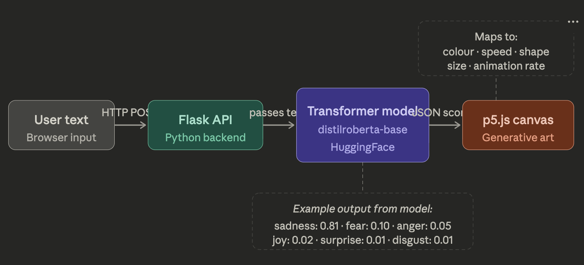
System design

Slide 5
Key components
Flask framework
JS front-end
p5.js for image generation (p5 canvas)
input methods (Speech-To-Text, text box)
Python backend
Transformer model for emotion analysis
OpenAI whisper library for Speech-to-text

Slide 6
Potential additions
Database
save images
save input strings
Generate multiple images
tinker with the parameters so that different images are created
Gallery section to view previous work

Slide 7
What we need to do / teams
Front end
user friendly interface
text input box
speech input method
Back end
model design
whisper (TSS)
flask framework

