Slide 1
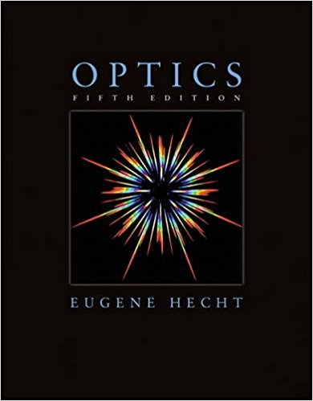
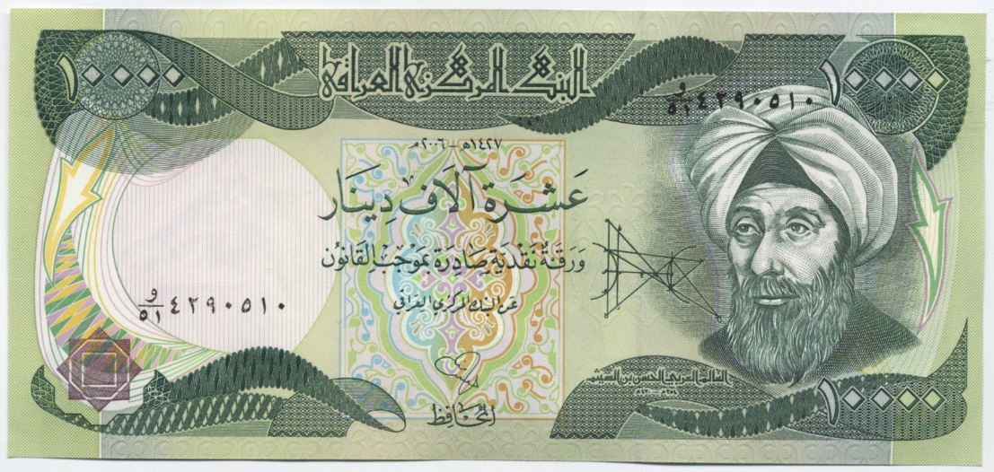
Introduction to Optics
P47 – Optics: Unit 1
Iraqi Dinar – Ibn al-Haytham (“Father of Optics”, 965-1040)

Slide 2
Course Outline
Unit 1: Electromagnetic Waves
Unit 2: Interaction with Matter
Unit 3: Geometric Optics
Unit 4: Superposition of Waves
Unit 5: Polarization
Unit 6: Interference
Unit 7: Diffraction
Unit 8: Fourier Optics
Unit 9: Modern Optics

Slide 3
Grading
35% Homework
5% Reading Quizzes
30% Labs
30% Exams (3)

Slide 4
Unit 1
Overview of Wave Mechanics
and Electrodynamics
the differential wave equation
phase and phase velocity
complex representation of waves
plane waves (1D and 3D)
EM waves in free space
energy and momentum of EM waves

Slide 5
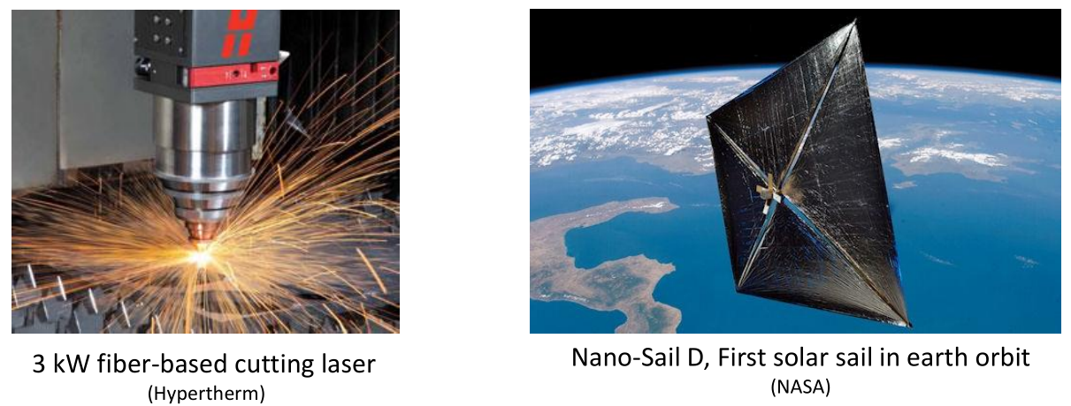
Unit 1
Electromagnetic
Energy and Momentum

Slide 6
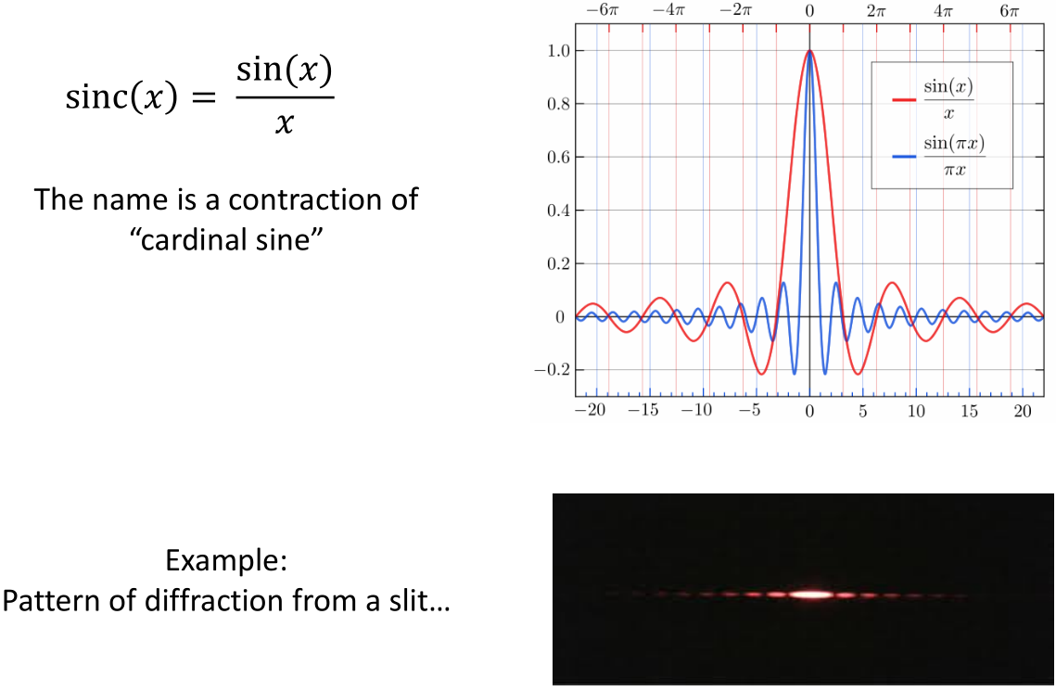
Unit 1
sinc(x) shows up all the time in optics
(and Fourier analysis)

Slide 7
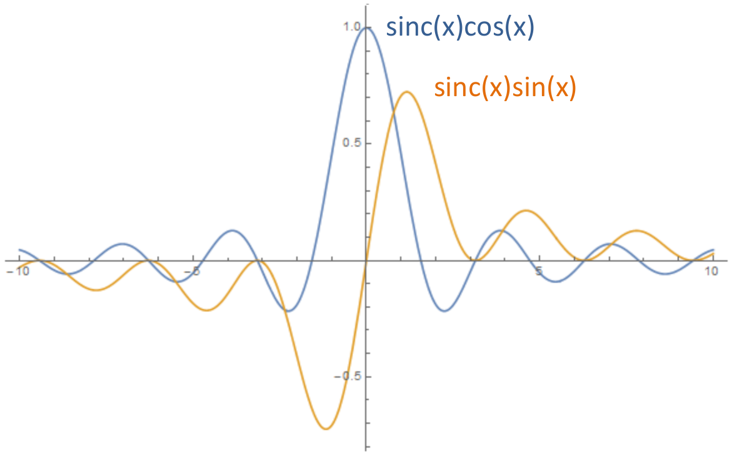
Unit 1

Slide 8
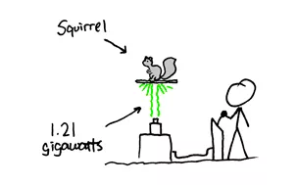
Unit 1
Momentum of EM Waves!
credit: xkcd

Slide 9
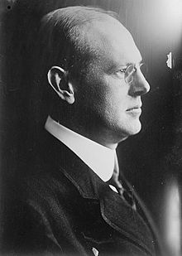
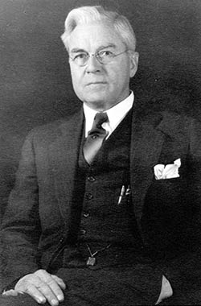
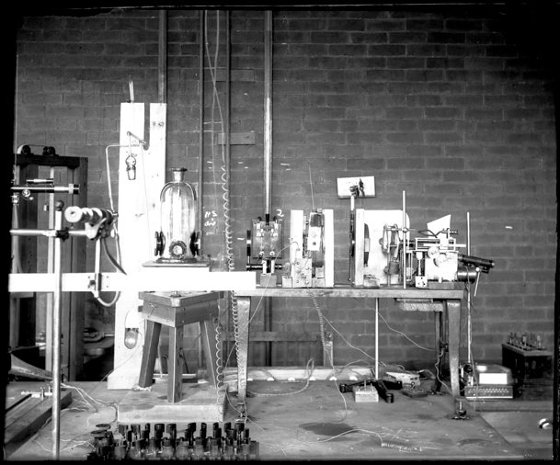
Unit 1
Measurement of light pressure in 1901-1903
(just down the hall! – Wilder 115)
Ernest Fox Nichols and Gordon Ferrie Hull

Slide 10
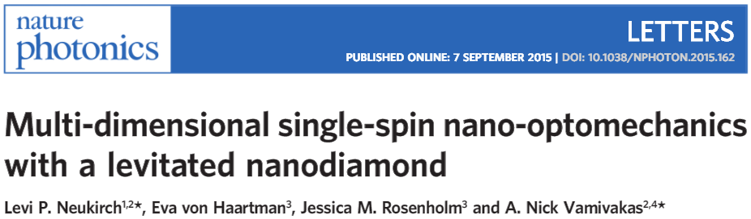
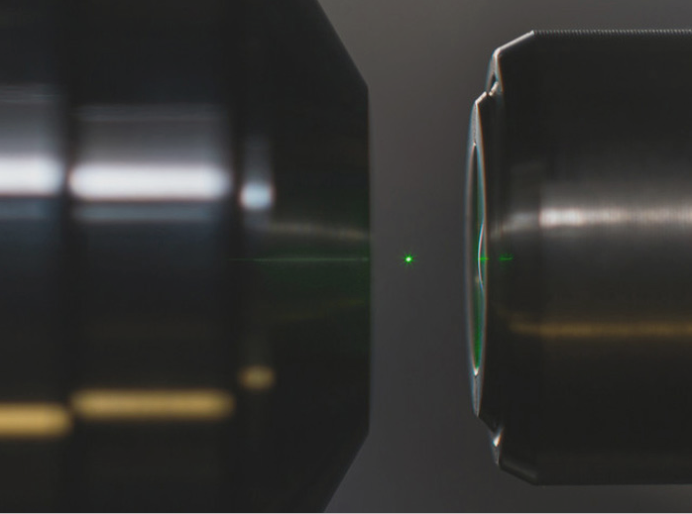
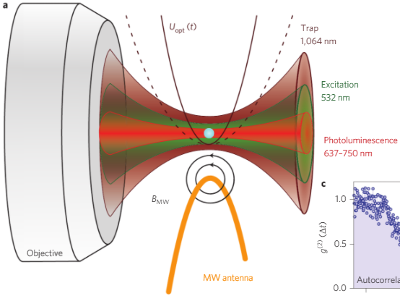
Unit 1

Slide 11
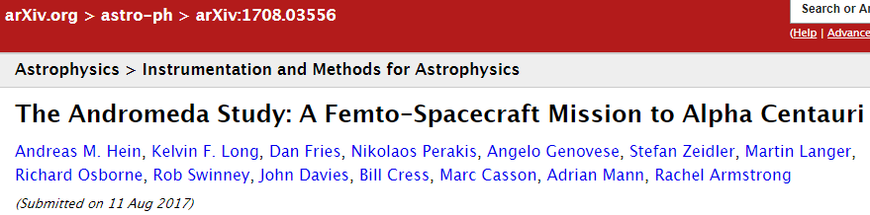
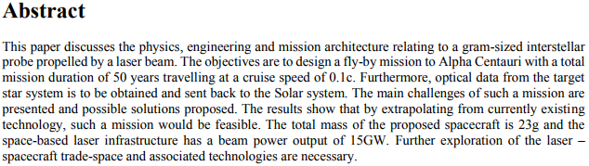
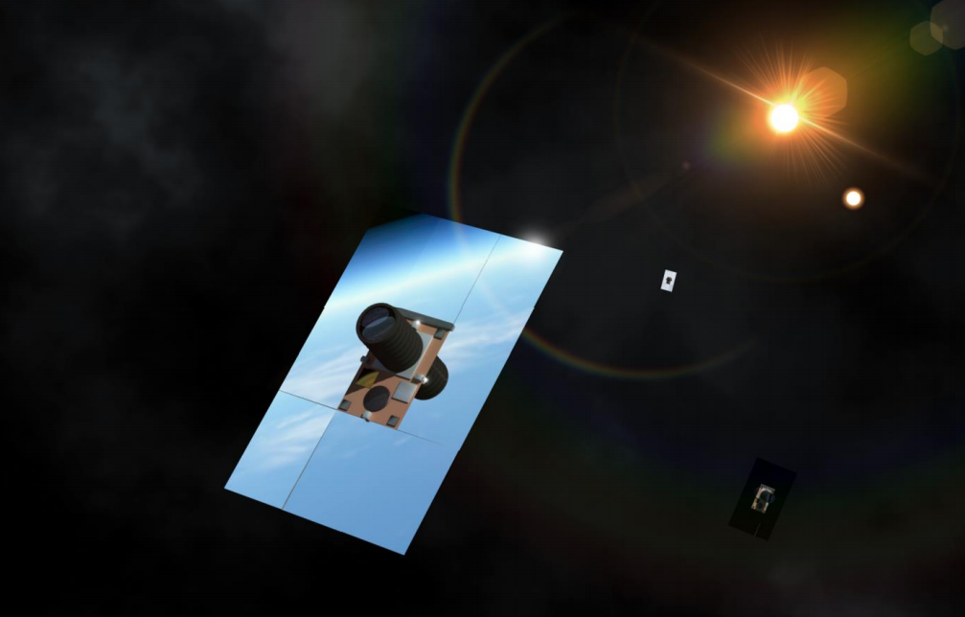
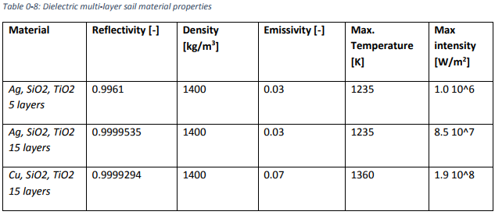
Unit 1

