Slide 1
Superposition
P47 – Optics: Unit 4

Slide 2
Unit 4
Course Outline
Unit 1: Electromagnetic Waves
Unit 2: Interaction with Matter
Unit 3: Geometric Optics
Unit 4: Superposition of Waves
Unit 5: Polarization
Unit 6: Interference
Unit 7: Diffraction
Unit 8: Fourier Optics
Unit 9: Modern Optics

Slide 3
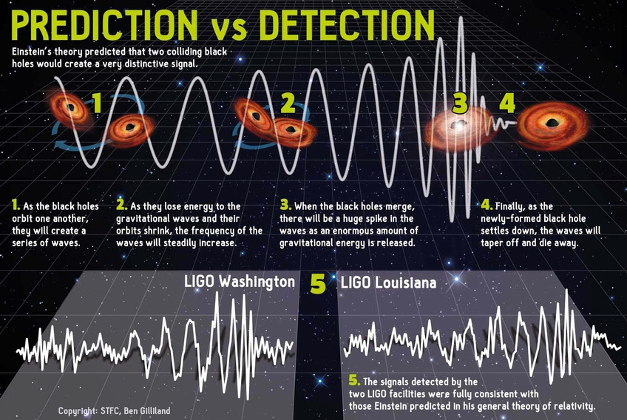
Unit 4
How to describe waves like this? → Superposition!

Slide 4
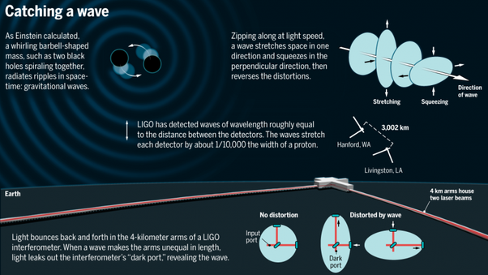
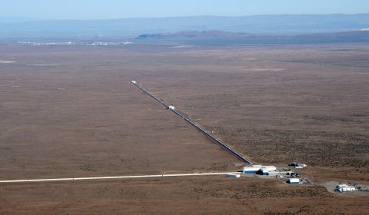
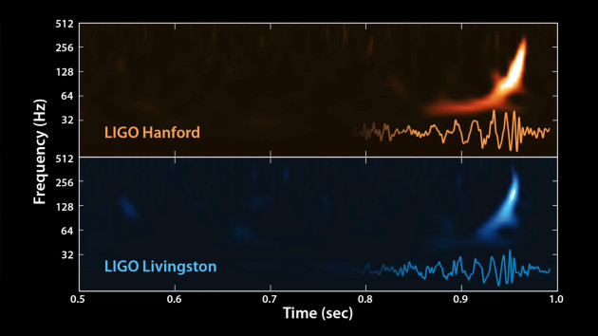
Unit 4

Slide 5

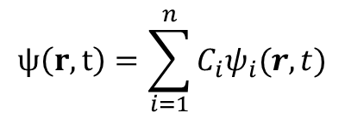
Unit 4
Superposition Principle
Assume we have a set of elementary solutions (e.g. plane wave) to the wave equation:
We can express complicated waves as sum of these elementary waves:
The result is still a solution of the wave equation because it’s a linear differential equation (no powers of r or t)
$$ψ_{i}(r,t)$$
$$ψ\left(r,t\right)=\sum_{i=1}^{n}{C_{i}ψ_{i}(r,t)}$$

Slide 6
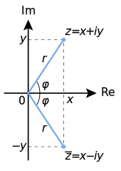

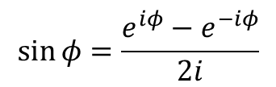


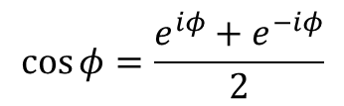

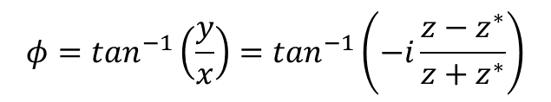



Unit 4
Superposition of two scalar monochromatic waves
$$Ee^{iφ}=E_{1}e^{iφ_{1}}+E_{2}e^{iφ_{2}}$$
$$e^{iφ}=cos{φ}+i\sin{φ}$$
$$\sin{φ}=\frac{e^{iφ}−e^{−iφ}}{2i}$$
$$\cos{φ}=\frac{e^{iφ}+e^{−iφ}}{2}$$
Complex number representation
$z={re}^{iφ}=x+iy$
$Re\left\{z\right\}=x=(z+z^{∗})/2$
$$z^{∗}={re}^{−iφ}=x−iy$$
$Im\left\{z\right\}=y=(z−z^{∗})/2i$
Modulus of a complex value:
$$r=\left|z\right|={\left(zz^{∗}\right)}^{1/2}$$
$$φ=\tan^{−1}\left(\frac{y}{x}\right)=\tan^{−1}\left(−i\frac{z−z^{∗}}{z+z^{∗}}\right)$$
Argument of a complex value:

Slide 7
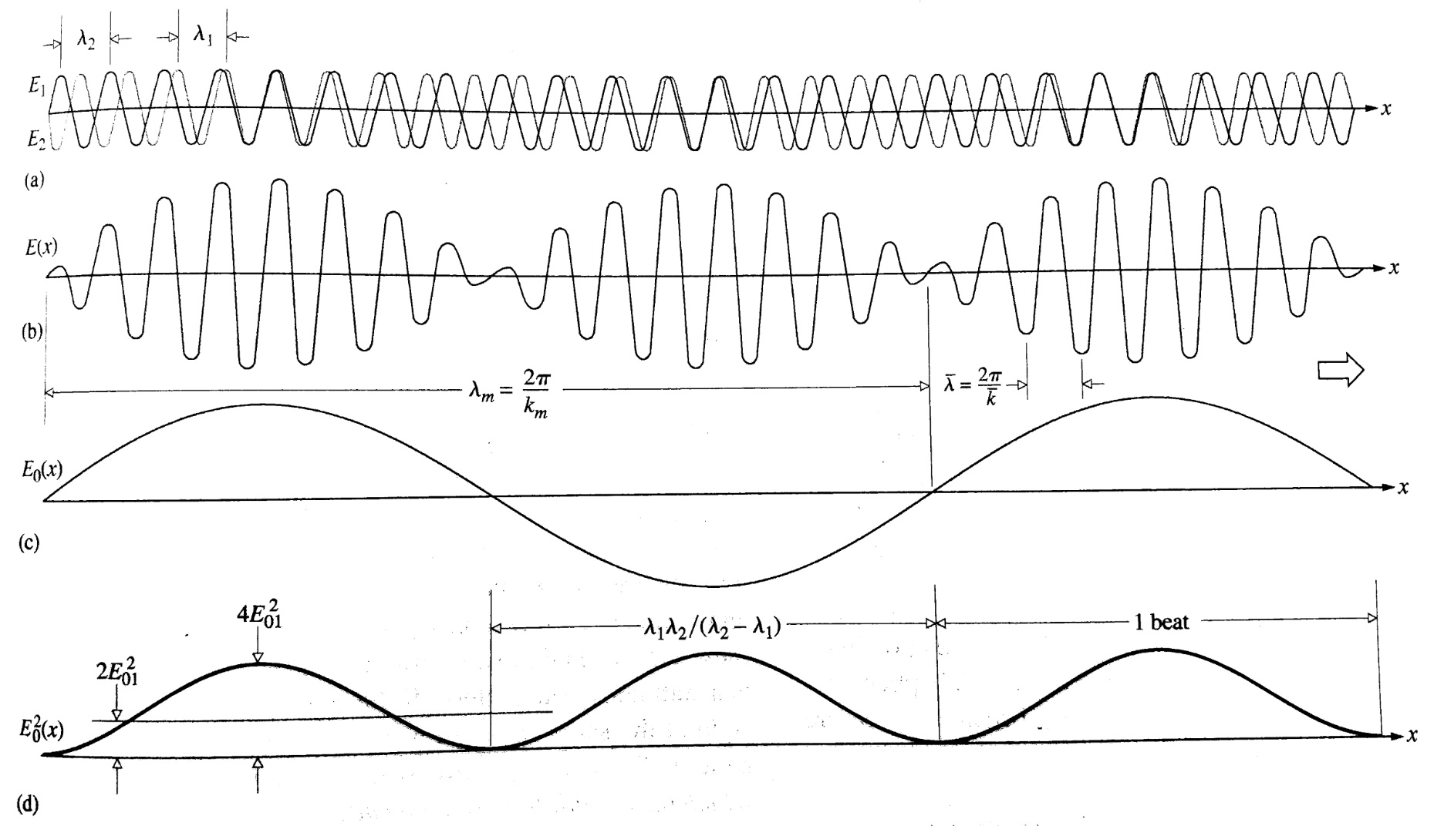
Unit 4
Superposition of two scalar monochromatic waves
modulation/beat/envelope
carrier

Slide 8

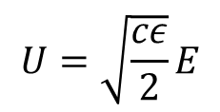

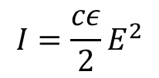

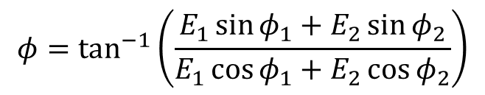
Unit 4
Superposition of two scalar monochromatic waves
$$Ee^{iφ}=E_{1}e^{iφ_{1}}+E_{2}e^{iφ_{2}}$$
$$E^{2}={E_{1}}^{2}+{E_{2}}^{2}+2E_{1}E_{2}\cos{(φ_{2}−φ_{1})}$$
$$φ=\tan^{−1}\left(\frac{E_{1}\sin{φ_{1}}+E_{2}\sin{φ_{2}}}{E_{1}\cos{φ_{1}}+E_{2}\cos{φ_{2}}}\right)$$
Note: detectors measure irradiance, not field amplitude
$$I=\frac{cε}{2}E^{2}$$
$$I=I_{1}+I_{2}+2\sqrt{I_{1}I_{2}}\cos{(φ_{2}−φ_{1})}$$
Sometimes it’s convenient to define a scaled field
$$U=\sqrt{\frac{cε}{2}}E$$

Slide 9
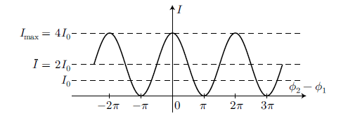



Unit 4
Superposition of two scalar monochromatic waves
$$I=I_{1}+I_{2}+2\sqrt{I_{1}I_{2}}\cos{(φ_{2}−φ_{1})}$$
$$I_{0}=I_{1}=I_{2}$$
If we take then
$$I={2I}_{0}\left[1+\cos\left(φ_{2}−φ_{1}\right)\right]$$

Slide 10

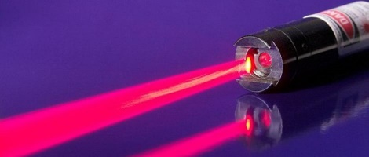



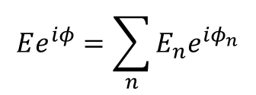
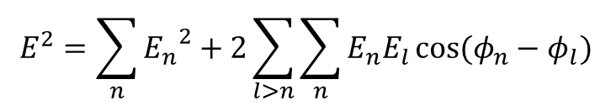
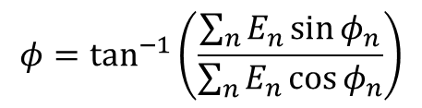

Unit 4
Superposition of many scalar monochromatic waves
$$Ee^{iφ}=\sum_{n}{E_{n}e^{iφ_{n}}}$$
$$E^{2}={E_{1}}^{2}+{E_{2}}^{2}+2E_{1}E_{2}\cos{(φ_{2}−φ_{1})}$$
n=2 case:
$$φ=\tan^{−1}\left(\frac{E_{1}\sin{φ_{1}}+E_{2}\sin{φ_{2}}}{E_{1}\cos{φ_{1}}+E_{2}\cos{φ_{2}}}\right)$$
Summing up a lot of sources, the result depends a lot of the relative phase, or coherence of the source elements
$$E^{2}=\sum_{n}{{E_{n}}^{2}}+2\sum_{l>n}{\sum_{n}{E_{n}E_{l}\cos{(φ_{n}−φ_{l})}}}$$
For N sources with random phase, this last term averages to zero!
$$φ=\tan^{−1}\left(\frac{\sum_{n}{E_{n}\sin{φ_{n}}}}{\sum_{n}{E_{n}\cos{φ_{n}}}}\right)$$
$$E^{2}=N{E_{0}}^{2}$$
If all fields are coherent at a single point in space:
$$E^{2}=N^{2}{E_{0}}^{2}$$

Slide 11
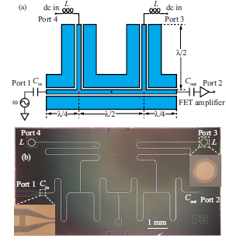
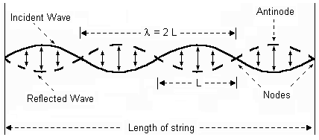



Unit 4
Standing Waves
Superposition of opposite-direction traveling waves creates a standing wave
Research Application
Rimberg group: inject DC current at the nodes of a microwave cavity without causing power leaks!
$$E={Re\{E}_{R}e^{i(kx−ωt+δ)}+E_{L}e^{i(kx+ωt+δ)}\}$$
Assume equal field amplitudes…
$$E=E_{0} Re\{e^{i(kx+δ)}(e^{iωt}+e^{−iωt})\}$$
Assume δ=π/2…
$$E={2E}_{0}\sin{kx}\cos{ωt}$$
Still oscillates in time, but has a fixed sinusoidal envelope.
Video: Argonne Natl. Labs Acoustic levitation!

Slide 12
Unit 4
Phase & Group Velocity
Can define many different “propagation” velocities
Phase velocity
Group velocity
Front velocity
Energy propagation velocity
Signal velocity
We’ll just focus on these two

Slide 13



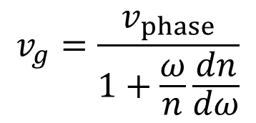



Unit 4
Group Velocity
$$v_{g}=\frac{v_{phase}}{1+\frac{ω}{n}\frac{dn}{dω}}$$
“Normal” Dispersion
Zero Dispersion
“Anomalous” Dispersion
$$\frac{dn}{dω}>0$$
$$\frac{dn}{dω}=0$$
$$\frac{dn}{dω}<0$$
$$v_{g}<v_{phase}$$
$$v_{g}=v_{phase}$$
$$v_{g}>v_{phase}$$
n(ω)
n(ω)
n(ω)
ω
ω
ω

Slide 14
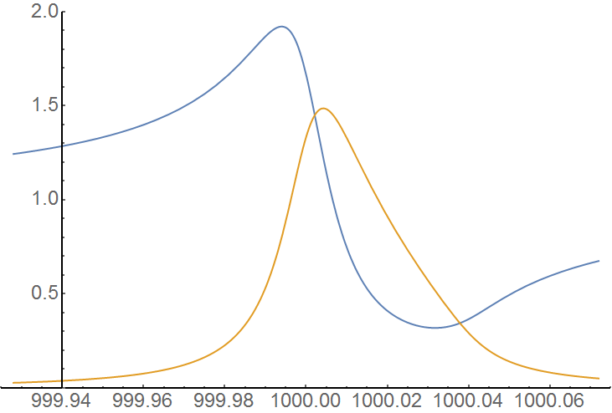
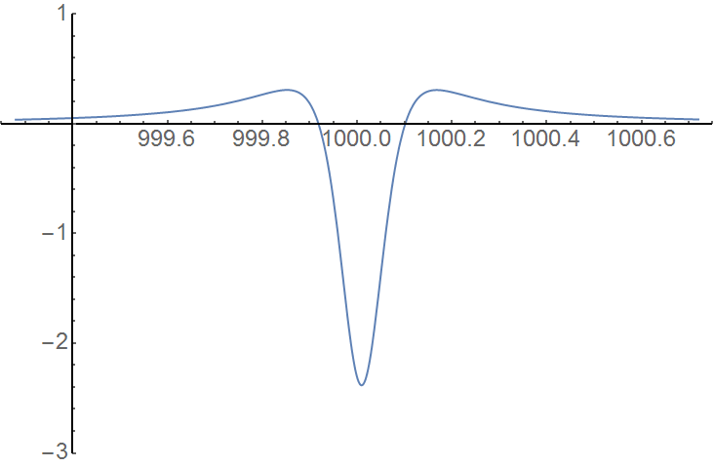

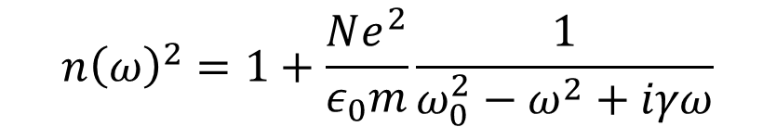




Unit 4
Dispersion Near a Strong Resonance
$$n{\left(ω\right)}^{2}=1+\frac{Ne^{2}}{ε_{0}m}\frac{1}{{ω_{0}^{2}−ω}^{2}+iγω}$$
$$n(ω)$$
$$\frac{dn}{dω}$$
$$ω$$
Normal
Normal
$$α(ω)$$
$$ω$$
Anomalous

Slide 15
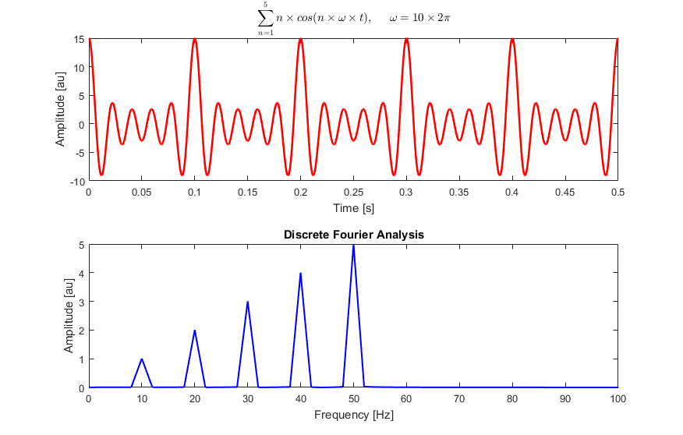
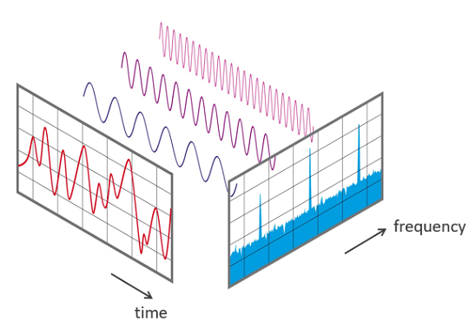
Unit 4
Fourier Analysis
Used to:
convert from time-domain to frequency-domain
define power/energy of a waveform
classify different signal types
define convolution

Slide 16
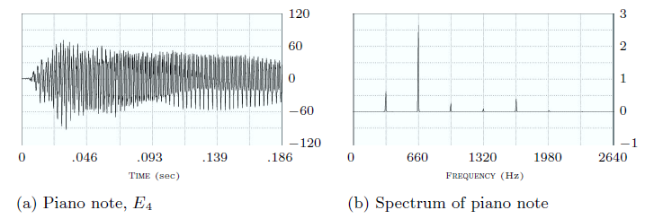
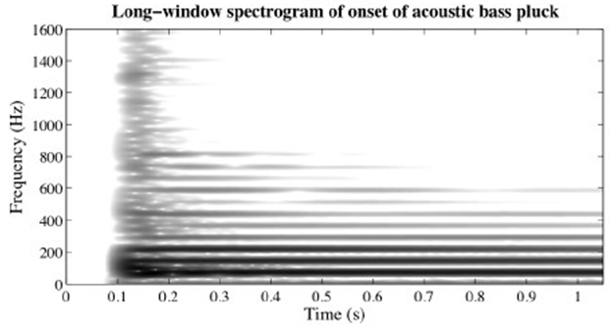
Unit 4
Fourier Analysis
Piano playing E4 (329.63 Hz)
The information in a waveform can be represented in a number of different ways:
Most instruments acquire data in either the time domain (oscilloscope) or frequency domain (spectrometer)
Sometimes it’s convenient to look at the data in a mixed representation (spectrogram)
Time domain signal
Frequency domain signal
Spectrogram: Time and Frequency
(Have to specify a window function)

Slide 17
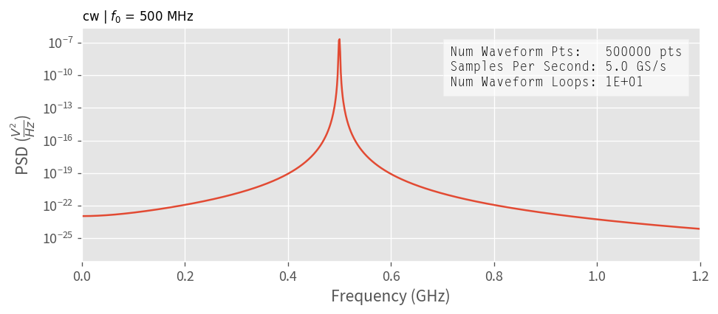
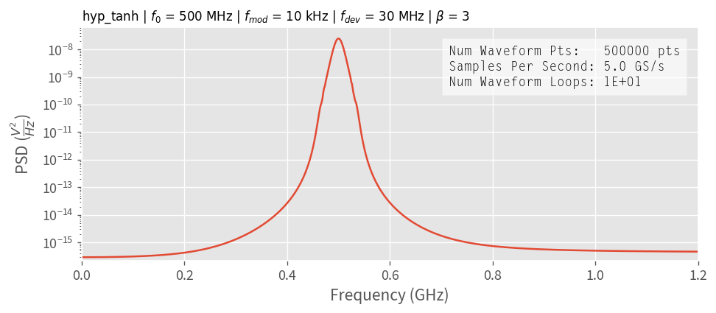
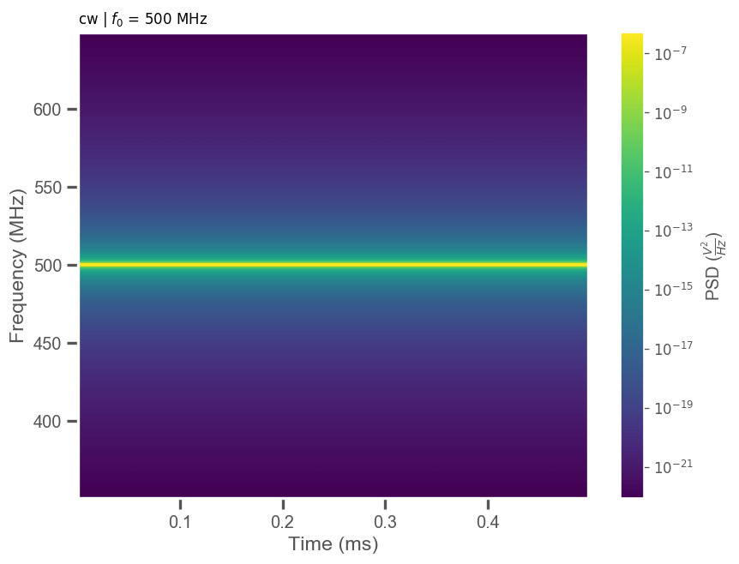
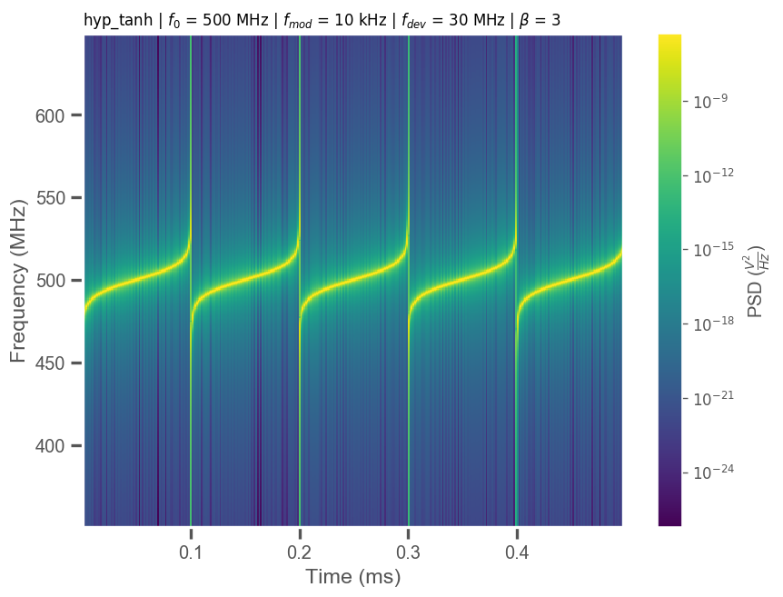
Unit 4
Fourier Analysis - Spectrogram

Slide 18
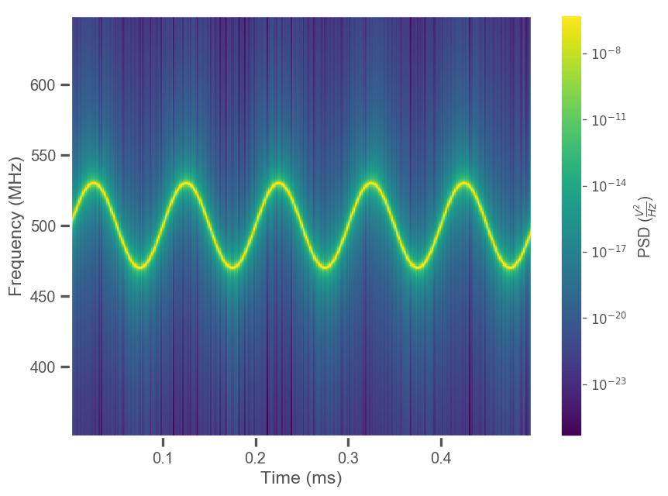
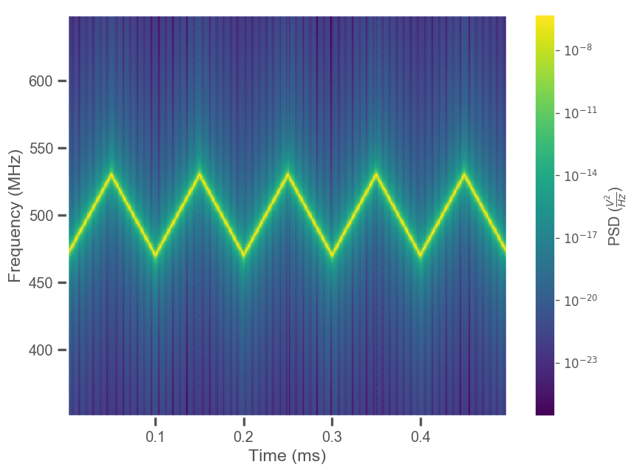
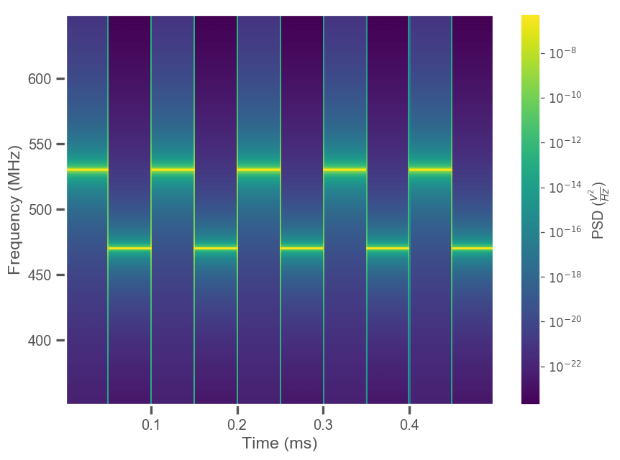
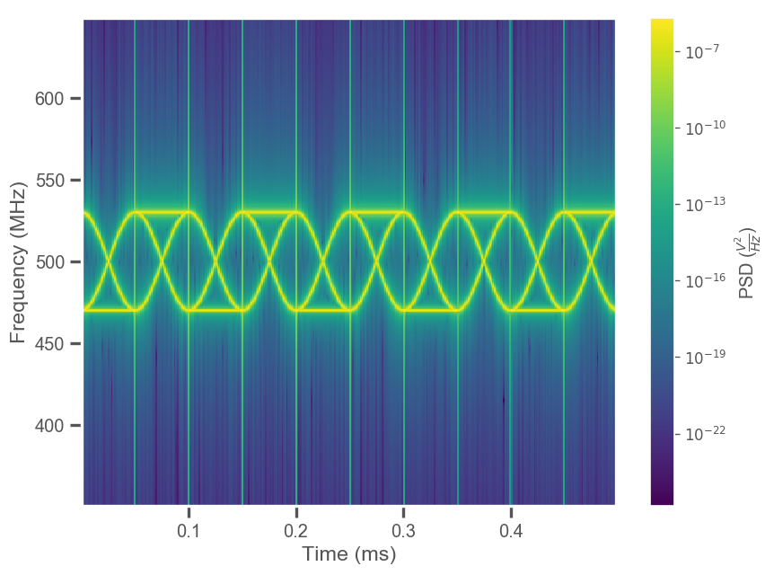
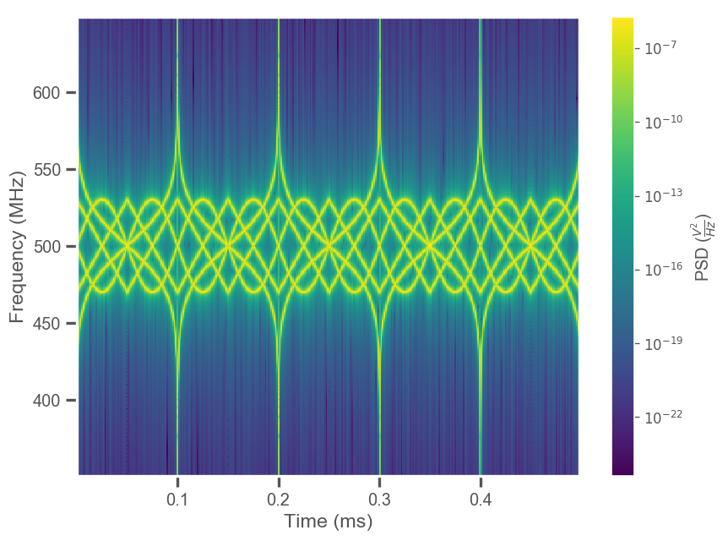
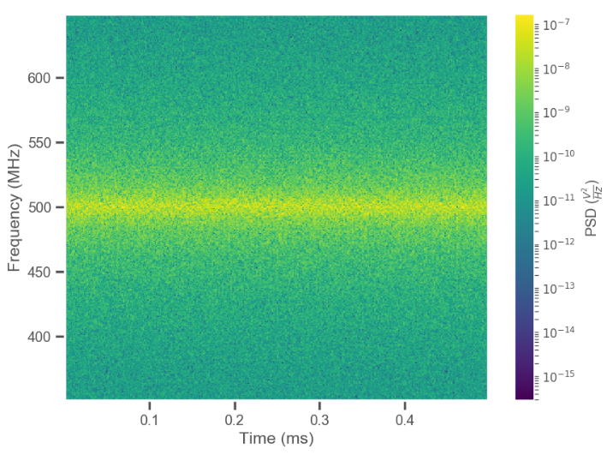
Unit 4
Fourier Analysis - Spectrogram

Slide 19
Unit 4
Fourier Analysis
Many transforms:
Fourier Transform
Laplace Transform
Hilbert transform
And many more…
Original
Problem
Solution of original problem
Difficult
solution
Integral
transform
Inverse
transform
Problem in transform space
Solution in transform space
Relatively easy
solution

Slide 20
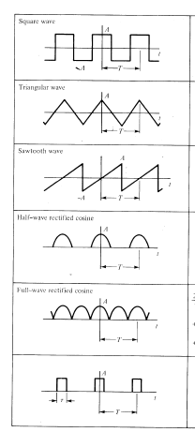
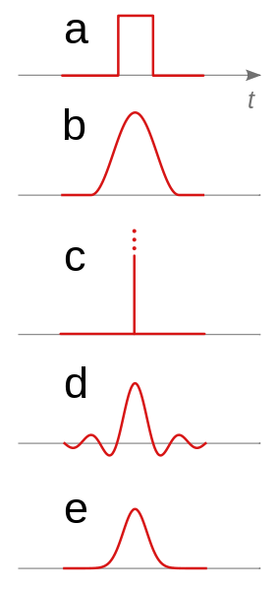
Unit 4
Fourier Analysis
Fourier Series
(periodic waveforms)
Fourier Transform
(non-periodic waveforms - pulses)
a) Rectangular
b) Cosine squared
c) Dirac delta function
d) Sinc pulse
e) Gaussian pulse

Slide 21
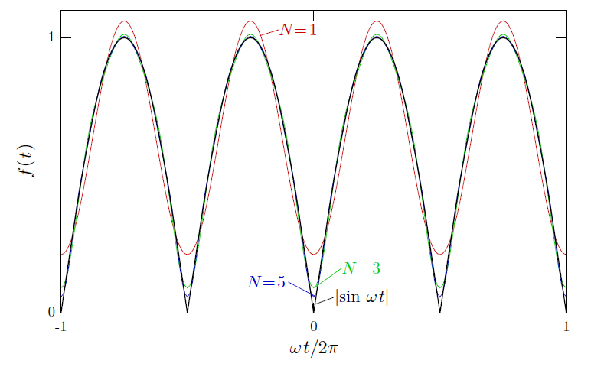

Unit 4
Fourier Analysis – Ex: Rectified Sine Wave
$$f\left(t\right)=\left|\sin{ωt}\right|$$
Even function with period π/ω, so only even harmonics allowed, right from the start…

Slide 22
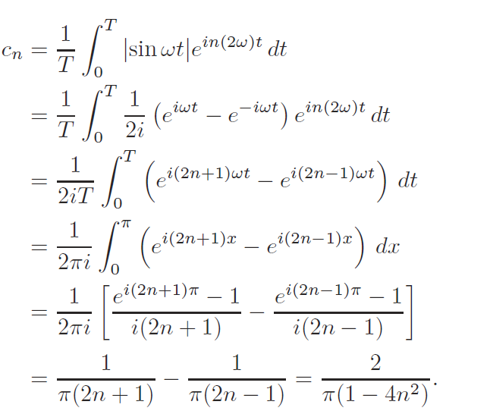
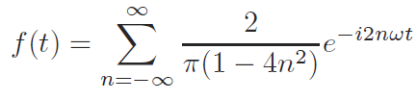



Unit 4
Fourier Analysis – Ex: Rectified Sine Wave
$$f\left(t\right)=\left|\sin{ωt}\right|$$
Even function with period π/ω, so only even harmonics allowed, right from the start…
$e^{i(2n+1)π}=−1$ for all values of n!
Note that
Because the function is real and even
In general we usually only have

