Slide 1
Interference
P47 – Optics: Unit 6

Slide 2
Unit 6
Course Outline
Unit 1: Electromagnetic Waves
Unit 2: Interaction with Matter
Unit 3: Geometric Optics
Unit 4: Superposition of Waves
Unit 5: Polarization
Unit 6: Interference
Unit 7: Diffraction
Unit 8: Fourier Optics
Unit 9: Modern Optics

Slide 3
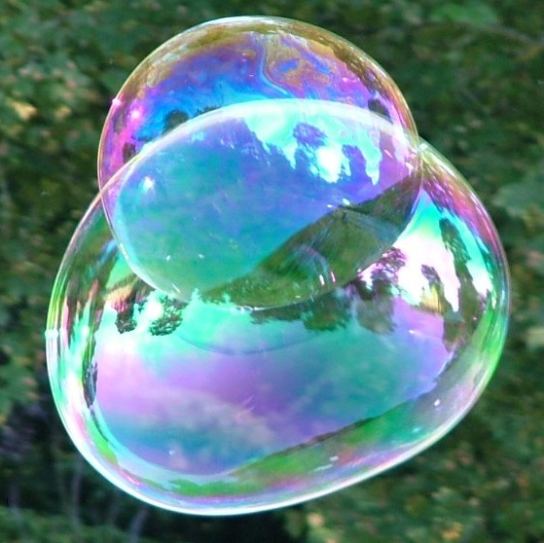
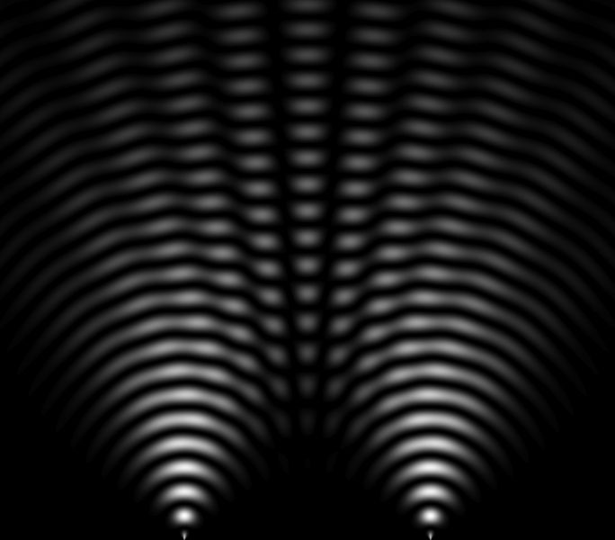
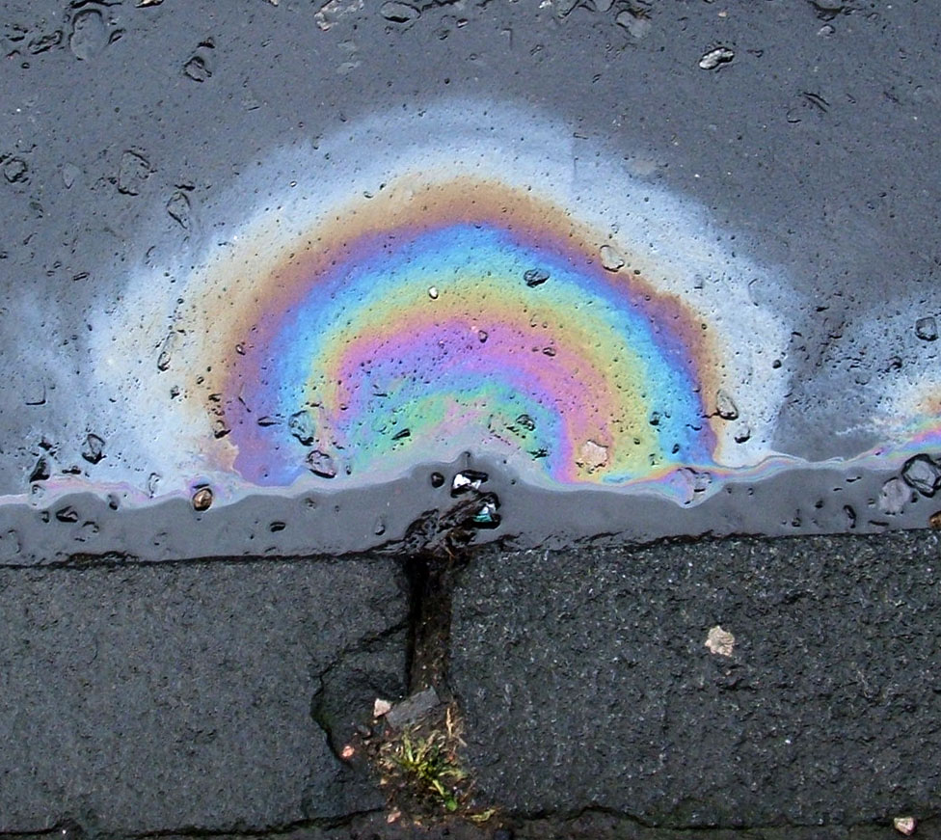
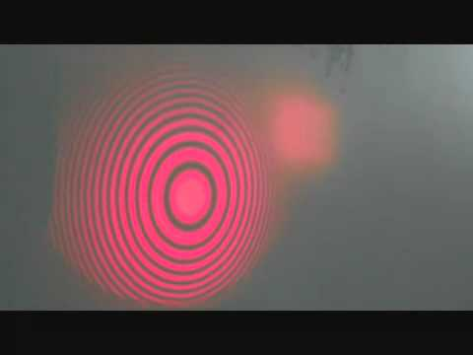
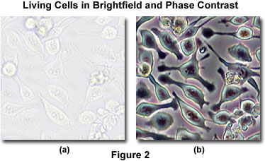
Unit 6
Interference

Slide 4
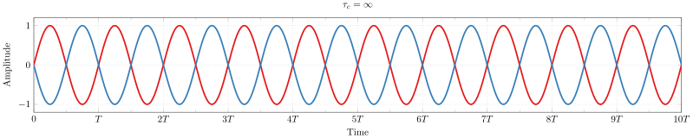
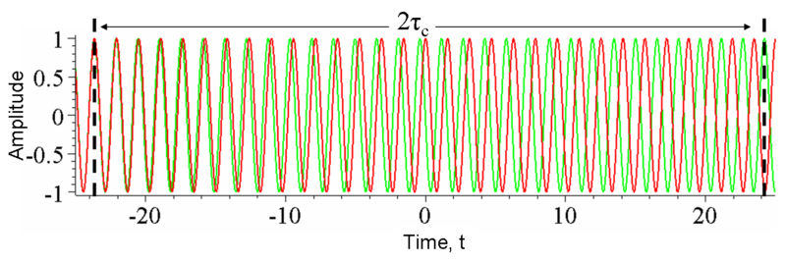
Unit 6
Temporal Coherence

Slide 5
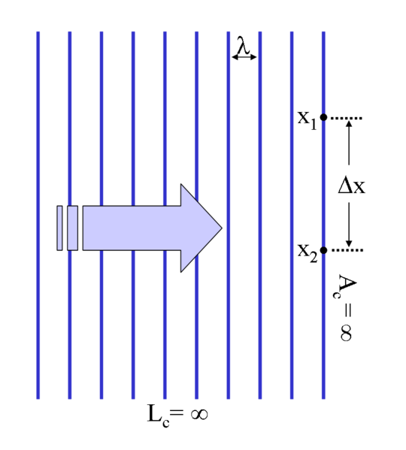
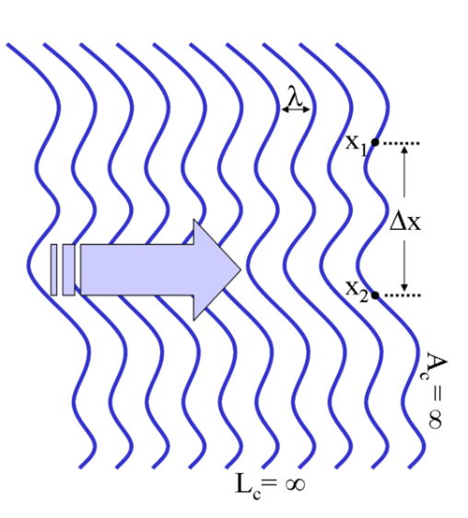
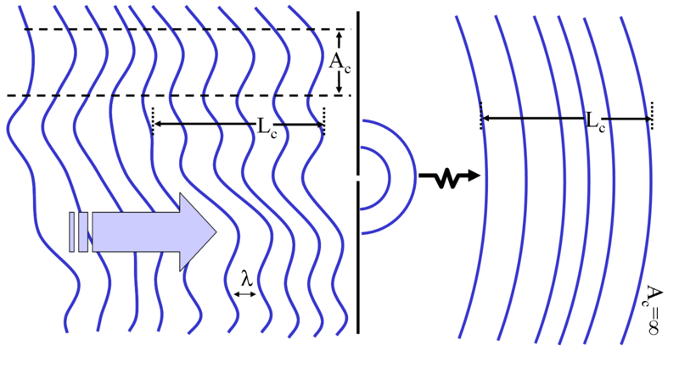
Unit 6
Spatial Coherence
plane wave
infinite temporal coherence
distorted wavefront
infinite temporal coherence
distorted wavefront
finite temporal coherence
diffracted wavefront
finite temporal coherence
infinite spatial coherence

Slide 6
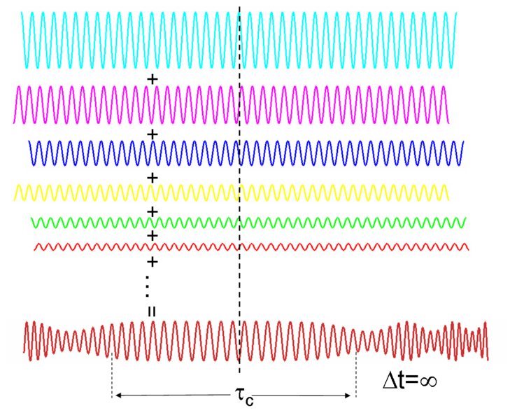
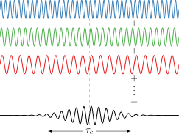
Unit 6
Spectral Coherence
waves of different frequencies
with some fixed phase relationship
→ add coherently
waves of different frequencies
without fixed phase relationship
→ add randomly (natural light)

Slide 7
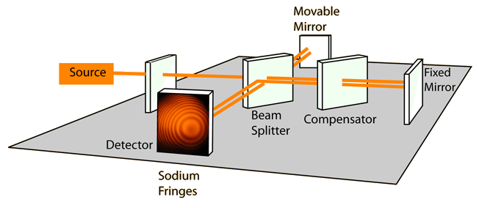
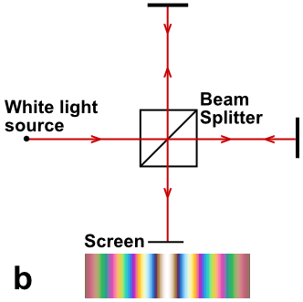
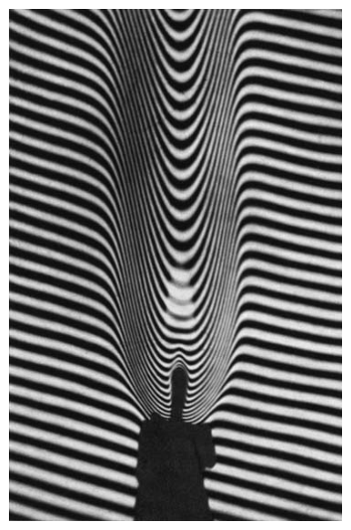
Unit 6
Michelson Interferometer

Slide 8
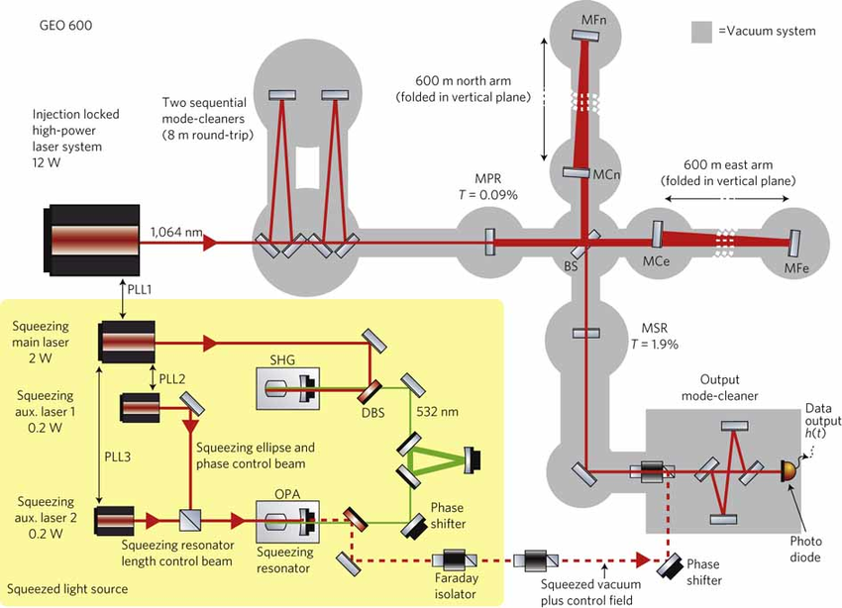
Unit 6
Michelson Interferometer
(writ large)

Slide 9
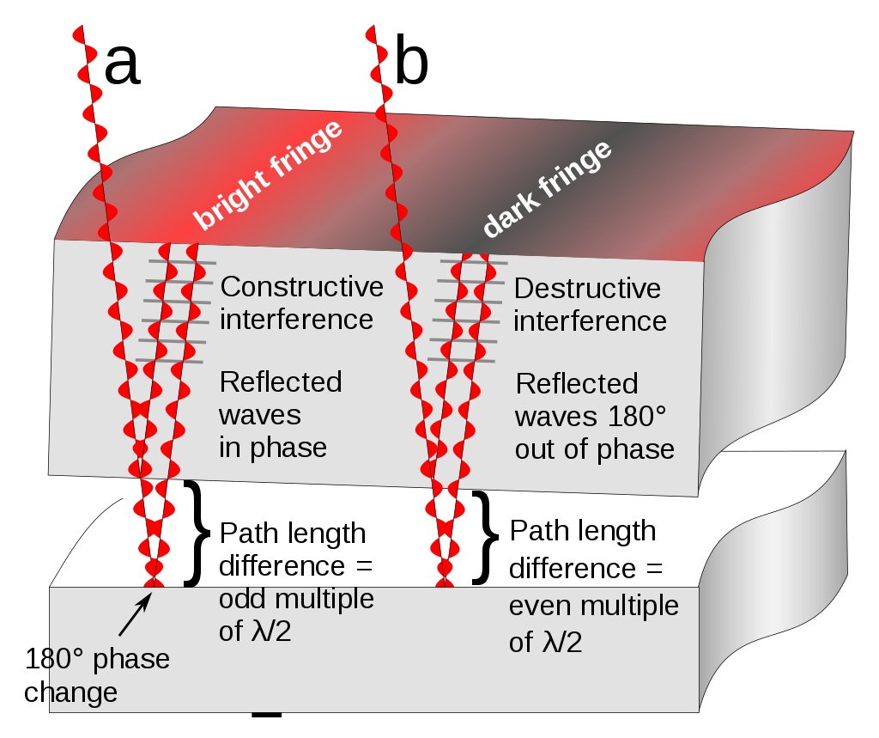

Unit 6
Thin-Film Interference

Slide 10
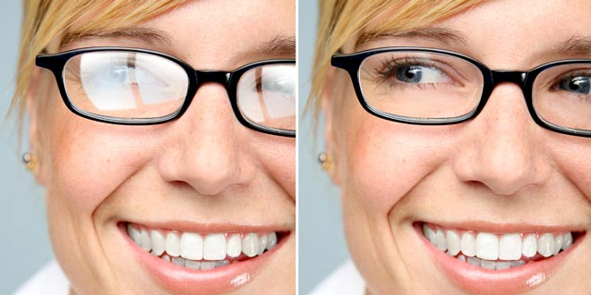
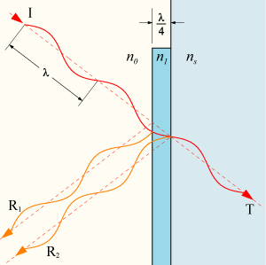
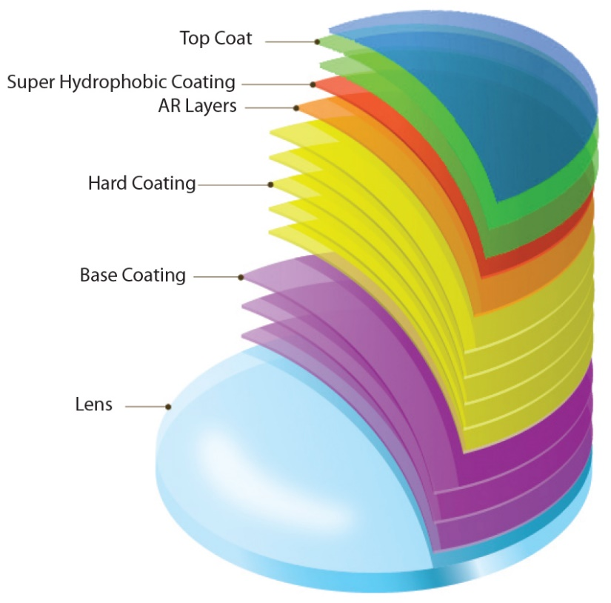
Unit 6
Anti-Reflection Coatings

Slide 11
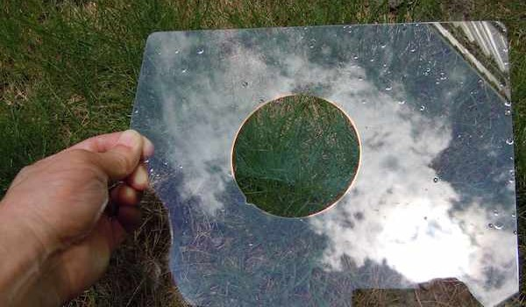
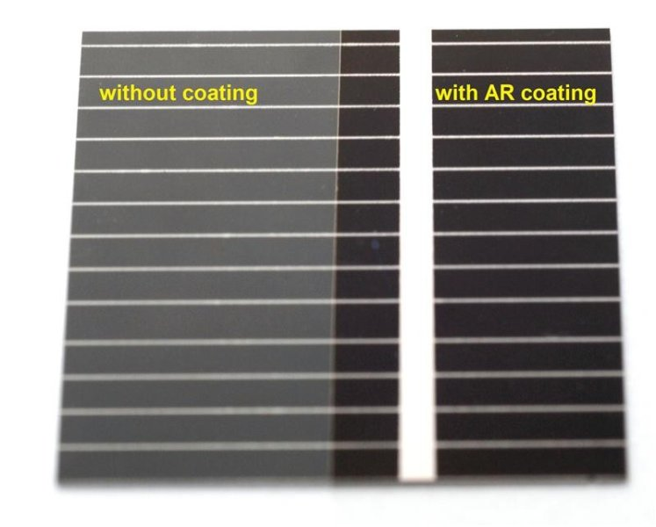
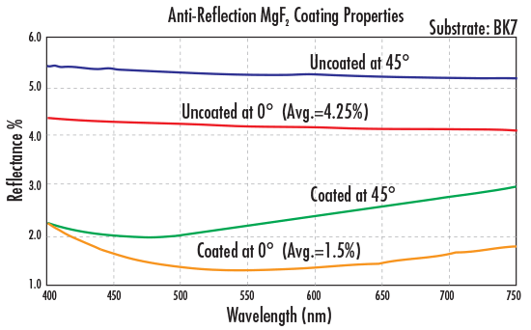
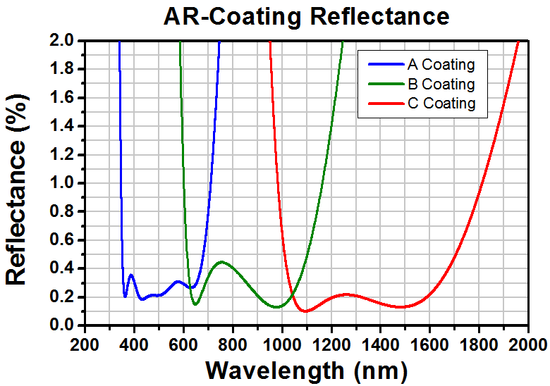
Unit 6
Anti-Reflection Coatings

Slide 12
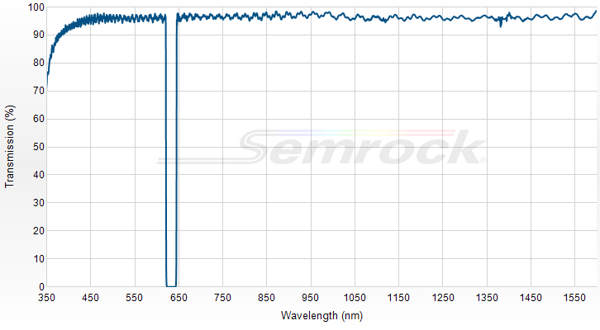
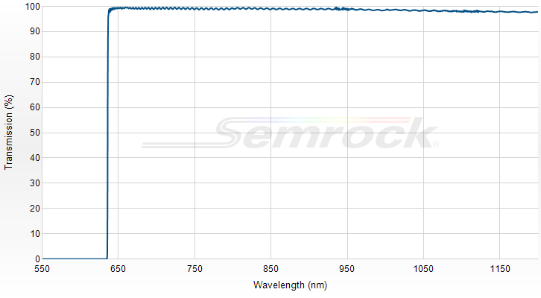
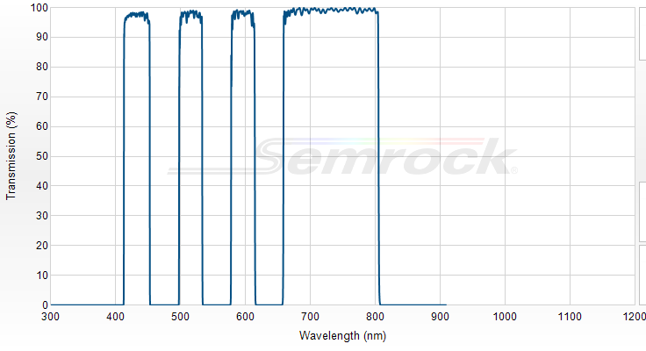
Unit 6
Multi-Layer Dielectric Mirrors/Filters

