Slide 1

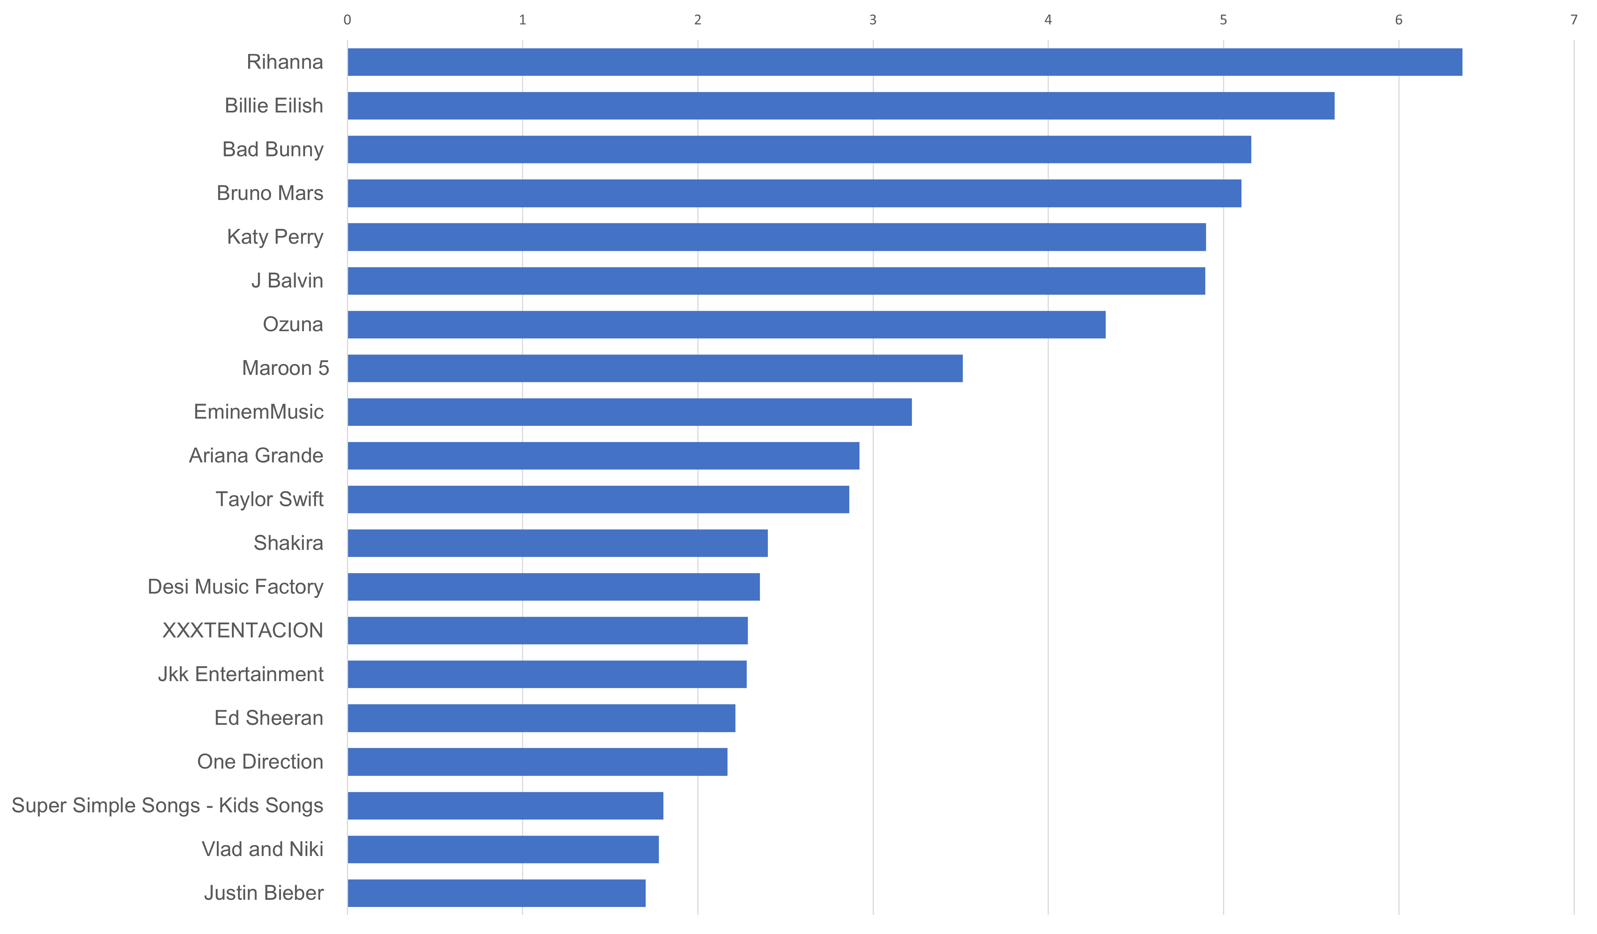

BEST CHANNELS BY VIEW RATE
The chart represents the TOP-20 channels out of TOP-100 best YouTube channels.
Views rate = Total views / (subscribers * video count)

