Slide 1
MOVIE PRESENTATION
EXPLOration of various Data for most actionable insights for a new movie studio.

Slide 2
What it entails
Reading into databases relevant to our analysis that have been collected over time to understand the parameters used to analyse movies.
Joining relevant tables together.
Performing data cleaning using relevant methods in SQL (Standard Query Language)
Visualizing Data to give better comparisons.
Perform different data analysis techniques to draw relevant assumptions that suit the Business question.
From the results of analysis come up with relevant conclusions on the type of movie the company should focus on producing.

Slide 3
Database Connecting, Reading and Cleaning
To carry out this analysis various datasets were acquired from Box office movies company movie basics and movie ratings. The database used in this case are im.db and the bom.movie_gross.csv.gz.
Import necessary libraries present in the python working environment and other SQL modules.
Make a connection using sqlite3
Read database using pandas
Using sql queries to join the database using a common identifier
.After joining check for null values
-convert some values into float/integer
-clean csv and drop rows with missing values
-change format for values so it can be interpretable by machine

Slide 4
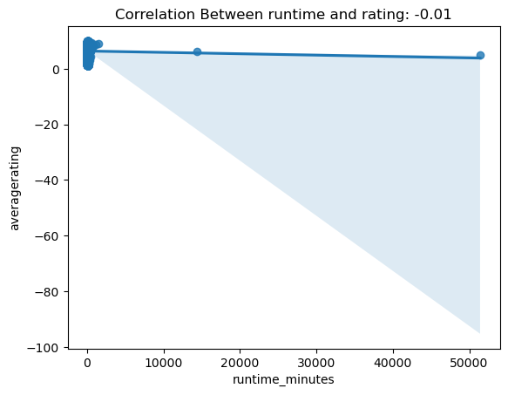
Data analysis ,exploration and visualization
This being the correlation between movie runtime and movie rating.The correlation gives a negative result indicating an increase in runtime slightly decreases the rating of the movie.

Slide 5
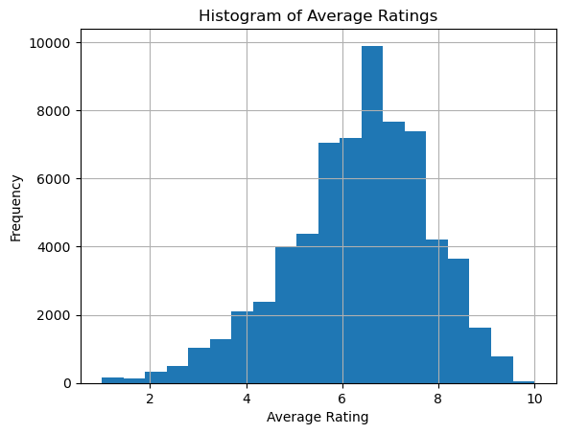
2.Exploration of data through visualizing the average rating of movies
-average rating of movies in the data set will give us wher most data oints fall.from the histogram you can see that its mostly spread in the centre meaning it’s a normal distribution

Slide 6
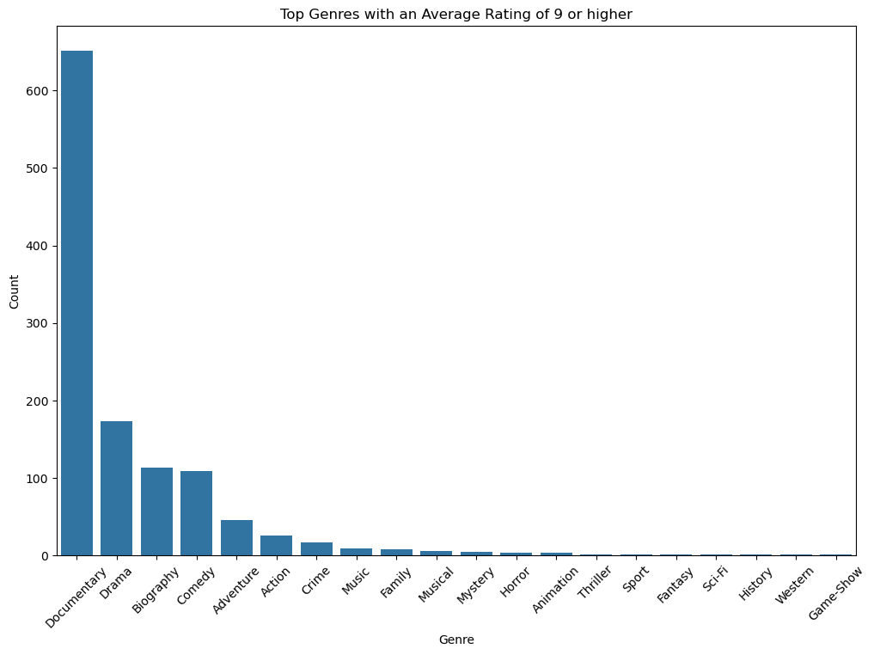
Rating base on genre to chose a particular genre for the company
When the genre average is visualised we can see that the movie genre with that the movie genre with the highest customer base is documentary,drama,biography,comedy and adventure movies

Slide 7
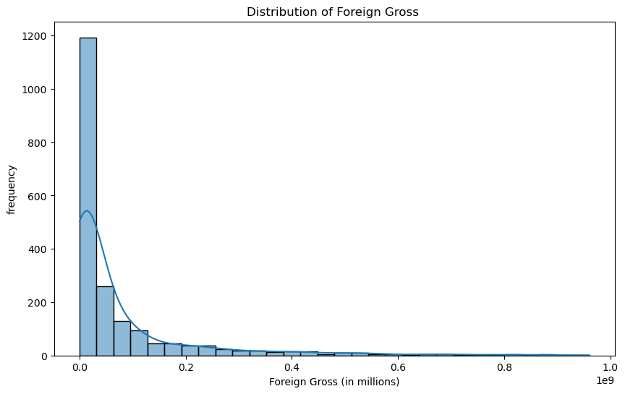
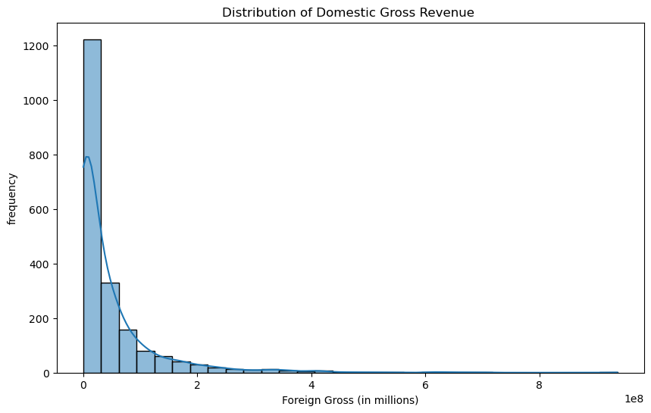
The visualizations below relate gross revenues to frequencies

Slide 8
recommendations
1.The studio should major on the top five movies with the highest rating most probably documentary movies
2.movies with balanced aspects will do better in the market
3.spend moderately to avoid losses

