Slide 1
Semi-supervised study
2026/06/24

Slide 2
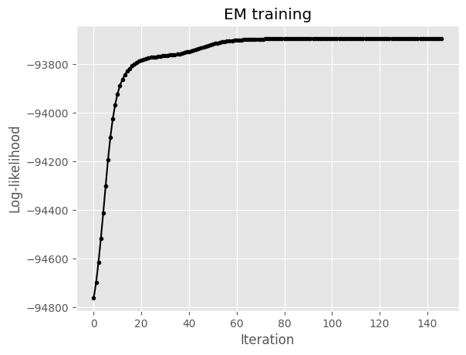
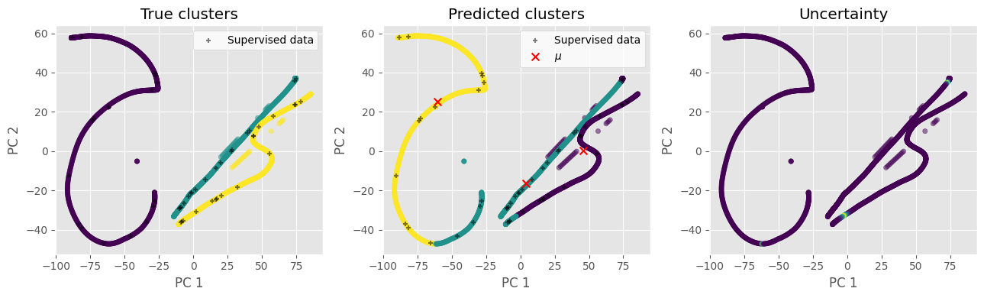
Fully unsupervised (β = 0, full covariance)
Silhouette: 0.2998111357081737
Completeness: 0.6273980349564303
Fowlkes-Mallows index: 0.7451652521812167
Homogeneity: 0.6176323837102664
Mutual Information: 0.678538526623476
Adjusted mutual information: 0.622251095013317
Normalized Mutual Information: 0.6224769098898842
Rand index: 0.827184794922935
Adjusted rand index: 0.6144056423445312
V-measure: 0.6224769098898842

Slide 3
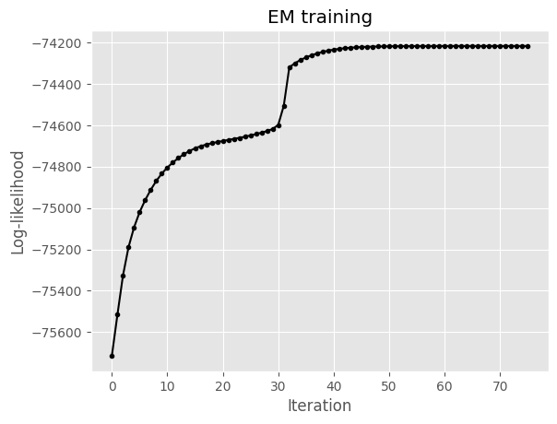
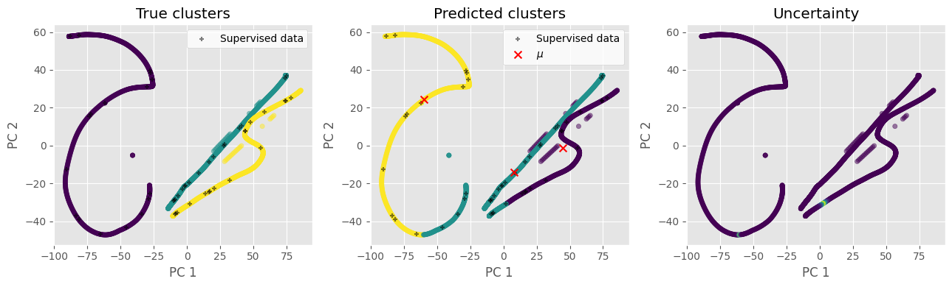
Mostly unsupervised (β = 0.25, full covariance)
Silhouette: 0.2842655695746486
Completeness: 0.6725440846120307
Fowlkes-Mallows index: 0.7632944195196653
Homogeneity: 0.6544388750330659
Mutual Information: 0.7189745902934597
Adjusted mutual information: 0.6631654472441469
Normalized Mutual Information: 0.6633679670782755
Rand index: 0.8371747123629654
Adjusted rand index: 0.6391212599806535
V-measure: 0.6633679670782754

Slide 4
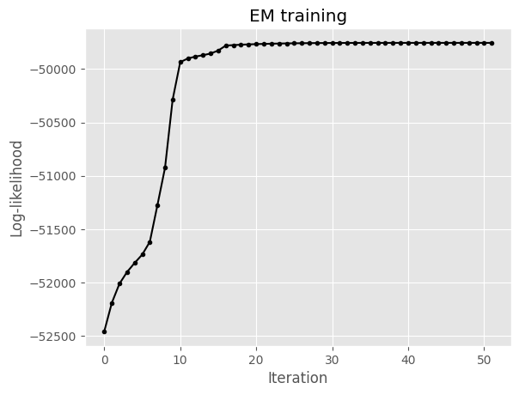
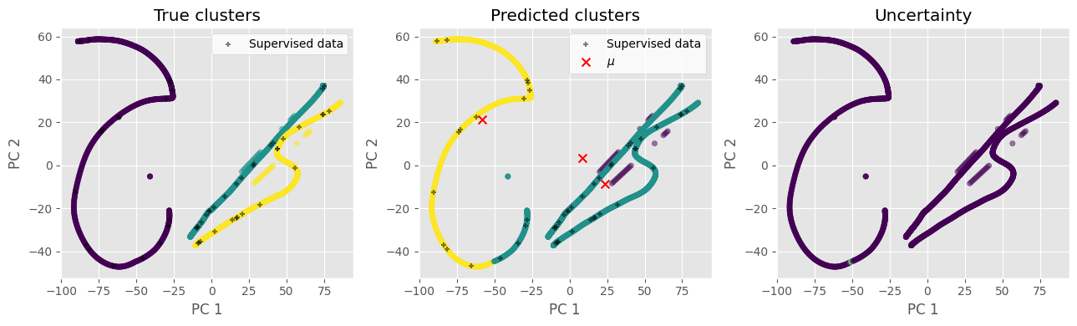
Balanced objective (β = 0.5, full covariance)
Silhouette: 0.34894549310751355
Completeness: 0.6891718971298522
Fowlkes-Mallows index: 0.6753782353415967
Homogeneity: 0.41248162633189894
Mutual Information: 0.45315738353803164
Adjusted mutual information: 0.5157175437276091
Normalized Mutual Information: 0.5160801266392561
Rand index: 0.6819488681075654
Adjusted rand index: 0.3950955506838093
V-measure: 0.5160801266392561

Slide 5
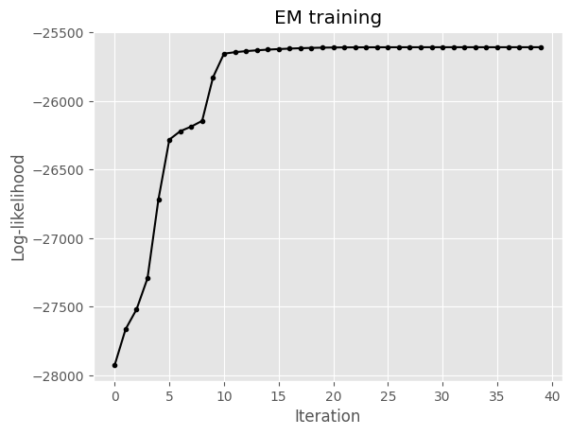

Mostly supervised (β = 0.75, full covariance)
Silhouette: 0.4088628142181719
Completeness: 0.6640332808802846
Fowlkes-Mallows index: 0.6732149630110269
Homogeneity: 0.4070363470130773
Mutual Information: 0.44717513276314386
Adjusted mutual information: 0.5043355872848532
Normalized Mutual Information: 0.5047023534337957
Rand index: 0.6819912674346033
Adjusted rand index: 0.3936453765321247
V-measure: 0.5047023534337957

Slide 6
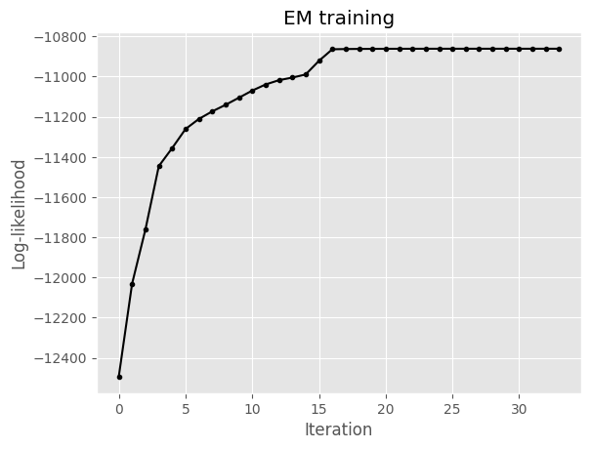
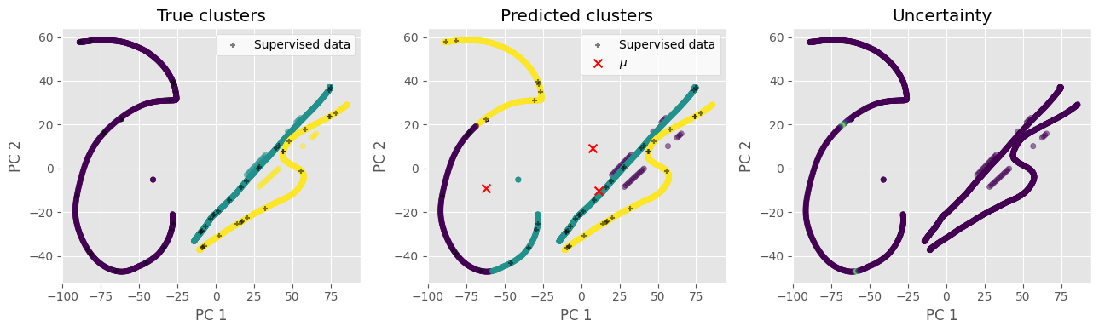
Mostly supervised (β = 0.9, full covariance)
Silhouette: 0.09112858146983326
Completeness: 0.5839133377632219
Fowlkes-Mallows index: 0.6919092045630955
Homogeneity: 0.5017036186283245
Mutual Information: 0.5511777606943362
Adjusted mutual information: 0.5394017121321106
Normalized Mutual Information: 0.5396957606389736
Rand index: 0.7642313341202649
Adjusted rand index: 0.5020994559197169
V-measure: 0.5396957606389735

Slide 7
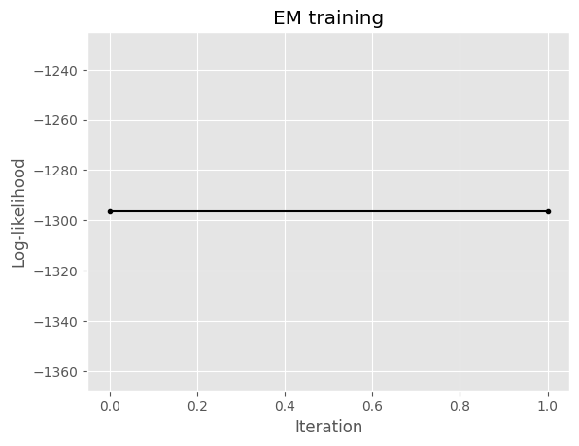
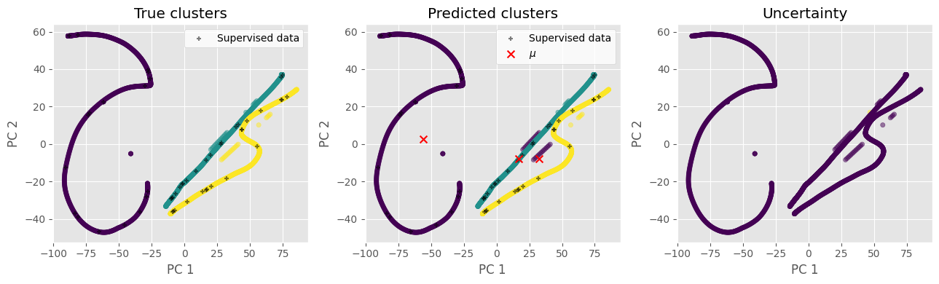
Fully supervised (β = 1, full covariance)
Silhouette: 0.21096108419347445
Completeness: 0.9561412864968315
Fowlkes-Mallows index: 0.981818800576102
Homogeneity: 0.9559793330209151
Mutual Information: 1.0502506429695209
Adjusted mutual information: 0.9560342237481432
Normalized Mutual Information: 0.9560603029002765
Rand index: 0.9878848162921958
Adjusted rand index: 0.9727345048839638
V-measure: 0.9560603029002765

Slide 8

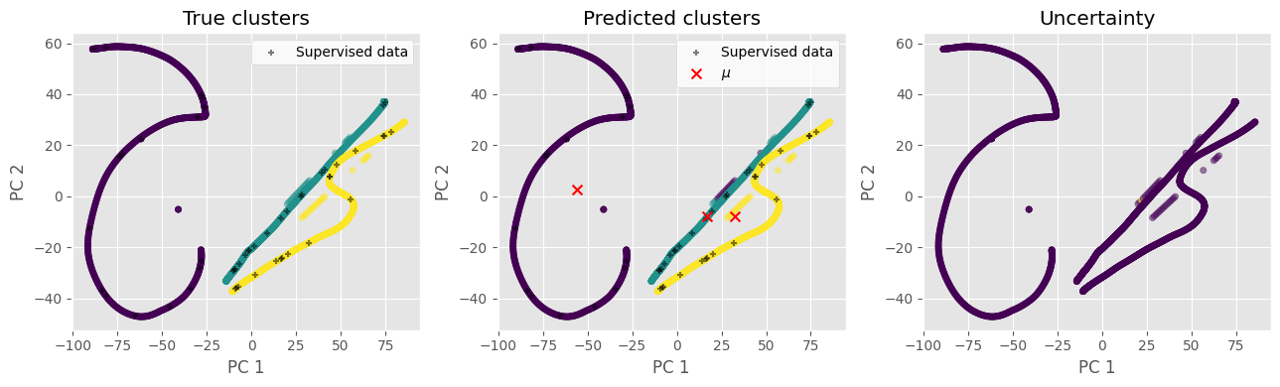
Fully supervised (β = 1, diagonal covariance)
Silhouette: 0.21526276215085657
Completeness: 0.9806541826971374
Fowlkes-Mallows index: 0.9922260415149939
Homogeneity: 0.9806133204075569
Mutual Information: 1.0773138442313808
Adjusted mutual information: 0.9806222575803965
Normalized Mutual Information: 0.9806337511266717
Rand index: 0.9948204982090524
Adjusted rand index: 0.9883425897841498
V-measure: 0.9806337511266717

Slide 9
Equations

