Slide 1
Summary
2026/06/11

Slide 2
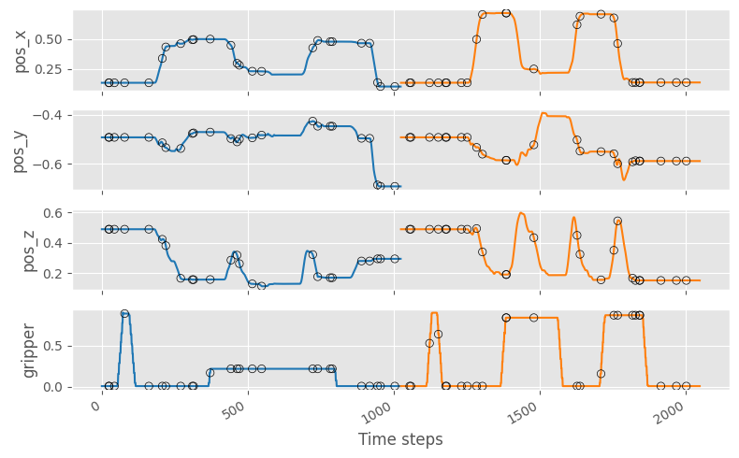
IROS data

Slide 3
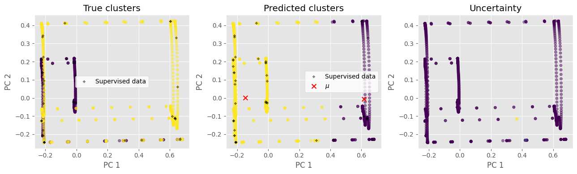
IROS data

Slide 4
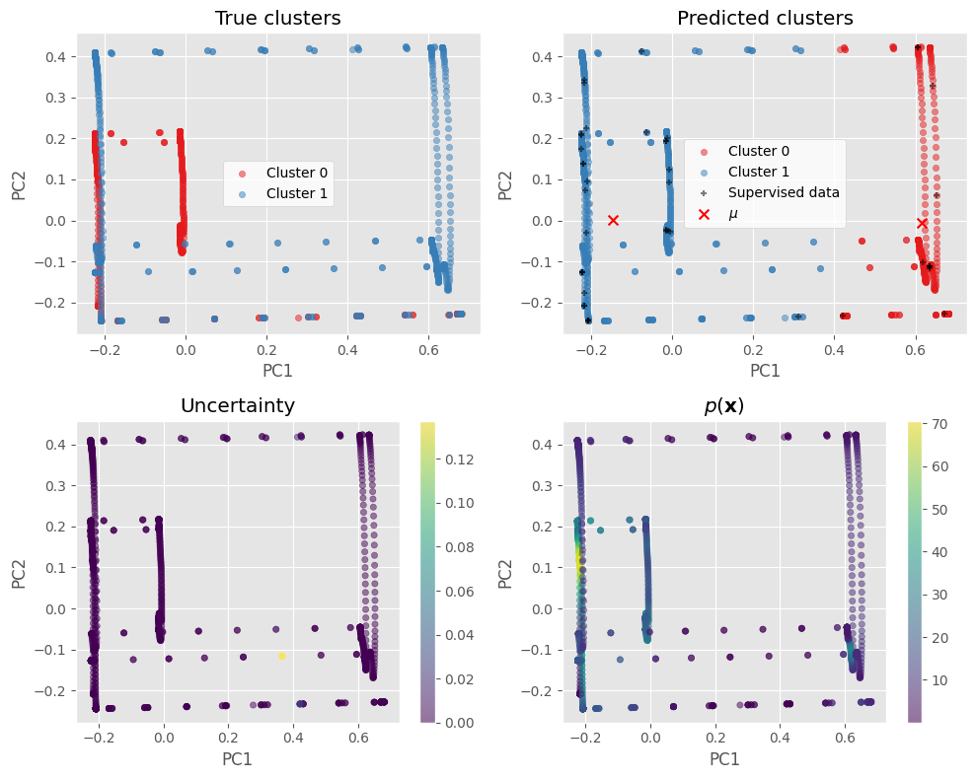
IROS data

Slide 5
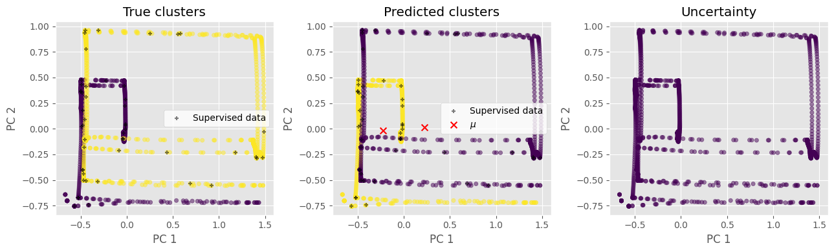
Augmented data

Slide 6
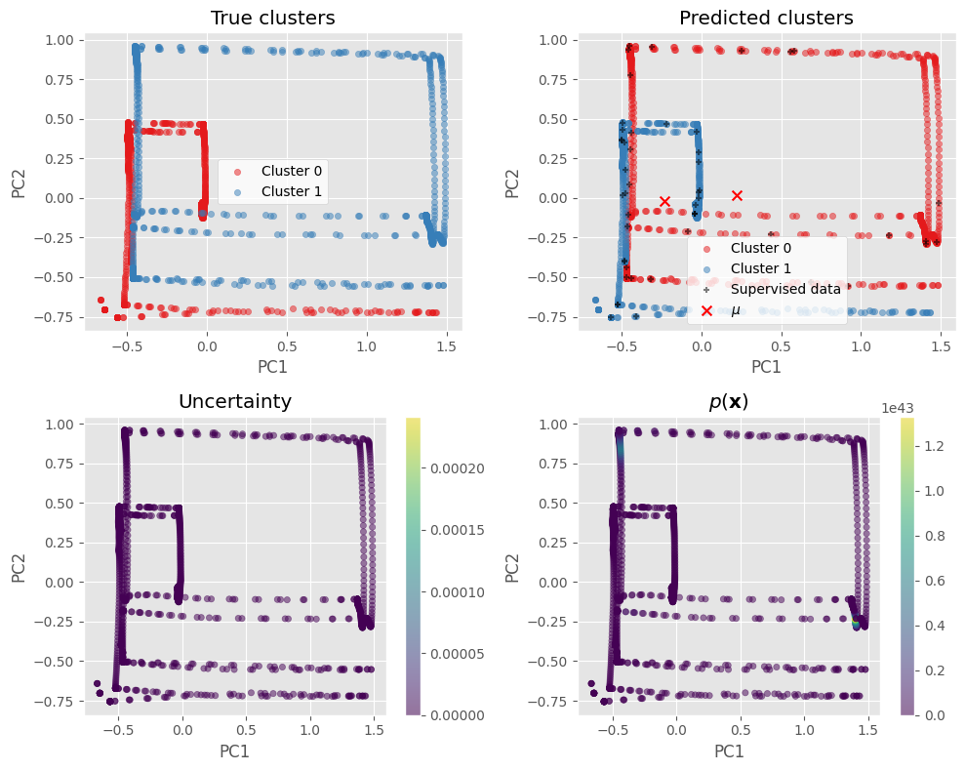
Augmented data

Slide 7

Ablation: no supervised data
With supervised data:

Slide 8
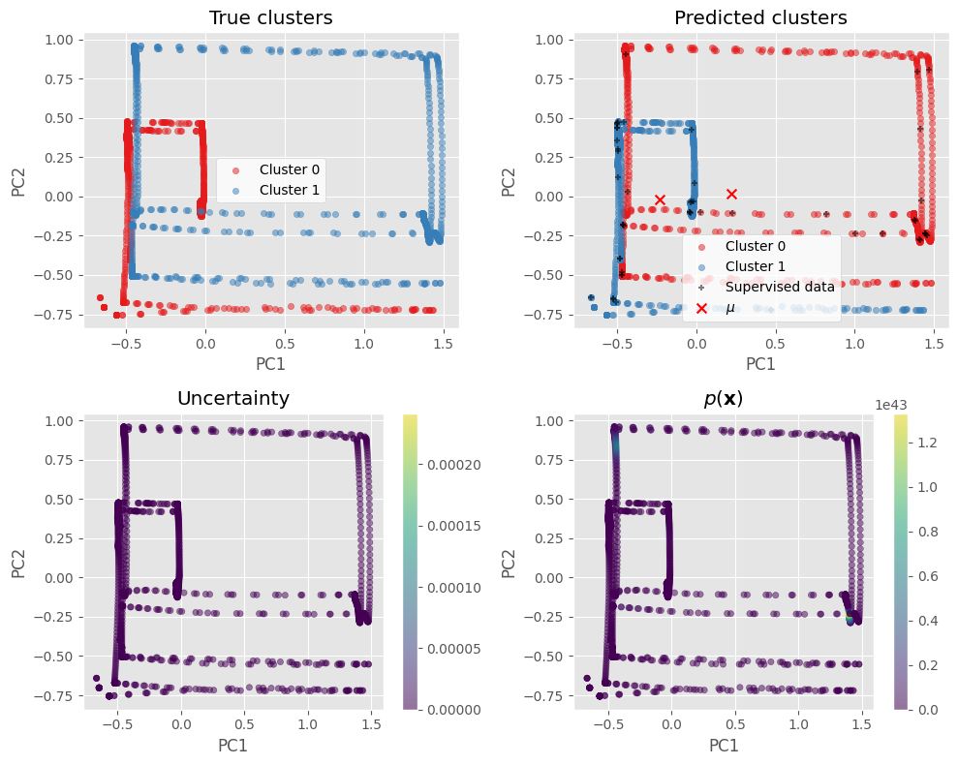
Ablation: no supervised data

