Slide 1
Features comparison
2026/06/11

Slide 2
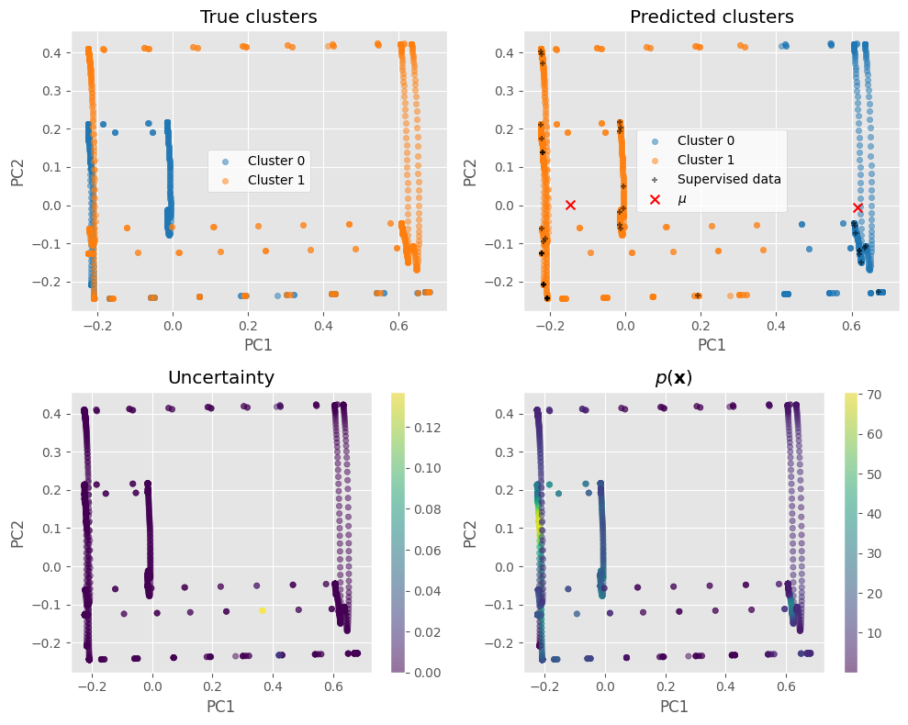
Raw data
Silhouette: 0.5798451622887544
Completeness: 0.18583247608913045
Fowlkes-Mallows index: 0.6293578165258057
Homogeneity: 0.1310895535018249
Mutual Information: 0.09086435441065205
Adjusted mutual information: 0.1533828870053072
Normalized Mutual Information: 0.15373305761107553
Rand index: 0.5495279868404983
Adjusted rand index: 0.09922293334768681
V-measure: 0.15373305761107553

Slide 3
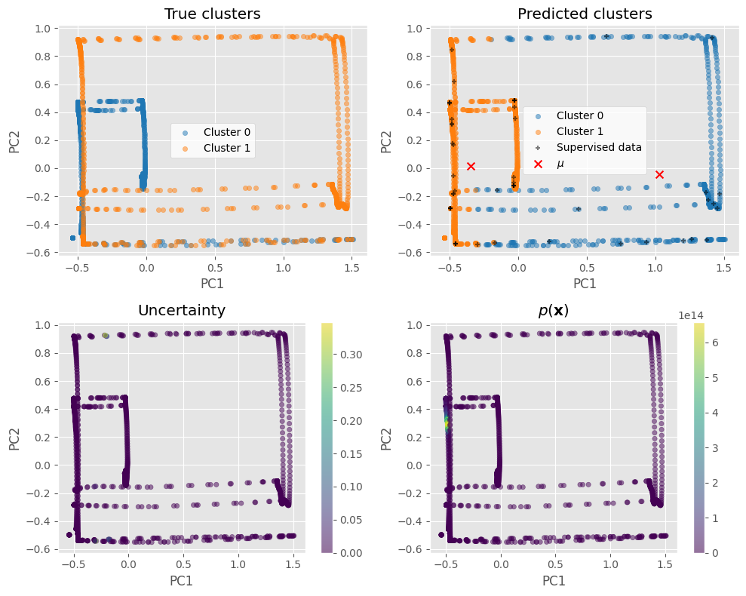
With rolling features
Silhouette: 0.4804429971752241
Completeness: 0.17924943389006504
Fowlkes-Mallows index: 0.6202846316899769
Homogeneity: 0.1461106554142152
Mutual Information: 0.10127618885012898
Adjusted mutual information: 0.16066632513777146
Normalized Mutual Information: 0.16099240889875116
Rand index: 0.5697366763861749
Adjusted rand index: 0.1395762388854762
V-measure: 0.16099240889875116

Slide 4
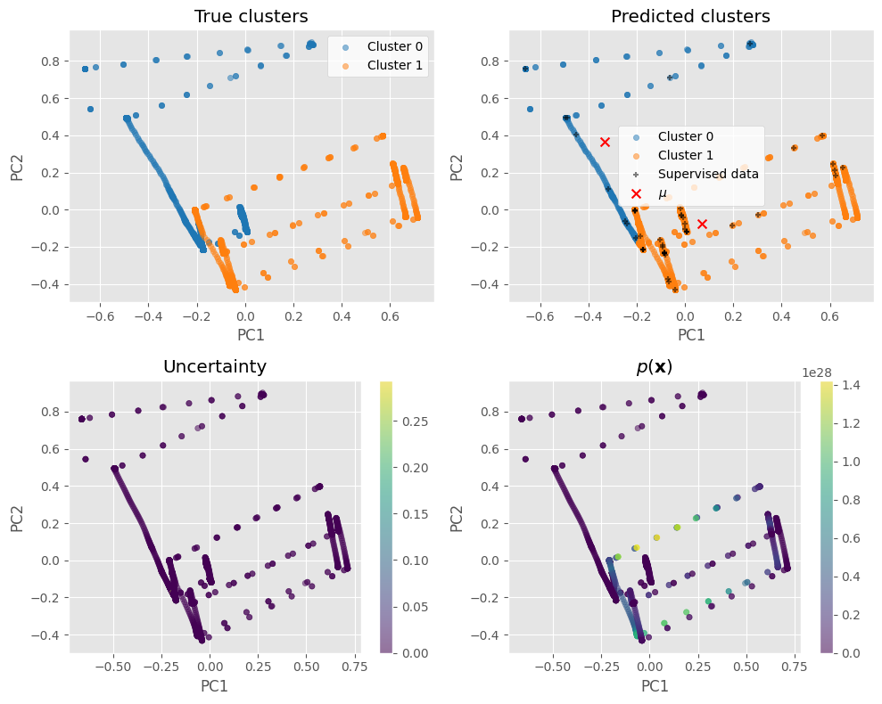
With expanding features
Silhouette: 0.34258343335093855
Completeness: 0.2978252887578735
Fowlkes-Mallows index: 0.6471008487445666
Homogeneity: 0.19649199216968377
Mutual Information: 0.13619787037502318
Adjusted mutual information: 0.2364476054924132
Normalized Mutual Information: 0.23677215652560646
Rand index: 0.5581968276746458
Adjusted rand index: 0.11658050460418784
V-measure: 0.2367721565256065

Slide 5
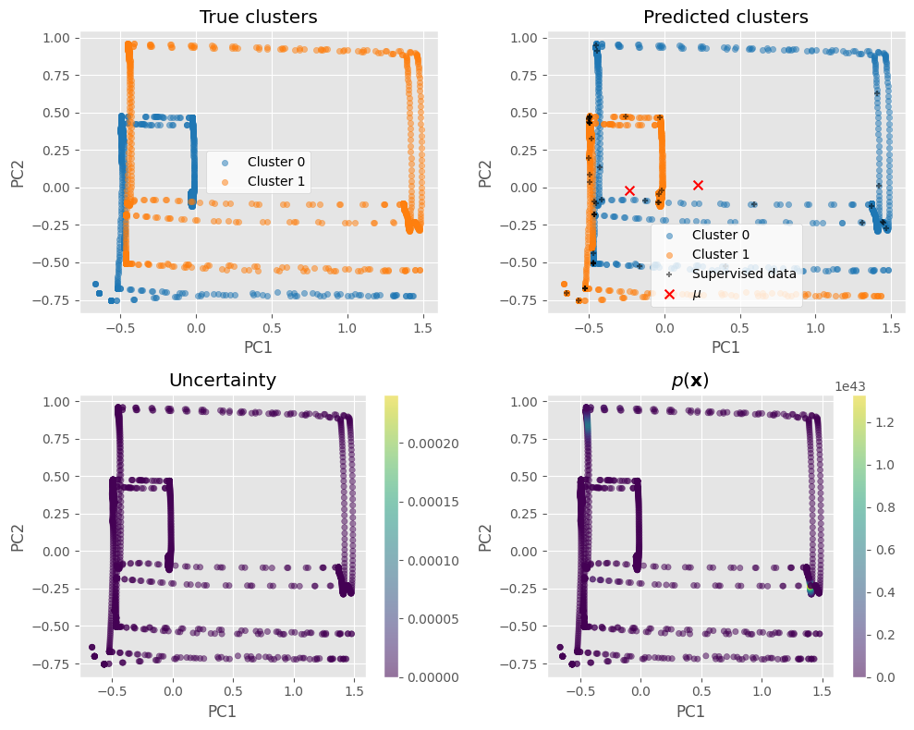
With both rolling & expanding features
Silhouette: 0.12915776469438026
Completeness: 0.9509074946529996
Fowlkes-Mallows index: 0.9873739635501082
Homogeneity: 0.9507969389191994
Mutual Information: 0.6590422174968696
Adjusted mutual information: 0.9508348829073767
Normalized Mutual Information: 0.9508522135725164
Rand index: 0.9873791104360039
Adjusted rand index: 0.9747582168364042
V-measure: 0.9508522135725164

Slide 6
ToDo: Plot true vs. predicted classes on timeseries

