Slide 1
Web Accessibility
Use your web development skills to make the world a little better
By: Kira Krul

Slide 2
Results of my (slightly unscientific) survey of 50-80 web developers, when asked about web accessibility:
Almost everyone knows what it means
Most people agree that they should use good accessibility practices
Almost none of those surveyed knew how to do it, or assumed they got it for free just by using HTML

Slide 3
The Plan
1. Get ~130 developers in a room with me
2. Make it too socially awkward for you to leave
3. Talk about accessibility until I'm kicked out, or until I finish the talk
4. ???
5. A few developers will make websites better for everyone!

Slide 4
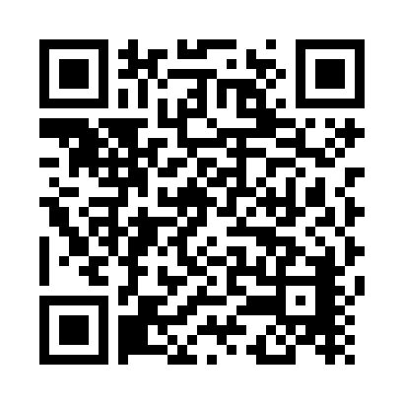
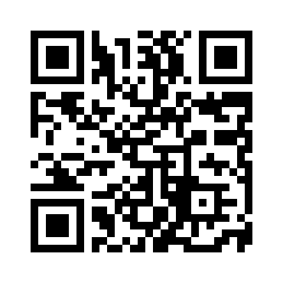
Why It Matters
• According to research, 1 in 4 people have a disability that affects their use of the web
• You personally might join them as you get older
• It's good for business (see resources below)
• They're people, and they deserve to be able to use the web like everyone else
Accessibility Statistics https://www.skynettechnologies.com/blog/web-accessibility-statistics
Business Benefits (W3C) https://www.w3.org/WAI/business-case/

Slide 5
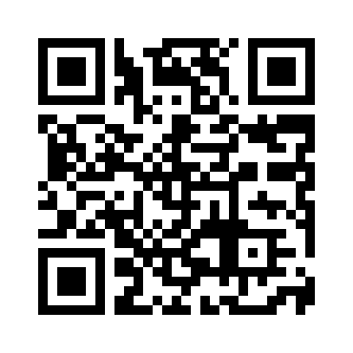
WCAG Quick Reference
WCAG 2.2 Quick Reference Guide https://www.w3.org/WAI/WCAG22/quickref/

Slide 6
Random Things I Learned While Researching
• Twitter has hotkeys like j/k for moving to next/previous tweet or l to like. As a vim user, I find it delightful, but unfortunately it breaks Success Criterion 2.1.4
• Some suggested techniques by WCAG are absolutely ancient. For example, the JavaScript code for SCR33 reads like it was written by a caveman
• Unskippable ads are unfortunately allowed. The X button needs to be at least 24×24 pixels for AA or 44×44 for AAA, but otherwise they're explicitly mentioned in the standard
• The example code for the demo was almost completely created by Claude. I never mentioned accessibility to it, so if you wondered how much it cares by default, you've just seen it

Slide 7
Thank You!
Find me at:
LinkedIn: linkedin.com/in/kira-krul
GitHub: github.com/kira-krul

