Slide 1
Fraud Decision Desk
APPROVED
Cost-Sensitive Fraud Decisioning Under Delayed and Censored Labels
FOR REVIEW
Ken Ira Lacson Talingting · Lawrence Abad · John Kelly Nogales · Smith Albert Surio
BLOCKED
College of Computing and Information Technologies, National University Philippines
Introduction to Machine Learning, Final Project · October 17, 2026
Notes:
KEN · 0:20 · Title
Good morning. We are Ken, Lawrence, John Kelly, and Smith. Our project is the
Fraud Decision Desk: a system that decides what a bank should do with an
application right now, before anyone knows if it is fraud.

Slide 2
The problem: deciding before you know
A bank must approve or refuse an application now
Whether it was fraud is only known weeks or months later
Some fraud is never reported at all
The real question
“What should we do right now?”
the waiting gap
Today
The bank must decide
30–120 days later
The truth arrives (sometimes never)
Notes:
KEN · 0:50 · The problem
When someone applies for a bank account, the bank has to decide immediately:
approve or refuse.
But the bank only finds out if it was fraud weeks or even months later, usually
30 to 120 days. And some fraud is never reported at all.
So the real question is not "is this fraud?" We can't know that yet. The real
question is: what should we do right now?

Slide 3
What we set out to do
1
Treat fraud as a decision
2
Price three actions
Choose an action, not just a score
Approve, review, or block, by comparing costs
3
Test it fairly
4
Be honest about limits
On months the system never saw, used only once
Say clearly what we did not prove
Notes:
KEN · 0:40 · What we set out to do
We had four goals.
One: treat fraud as a decision, not just a prediction.
Two: choose between three actions: approve, review, or block, by comparing
what each one would cost.
Three: test it fairly, on months the system had never seen, and only once.
And four: be honest about the limits.
Lawrence will explain how it works.

Slide 4
Our idea: price every option, pick the cheapest
1 Estimate the risk
2 Price each option
3 Stamp the cheapest
12.5%
Let it through
0.2404
FOR REVIEW
16 OCT 2026
Manual check
0.0576
fraud risk, estimated by a model trained on past months
Block it
0.0875
The lowest expected loss wins. No fixed 50% cut-off.
expected loss, in cost units
Same risk, bigger credit limit → bigger possible loss → more caution
Notes:
LAWRENCE · 1:00 · Our idea: price every option
Our system works in three steps.
First, a model looks at the application and estimates a fraud risk, say 12.5%.
Second, it puts a price on each option. If we let it through, we risk
losing the money. If we send it for a manual check, we pay for the check,
but we stop most of the loss. If we block it, we might turn away a genuine
customer, and that has a cost too.
Third, it simply picks the cheapest option and stamps it.
One important detail: a bigger credit limit means a bigger possible loss. So
the same risk can get approved for a small amount but checked for a large one.
You'll see this in the demo.

Slide 5
How we tested it fairly
Month 0
Month 1
Month 2
Month 3
Month 4
Month 5
Month 6
Month 7
Learn
397,039 apps
Tune
278,627 apps
Test once
227,491 apps
Unknown
96,843 apps
Time order kept, like real life: no shuffling
1,000,000
1 month
9.68%
applications, Bank Account Fraud dataset (synthetic)
late: fraud answers arrive one month after the decision
had no answer yet (month 7): set aside, not counted as safe
Notes:
LAWRENCE · 0:50 · How we tested it fairly
We used one million applications from the Bank Account Fraud dataset. It is a
synthetic dataset, built to look like real bank data.
We kept time in order, like real life. The system learned from the first three
months, we tuned it on the next two, and we tested it once on the last two
months: 227,491 applications it had never seen.
We also copied the real delay: fraud answers arrive one month late. That means
the final month, 96,843 applications or 9.68%, had no answer yet. We set those
aside instead of pretending they were safe.
John Kelly will now show you the system.

Slide 6
The system: in, through, out
In
Through
Out
Application details (28)
Risk model (Logistic Regression)
Fraud risk %
Requested credit limit
Price the three options
Stamp: approve / review / block
Fixed cost settings
Pick the cheapest
Reason, worklist, CSV download
Notes:
JOHN KELLY · 0:45 · The system
Here is the system in one picture.
In: the application's details, the requested credit limit, and our fixed
cost settings.
Through: a risk model estimates the fraud risk, then the desk prices the
three options and picks the cheapest.
Out: the fraud risk, a stamp (approved, for review, or blocked), the reason
behind it, and for a batch, a ranked worklist you can download.
Let me show you.

Slide 7
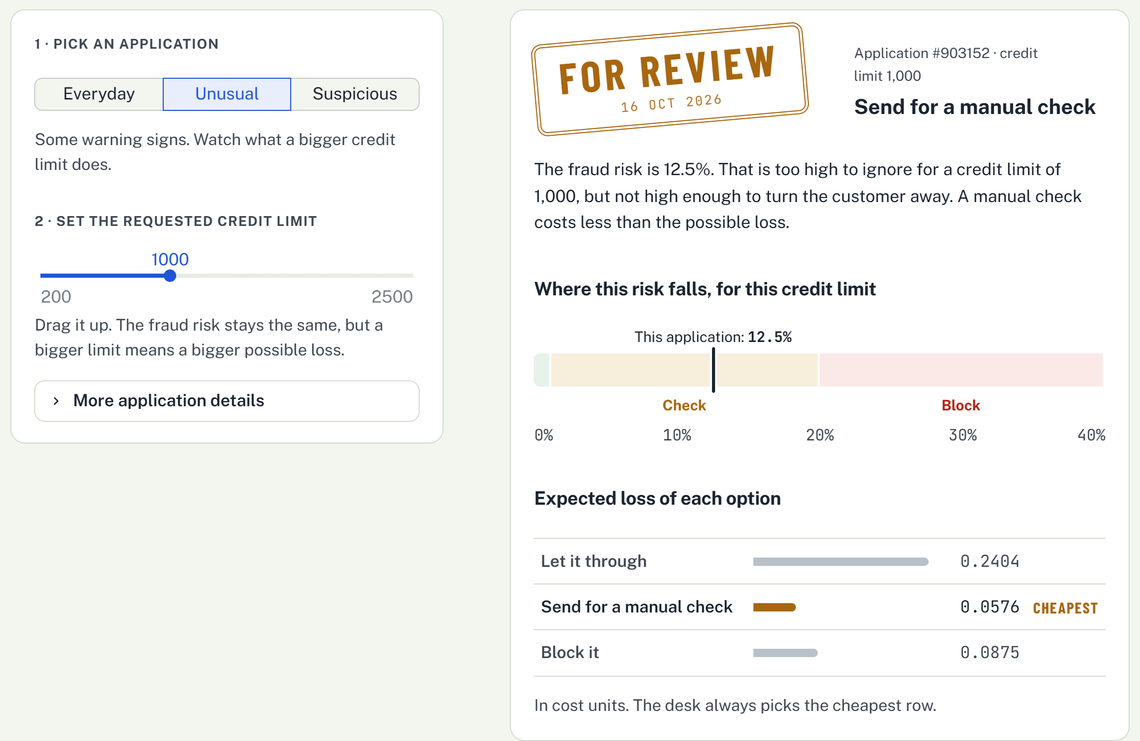
Live demo
1
Everyday
APPROVED 1.3% risk
2
Unusual, limit 200
APPROVED 12.5% risk
3
Raise limit to 1,000
FOR REVIEW same 12.5% risk
4
Suspicious
BLOCKED 29.8% risk
5
Batch of 500
450 approved · 46 review · 4 blocked
delayed-label-fraud-decisioning-gefp9s9mbkfdyzhhvescdm.streamlit.app
Notes:
JOHN KELLY · 2:30 · Live demo
Before you start: open the app in a browser tab before the presentation. If
the internet fails, use the screenshots on this slide and say the same lines.
1. Check one application → Everyday (0:30)
> This is a typical application. The fraud risk is 1.3%. The desk stamps it
> APPROVED. Below, you can see why: letting it through is the cheapest of
> the three options.
2. Unusual (0:15)
> This one has some warning signs: 12.5% risk. At a small credit limit of 200,
> it is still approved.
3. Drag the credit limit up to about 1,000 (0:30)
> Now watch. I'm only raising the credit limit. The risk stays at 12.5%, but
> the stamp changes to FOR REVIEW. A bigger amount means a bigger possible
> loss, so a manual check is now the cheapest option.
4. Suspicious (0:20)
> This one was real fraud in the dataset. Risk is almost 30%. The desk
> BLOCKS it.
5. Check a batch → Use the 500-application sample (0:35)
> The desk can also check many at once. Out of 500 applications, 450 are
> approved, 46 go for review, and 4 are blocked. The worklist puts the most
> important ones on top, and you can download every decision.
6. Study results tab (0:20)
> And this tab shows what we found when we tested it. Smith will explain.

Slide 8
Result: the desk cut costs by more than half
57.91%
lower cost than the best simple rule
95% confidence: 53.95% to 62.13%
Tested once on 227,491 applications
Cost per application: 0.007491 vs 0.017798
Notes:
SMITH · 1:00 · Result: the desk cut costs by more than half
Here is our main result.
We compared the desk with simpler strategies: approve everyone, block
everyone, random, and the usual approach of a model with a 50% cut-off.
The best simple rule cost 0.017798 per application. Our desk cost 0.007491.
That is 57.91% lower.
And we checked that this isn't luck: with 95% confidence, the real reduction
is between 53.95% and 62.13%.
Why does the 50% cut-off do so badly? Because only about 1 in 100 applications
is fraud, so the model almost never says "above 50%". It ends up approving
nearly everything.

Slide 9
It holds up
Never below
47.76%
cheaper, in every scenario
The three models tied
1.07% measured gap
5% bar for a real difference
So we used the simplest one.
Notes:
SMITH · 0:40 · It holds up
We didn't want a result that only works with our exact cost guesses. So we
halved and doubled each cost, one at a time. The desk was still at least
47.76% cheaper every time.
We also compared three different models. They were within 1.07% of each
other, below the 5% bar we set in advance for a real difference. So we chose
the simplest one. The lesson: the decision rule does the work, not a
fancier model.

Slide 10
The decision rule, not the model, does the work
What we showed
What we did not show
Weighing costs beats a fixed cut-off: 57.91% lower cost
95% confidence: 53.95% to 62.13%
Bigger amounts get more caution, automatically
Unknown outcomes reported, not hidden (9.68%)
Real bank data: the dataset is synthetic
Other delays: only one month was tested
True amounts: credit limit stands in for the amount at risk
Notes:
SMITH · 0:40 · Conclusion and limits
To conclude: weighing the cost of each option beats a fixed cut-off, by
57.91%. Bigger amounts automatically get more caution. And we reported the
applications we couldn't judge instead of hiding them.
We also want to be clear about the limits. The data is synthetic, not from a
real bank. We tested one delay, one month. And the credit limit stands in for
the amount at risk.
Thank you. We're happy to take your questions.

Slide 11
Thank you
APPROVED
Questions?
FOR REVIEW
App delayed-label-fraud-decisioning-gefp9s9mbkfdyzhhvescdm.streamlit.app
Code github.com/kira-ml/delayed-label-fraud-decisioning
BLOCKED
Notes:
ALL · Q&A
Prepared answers. Whoever owns the topic answers.
Q: Why not just use accuracy? (Smith)
A: Fraud is about 1% of applications, so "approve everyone" is 99% accurate and still loses money. Cost is what the bank cares about.
Q: Why Logistic Regression? (Lawrence)
A: All three models were within 1.07%, below our 5% bar. When it's a tie, we pick the simplest and fastest to explain.
Q: Where do the cost numbers come from? (Lawrence)
A: They were fixed before any modelling. Wrongly blocking = 0.1, a manual check = 0.02, loss left after a check = 30%. The loss scale comes from the average credit limit in the training months only (521.16).
Q: What if the costs are wrong? (Smith)
A: We halved and doubled each one. The desk stayed at least 47.76% cheaper.
Q: How do you know the probabilities are trustworthy? (Lawrence)
A: We required the risk scores to match real fraud rates before using them (calibration error 0.0033, our limit was 0.05).
Q: What happened to the last month? (Ken)
A: Its fraud answers would arrive after the data ends, so we set aside 96,843 applications (9.68%) instead of counting them as safe.
Q: Is this ready for a real bank? (Ken)
A: No. It's a controlled test on synthetic data with one delay setting. It shows the approach works; a bank would need to test it on its own data.
Q: What does "cost unit" mean? (John Kelly)
A: One unit is the loss from one fraudulent application of average size.

Slide 12
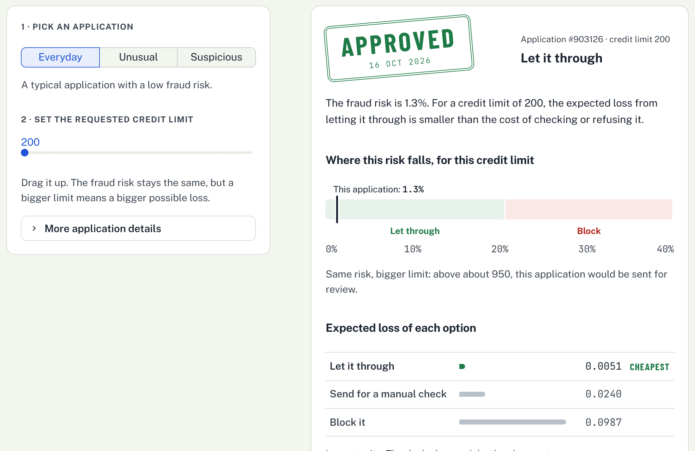
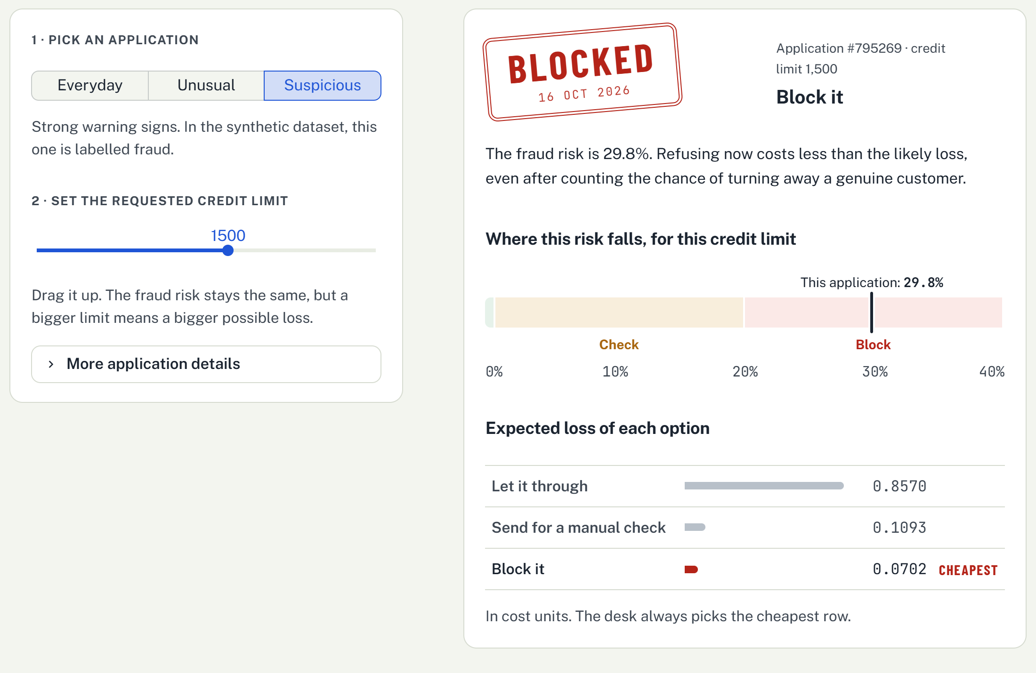
Backup: one application
Everyday: APPROVED
Suspicious: BLOCKED
Notes:
Backup only. If the internet or the app fails during the demo, jump here and walk through the same steps with these screenshots (the lines are in the slide 7 notes).

Slide 13
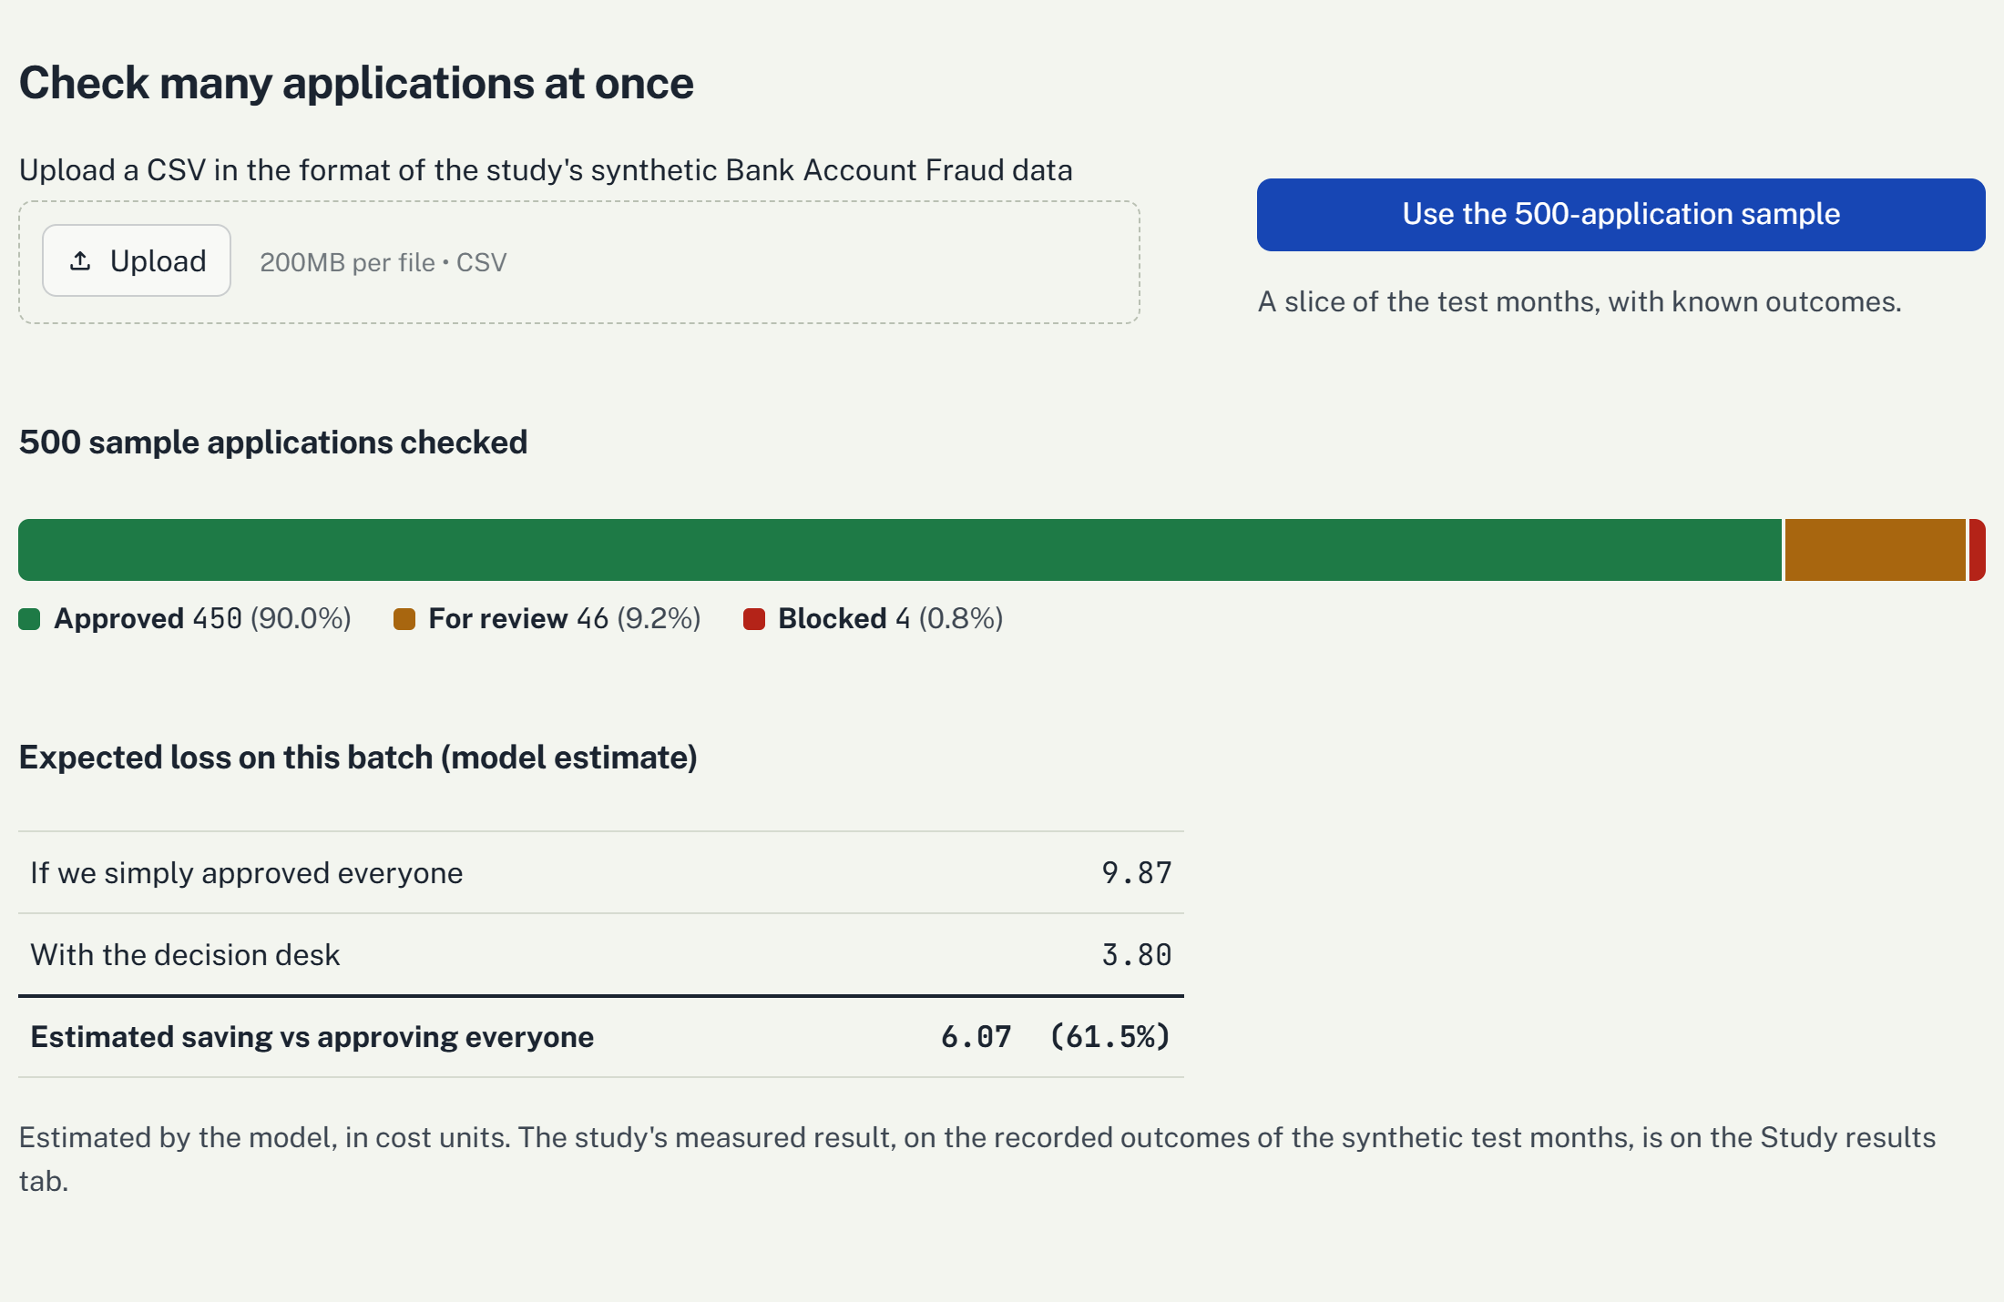
Backup: raised limit and batch
Unusual at 1,000: FOR REVIEW
Batch of 500 sample applications
Notes:
Backup only. If the internet or the app fails during the demo, jump here and walk through the same steps with these screenshots (the lines are in the slide 7 notes).

