Slide 1

Film Industry Analysis
Kira Fleischer, Tejas Ramesh, Sanchit goel

Slide 2
Introduction
Our goal is to develop an application that provides valuable insights into the film industry, with a focus on two primary use cases:
Movie Recommendations
Cast & Crew Similarity: Using a graph database to identify films with similar actors, directors, and crew members.
Content-Based Similarity: Leveraging a vector database to recommend films based on shared content features.
Modeling Actor-Director Collaborations
Analyzing past collaborations to identify which pairings produce the highest-rated films, offering insights into successful creative partnerships.

Slide 3
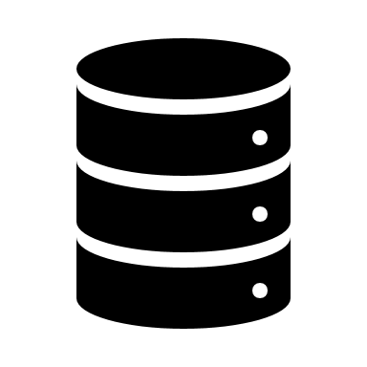
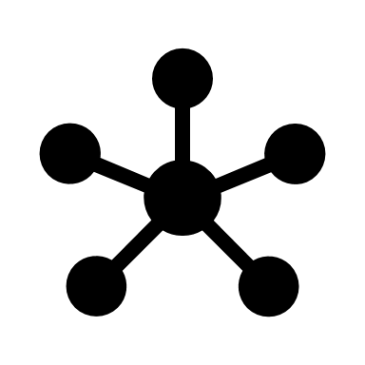

Data Sources
PostgreSQL (Relational)
Golden data source
All data about movies and cast/crew
Neo4j (Graph)
Person-Movie relationships
FAISS (Vector DB)
Vector embeddings for movies' synopsis

Slide 4
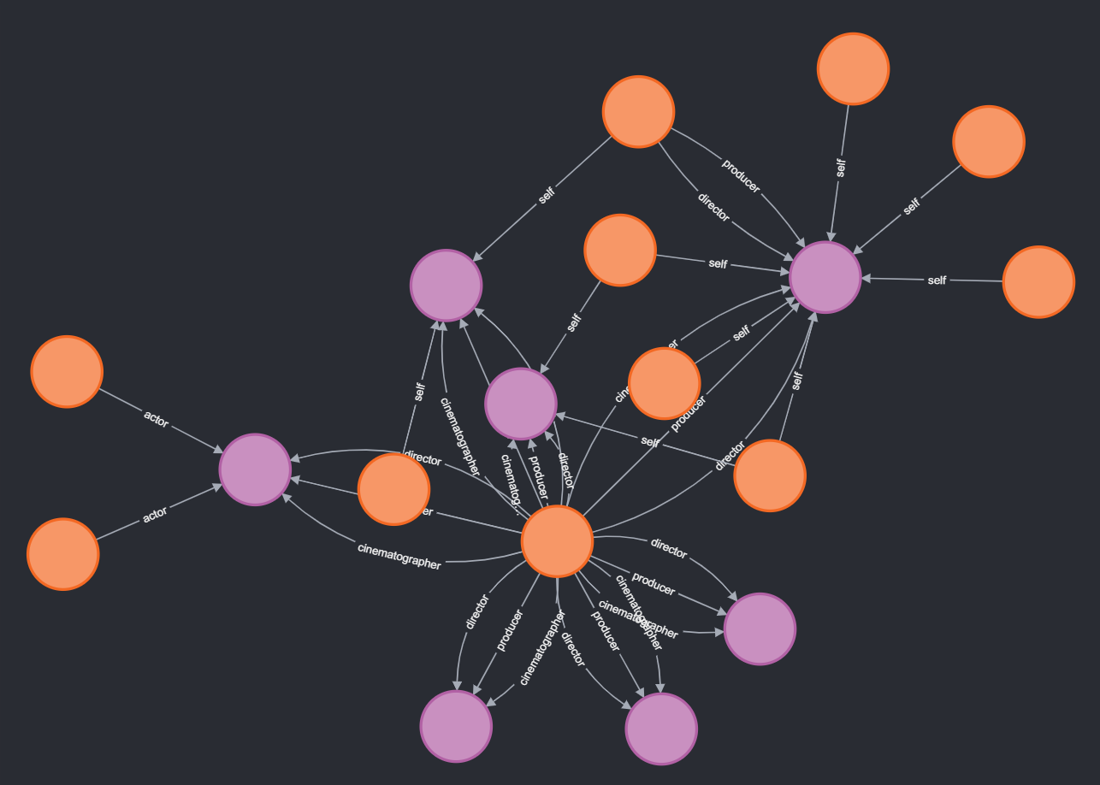
Neo4j
Graph summary:
Nodes :
Person (55.5K)
Movie (33.1K)
Relationships (13)
Actor/Actress
Director/Producer/Writer
Composer/Cinematographer
Etc.

Slide 5
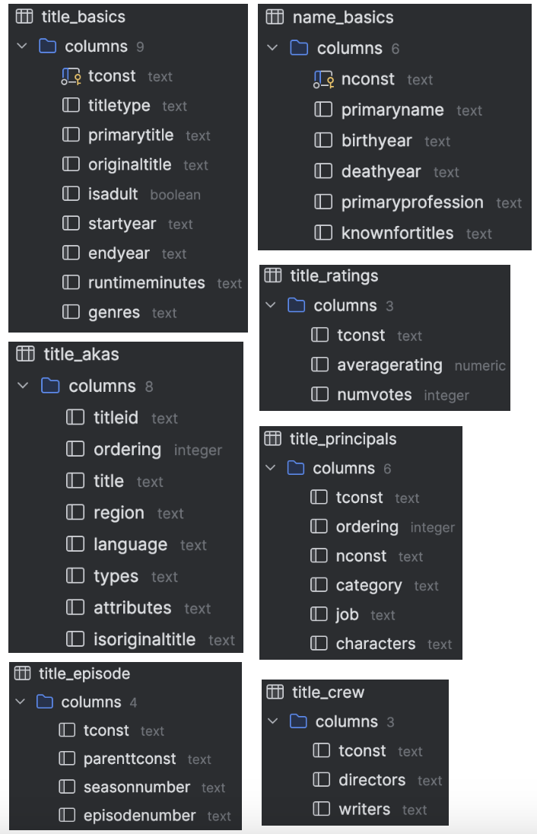
PostgreSQL
7 tables from the IMDb website in TSV format
Sampled the first 100,000 rows from each table to import into PostgreSQL
Data well-structured with relationships present between tables (tconst, nconst)

Slide 6
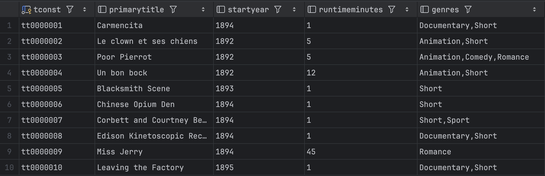
title_basics

Slide 7
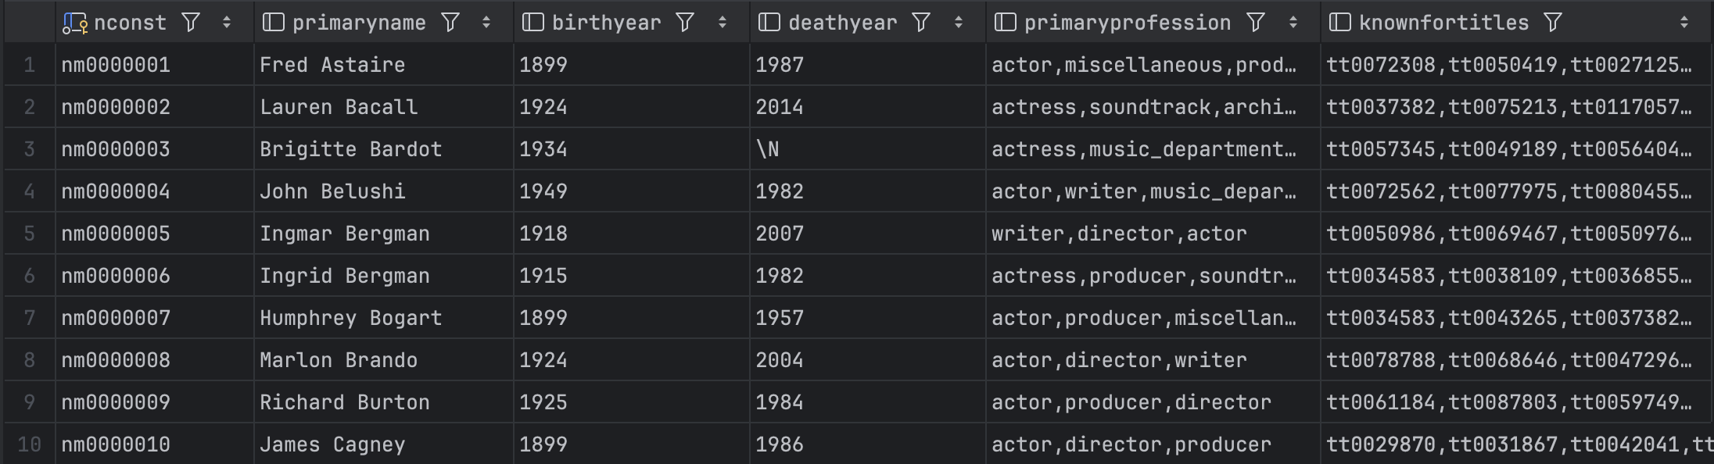
name_basics

Slide 8
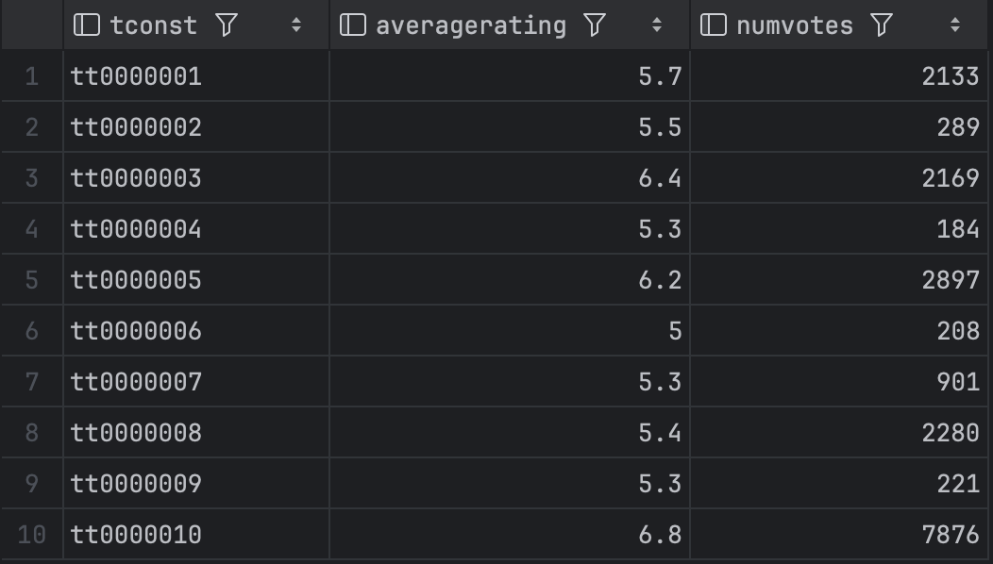
title_ratings

Slide 9
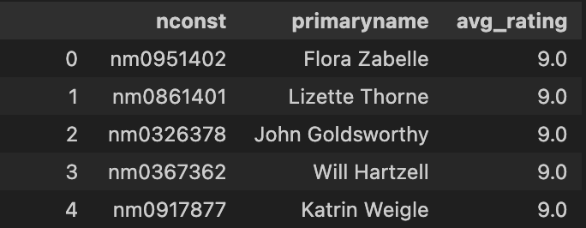
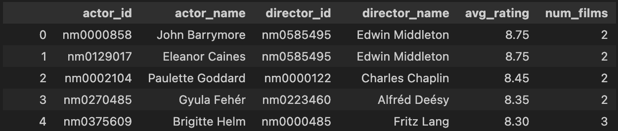
Role of Relational Data
Display more information about movies, actors, and directors of interest
For example, we can determine which actors star in the highest average rated films
Or, we can determine average film ratings for frequent actor-director pairs
More on this later

Slide 10
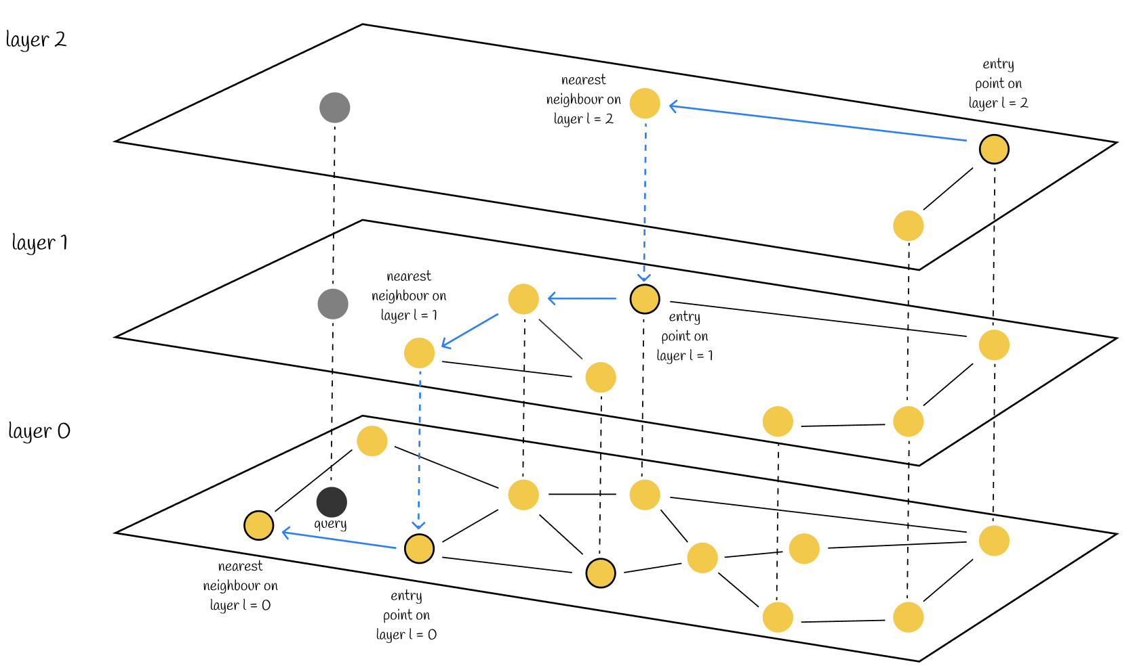
Faiss
Sampled 5000 movies, and scraped their plot synopsis from IMDB and Wikipedia.
Embedded plot synopses using Sentence-Transformer model (all-MiniLM-L6-v2).
Used Hierarchical Navigable Small World (HNSW) indexing, achieving O(log N) complexity for nearest-neighbor retrieval.

Slide 11

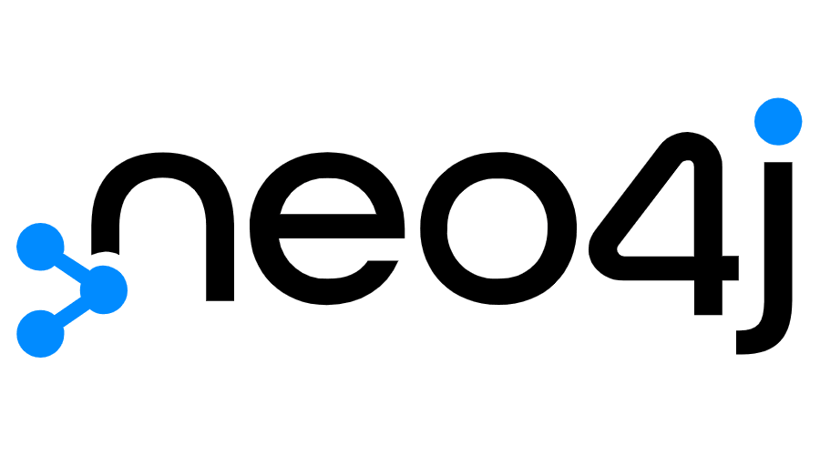


System Design
Faiss

Slide 12
Demonstration & Use Cases
Similar movie recommendations using Graph DB
Similar Movie Recommendations using Vector db
Actor-director collaboration modeling

Slide 13

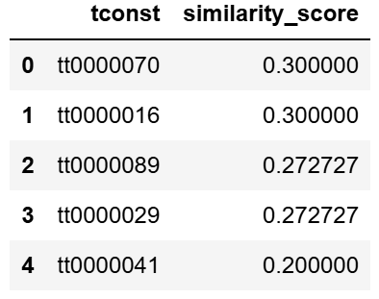
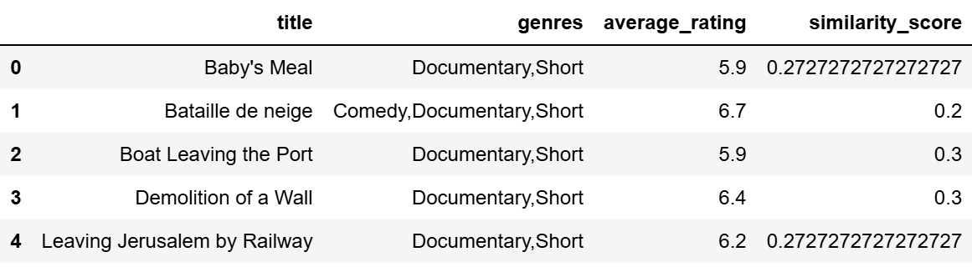
Graph Database for Movie Recommendations – Collaborative filtering
Similar movies like
'The Arrival of a Train' ?
'The Arrival of a Train'
Notes:
• Uses actors, directors, and crew relationships to calculate similarity.
• Good for collaborative filtering and network-based recommendations.
• Works well for users looking for movies with shared cast & creators.
Limitations of Graph-Based Recommendations
Not Content-Aware → Ignores the actual storyline or themes of a movie.
Weak for New Movies → Cold-start problem for movies without strong graph connections.
Misses Thematic Similarity → Movies with different actors/directors but similar stories are not recommended.

Slide 14
Demonstration & Use Cases
Similar movie recommendations using Graph DB
Similar Movie Recommendations using Vector db
Actor-director collaboration modeling

Slide 15
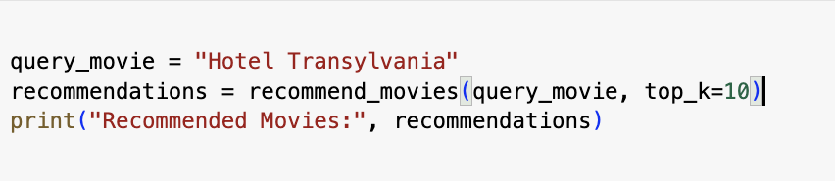
Vector Database (FAISS) for Movie Recommendations – Content based filtering
Uses high-dimensional embeddings to represent movies based on plot synopsis.
Understands thematic & narrative similarities between movies.
Avoids cold start problem - works for new & lesser-known movies without prior audience interaction.
## Recommended Movies: [('House of Frankenstein', 0.74598217), ('Bud Abbott Lou Costello Meet Frankenstein', 0.85303336), ('Love at First Bite', 0.89539623), ('Billy the Kid Versus Dracula', 0.90585554), ('Cube 2: Hypercube', 0.90817416), ('The Return of the Vampire', 0.9284278), ('Monsters University', 0.93450934), ('Friday the 13th Part III', 0.9452752), ('Dracula: The Musical', 0.9492428), ('Count Dracula', 0.9529716)]
Notes:
Unlike graph-based recommendations, which rely on actor-director relationships, FAISS allows us to perform content-based filtering. By embedding movie plot synopses, we can represent each film as a vector in high-dimensional space. This approach enables us to find movies with similar themes and narratives, independent of past user interactions.
One key advantage of this method is that it avoids the cold start problem, meaning it can recommend movies that haven’t been widely watched or rated yet. As seen in our example, the system identified thematically similar films purely based on their plot, without relying on user reviews or past viewing history.

Slide 16
Demonstration & Use Cases
Similar movie recommendations using Graph DB
Similar Movie Recommendations using Vector db
Actor-director collaboration modeling

Slide 17
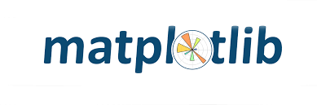
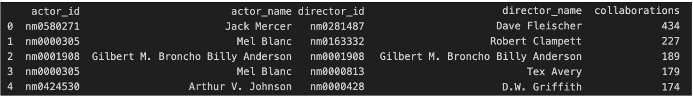
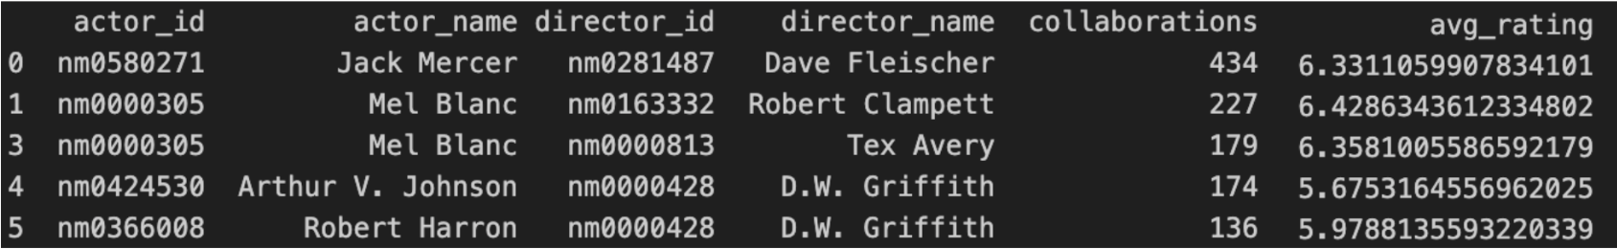
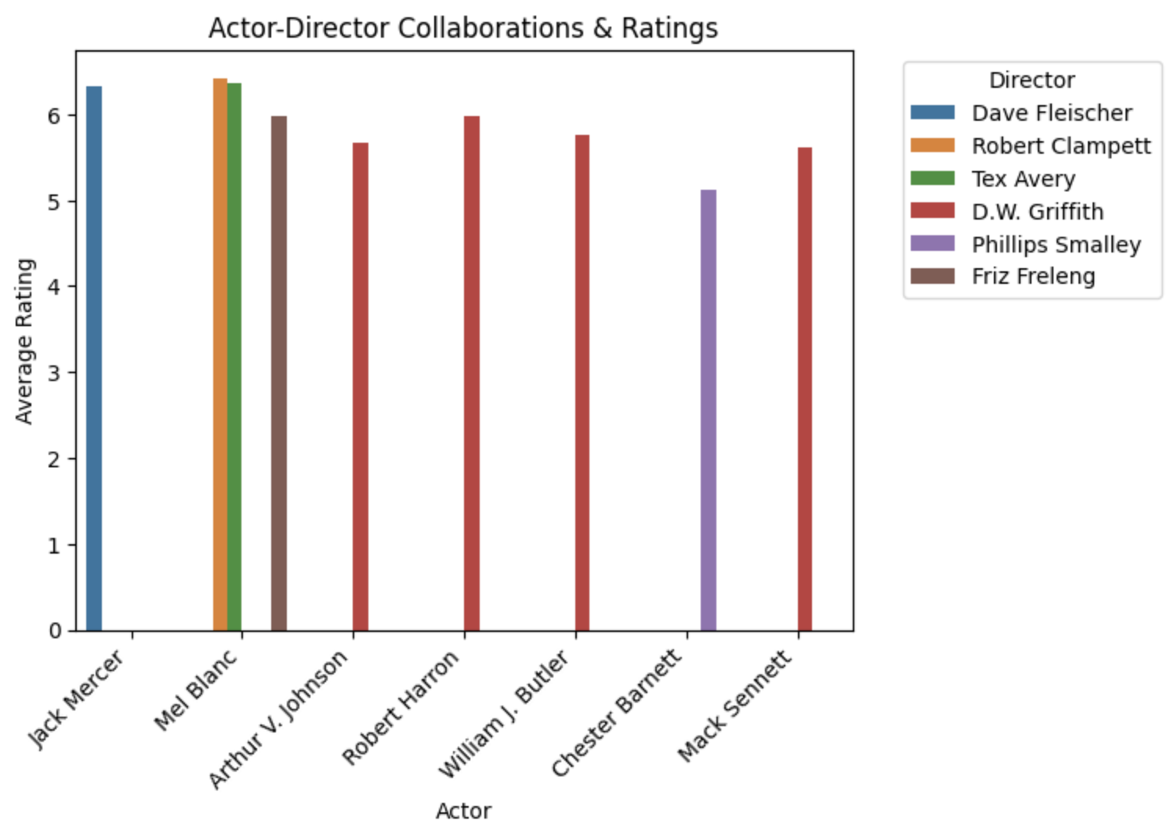
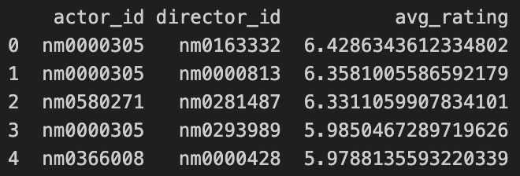
Actor-Director Collaboration Modeling

Slide 18
Demonstration

Slide 19
Conclusion and Future Work
Hybrid Recommendation System
Graph DB captures collaborative & social filtering, leveraging actor/director relationships.
Vector DB (FAISS) enables semantic search based on plot similarity & thematic connections.
Hybrid Model:
Step 1: Use Graph DB to find movies with shared actors/directors.
Step 2: Use FAISS to refine recommendations based on plot embeddings.
Step 3: Merge scores from both methods for a balanced final recommendation.

