Slide 1
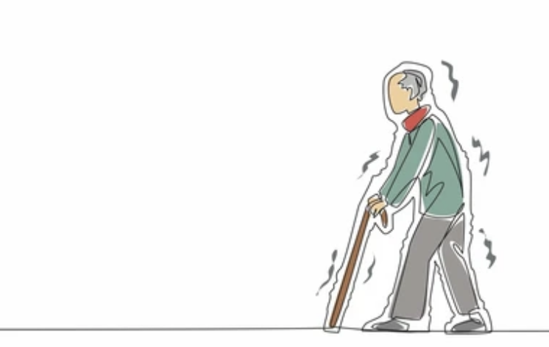
Voice as a Diagnostic Tool: A Machine Learning Approach to Identifying Parkinson’s Disease
Kira Fujibayashi
MPCS 56430: Introduction to Scientific Computing

Slide 2
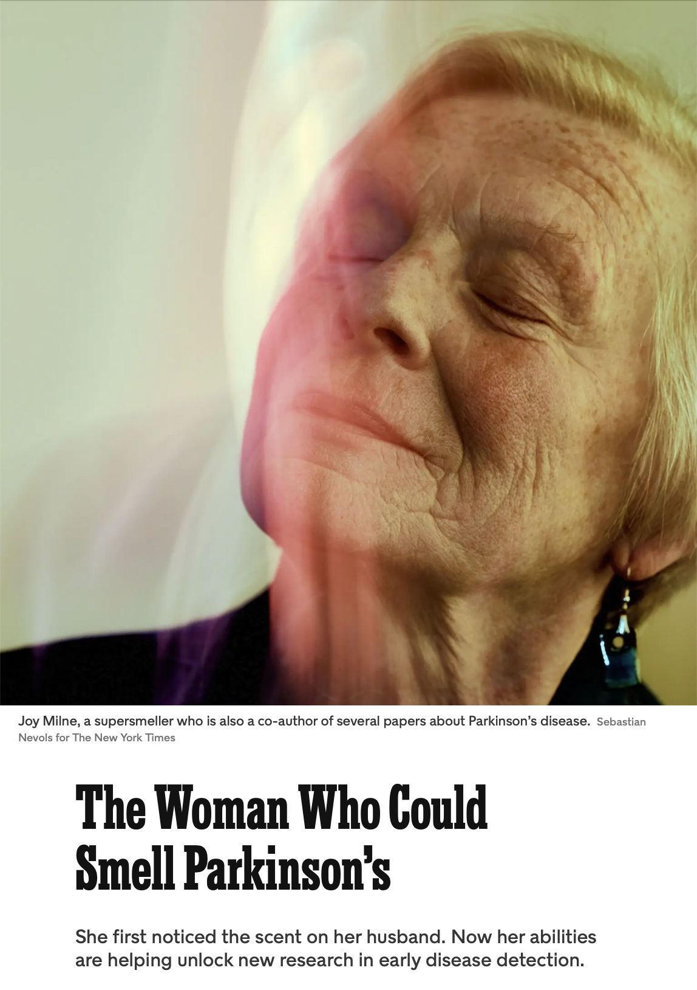
A Machine Learning Approach to Identifying and Staging Parkinson’s Disease
Inspired by the New York Times article¹ on unconventional diagnostic tools (e.g., smell), this project explores the uses of AI as a medium for early detection of Parkinson’s Disease
AI and Machine Learning in early disease diagnosis:
Identification of lung cancer and other cancers using AI-based imaging analysis on CT and MRI scans.
Prediction of cardiovascular diseases through wearable sensor data and AI-enhanced ECG monitoring.
Screening for diabetic retinopathy using AI models trained on retinal imaging datasets.
Notes:
Relevance to Scientific Computing
Leverage key aspects of data preprocessing, feature extraction, and numerical computation for analyzing voice signals.
Exploring applications of machine learning algorithms and model evaluation techniques in healthcare diagnostics.
Contributes to interdisciplinary research, combining computer science, neuroscience, and medicine.

Slide 3
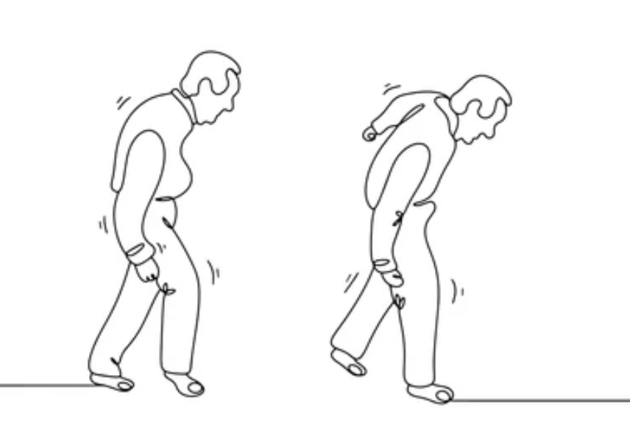

What is Parkinson’s Disease?
Parkinson’s Disease²
Parkinson’s Disease (PD) is one of the most prevalent long-term neurodegenerative disorders, affecting more than 10 million of individuals worldwide and nearly one million people in the United States.³
Despite significant research, the exact cause of PD remain unknown. It is believed to be caused by an interaction of genetic, environmental, and neurobiological factors.
Diagnosis and disease progression testing is often quite subjective.
While there is no cure, early detection and treatment significantly improve patient outcomes and quality of life. Methods for early detection as well as disease progression include
Analysis of speech patterns for vocal biomarkers.
Analysis of handwriting or typing dynamics.
Olfactory (smell) testing, as PD often causes early smell loss.
Gait analysis using wearable sensors to detect subtle motor changes.
Eye-tracking studies to identify abnormal ocular movements.
Blood biomarkers and genetic testing for predisposition.
Notes:
Why Voice?
Non-Invasive and Cost-Effective: Voice data can be collected remotely and analyzed efficiently.
Unique Vocal Biomarkers: Parkinson’s manifests in subtle voice changes, such as reduced volume, monotonicity, and tremor.
Potential for Early Detection: Voice patterns often change before motor symptoms appear, providing an opportunity for timely intervention.
Relevance to Scientific Computing
Leverage key aspects of data preprocessing, feature extraction, and numerical computation for analyzing voice signals.
Exploring applications of machine learning algorithms and model evaluation techniques in healthcare diagnostics.
Contributes to interdisciplinary research, combining computer science, neuroscience, and medicine.

Slide 4

Why voice?
Voice Changes Linked to Parkinson’s Disease: Parkinson’s manifests in subtle voice changes, such as reduced volume, monotonicity, and tremor. Research has shown that approx. 90% of patients with PD exhibit some form of vocal impairment. ⁴
Reduced vocal volume (hypophonia): Speech becomes softer.
Monotonic speech: Loss of natural pitch variation and expressiveness.
Speech tremor: Subtle quivering or instability in voice.
Slurred or imprecision articulation: Difficulty enunciating words clearly.
Slower speech rate: Speech becomes more labored and slower.
Why Voice?
Potential for Early Detection: Voice patterns often change before motor symptoms appear, providing an opportunity for timely intervention.⁵
Non-Invasive and Cost-Effective: Voice data can be collected remotely and analyzed efficiently.
Notes:
For many PWP, the requisite physical visits to the clinic for monitoring and treatment are difficult. Widening access to the Internet and improved telecommunication systems bandwidth offers the possibility of remote monitoring of patients (telemedicine [5]), with substantial opportunities for lowering the inconvenience and cost of physical visits. However, in order to exploit these opportunities, there is the need for reliable clinical monitoring tools.
Research has shown that approximately 90% of PWP exhibit some form of vocal impairment [6, 7]. Vocal impairment may also be one of the earliest indicators for the onset of the illness [8], and the measurement of voice is noninvasive and simple to administer. Thus, voice measurement to detect and track the progression of symptoms of PD has drawn significant attention [9, 10].

Slide 5
Methodology/Approach
Goal: Design, train and evaluate a model for analyzing voice recordings to extract meaningful features like frequency, amplitude, and tremor patterns.
Dataset Overview: Researchers at Istanbul University, Department of Neurology gathered voice recordings from 188 Parkinson’s patients and 64 healthy individuals, featuring sustained phonation of the vowel /a/ analyzed with various speech signal processing techniques, including MFCCs, wavelet transforms, and vocal fold features, for early Parkinson’s detection. Each subject recorded three phonations.⁶
Traditional Features: Derived from basic acoustic properties includes features like shimmer and jitter.
Time-Frequency Features: Capture variations in energy distribution over time and frequency.
Mel-Frequency Cepstral Coefficients (MFCCs): Represent vocal tract characteristics and are widely used in speech recognition.
Vocal Fold Features: Measure vocal fold vibrations, tremors, and irregularities.
Non-Traditional Features: Advanced mathematical models, often rooted in non-linear dynamics and chaos theory. Capture complex patterns in voice data, such as irregularities and long-term correlations, which are harder to measure with traditional approaches.
Wavelet Transform-Based Features: Decompose voice signals into different frequency components to detect patterns.
Pitch Period Entropy (PPE): Focuses on irregularities in pitch variation while filtering out natural vibrato and microtremors.
Recurrence Period Density Entropy (EPDE): Quantifies the periodicity and stability of vocal fold oscillations, highlight irregularities.
Detrended Fluctuation Analysis (DFA): Captures long-term correlations in the signal, useful for identifying roughness and variability in sustained phonations.
TWQT Features: Capture time-weighted frequency properties to identify subtle voice impairments.
Notes:
Time-Frequency Features: Capture variations in energy distribution over time and frequency. Traditional measures like jitter and shimmer fall under this category, focusing on cycle-to-cycle variations in pitch and amplitude.
Mel-Frequency Cepstral Coefficients (MFCCs): Represent vocal tract characteristics and are widely used in speech recognition. While effective in capturing vocal tract behavior, they are not specifically tailored to dysphonia in Parkinson’s disease.
Vocal Fold Features: Measure vocal fold vibrations, tremors, and irregularities, including traditional jitter and shimmer measures. Examples: MDVP jitter, shimmer, and harmonics-to-noise ratio (HNR), which assess fundamental frequency stability and noise levels.
Wavelet Transform-Based Features:
Decompose voice signals into different frequency components, offering finer detection of subtle patterns related to voice impairments.
Examples include advanced spectral methods that can capture non-linear dynamics in Parkinson’s dysphonia.
Pitch Period Entropy (PPE):
A novel measure designed specifically for Parkinson’s disease, focusing on irregularities in pitch variation while filtering out natural vibrato and microtremor.
Recurrence Period Density Entropy (RPDE):
Quantifies the periodicity and stability of vocal fold oscillations, highlighting irregularities in Parkinson's patients.
Detrended Fluctuation Analysis (DFA):
Captures long-term correlations in the signal, useful for identifying roughness and variability in sustained phonations.
TWQT Features (Time-Weighted Frequency Properties):
Represent subtle temporal and frequency changes, often capturing intricate patterns overlooked by traditional features.

Slide 6
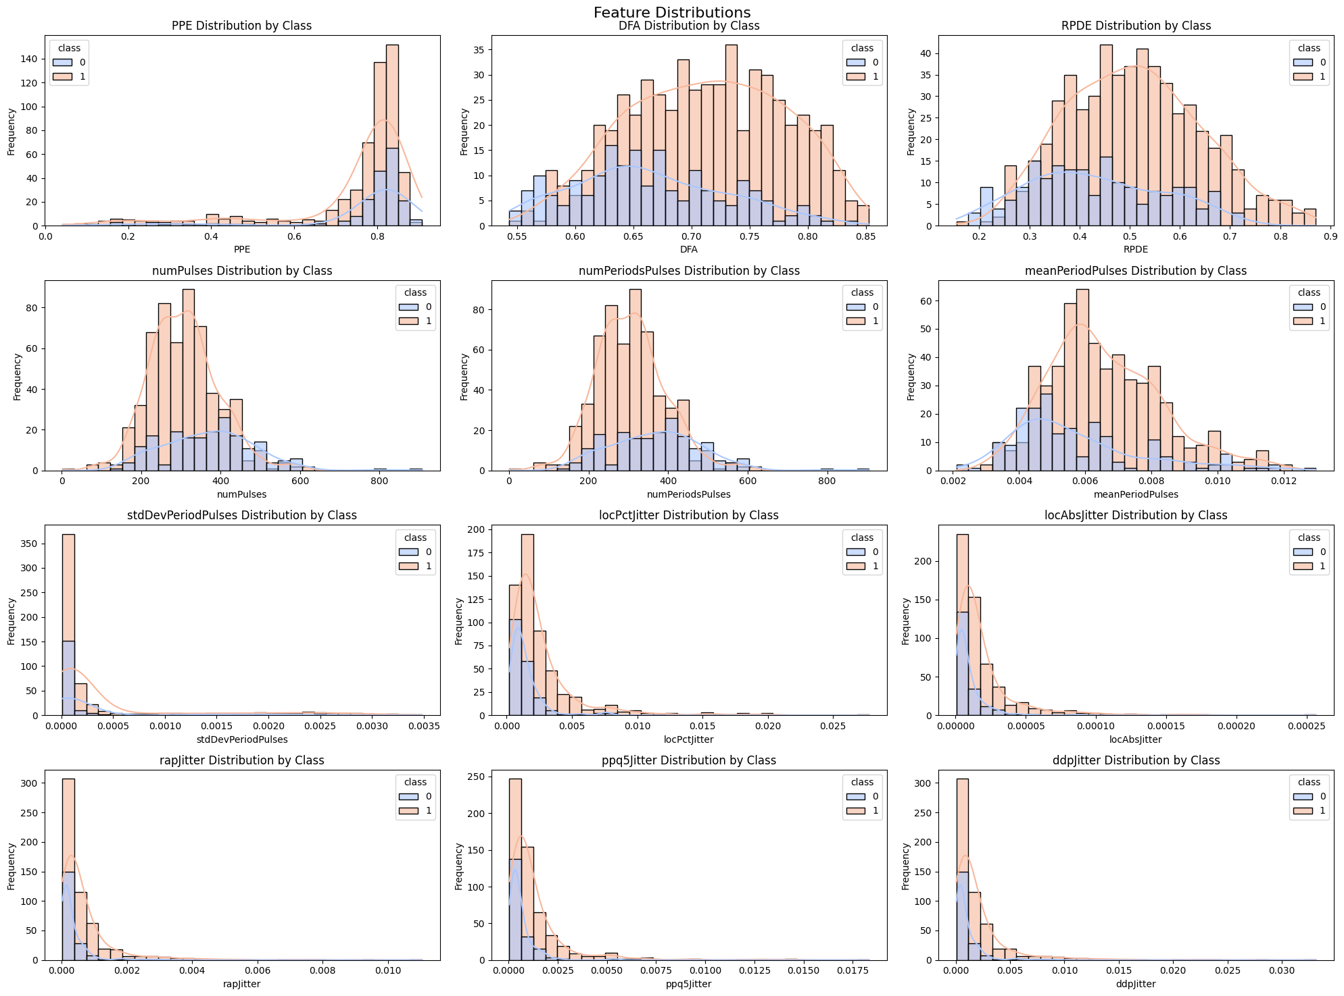
Exploratory Data Analysis
PPE (Pitch Period Entropy): The histogram shows a noticeable separation between the distributions of the Parkinson's group (class 1) and the healthy group (class 0). Higher PPE values for Parkinson's patients indicate increased pitch irregularities in their voice.
DFA (Detrended Fluctuation Analysis): The chart shows a broad but distinct shift, with Parkinson's patients tending toward higher values, reflecting greater variability or "roughness" in their voice signals. This is consistent with incomplete vocal fold closure in Parkinson's leads to increased turbulent noise.
RPDE (Recurrence Period Density Entropy): RPDE values for Parkinson's patients appear spread across a wider range, indicating greater irregularity in vocal fold vibration. This indicates that this metric captures deviations from periodicity associated with dysphonia.
Jitter-Related Features (e.g., locPctJitter, rapJitter): Parkinson’s patients tend to show a slight rightward skew, meaning higher jitter values compared to healthy individuals. This indicates cycle-to-cycle variations in pitch period, reflecting the instability of vocal fold vibration in PD.
Shimmer-Related Features (e.g., locAbsJitter, ddpJitter): Similar to jitter, shimmer-related features likely reflect increased amplitude variation for Parkinson’s patients.
Notes:
Pitch Period Entropy (PPE) is a novel measure introduced in the Little et. al (2009) to assess vocal irregularities specifically associated with Parkinson's disease (PD) dysphonia. It addresses the challenges in distinguishing normal variations in voice pitch (caused by natural vibrato and microtremor) from abnormal variations caused by PD.

Slide 7

Next Steps
Key Questions:
What are the most predictive vocal features for detecting Parkinson’s?
Do the non-traditional measures (e.g., PPE, DFA, RPDE) consistently outperform traditional features (e.g., jitter, shimmer, harmonics-to-noise ratio) in distinguishing Parkinson’s patients?
How does the combination of traditional and non-traditional measures impact classification performance?
Can this approach improve accessibility and affordability in early diagnostics?
How well does the approach generalize across different recording devices, environments, and speaker variations?
How robust are the methods (especially non-traditional metrics like PPE) when random noise is introduced to recordings, mimicking real-world conditions (e.g., background noise, low-quality microphones)?
Notes:
Implement: Train a machine learning model to classify speech characteristics as indicative of Parkinson’s or healthy controls.
Evaluate: Assess the accuracy, sensitivity, and robustness of the models and identify which model performs best.

Slide 8
References
https://www.parkinson.org/understanding-parkinsons/statistics
https://www.kaggle.com/datasets/dipayanbiswas/parkinsons-disease-speech-signal-features/data
https://pmc.ncbi.nlm.nih.gov/articles/PMC11114626/#REF22
https://pubmed.ncbi.nlm.nih.gov/33090328/
https://pmc.ncbi.nlm.nih.gov/articles/PMC3051371/

Slide 9
Exploratory Data Analysis
Exploratory Data Analysis:
Model Results
TBD
Key Observations
TBD
Importance
TBD
Notes:
Relevance to Scientific Computing
Leverage key aspects of data preprocessing, feature extraction, and numerical computation for analyzing voice signals.
Exploring applications of machine learning algorithms and model evaluation techniques in healthcare diagnostics.
Contributes to interdisciplinary research, combining computer science, neuroscience, and medicine.

