Slide 1


Notes:
Nicoline

Slide 2


Notes:
Nicoline

Slide 3
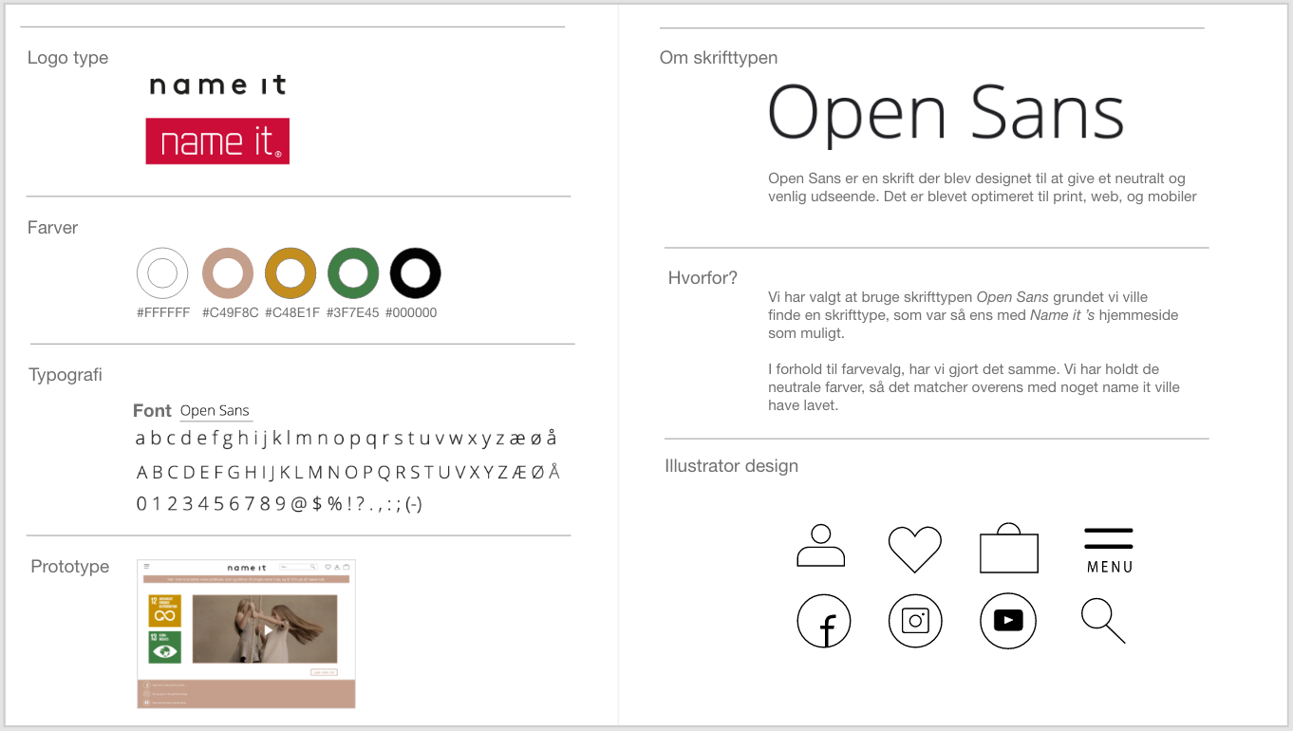
Styleguide
Notes:
Pernille

Slide 4
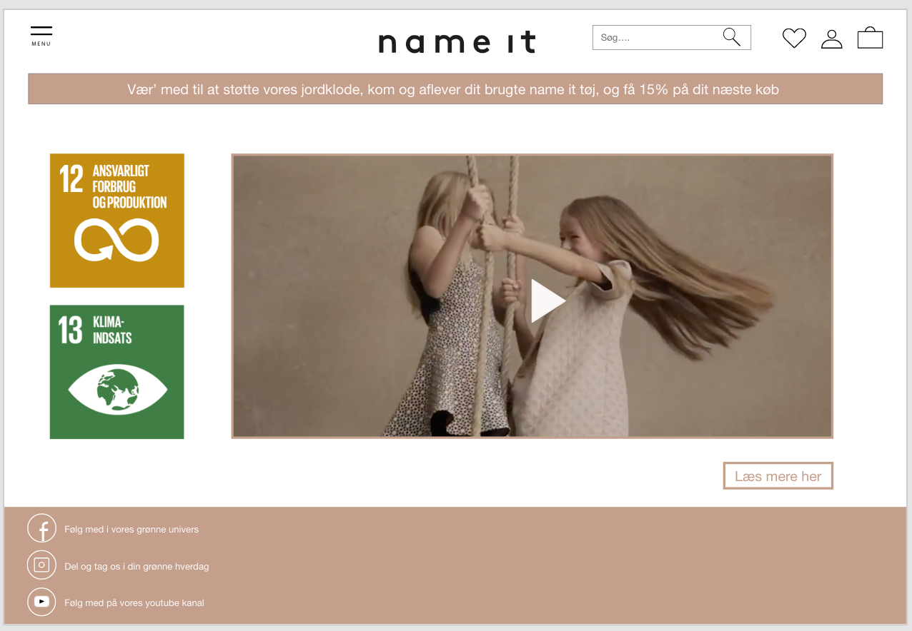
Prototype
Notes:
Kira

Slide 5
Name it kampagne video og Landing page
http://fdjdesign.dk/nameit/index.html?fbclid=IwAR39HK02F6Z5zNLlkKypxRQUpzCWGgfupk2djLOAfaj25oLdjwHfZk8DAQ0
Notes:
Freja

