Slide 1

Computer Fundamentals and Programming
GROUP DOTES
INTRO TO ML

Slide 2
MACHINE LEARNING
NEURAL NETWORKS ( How do NNs work?)
TOPICS
CLASIFICATION VS REGRESSION NN
CONVOLUTIONAL NEURAL NETWORKS
TRANSFER LEARNING

Slide 3
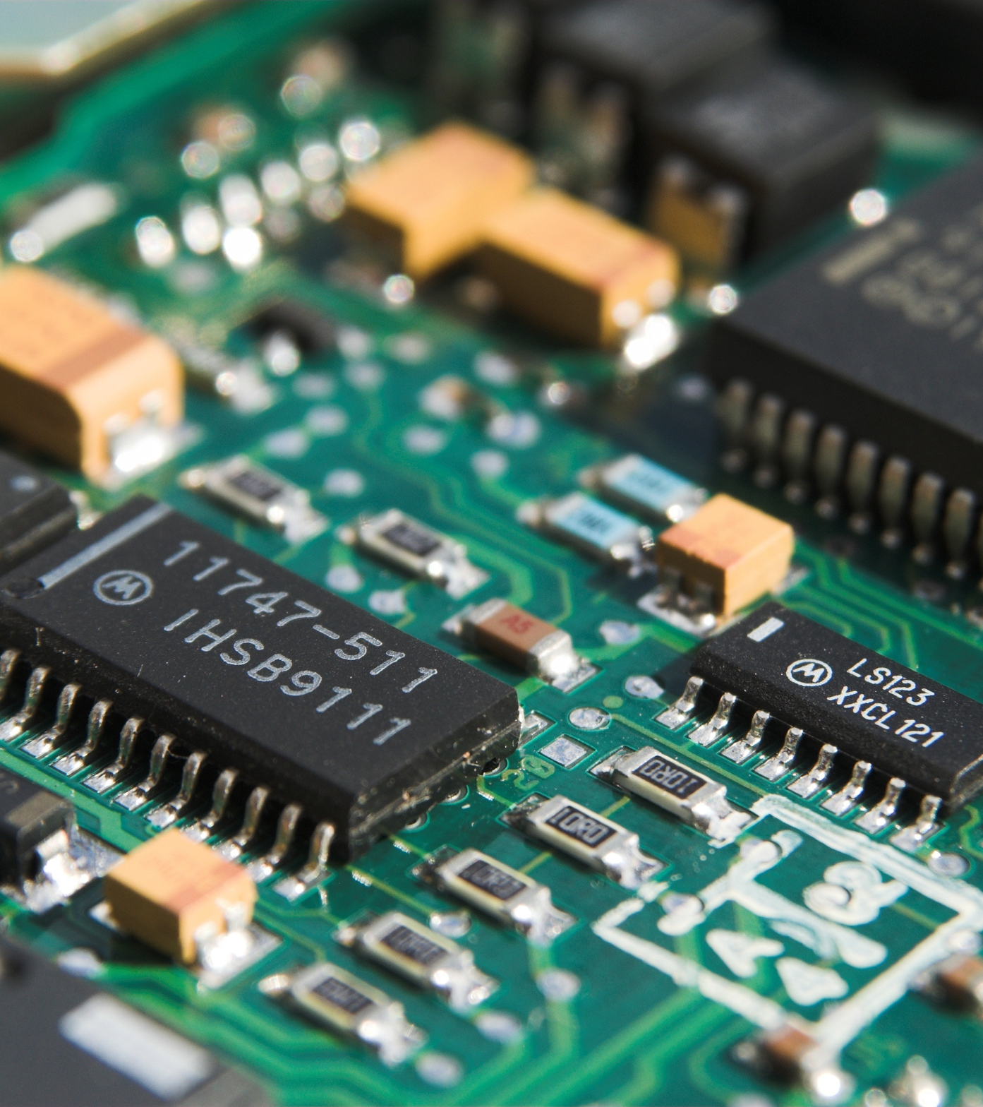
Machine Learning
Machine learning is a subfield of artificial intelligence or AI focused on the development of algorithms and statistical models that enable computers to perform tasks without explicit instructions. Instead, these systems learn from data, identifying patterns and making decisions based on that information.

Slide 4
Deep Learning
Deep learning is a subset of machine learning that focuses on algorithms inspired by the structure and function of the brain called artificial neural networks. These neural networks are designed to automatically and adaptively learn features and patterns from data, making them particularly powerful for tasks that involve large amounts of unstructured data, such as images, audio, and text.

Slide 5
Neural Networks
Neural networks are computational models inspired by the human brain, designed to recognize patterns and relationships in data. They are a fundamental component of machine learning and artificial intelligence, particularly effective in tasks involving large amounts of unstructured data such as images, audio, and text.

Slide 6
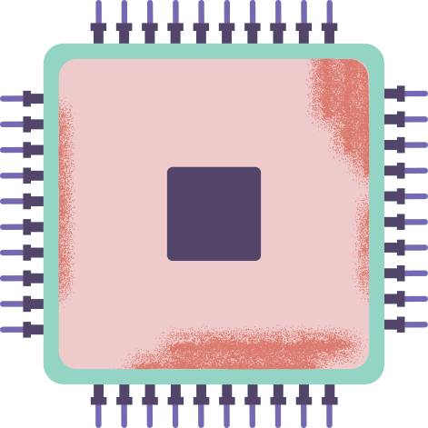
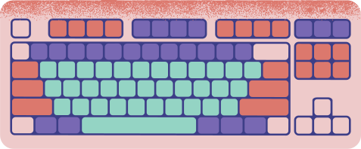
Neurons and Layers
Neurons
Layers
Neurons are the fundamental units of a neural network, functioning similarly to biological neurons. Each neuron receives one or more inputs, processes them, and produces an output.
Neural networks are structured in layers, each consisting of multiple neurons

Slide 7
Neural Networks
Activiation Functions
Loss Functions
Activation functions are crucial in neural networks as they introduce non-linearity into the model, allowing the network to learn and represent complex patterns in the data.
Loss functions, also known as cost functions, measure how well a neural network's predictions match the actual target values.

Slide 8
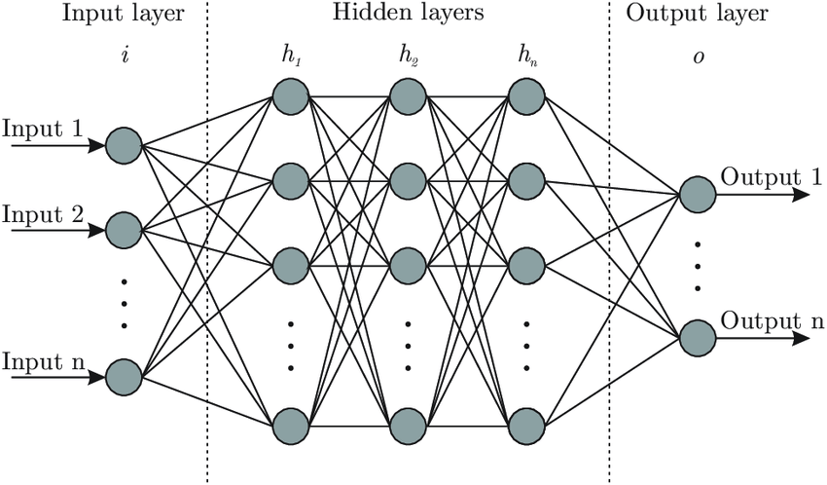
Neural Network Structure

Slide 9
Neural Networks
Forward and Back Propagation
Gradient Descent
Gradient Descent is a fundamental optimization algorithm used to minimize the loss function in neural networks and other machine learning models.
Forward and backpropagation are fundamental processes in training neural networks. They allow the network to learn from data by adjusting its weights and biases to minimize errors in predictions.

Slide 10
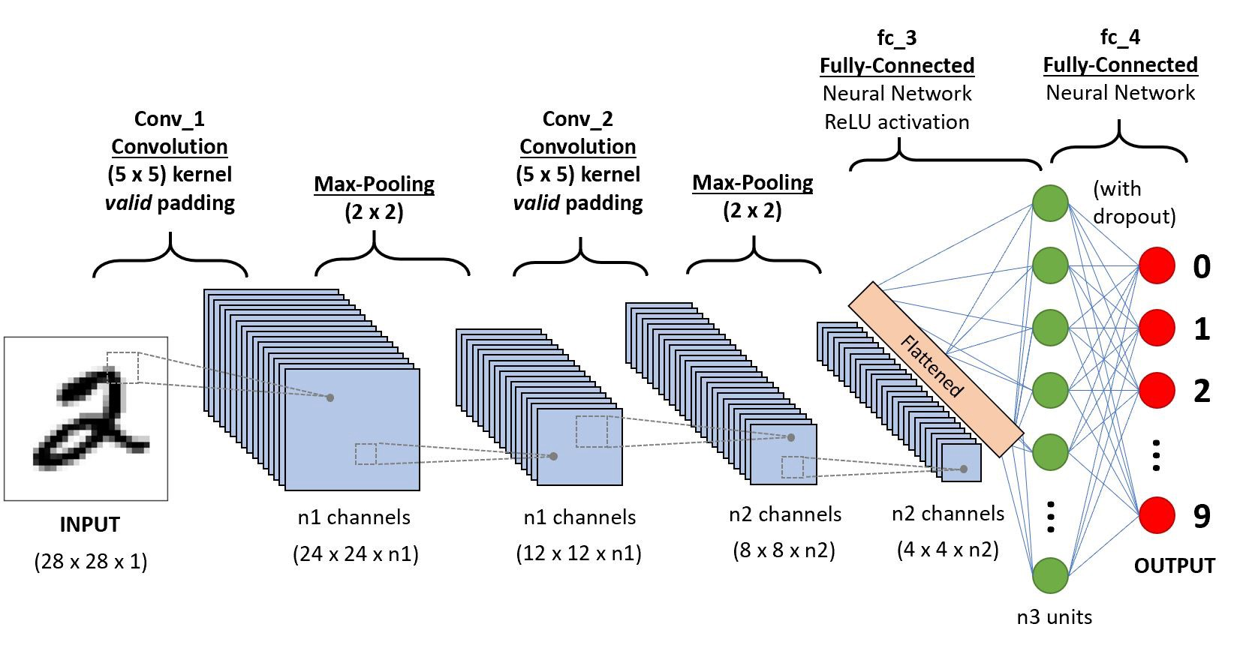
CNN Structure

Slide 11

Classification vs Regression NN
Neural networks (NNs) can be used for both classification and regression tasks, each serving different types of problems and requiring specific configurations and loss functions.
CLASSIFICATION
REGRESSION NN
The purpose of this is to categorize input data into predefined classes or labels.
The purpose of this is to predict a continuous output value based on input data.

Slide 12
Convolutional Neural Networks
Convolutional Neural Networks (CNNs) are a class of deep neural networks that are particularly effective for processing structured grid data such as images. CNNs leverage spatial hierarchies in data through the use of convolutional layers, pooling layers, and fully connected layers, making them well-suited for tasks like image classification, object detection, and image segmentation.

Slide 13
Transfer Learning
PyTorch, a popular deep learning framework, provides powerful tools for implementing transfer learning. In PyTorch, transfer learning can be achieved using pre-trained models from the torchvision library, which offers a collection of popular convolutional neural networks (CNNs) pre-trained on large datasets like ImageNet.
allows us to take the patterns (also called weights) another model has learned from another problem and use them for our own problem.

Slide 14
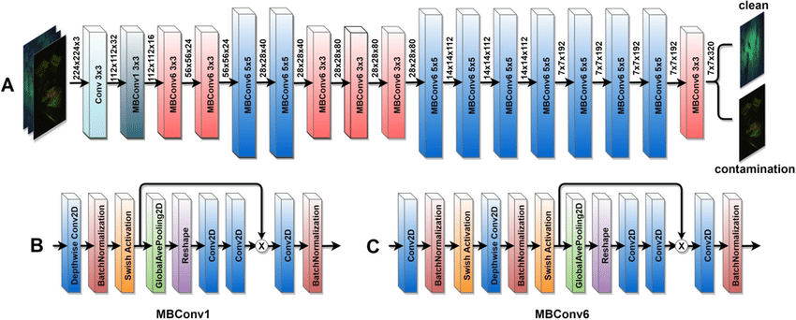
Efficientnet_b0 model

Slide 15
Computer Fundamentals and Programming
GROUP DOTES
Final Defense
ESC - 12 , EF
BSME - 1

