Slide 1

PRODUCT OWNER
Product Owner Illustration
Hồ Mai Kim Chi
Lương Phát Thịnh
Nguyễn Minh Trí
Nguyễn Huy Nam
Giáo viên : Hồ Trần Nhật Thủy
Lớp : IS208.I21

Slide 2

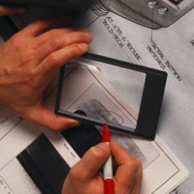
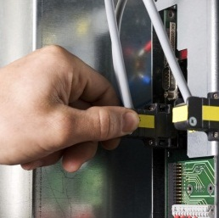

CONTENT
Who is Product Owner?
What make Product Owner important ?
Product Owner
How can be effective P.O ?
Product Owner Illustration

Slide 3
CONTENT
Who is Product Owner?
What make Product Owner important ?
Product Owner
How can be effective P.O ?
Product Owner Illustration

Slide 4
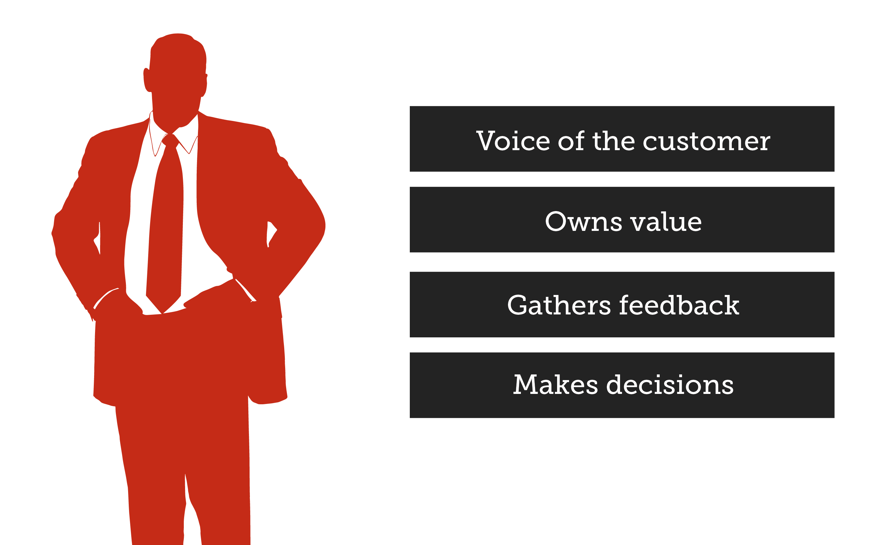
WHO IS PRODUCT OWNER?

Slide 5


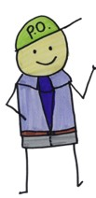


WHO IS PRODUCT OWNER?
Vision
Analyzing user’s requirement
Product Backlog
Maximizing value

Slide 6
CONTENT
Who is Product Owner?
What make Product Owner important ?
Product Owner
How can be effective P.O ?
Product Owner Illustration

Slide 7
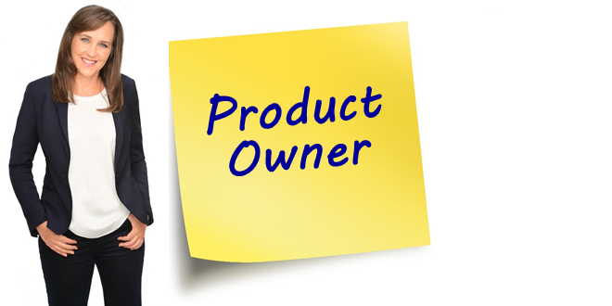

WHAT MAKE PRODUCT OWNER BECOME IMPORANT?

Slide 8
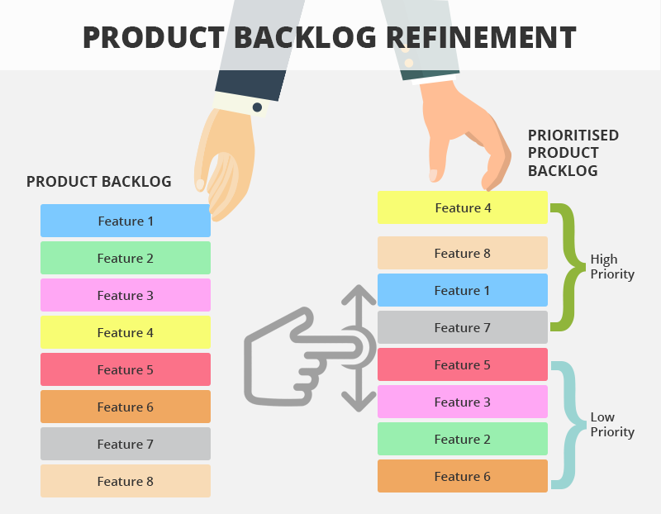
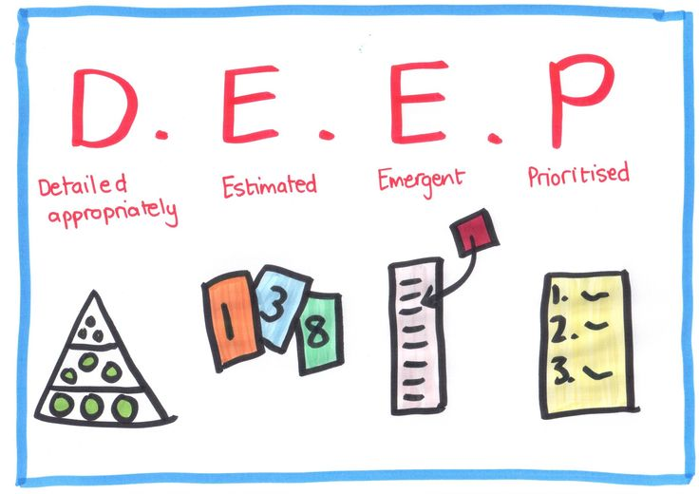
WHAT MAKE PRODUCT OWNER BECOME IMPORANT?

Slide 9



WHAT MAKE PRODUCT OWNER BECOME IMPORANT?
Optimized

Slide 10
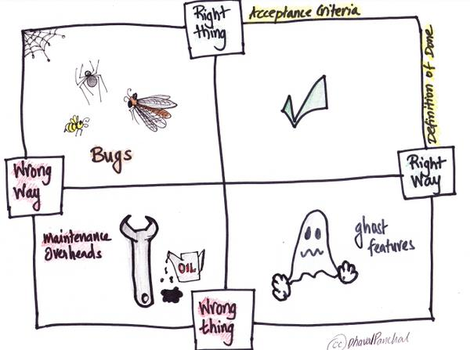


WHAT MAKE PRODUCT OWNER BECOME IMPORANT?

Slide 11
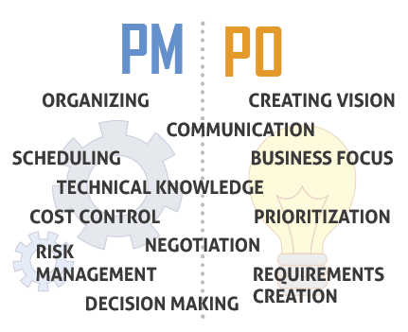
WHAT MAKE PRODUCT OWNER BECOME IMPORANT?

Slide 12
CONTENT
Who is Product Owner?
What make Product Owner important ?
Product Owner
How can be effective P.O ?
Product Owner Illustration

Slide 13
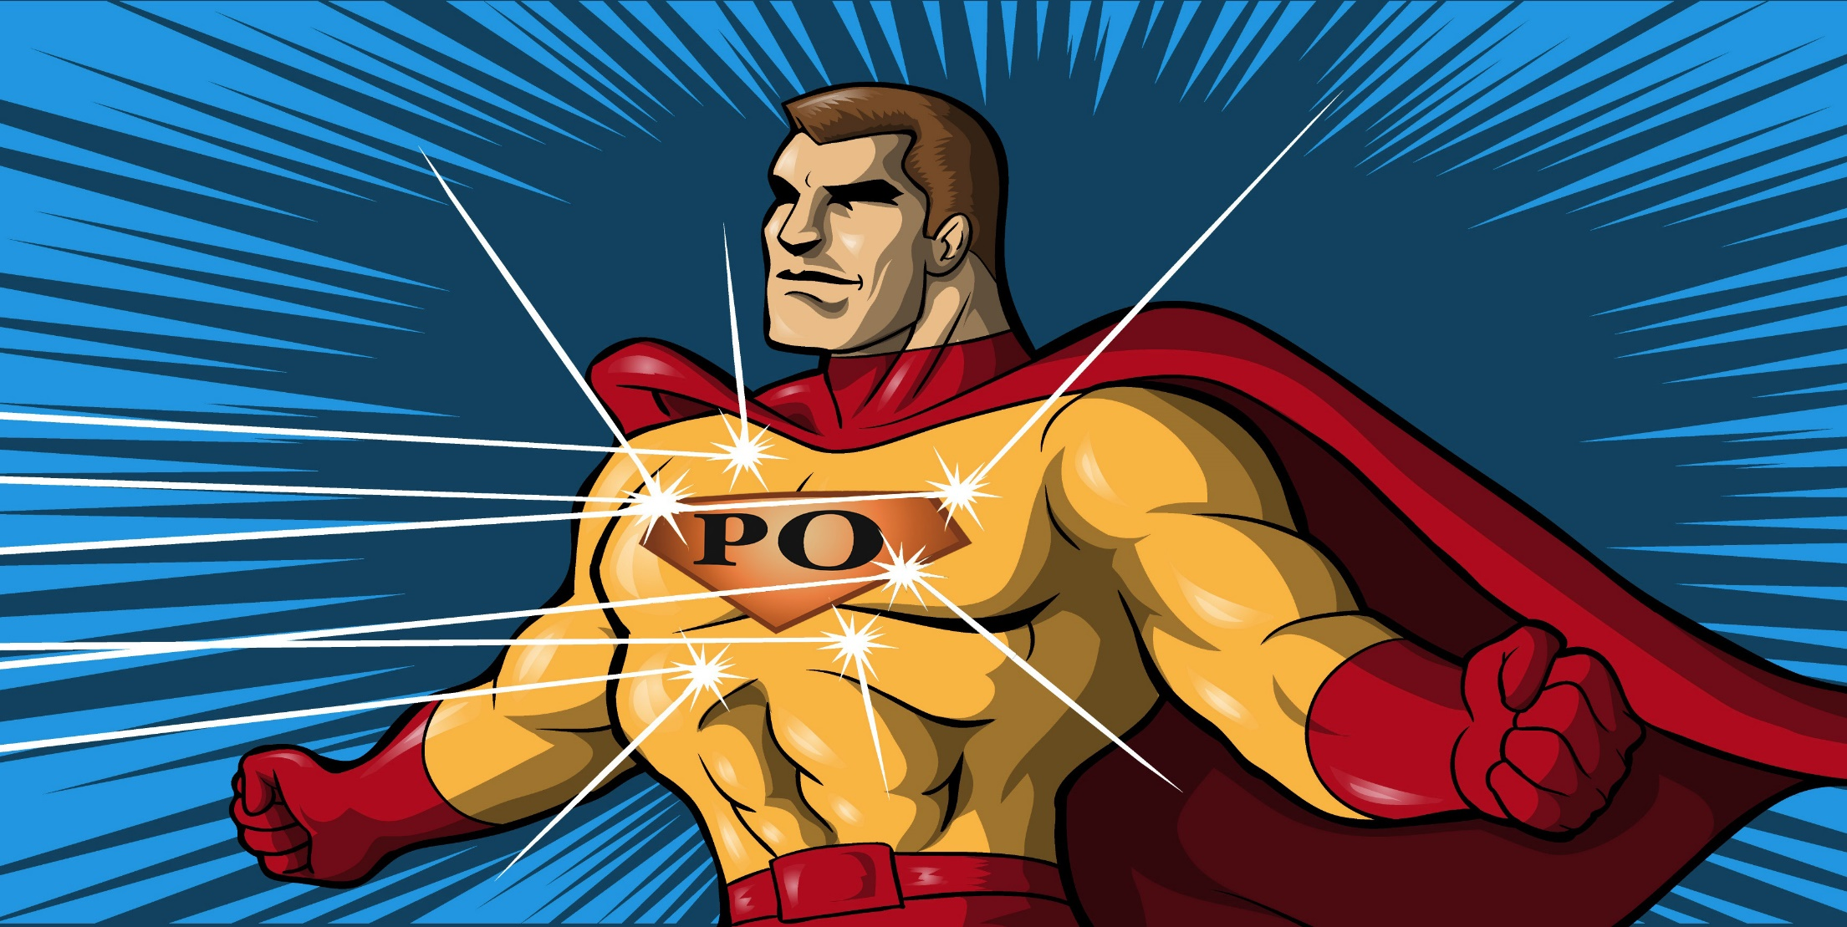
HOW CAN BE EFFECTIVE PRODUCT OWNER

Slide 14
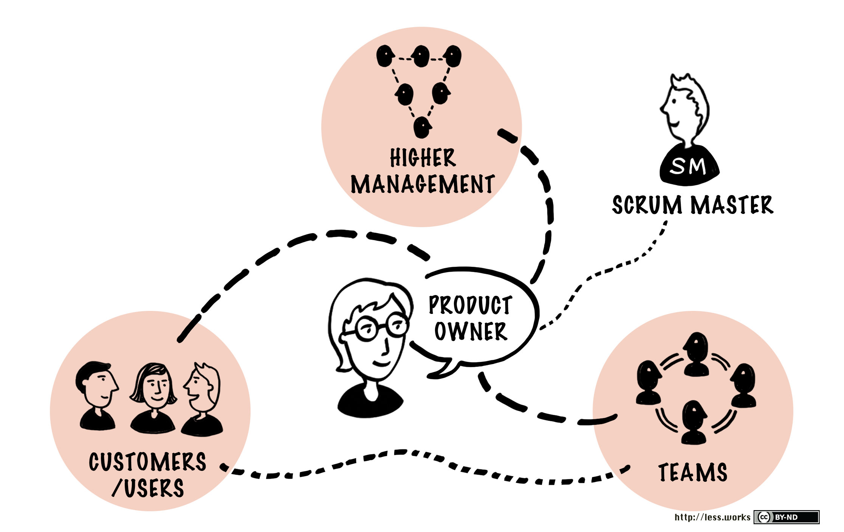
HOW CAN BE EFFECTIVE PRODUCT OWNER

Slide 15
CONTENT
Who is Product Owner?
What make Product Owner important ?
Product Owner
How can be effective P.O ?
Product Owner Illustration

Slide 16



Product Owner Illustration
HUMANNOID HAND FOR DISABLED PEOPLE USING FLEX SENSOR
COMMUNICATE
DIRECT VALUE

Slide 17

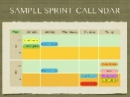
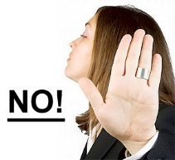
Plaining 2
How
SPRINT
Release
Plaining 1
What
Product backlog
(Phân đoạn quan trọng khởi nguyên của 1 dự án do PO thực hiện)
FINISHED WORK

Slide 18


