Slide 1
ASSIGNMENT 3 KIRA LOWE

Slide 2






2. Write SQL codes to get a list of:
Unique student IDs
Instructors
Instructors

Slide 3

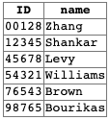
3. Write in SQL codes to do following queries:
i. Students (unique ID & names) who have taken at least one CS class

Slide 4

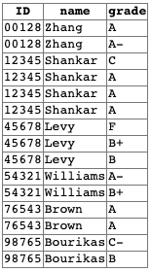
3. Write in SQL codes to do following queries:
Student name, ID, and grade who have taken at least one CS class

Slide 5

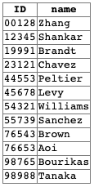
3. Write in SQL codes to do following queries:
ID and name of each student who has not taken any course offered before 2017

Slide 6

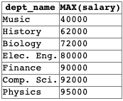
3. Write in SQL codes to do following queries:
For each department, find the maximum salary of instructors in that department

Slide 7




3. Write in SQL codes to do following queries:
The lowest, across all departments, of the per-department maximum salary computed by the preceding query
Add name

Slide 8

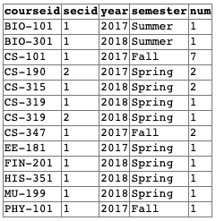
5. Write SQL query to find the number of students in each section. The result columns should appear in the order “courseid, secid, year, semester, num”

Slide 9

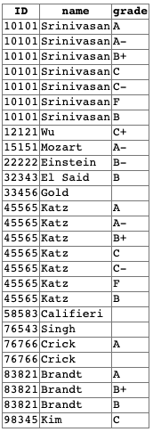
4. Find instructors (with name and ID) who have never given an A grade in any course she or he has taught
WHERE takes.grade <> ‘%A%’
AND NOT takes.grade LIKE '%A%'
FROM TABLE WHERE instructor.id NOT IN (SELECT instructor.id FROM TABLE WHERE takes.grade LIKE '%A%’)
WHERE NOT EXISTS (SELECT 1 FROM takes takes2 WHERE takes2.grade = takes.grade AND takes.grade LIKE '%A%’)

