Slide 1
MRA Project - Milestone 1
Great-Learning : Kiran.N

Slide 2
Table of Contents
Problem Statement
About Data
Exploratory Analysis
RFM Analysis
RFM – Assumptions and Parameters Used
KNIME Work Flow
RFM Metrics
List of Best, Loyal, About to Churn and Lost Customers

Slide 3
Problem Statement
An automobile parts manufacturing company has collected data of transactions for 3 years. They do not have any in-house data science team, thus they have hired you as their consultant. Your job is to use your magical data science skills to provide them with suitable insights about their data and their customers.

Slide 4
About Data
In the given dataset each row represent one transaction of a customer.
Given dataset has 20 columns with 2747 rows of data.
Out of 20 columns, 5 are of integer type, 12 are of string/object type, 2 are of floating type and 1 is of date type.
There are no null values present in the data.
All these 2747 transactions are carried out by 89 Unique Customers.
Going forward we will group the data by customer name for RFM Analysis.

Slide 5
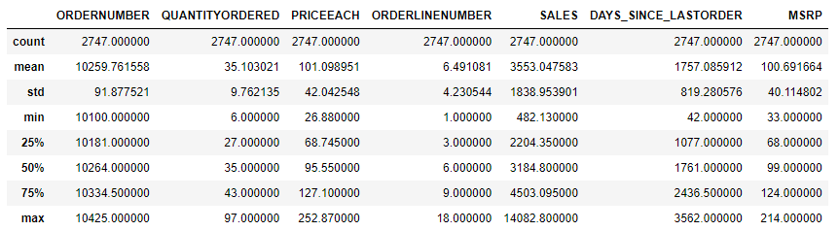
About Data [Cont..]
Descriptive Statistics of Numeric Columns

Slide 6
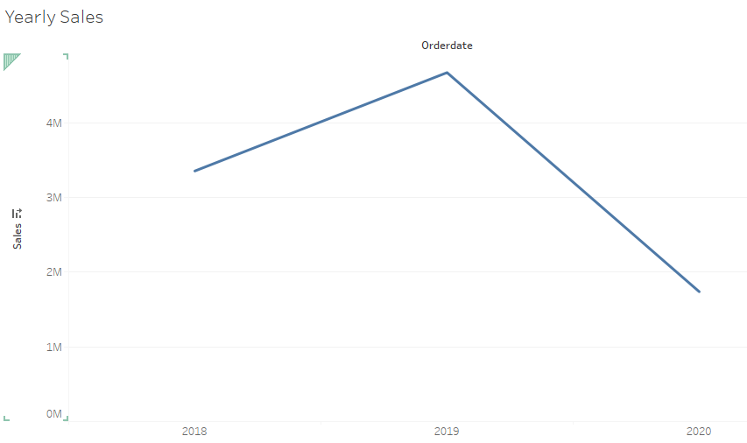
Exploratory Analysis – Yearly Sales Trend

Slide 7
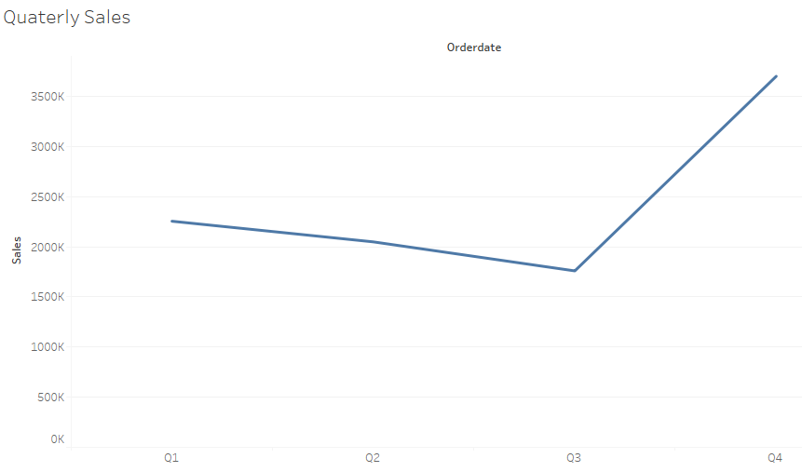
Quarterly Sales Trend

Slide 8
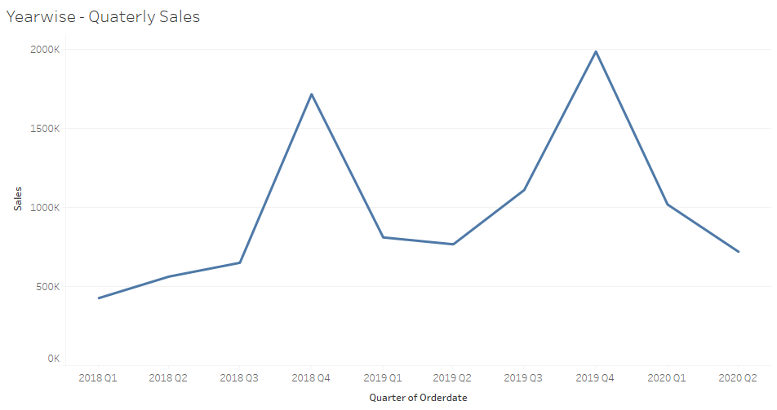
Year Wise - Quarterly Sales Trend

Slide 9
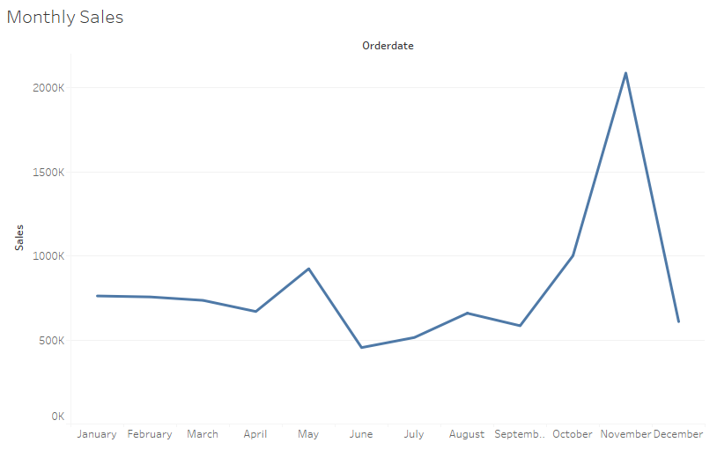
Monthly Sales Trend

Slide 10
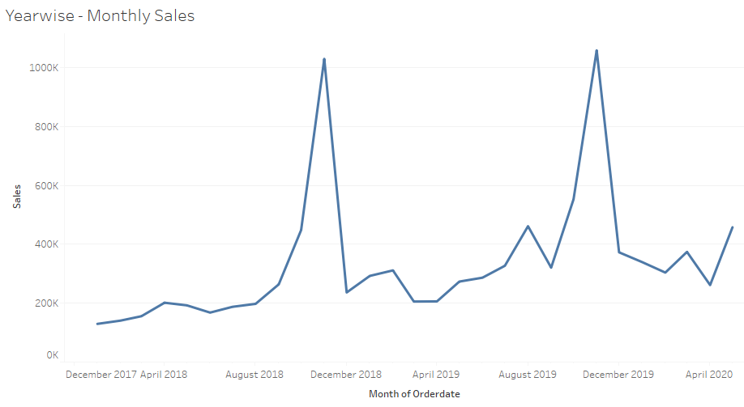
Year Wise - Monthly Sales Trend

Slide 11
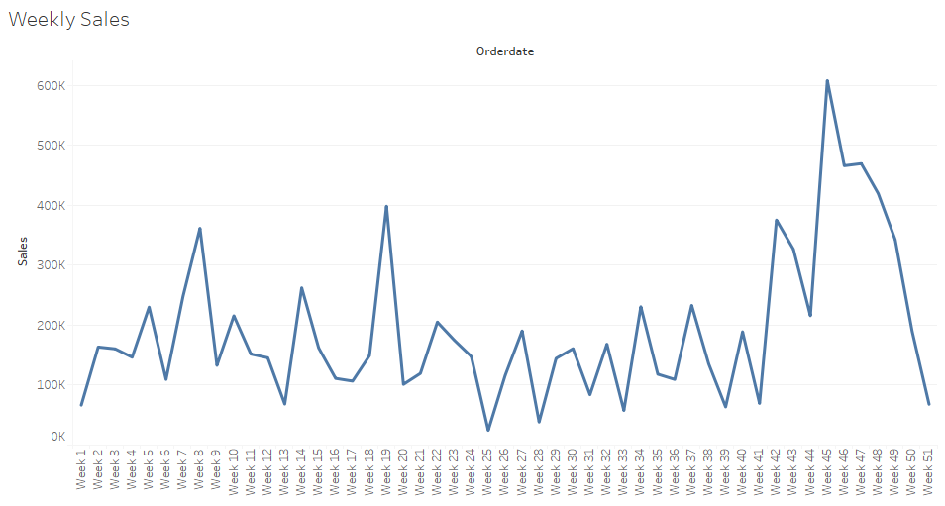
Weekly Sales Trend

Slide 12
Inferences From Sales Trends
The given dataset consists of transactions from Jan – 2018 to May – 2020.
Sales were high in the year 2019 compared to 2018.(for 2020 we do not have complete data)
We observe more sales happening in the 4th Quarter compared to other 3 quarters.
We observe more sales happening in Sept to Nov month compared to other months.
We observe a seasonality trend where more sales are happening in Sep – Nov month every year.
We observe a seasonality trend where more sales are happening 4th Quarter every year.
We observe uptrend in sales from week – 41 to week – 45.

Slide 13
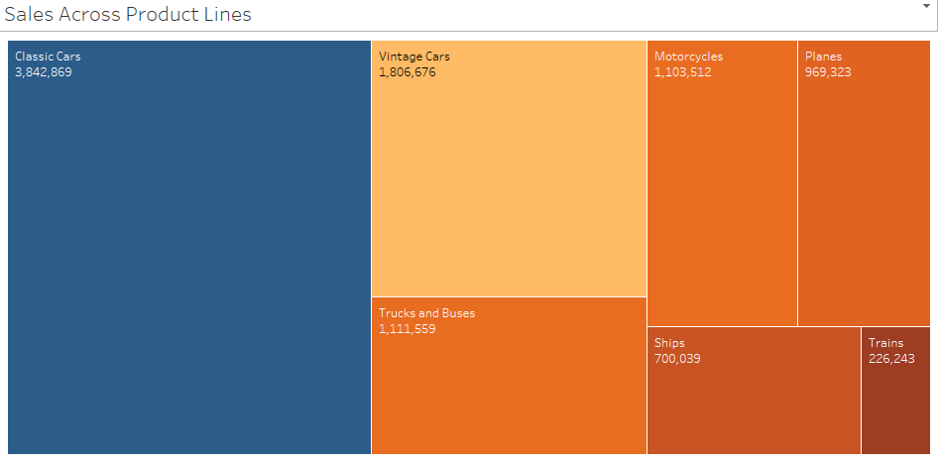
Sales Across Different Product lines

Slide 14
Inference
Highest sales are from the Classic Cars product line.
Vintage Cars product line stands second with highest sales.
Least sales were from the Trains product line.

Slide 15
RFM - Analysis
RFM analysis is a marketing technique used to quantitatively rank and group customers based on the recency, frequency and monetary total of their recent transactions to identify the best customers and perform targeted marketing campaigns.

Slide 16
RFM – Assumptions and Parameters Used
We have grouped all the transactions for each customer.
We have used ‘DAYS_SINCE_LASTORDER’ column from given dataset to measure Recency parameter .
We have used ‘SALES’ column from given dataset to measure Monetary parameter .
We have used count of transactions for each customer as a measure to Frequency parameter.
We have 4 segments present with 4 being given highest and 1 being given lowest weightage.

Slide 17
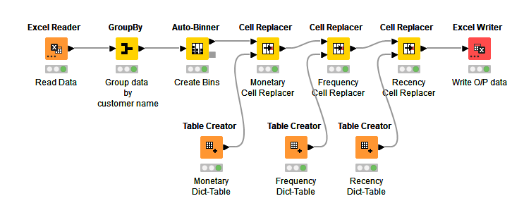
KNIME Work-Flow Used to compute Segmentation based on RFM

Slide 18
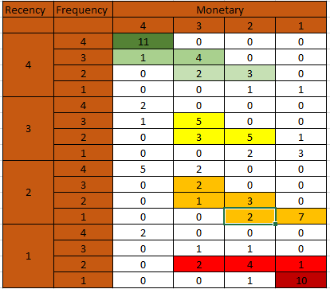
RFM Metrics

Slide 19
Best Customers
Anna's Decorations, Ltd
Australian Collectors, Co.
Euro Shopping Channel
La Rochelle Gifts
Land of Toys Inc.
Mini Gifts Distributors Ltd.
Online Diecast Creations Co.
Salzburg Collectables
Souveniers And Things Co.
Technics Stores Inc.
The Sharp Gifts Warehouse

Slide 20
Loyal Customers
Auto Canal Petit
Baane Mini Imports
Diecast Classics Inc.
Oulu Toy Supplies, Inc.
UK Collectables, Ltd.

Slide 21
Customers In the Verge of Churning
    CAF Imports
    Cambridge Collectables Co.
    Collectable Mini Designs Co.
    Daedalus Designs Imports
    Microscale Inc.
    Mini Caravy
    Motor Mint Distributors Inc.

Slide 22
Customers In the Verge of Churning [cont..]
Online Mini Collectables
Osaka Souveniers Co.
Petit Auto
Super Scale Inc.
Vitachrome Inc.
West Coast Collectables Co

Slide 23
Lost Customers
Alpha Cognac
Auto-Moto Classics Inc.
Bavarian Collectables Imports, Co.
Clover Collections, Co.
Double Decker Gift Stores, Ltd
Gift Ideas Corp.
Iberia Gift Imports, Corp.
Mini Auto Werke
Royale Belge
Signal Collectibles Ltd.

Slide 24
Thank You

