Slide 1
MRA Project - Milestone 2
Great-Learning : Kiran.N

Slide 2
Table Of Content
Problem Statement
About Data
Exploratory Data Analysis
Association Rules
KNIME Work Flow
Threshold Values used for Computation
Computed Association Rules
Support, Confidence & Lift
Recommendations

Slide 3
Problem Statement
A Grocery Store shared the transactional data with you. Your job is to identify the most popular combos that can be suggested to the Grocery Store chain after a thorough analysis of the most commonly occurring sets of menu items in the customer orders. The Store doesn’t have any combo meals. Can you suggest the best combo meals?

Slide 4
About Data
In the given dataset each row represent one item of an Order.
Given dataset has 3 columns with 20641 rows.
Out of 3 columns 1 is of date type, 1 is numeric and 1 is object/string type.
There are no null values present in the data.
There are total 1139 unique orders with multiple items in each order.

Slide 5
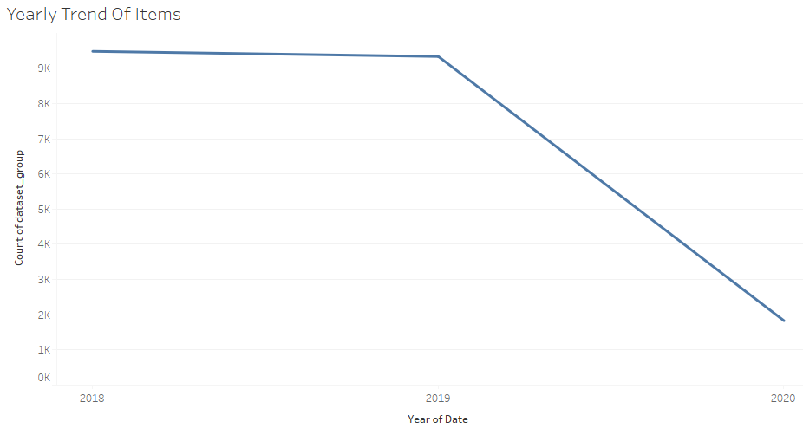
Exploratory Analysis – Yearly Trend

Slide 6
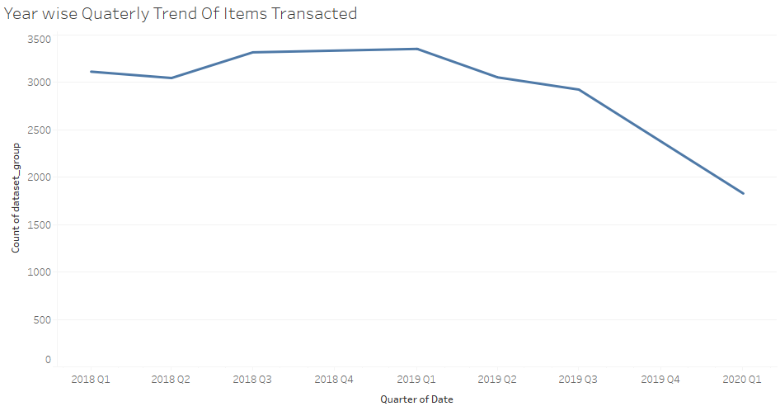
Year Wise - Quarterly Trend

Slide 7
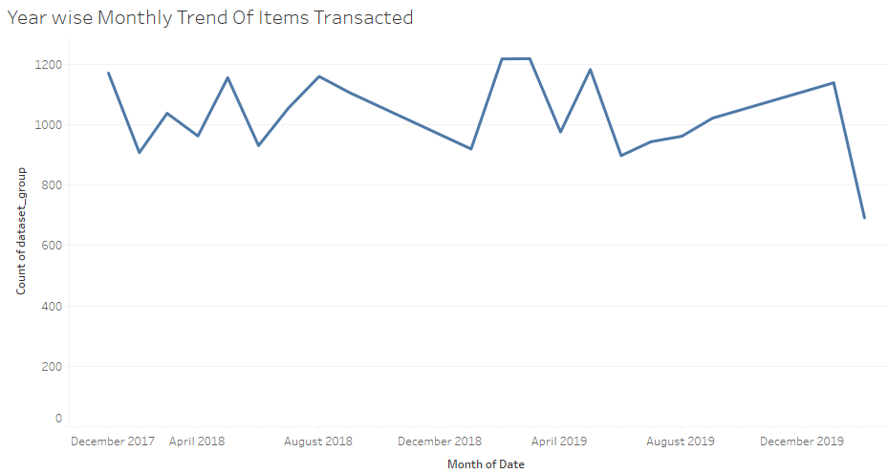
Year Wise - Monthly Trend

Slide 8
Association Rules
  Association rule mining finds interesting associations and relationships among large sets of data items. This rule shows how frequently a itemset occurs in a transaction. A typical example is a Market Based Analysis.
  Market Based Analysis is one of the key techniques used by large relations to show associations between items. It allows retailers to identify relationships between the items that people buy together frequently.
  In this scenario we have data about multiple orders. We apply Market Basket Analysis on given dataset to find which all items were bought together to come up with combo plans and also the recommend an item to be bought when certain items were bought.

Slide 9
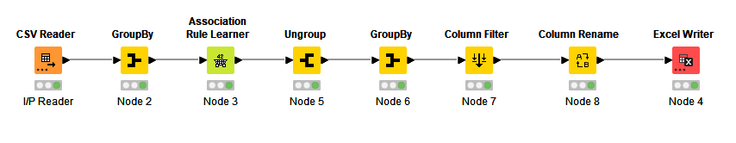
KNIME Workflow

Slide 10
Threshold Values
For Building Association Rules we have configured following threshold Values
Minimum Support: 0.05
Minimum Confidence: 0.55
With the above threshold Values we have come up with 84 different Association Rules.

Slide 11
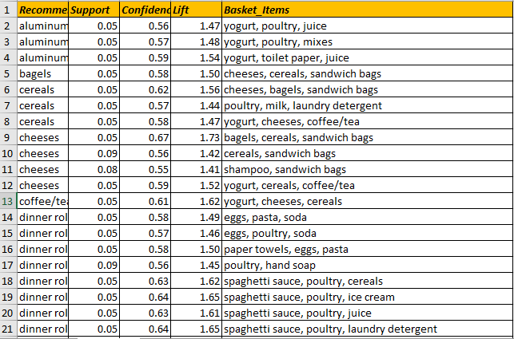
Association Rules

Slide 12
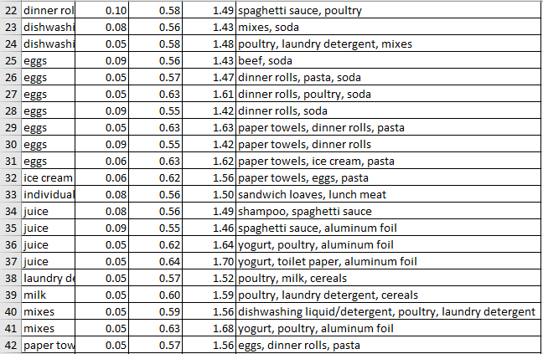

Slide 13
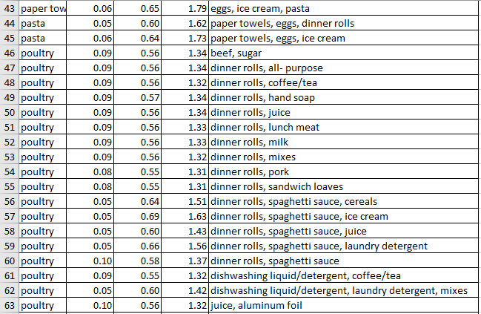

Slide 14
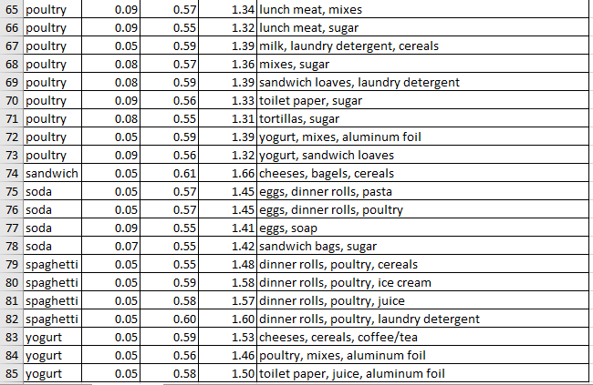

Slide 15
Final Association Identified

Slide 16
Support
The percentage of transactions that contain all of the items in an basket.
The higher the support the more frequently the basket occurs.
Rules with a high support are preferred since they are likely to be applicable to a large number of future transactions.

Slide 17
Confidence
The probability that a transaction that contains the items in the basket also contains the item on recommended column.
The higher the confidence, the greater the likelihood that the item in recommended column will be purchased or, in other words, the greater the return rate you can expect for a given rule.

Slide 18
Lift
The probability of all of the items in a rule occurring together (otherwise known as the support) divided by the product of the probabilities of the items in the basket and recommendation occurring as if there was no association between them.
Lift summarizes the strength of association between the products in the basket and recommendation of the rule.
The larger the lift the greater the link between the two products.

Slide 19
Recommendations Based on Association Rules
When eggs, ice cream, pasta are bought provide discounts on paper towels.
When yogurt, cheeses, cereals are bought provide discounts on coffee/Tea.
When bagels, cereals, sandwich bags are bought provide discounts on cheeses.
When yogurt, poultry, aluminum foil are bought provide discounts on mixes
When food items are bought give discounts on packaging items used for packing food.
When food items are bought provide combo offers with beverages.

Slide 20
Recommended Food Combos
spaghetti sauce, poultry, ice cream, dinner rolls
spaghetti sauce, poultry, cereals, dinner rolls
yogurt, cheeses, cereals, coffee/Tea
spaghetti sauce, poultry, juice, dinner rolls
dinner rolls, poultry, soda, eggs
dinner rolls, poultry, ice cream, spaghetti sauce
dinner rolls, poultry, juice, spaghetti sauce
yogurt, cereals, coffee/tea, cheeses
dinner rolls, spaghetti sauce, cereals, poultry
sandwich loaves, lunch meat, individual meals

Slide 21
Association Rules for food items

Slide 22
THANK YOU

