Slide 1

Convolution Neural Network powered Image Classification: A Novel Approach to Facial Expression Recognition

Slide 2
Introduction
Understanding and interpreting emotions from images is a captivating domain within the field of computer vision and artificial intelligence. The ability to automatically recognize emotions in images has numerous potential applications, from enhancing user experiences in social media and marketing to aiding in mental health diagnostics.
In this project, we have taken a unique approach by creating an image classification system that distinguishes between happiness and sadness using Convolutional Neural Networks (CNNs). The key distinction in our project is that it is not geared towards achieving high accuracy metrics or fine-tuned model performance. Instead, our focus is on providing a user-friendly interface that allows individuals to submit their own images and instantly receive predictions about the emotional state conveyed within those images.

Slide 3
Introduction
The two classes, "happy" and "sad," were selected due to the distinct visual cues that often accompany these emotional states. This binary classification problem simplifies the task and makes it accessible for the intended user base.
Our project leverages the power of OpenCV for image preprocessing and TensorFlow for building and deploying the CNN model. Users can upload their images through a graphical user interface, and the system will process these images through the trained model. It will then provide a simple prediction: whether the depicted emotion is "happy" or "sad."
To achieve this, we have followed best practices for CNN model development.

Slide 4


Dataset
Happy
Sad

Slide 5
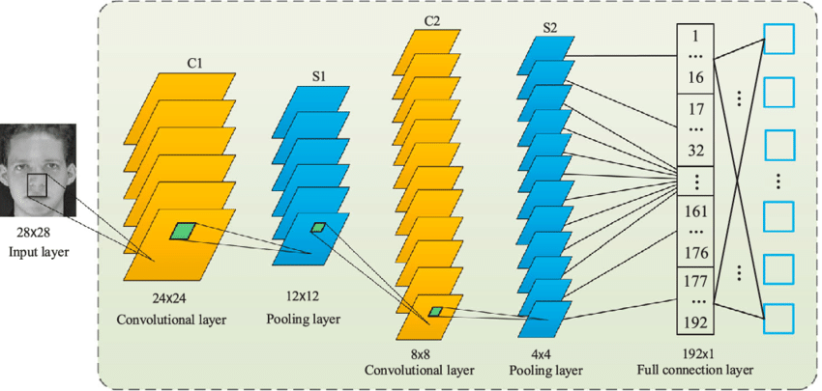

Slide 6
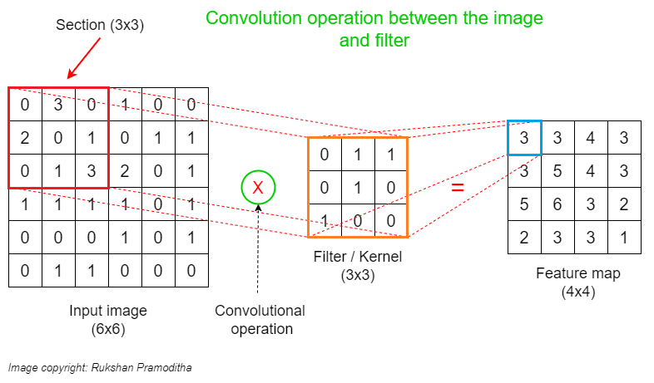

Slide 7
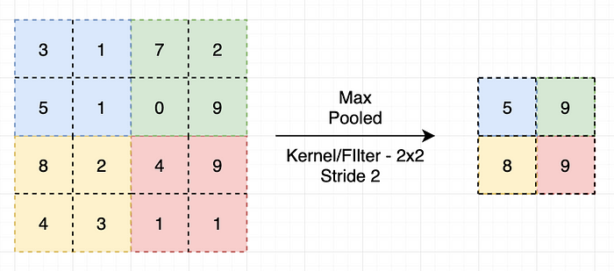

Slide 8
Image Processing
Color Space Conversion: We standardized the color space of all images to RGB. RGB is the standard color space for digital images and is widely used in various image processing tasks. Converting all images to the same color space ensures consistency in the input data, making it easier for the CNN model to interpret and extract meaningful features.
Image Resizing: We resized all images to a standard dimension of 256x256 pixels. Consistent image dimensions ensure uniformity in the input data, preventing the model from being biased towards images with larger or smaller dimensions. Additionally, resizing images to a standard size reduces computational complexity during training and inference.
These preprocessing steps ensure that the dataset is well-suited for the CNN model, enabling it to learn effectively and perform accurate facial expression recognition.

Slide 9
CNN architecture
Description | Layer | Number of Layers | Kernel Size | Stride | Activation Function | Number of Filters
Input image size 256x256 pixels with 3 channels (RGB). | Input Shape | None | None | None | None | None
Extracts features from the input image. | Convolutional Layers | 3 | 3 | 1 | relu | 16, 32, 16
Downsamples the feature maps. | Max Pooling Layers | 3 | 2 | 2 | None | None
Converts 3D feature maps to 1D feature vector. | Flattening Layer | 1 | None | None | None | None
Classifies the input image. | Dense Layers | 2 | None | None | relu, sigmoid | None
Binary classification | Output | None | None | None | None | None

Slide 10
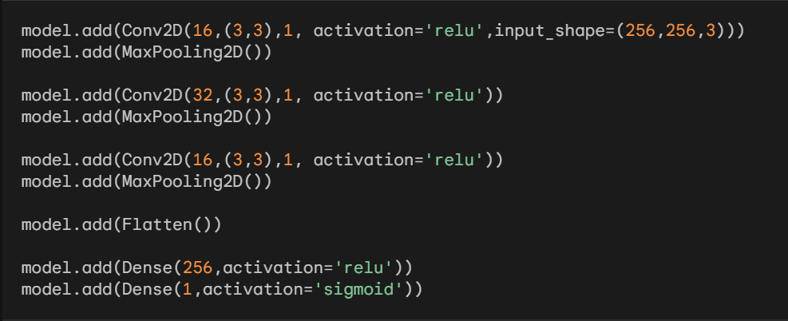
CNN Model

Slide 11
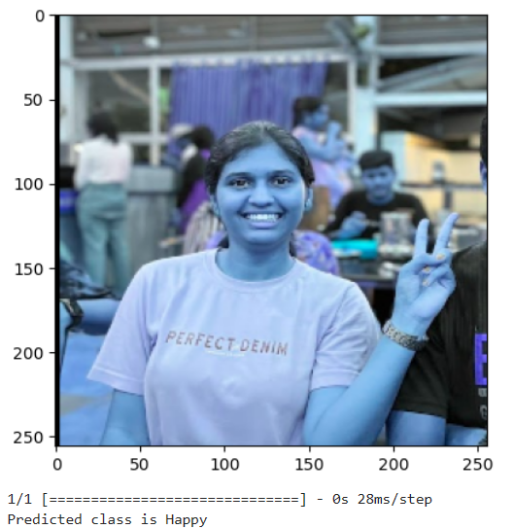
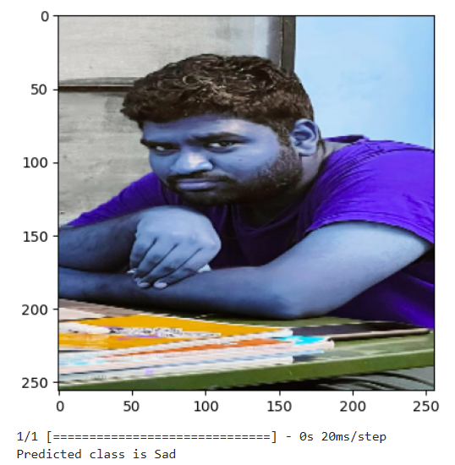
Live Results

Slide 12
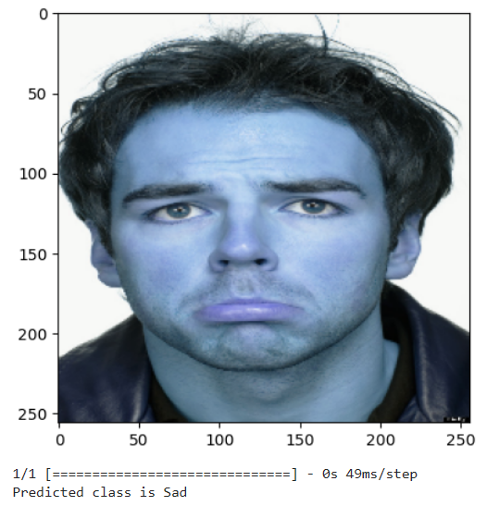
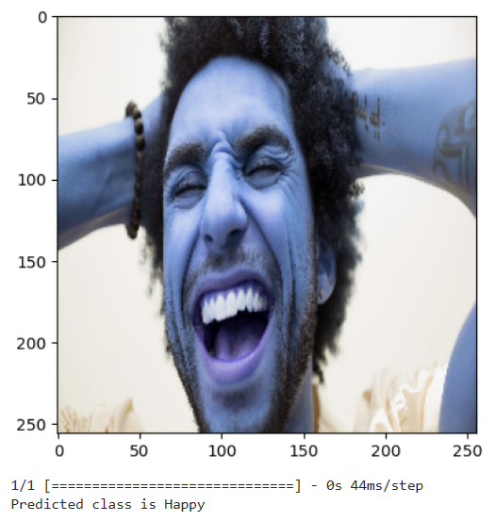
Results from Dataset

Slide 13
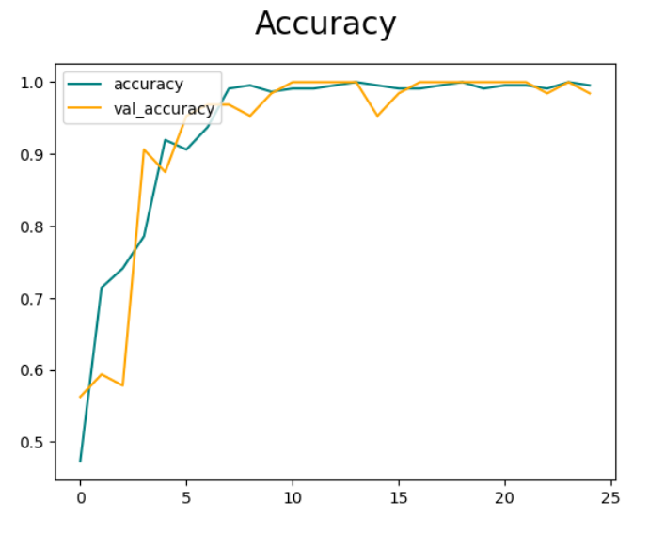

Slide 14

Conclusion
The CNN model effectively classified images with people faces, identifying the emotion being expressed by the person in each image, specifically whether they were happy or sad. The model demonstrated high accuracy in its classification, indicating its potential for real-world applications such as mood detection or emotion recognition.

Slide 15

Future Scope
The human emotion recognition systems offer a powerful tool for understanding human emotions, enhancing human-computer interaction, improving security and surveillance, personalizing education and training, providing accessibility aids, supporting mental health, promoting cross-cultural understanding, and advancing robotics. As this technology continues to evolve, we can expect to see even more groundbreaking applications emerge in the future

Slide 16

Thank You
22MDT0116 KIRAN DESHPANDE 22MDT0093 VAMSHI KRISHNA

