Slide 1
Frameworks for Safe Reinforcement Learning
CSE 598: AI Safety & Assessment - Spring 2024 - Final Project Presentation
Group #6: Kiran S (ksthanus@asu.edu)

Slide 2





Safe Reinforcement Learning
Formulated using Constrained Markov Decision Processes.
[1] Gu, Shangding & Yang, Long & Du, Yali & Chen, Guang & Walter, Florian & Wang, Jun & Yang, Yaodong & Knoll, Alois. (2022). A Review of Safe Reinforcement Learning: Methods, Theory and Applications. 10.48550/arXiv.2205.10330.

Slide 3
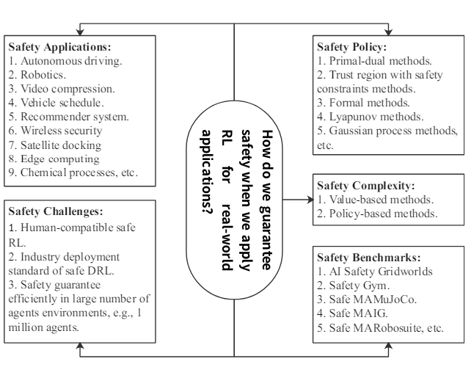
Aspects of Safe Reinforcement Learning
[1] Gu, Shangding & Yang, Long & Du, Yali & Chen, Guang & Walter, Florian & Wang, Jun & Yang, Yaodong & Knoll, Alois. (2022). A Review of Safe Reinforcement Learning: Methods, Theory and Applications. 10.48550/arXiv.2205.10330.

Slide 4
The Need for Infrastructures in Safe RL
Open-source, Unified, Comprehensive & Easily Extensible.
Maintainable.
High-performance.
Ease of benchmarking for different kinds of Safe RL Algorithms: Off-Policy, On-Policy, Offline, Model-based.

Slide 5
Existing Frameworks / Infrastructures
Not that many!
Safety Starter Agent for Benchmarking Safe Exploration in Deep Reinforcement Learning - OpenAI (2019)
Not maintained - only built on TensorFlow v1 backend!
Safety Gymnasium
Bullet Safety Gym

Slide 6
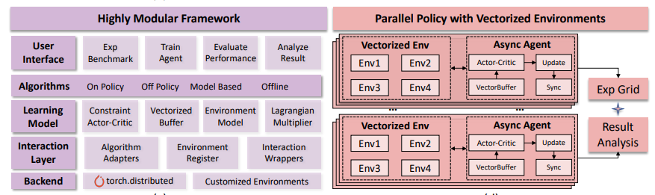
Framework #1: OmniSafe
\graphicspath{{./Screenshots}}
[2] Ji, Jiaming & Zhou, Jiayi & Zhang, Borong & Dai, Juntao & Pan, Xuehai & Sun, Ruiyang & Huang, Weidong & Yiran, Geng & Liu, Mickel & Yang, Yaodong. (2023). OmniSafe: An Infrastructure for Accelerating Safe Reinforcement Learning Research.

Slide 7
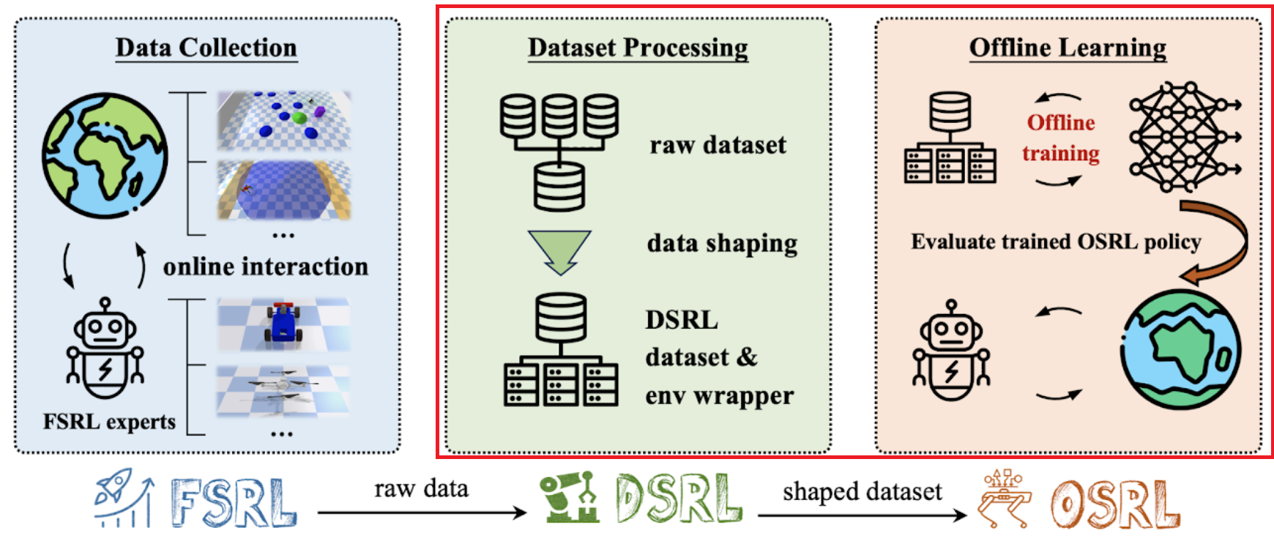
Framework #2 - OSRL Suite
[3] Liu, Zuxin & Guo, Zijian & Lin, Haohong & Yao, Yihang & Zhu, Jiacheng & Cen, Zhepeng & Hu, Hanjiang & Yu, Wenhao & Zhang, Tingnan & Tan, Jie & Zhao, Ding. (2023). Datasets and Benchmarks for Offline Safe Reinforcement Learning.

Slide 8
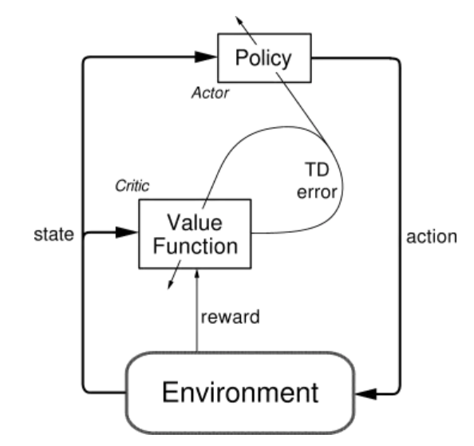
Preliminaries - #1 - Actor-Critic Architecture
[4] Sutton, R. S., & Barto, A. G. (2018). Reinforcement learning: An introduction (2nd ed.). The MIT Press.

Slide 9
Online Algorithms - #1
Policy Gradient
Aims to directly optimize the policy parameters to maximize the expected cumulative reward.
Gradient Ascent to update policy parameters in direction of higher expected reward.
Trust Region Policy Optimization (TRPO)
Policy optimization algorithm designed to improve stability and sample efficiency in policy gradient methods.
Introduces a trust region constraint: ensures that new policy does not deviate too much from current policy.
Maximizes a surrogate objective function while limiting the KL divergence between the new and old policies.
Proximal Policy Optimization (PPO)
Similar ideas to TRPO, but more efficient.
Uses Generalized Advantage Estimation (GAE) to correctly estimate taking specific actions in a given state - these advantages are used to construct the surrogate objective function.
Additional clipping mechanism to ensure stable updates & prevent large policy changes.

Slide 10
Online Algorithms - #2
Conservative Policy Optimization (CPO)
Derivative of TRPO
Introduces a safety constraint that explicitly limits the likelihood of the policy performing poorly in any state.
CPO optimizes the policy by maximizing a conservative objective function subject to this safety constraint.
Provably Convergent Policy Optimization (PCPO)
Extension of CPO that aims to provide theoretical guarantees on convergence and optimality.
Introduces additional regularization terms to the objective function to ensure convergence to a globally optimal policy.
Computationally Expensive.

Slide 11
Offline Algorithms - #1
Batch-Constrained Q-Learning (BCQ)
Behavioural Cloning & Behavioral Policy.
Soft Q-Learning.
Regularization.
Constrained Penalty Q-learning (CPQ)
Penalty Term: Introduces a penalty term to the Q-Learning Function - prioritizes actions which are both optimal and safe.
Regularization techniques to ensure learned policy remains close to behavioural policy.

Slide 12

Metrics for Evaluation
Cumulative Discounted Reward - Maximize!
Overall Cost - Minimize!

Slide 13
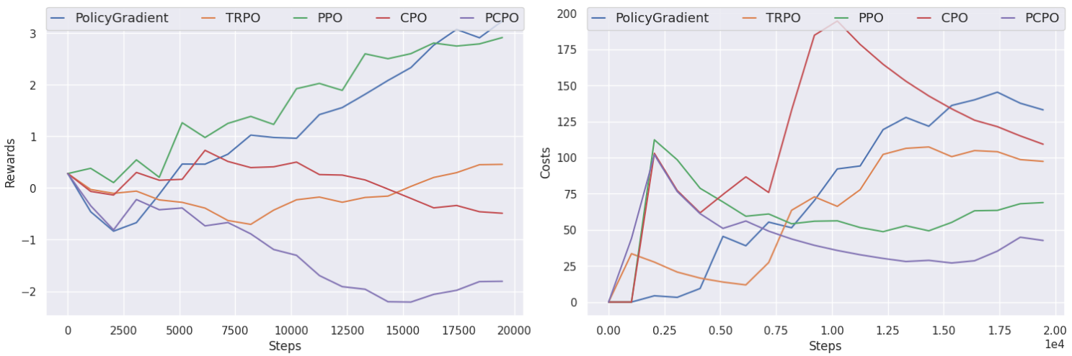
OmniSafe Results #1 - Env: Safety Point Goal

Slide 14
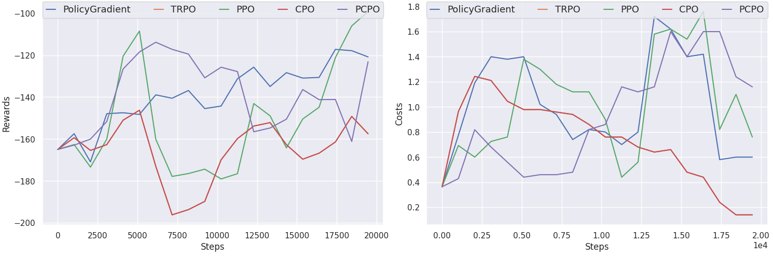
OmniSafe Results #2 - Env: Safety AntVelocity

Slide 15
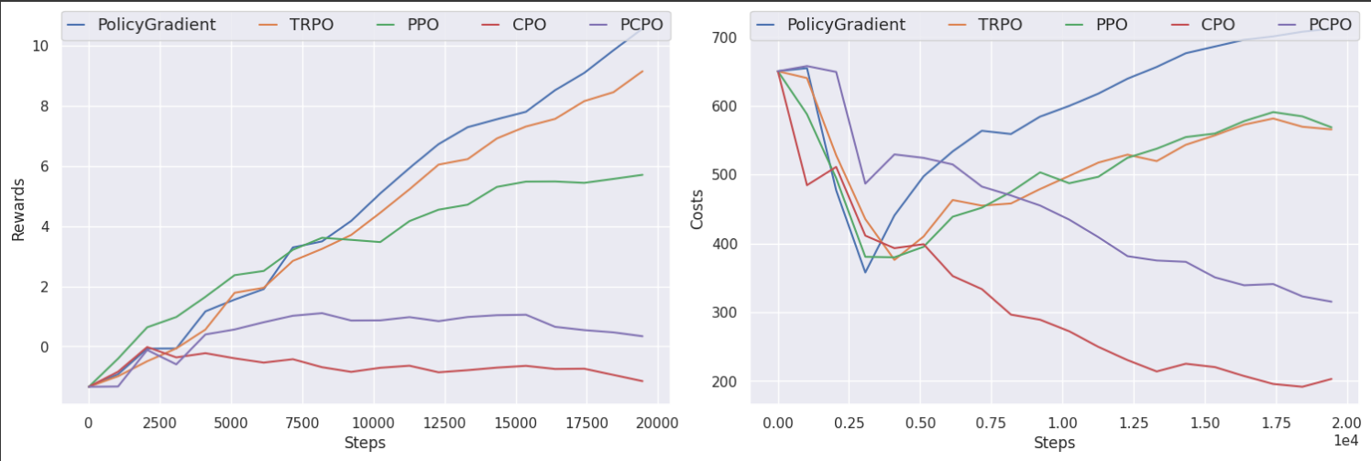
OmniSafe Results #3 - Env: Safety Car Circle

Slide 16
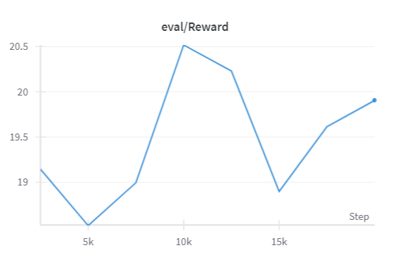
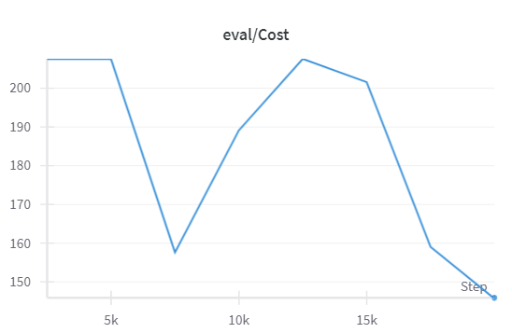
OSRL Suite Results #1 - Algo: BCQ Env: Safety Car Circle

Slide 17
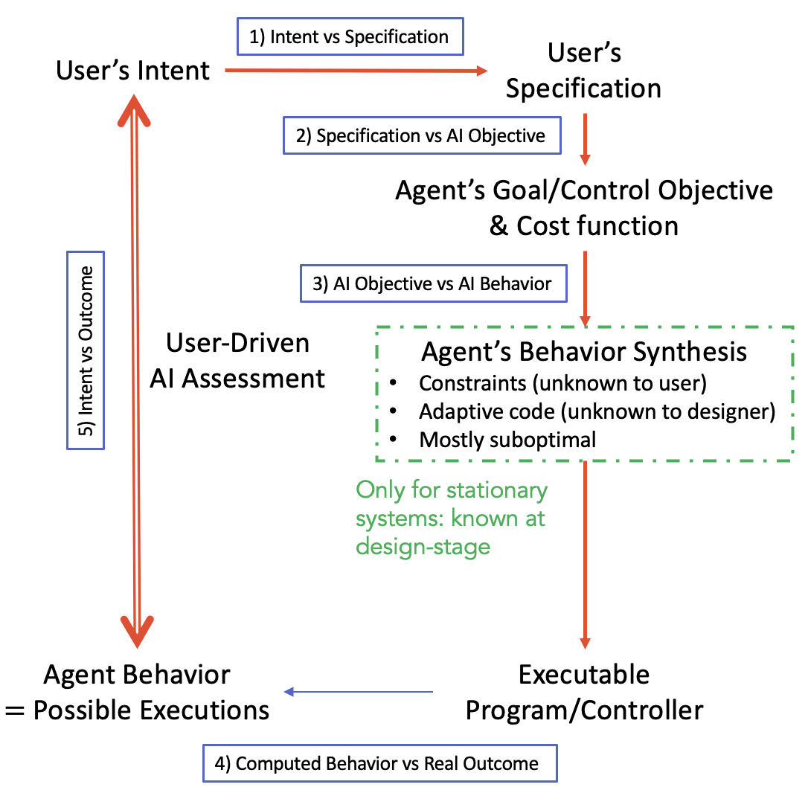
The Safety Dimensions!
NO
NO
YES
NO
NO
‹#›

Slide 18
Contributions & Learning Outcomes
Solo project!
Worked on Reinforcement Learning fundamentals- implementing Policy Gradient algorithm using OpenAI Spinner RL framework (used for Deep RL experiments)
Thorough investigation and understanding of Omnisafe framework - ran algorithms for several environments and conditions.
Thorough investigation of OSRL Suite - specific to Offline RL Algorithms.
OmniSafe is beginner-friendly and compatible for advanced RL research - modular and extensible.
OSRL Suite provides a different flavour for large-scale dataset collection for improving training paradigms in Offline Reinforcement Learning scenarios.
Deep Reinforcement Learning is really difficult!
Even for simple environments and actor-critic models, convergence to optimal solution usually takes a long time (contrary to more traditional deep learning use cases).
Computationally expensive.

Slide 19
Remaining Deliverables
Consolidating results acquired for Offline Learning Algorithms achieved using OSRL with the Online Algorithms used in OmniSafe.
Implementing the Constrained-Policy Q-Learning (CPQ) Offline RL Algorithm (available in OSRL) in OmniSafe - including methods for plugging in datasets available for the test environments presented.

Slide 20
References
[1] Gu, Shangding & Yang, Long & Du, Yali & Chen, Guang & Walter, Florian & Wang, Jun & Yang, Yaodong & Knoll, Alois. (2022). A Review of Safe Reinforcement Learning: Methods, Theory and Applications. 10.48550/arXiv.2205.10330.
[2] Ji, Jiaming & Zhou, Jiayi & Zhang, Borong & Dai, Juntao & Pan, Xuehai & Sun, Ruiyang & Huang, Weidong & Yiran, Geng & Liu, Mickel & Yang, Yaodong. (2023). OmniSafe: An Infrastructure for Accelerating Safe Reinforcement Learning Research.
[3] Liu, Zuxin & Guo, Zijian & Lin, Haohong & Yao, Yihang & Zhu, Jiacheng & Cen, Zhepeng & Hu, Hanjiang & Yu, Wenhao & Zhang, Tingnan & Tan, Jie & Zhao, Ding. (2023). Datasets and Benchmarks for Offline Safe Reinforcement Learning.
[4] Sutton, R. S., & Barto, A. G. (2018). Reinforcement learning: An introduction (2nd ed.). The MIT Press.

Slide 21
THANK YOU! QUESTIONS?

Slide 22
Preliminaries - #2
Online Reinforcement Learning
Actively interact with the environment, collecting data in real-time as they learn.
Allows for adaptation to changing environments => Better generalization to unseen states.
Examples: Policy Gradient, Proximal Policy Optimization (PPO), Trust Region Policy Optimization (TRPO)
Offline Reinforcement Learning
Learn from a fixed dataset of experiences without actively interacting with the environment.
Examples: BCQ (Batch Constrained Q-learning), and BEAR (Batch Constrained Deep Q-learning from Demonstrations)

Slide 23
Definitions - #1
Actor
Role is to learn a policy that maps states to actions, aiming to maximize the expected cumulative reward over time.
Represented as a parametrized function (eg: Neural networks).
Critic
Responsible for evaluating the quality of actions or states, i.e. the Value / Q-Function in value-based methods.
Actor-Critic
Class of RL algorithms that combines both actor and critic components.
Leverage the advantages of both policy gradient and value-based approaches, offering a balance between sample efficiency and stability in learning.
A2C (Advantage Actor-Critic), DDPG (Deep Deterministic Policy Gradient)

