Slide 1
Data Structures
Maryam Imtiaz Malik
maryam.imtiaz@numl.edu.pk

Slide 2
Infix to PostFix
Scan X from left to right and repeat Step 2 to 5 for each element of X until the Stack is empty.
If an operand is encountered, add it to Y.
If a left parenthesis is encountered, push it onto Stack.
If an operator is encountered ,then:
Repeatedly pop from Stack and add to Y each operator (on the top of Stack) which has the same precedence as or higher precedence than operator.
Add operator to Stack.
If a right parenthesis is encountered ,then:
Repeatedly pop from Stack and add to Y each operator (on the top of Stack) until a left parenthesis is encountered.
Remove the left Parenthesis.

Slide 3
Infix to Postfix Conversion
Symbol Scanned | Stack | Output
( | ( | -
a | ( | a
+ | ( + | a
b | ( + | a b
) |  | a b +
* | * | a b +
( | * ( | a b +
c | * ( | a b + c
+ | * ( + | a b + c
d | * ( + | a b + c d
) | * | a b + c d +
 |  | a b + c d + *
(a + b) * (c + d)

Slide 4
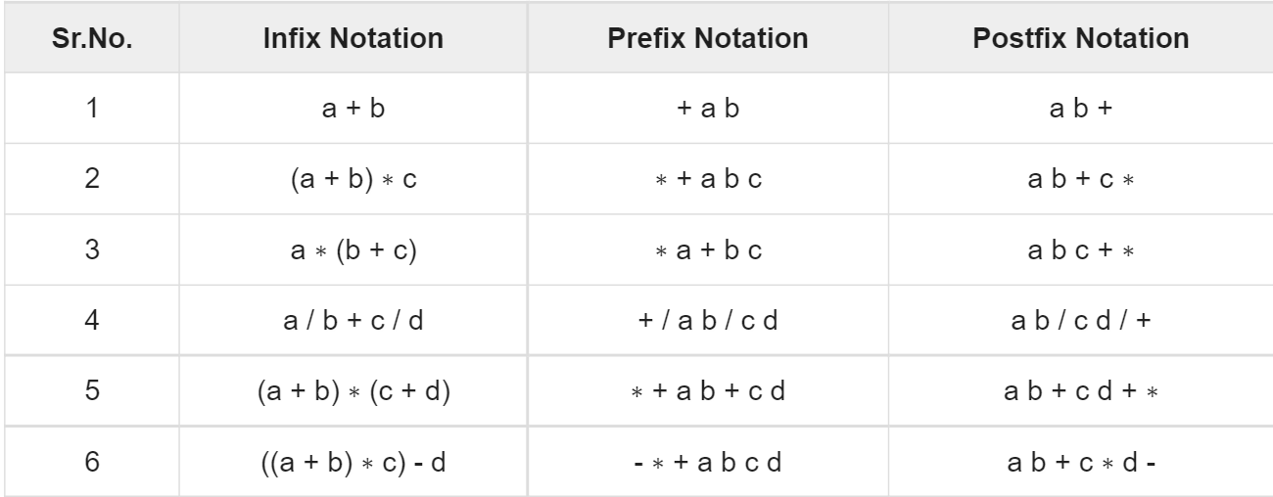
Example

Slide 5
Evaluation of Postfix Expression
Step 1: Create an empty stack used for storing the operands.
Step 2: Scan each element of an expression one be one and do the following:
If the element is an operand then push it into the stack.
If the element is an operator then pop two operands from the stack. Perform operation on these operands. Push the final result into the stack.

Slide 6
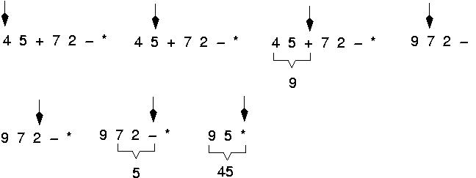
Evaluate Postfix Expression
Expressions are evaluated from left to right.

Slide 7
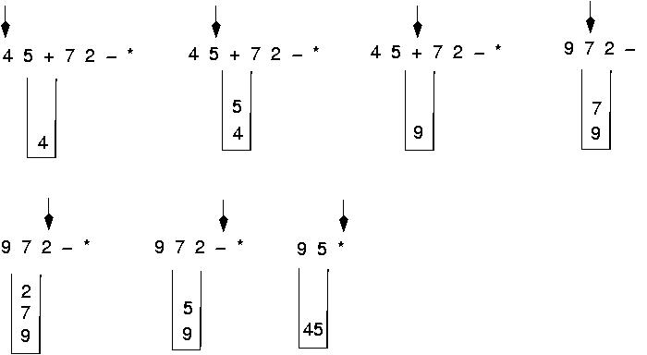
Postfix Expression

