Slide 1
Data Structures
Maryam Imtiaz Malik
maryam.imtiaz@numl.edu.pk

Slide 2
What is a stack?
It is an ordered group of homogeneous items.
Items are added to and removed from the top of the stack
LIFO property: Last In, First Out
The last item added would be the first to be removed
TOP OF THE STACK
TOP OF THE STACK

Slide 3
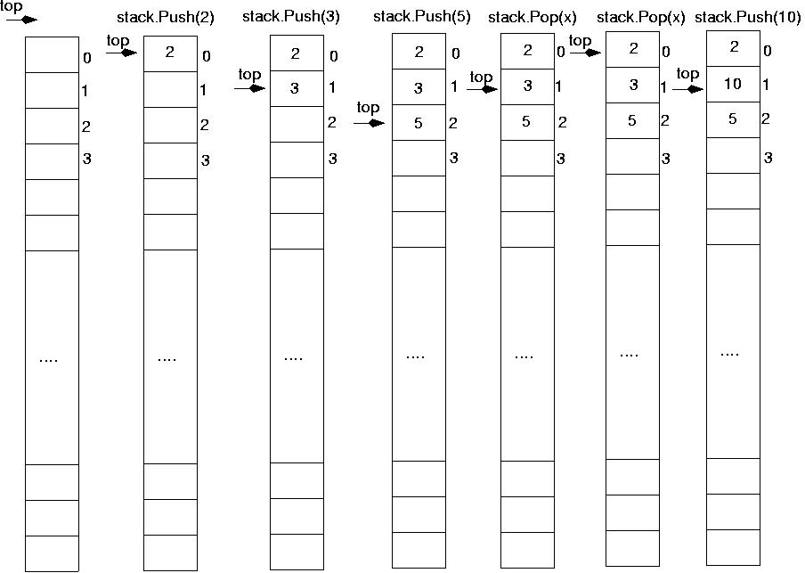
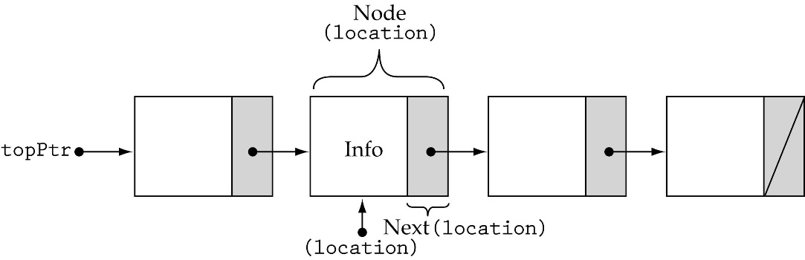
Stack Implementations
Array-based
Linked-list-based

Slide 4
Array-based Stacks
template<class ItemType>
class StackType {
public:
StackType(int);
~StackType();
bool IsEmpty() const;
bool IsFull() const;
ItemType Top() const;
void Push(ItemType);
void Pop();
private:
int top, maxStack;
ItemType *items;
};
dynamically allocated array

Slide 5
Array-based Stacks (cont’d)
template<class ItemType>
StackType<ItemType>::StackType(int size)
{
top = -1;
maxStack = size;
items = new ItemType[maxStack];
}
template<class ItemType>
StackType<ItemType>::~StackType()
{
delete [ ] items;
}
O(1)
O(1)

Slide 6
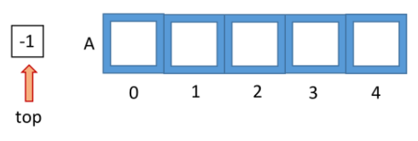
Array-based Stacks (cont.)
template<class ItemType>
bool StackType<ItemType>::IsEmpty() const
{
return (top == -1);
}
template<class ItemType>
bool StackType<ItemType>::IsFull() const
{
return (top == maxStack-1);
}
O(1)
O(1)

Slide 7
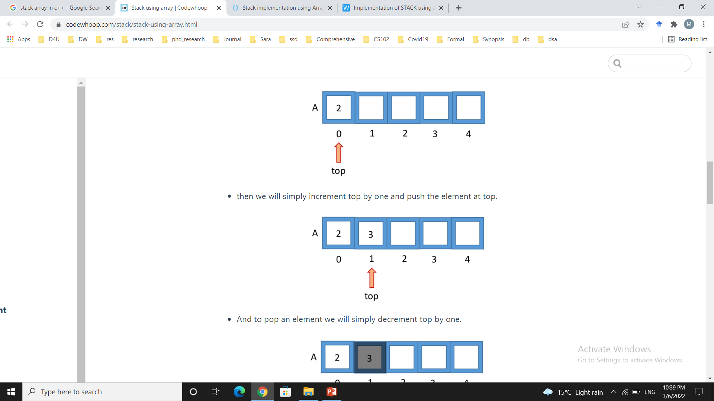
Push (ItemType newItem)
Function: Adds newItem to the top of the stack.
Preconditions: Stack has been initialized and is not full.
Postconditions: newItem is at the top of the stack.

Slide 8
Stack overflow
The condition resulting from trying to push an element onto a full stack.
if(!stack.IsFull())
stack.Push(item);

Slide 9
Array-based Stacks (cont.)
template<class ItemType>
void StackType<ItemType>::Push(ItemType newItem)
{
top++;
items[top] = newItem;
}
O(1)

Slide 10
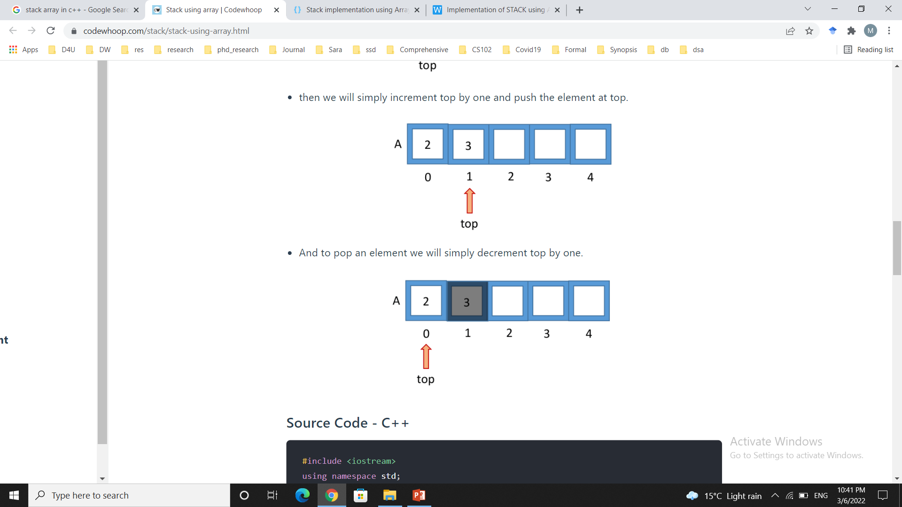
Pop (ItemType& item)
Function: Removes topItem from stack and returns it in item.
Preconditions: Stack has been initialized and is not empty.
Postconditions: Top element has been removed from stack and item is a copy of the removed element.

Slide 11
Stack underflow
The condition resulting from trying to pop an empty stack.
if(!stack.IsEmpty())
stack.Pop(item);

Slide 12
Array-based Stacks (cont.)
template<class ItemType>
void StackType<ItemType>::Pop()
{
top--;
}
O(1)

Slide 13
Array-based Stacks (cont.)
template<class ItemType>
ItemType StackType<ItemType>::Top() const
{
return items[top];
}
O(1)

