Slide 1
Hands-On Hadoop Tutorial
Chris Sosa
Wolfgang Richter
May 23, 2008

Slide 2
General Information
Hadoop uses HDFS, a distributed file system based on GFS, as its shared filesystem
HDFS architecture divides files into large chunks (~64MB) distributed across data servers
HDFS has a global namespace

Slide 3
General Information (cont’d)
Provided a script for your convenience
  Run source /localtmp/hadoop/setupVars from centurtion064
  Changes all uses of {somePath}/command to just command
Goto http://www.cs.virginia.edu/~cbs6n/hadoop for web access. These slides and more information are also available there.
Once you use the DFS (put something in it), relative paths are from /usr/{your usr id}. E.G. if your id is tb28 … your “home dir” is /usr/tb28

Slide 4
Master Node
Hadoop currently configured with centurion064 as the master node
Master node
  Keeps track of namespace and metadata about items
  Keeps track of MapReduce jobs in the system

Slide 5
Slave Nodes
Centurion064 also acts as a slave node
Slave nodes
  Manage blocks of data sent from master node
  In terms of GFS, these are the chunkservers
Currently centurion060 is also another slave node

Slide 6
Hadoop Paths
Hadoop is locally “installed” on each machine
  Installed location is in /localtmp/hadoop/hadoop-0.15.3
  Slave nodes store their data in /localtmp/hadoop/hadoop-dfs (this is automatically created by the DFS)
  /localtmp/hadoop is owned by group gbg (someone in this group must administer this or a cs admin)
Files are divided into 64 MB chunks (this is configurable)

Slide 7
Starting / Stopping Hadoop
For the purposes of this tutorial, we assume you have run the setupVars from earlier
start-all.sh – starts all slave nodes and master node
stop-all.sh – stops all slave nodes and master node

Slide 8
Using HDFS (1/2)
hadoop dfs
  [-ls <path>]
  [-du <path>]
  [-cp <src> <dst>]
  [-rm <path>]
  [-put <localsrc> <dst>]
  [-copyFromLocal <localsrc> <dst>]
  [-moveFromLocal <localsrc> <dst>]
  [-get [-crc] <src> <localdst>]
  [-cat <src>]
  [-copyToLocal [-crc] <src> <localdst>]
  [-moveToLocal [-crc] <src> <localdst>]
  [-mkdir <path>]
  [-touchz <path>]
  [-test -[ezd] <path>]
  [-stat [format] <path>]
  [-help [cmd]]

Slide 9
Using HDFS (2/2)
Want to reformat?
Easy
  hadoop namenode –format
Basically we see most commands look similar
  hadoop “some command” options
  If you just type hadoop you get all possible commands (including undocumented ones – hooray)

Slide 10
To Add Another Slave
This adds another data node / job execution site to the pool
  Hadoop dynamically uses filesystem underneath it
  If more space is available on the HDD, HDFS will try to use it when it needs to
Modify the slaves file
  In centurion064:/localtmp/hadoop/hadoop-0.15.3/conf
  Copy code installation dir to newMachine:/localtmp/hadoop/hadoop-0.15.3 (very small)
  Restart Hadoop

Slide 11
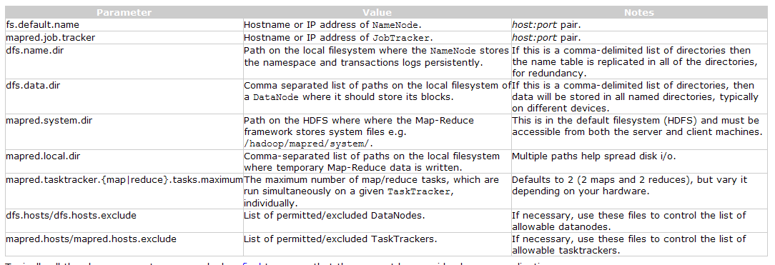
Configure Hadoop
Can configure in {$installation dir}/conf
  hadoop-default.xml for global
  hadoop-site.xml for site specific (overrides global)

Slide 12

That’s it for Configuration!

Slide 13
Real-time Access

