Slide 1
IEEE STANDARDS
In 1985, the Computer Society of the IEEE started a project, called Project 802, to set standards to enable intercommunication among equipment from a variety of manufacturers. Project 802 is a way of specifying functions of the physical layer and the data link layer of major LAN protocols

Slide 2

IEEE standard for LANs
13.<number>

Slide 3
The Data Link Layer is divided into two Part MAC Media Access Control) Sublayer and LLC (Logic Link Control) Sublayer
Ethernet and Wi-Fi are both “multi-access” technologies
  Broadcast medium, shared by many hosts
  Simultaneous transmissions will result in collisions
Media Access Control (MAC) protocol required
  Rules on how to share medium

Slide 4

Ethernet evolution through four generations
13.<number>

Slide 5

802.3 MAC frame
13.<number>

Slide 6
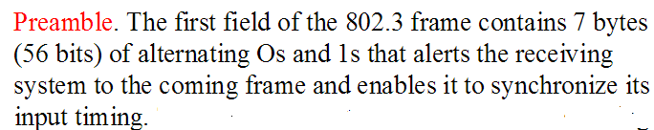


Slide 7
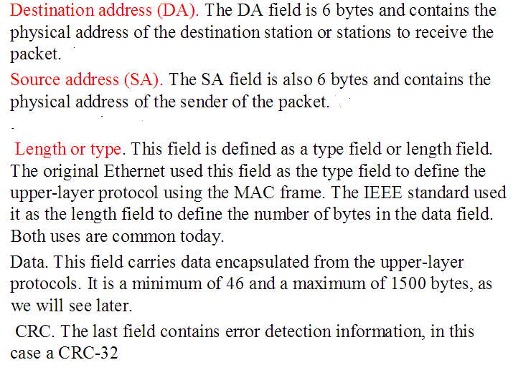

Slide 8

Minimum and maximum lengths
13.<number>

Slide 9
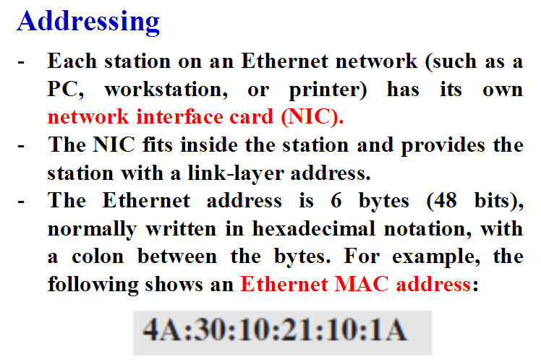

Slide 10
Unicast , Multicast and Broadcast
To find the type of the address, we need to look at the second hexadecimal digit from the left. If it is even, the address is unicast. If it is odd, the address is multicast. If all digits are F’s, the address is broadcast.
Example
4A:30:10:21:10:1A - unicast because A in binary is 1010(even)
b. 47:20:1B:2E:08:EE - multicast address because 7 in binary is 0111 (odd)
c. FF:FF:FF:FF:FF:FF - broadcast address because all digits are F’s.

Slide 11
Unicast
Unicast is the term used to describe communication where a piece of information is sent from one point to another point. In this case there is just one sender, and one receiver.
Unicast transmission, in which a packet is sent from a single source to a specified destination.
Broadcast
Broadcast is the term used to describe communication where a piece of information is sent from one point to all other points. In this case there is just one sender, but the information is sent to all connected receivers.
Broadcast transmission is supported on most LANs (e.g. Ethernet)
Multicast
Multicast is the term used to describe communication where a piece of information is sent from one or more points to a set of other points. In this case there is may be one or more senders, and the information is distributed to a set of receivers (theer may be no receivers, or any other number of receivers).
One example of an application which may use multicast is a video server sending out networked TV channels.

Slide 12
Ethernet CSMA/CD
CSMA/CD- 1 persistent (carrier sense multiple access with collision detection) media access protocol is used.
    Data is transmitted in the form of packets.
    Sense channel prior to actual packet transmission.
    Transmit packet only if channel is sensed idle; else, defer the transmission until channel becomes idle.
    After packet transmission is started, the node monitors its own transmission to see if the packet has experienced a collision.
    If the packet is observed to be undergoing a collision, the transmission is aborted and the packet is retransmitted after a random interval of time using Binary Exponential Backoff algorithm.

Slide 13

Categories of Standard Ethernet
All uses Manchester Encoding
Topology
Cable
Thick Ethernet/
Thicknet
Thin Ethernet/
Cheapernet
Twisted pair
Ethernet

Slide 14
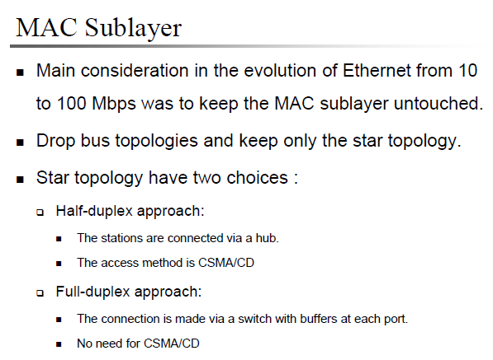
FAST ETHERNET
Fast Ethernet was designed to compete with LAN protocols such as FDDI or Fiber Channel. IEEE created Fast Ethernet under the name 802.3u. Fast Ethernet is backward-compatible with Standard Ethernet, but it can transmit data 10 times faster at a rate of 100 Mbps.

Slide 15

Fast Ethernet topology

Slide 16
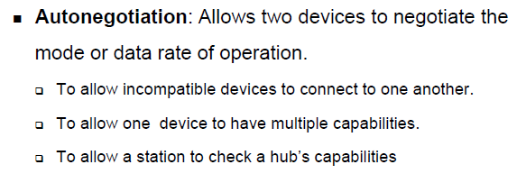
New feature added to the Fast Ethernet

Slide 17

Fast Ethernet implementations

Slide 18
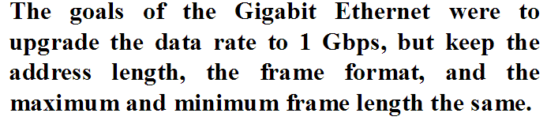
GIGABIT ETHERNET
The need for an even higher data rate resulted in the design of the Gigabit Ethernet protocol (1000 Mbps). The IEEE committee calls the standard 802.3z.
MAC Sublayer
For medium access – Half duplex and Full duplex mode
Carrier Extension – To allow for a longer network, frame length is increased.
Frame bursting – The carrier extension is inefficient if there are series short frames to send. To improve efficiency, frame bursting or multiple frames are sent.

Slide 19

Physical Layer : Topologies of Gigabit Ethernet
13.<number>

Slide 20

Summary of Gigabit Ethernet implementations

Slide 21
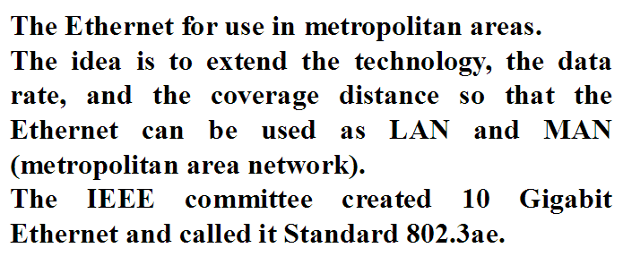

10 Gigabit Ethernet

Slide 22
