Slide 1


A Study of Rare Earth Element Abundance in Various Locations Worldwide; Statistical Approach
Presented by
Kiran Vishnu Sanap
Under the guidance of
Dr. Mohan Manohar Kale
Head of department,
Department of Statistics,
Savitribai Phule Pune University

Slide 2

What are Rare Earth Elements?
Rare Earth Elements (REEs) are 17 metallic elements with special magnetic, optical, and chemical properties used in modern technology.
Place in Periodic Table
REEs belong to the Lanthanide series (La–Lu) in the f-block, plus Scandium (Sc) and Yttrium (Y).
Which Elements Are REEs?
La, Ce, Pr, Nd, Pm, Sm, Eu, Gd, Tb, Dy, Ho, Er, Tm, Yb, Lu,Sc,Y
Total = 17 REEs
Light REEs, Heavy REEs & Oxides
  Light REEs (LREEs):
  La, Ce, Pr, Nd, Pm, Sm, Eu
  More common, used in magnets, catalysts, polishing.
  Heavy REEs (HREEs):
  Gd, Tb, Dy, Ho, Er, Tm, Yb, Lu + Y
  Rarer, used in high-strength magnets, lasers, advanced tech.
  REE Oxides (REOs):
  REEs are mainly found as oxides such as La₂O₃, CeO₂, Nd₂O₃, Dy₂O₃, etc.

Slide 3
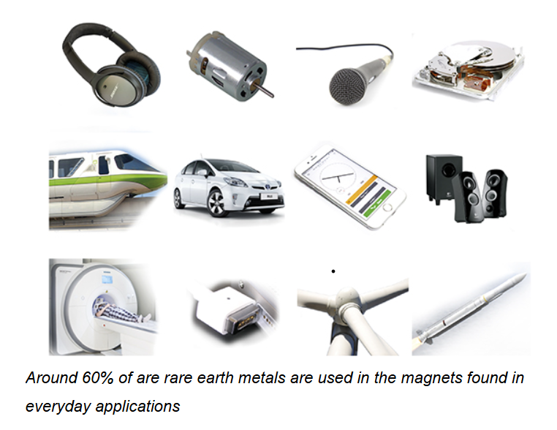
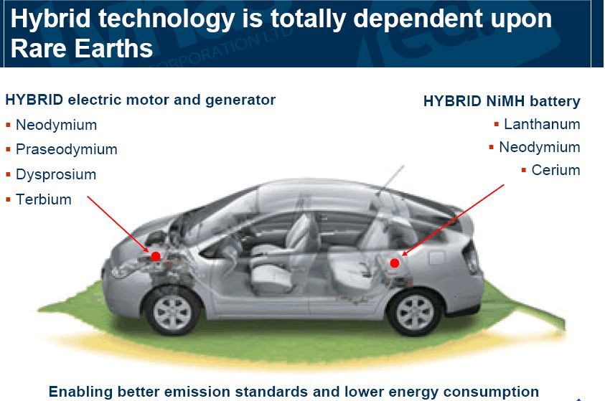

REEs Are Everywhere Around Us, Yet Invisible
REEs are hidden inside devices we use every day.
Essential for making strong, permanent magnets.
Used in electronics, vehicles, medical machines, speakers, nd trains.
About 60% of REEs go into magnet-based applications.
Motors & generators use Nd, Pr, Dy, Tb for powerful magnets.
NiMH batteries contain La, Nd, Ce to store energy efficiently.
REEs enable better fuel efficiency, lower emissions, and improved performance.
Screens use Eu, Tb, Y for bright colors.
Microphones & vibration motors use Nd, Dy, Gd for strong tiny magnets.
Cameras use La and Y for high-quality lenses.
Batteries & circuitry include La, Pr, Nd for stable power and performance.

Slide 4
Aim/Objectives
1. Study the abundance and distribution of Rare Earth Elements (REEs) across multiple rock types.
2. Compare REE patterns from different geological sites around the world.
3. Apply statistical and geochemical methods to evaluate REE behavior in various lithologies.
4. Identify enrichment trends, fractionation patterns, and anomalies within REE datasets.
5. Assess the geological significance and resource potential of REE-bearing rocks.
6. Provide data-driven insights to support exploration and geochemical interpretations.

Slide 5
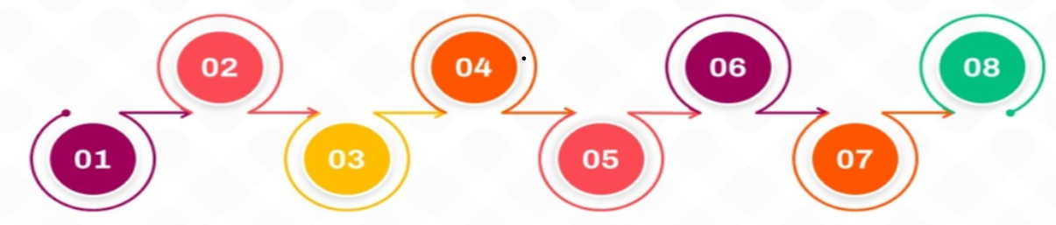
Methodology Followed
Skewness
Skewness shows how asymmetric a distribution is.
0 = symmetrical (normal).
Positive > 0 = right-tailed.
Negative < 0 = left-tailed.
Helps choose suitable statistical methods in REE analysis.
Log Transformation
Square root transformation applied.
Reduces skewness.
Stabilizes variance.
Lessens extreme values’ effect.
Makes data suitable for analysis.
Cluster Profiling
Profiled clusters after K-Means & Hierarchical.
Checked key variables per cluster.
Found trends and features.
Labeled clusters clearly.
Shows patterns for decisions.
ANOVA
Used One-Way ANOVA to check group differences.
Used High-Dimensional Hotelling’s T^2 test for multivariate differences.
Missing Data Imputation
Outliers present in data.
Missing values filled with median.
Median gives stable, reliable replacement.
Kurtosis
Kurtosis shows how peaked or heavy-tailed a distribution is.
Kurtosis = 3: Normal (mesokurtic).
Kurtosis > 3: Leptokurtic — heavier tails, sharper peak, more outliers.
Clustering
Clustering groups similar data.
Methods: K-means, Hierarchical, DBSCAN.
Hierarchical shows tree (dendrogram).
No set cluster number needed.
Helps classify REE samples.
Shows patterns nd relationship
Regression Analysis
Regression shows variable relationships.
Predicts trends and associations.
Elastic Net = Lasso + Ridge.
Handles many correlated variables.
Shrinks coefficients, selects features.
Prevents overfitting.

Slide 6
Data Description
Parameter | Bayan Obo (China) | Belaya Zima (Russia) | Fen Complex (Norway)
Location | Inner Mongolia, China | Eastern Sayan Mountains, Siberia, Russia | Telemark region, Norway
Geological Setting | World’s largest REE carbonatite deposit | Carbonatite–silicate intrusive complex | Classical carbonatite complex & type locality
Rock Types in Dataset | Carbonatite (Cbt) & Fenite (Ft) | Melteigite (M), Ijolite (I), Alkaline Syenite (A), Calcite–Dolomite Carbonatite (CD), Ankerite Carbonatite (AC) | Carbonatite (C), Transitional Carbonatite (TWC), Rødbergite (R), Transitional Rødbergite (TRE)
Sample Count (Given) | 149 | 1,104 | 542
Missing Values | 19 | 116 | 8
Total Observations | 168 | 1,220 | 550
Number of Elements Measured | 14 REEs (La–Lu) | 70+ elements (Major oxides, trace elements & REEs) | 22 elements (REEs + HFSE + La/Yb ratio)
Notable Features | Largest global REE reserves; strong LREE enrichment | Highly variable REE patterns; strong enrichment in CD & AC | Classic LREE-enriched carbonatite system; significant Nb–Th–REE enrichment
Key Rock Examples | 90/39, 90/43, 90/44, 90/48 (Cbt); 90/49, 90/51 (Ft) | 2309/109–114 (M); C1-135-144 (A); c411/25-34 (CD) | 15-82, 15-83 (C); 15-86 (R); 15-91 (TRE)

Slide 7
Summary Statistics
Site | Average REE/Element Behavior | Variability (SD / Range) | Overall Geochemical Pattern
Bayan Obo (China) | • Cbt: Very high REEs (~1,000–15,000) • Ft: Very low REEs (~9–420) | • Cbt: Very high SD (24,000–33,000) • Ft: Low–moderate variation | • Strong LREE enrichment • Fenites reflect metasomatic alteration • Clear Cbt–Ft geochemical separation
Belaya Zima (Russia) | • CD & AC: Highest mean values • M/I/A: Lower & stable | • CD & AC: Extremely high SD & wide ranges • M/I/A: Low SD (more stable) | • Highly heterogeneous • Strong enrichment in CD & AC • Clear low → high trend (M/I/A → CD/AC)
Fen Complex (Norway) | • C & TWC: Low–moderate averages • R & TRE: Highest REE averages | • C/TWC: Low variation • R & TRE: High variation, wide ranges | • Classic carbonatite pattern • Strong LREE enrichment • TRE consistently most enriched

Slide 8

Dealing with missing data:
Dataset contained outliers and skewed distributions.
Median imputation was chosen to avoid distortion from extreme values.
Median provides a robust and stable replacement for missing data.
Bayan Obo
NRMSE = 0.0675 (~6.7%)
Indicates excellent performance
2) Belaya Zima
NRMSE = 0.0321 (3%)
Highly accurate imputation
3) Fen
NRMSE = 0.1631 (16%)
Indicates good but slightly higher error
Log Transformation: To address skewness and stabilize the variance in the dataset, a log transformation was applied to our data set.

Slide 9
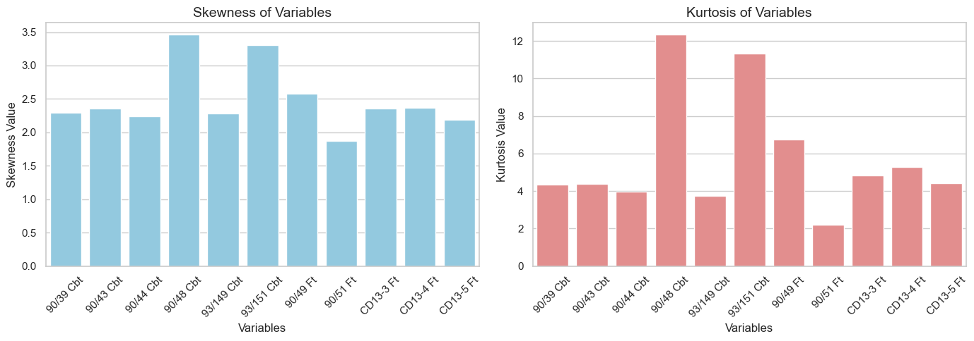
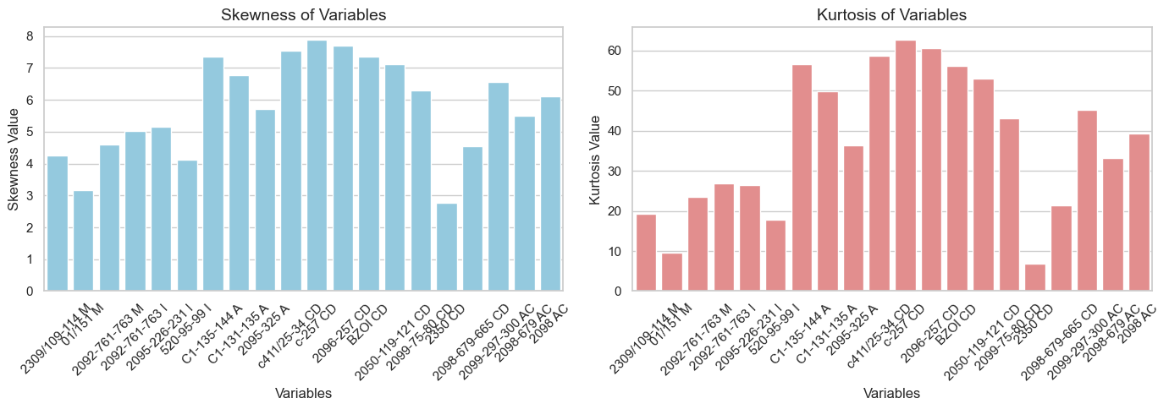
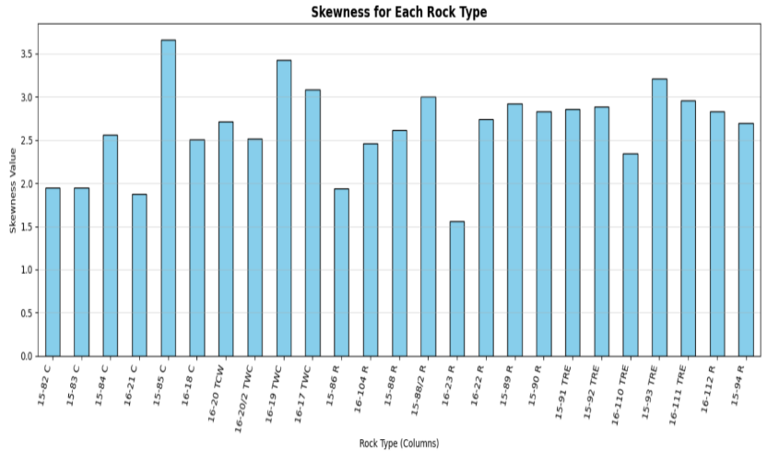
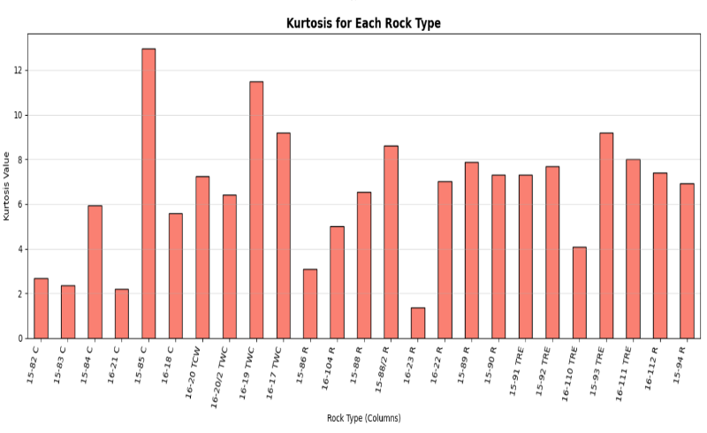
Skewness And Kurtosis
Bayan Obo – China
Skewness - 1.87 – 3.47
Kurtosis – 2.19 – 12.35
Mostly positive skew; data moderately to highly right-skewed. Leptokurtic, peaked distributions with occasional extreme values.
Belaya zima – Russia
Skewness – 3.07 – 7.65
Kurtosis – 8.95 – 59.26
Highly positive skew; strong right tails and extreme values. Leptokurtic to extremely leptokurtic, sharp peaks indicate non-normality.
Fen – Norway
Skewness – 1.5 – 3.5
Kurtosis – >3 (some >10)
Right-skewed; few large values influence results. Leptokurtic, heavy tails, reflecting natural variability.

Slide 10
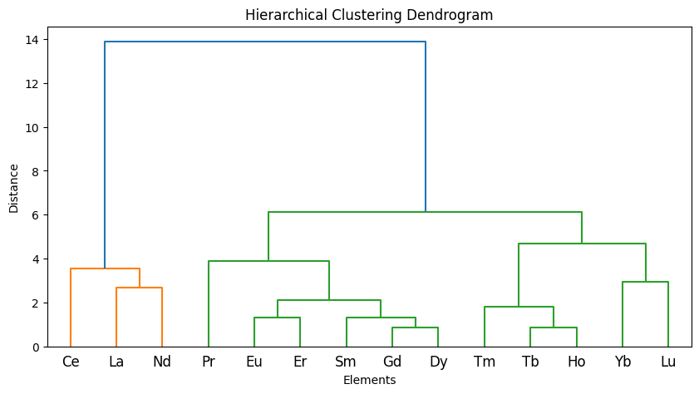
Clustering of Bayan Obo
REE Fractionation Pattern
LREEs: Highly enriched (typical carbonatitic signature)
MREEs: Moderately enriched (controlled by apatite)
HREEs: Depleted (indicates garnet retention in the source)
Ce Anomaly: Ce clusters separately, showing it behaves differently from other REEs
Cluster 1 (LREE): La, Ce, Nd
Cluster 1 (LREE): La, Ce, Nd
Cluster 2 (MREE): Pr, Sm, Eu, Gd, Dy, Er
Cluster 2 (MREE): Pr, Sm, Eu, Gd, Dy, Er
Cluster 0 (HREE): Tb, Ho, Tm, Yb, Lu

Slide 11
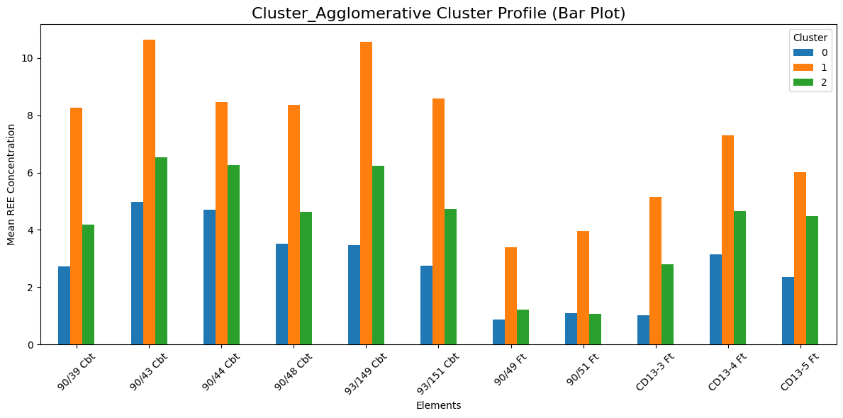
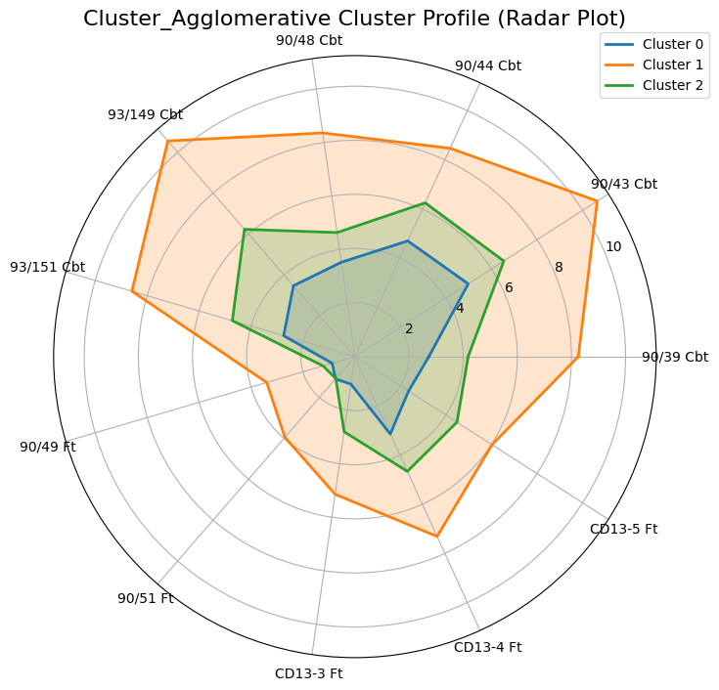
Profiling of Bayan Obo
Cluster 1 – Highly Enriched REE Group
Highest REE concentrations in both plots.
Largest bars and widest radar shape.
Represents fertile, enriched, less-fractionated samples.
Key Samples: 90/43 Cbt, 93/149 Cbt, 93/151 Cbt.
Cluster 2 – Moderately Enriched Group
Intermediate REE values in both graphs.
Indicates mixed or moderately evolved signatures.
Neither strongly enriched nor depleted.
Cluster 0 – Depleted REE Group
Lowest REE concentrations in both plots.
Smallest bars and smallest radar shape.
Represents depleted or strongly fractionated REE patterns, especially in Ft samples.

Slide 12
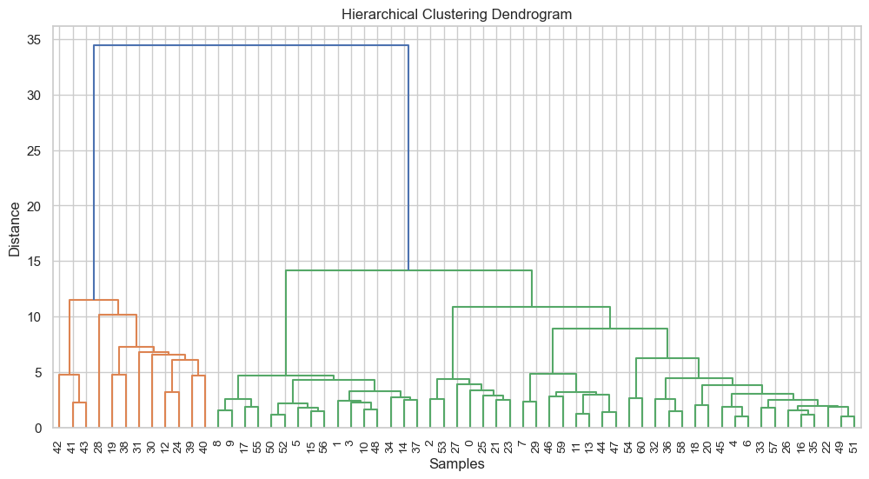
Clustering of Belaya Zima
Three clear geochemical clusters identified:
  Cluster 1: HREE- and HFSE-enriched group (with Y, Sc).
  Cluster 2: LREE-rich group with moderately high major oxides and Ba–Sr–Rb enrichment.
  Cluster 3: Major-oxide–dominated group with overall low REE content.
Distinct REE fractionation pattern: HREE enrichment vs. LREE enrichment vs. REE-poor signatures clearly separated.
Reflects strong source and process differences: Variations indicate differences in source composition, melt evolution, and fractionation controls.
Cluster 1 High Gd–Lu, Zr, Nb, Hf, Ta, W, Th, U, plus Y and Sc.
Cluster 2 LREEs (La–Eu).
Cluster 3 SiO₂, Al₂O₃, CaO, MgO, FeO/Fe₂O₃

Slide 13
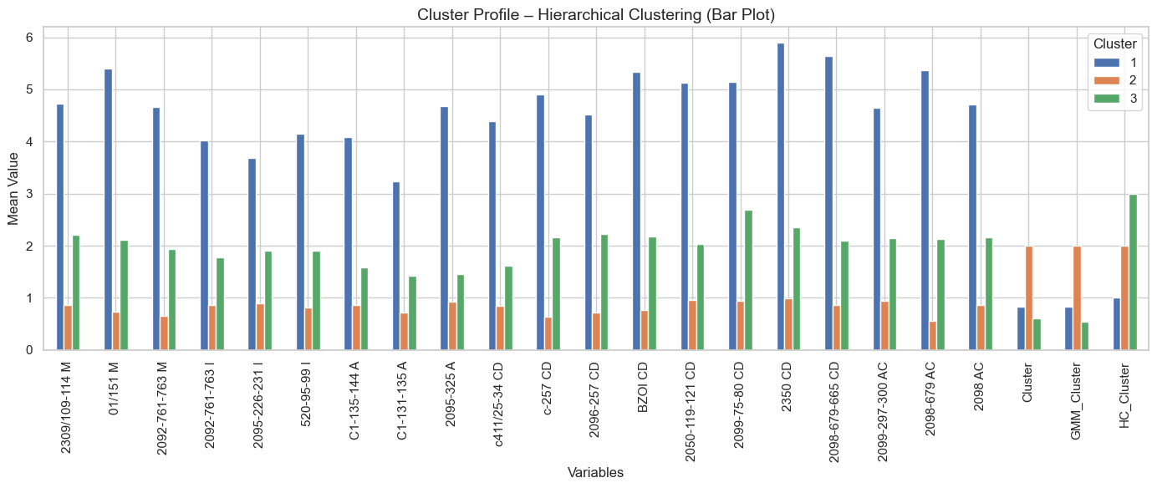
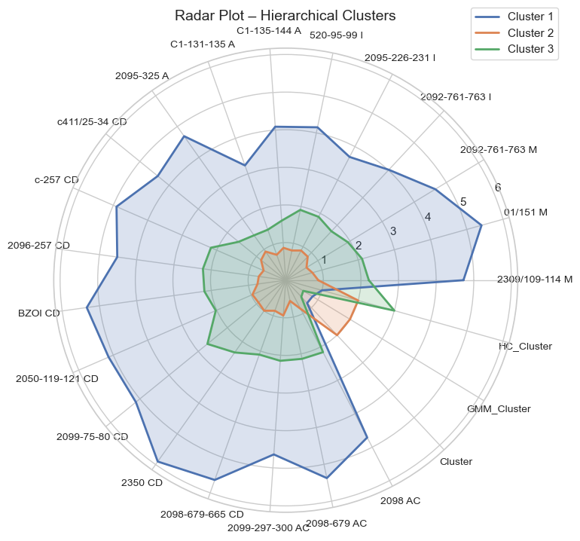
Profiling of Belaya Zima
Cluster 1 – Highly Enriched Group (Blue)
Highest REE values in both plots.
Largest radar shape and tallest bars.
Represents strongly enriched, evolved-source samples.
Key Samples: 2309/109–114 M, 01/151 M, 2092-761-763 M.
Cluster 2 – Moderately Enriched Group (Orange)
Intermediate REE values across variables.
Indicates mixed or moderately evolved signatures.
Key Samples: 2095-226-231 I, 520-95-99 I, C1-135-144 A.
Cluster 3 – Depleted Group (Green)
Lowest REE values in both graphs.
Smallest radar area and shortest bars.
Represents depleted or fractionated REE patterns.
Key Samples: 2098 AC, HC_Cluster group, other low-REE samples.

Slide 14
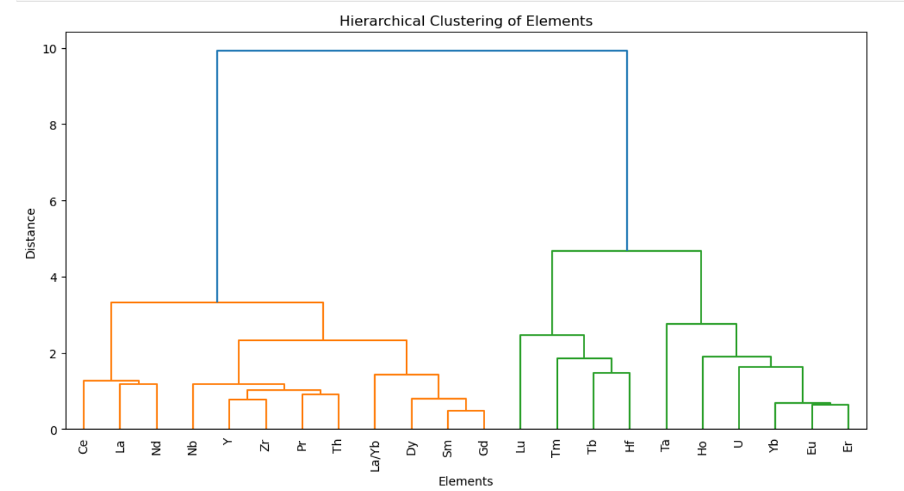
Clustering of Fen
Two clear geochemical clusters identified:
Cluster 1 – LREE-Dominant Group (Left Side)
Groups mainly LREEs that behave similarly in geochemical processes.
Indicates similar mobility, enrichment, and fractionation patterns.
Cluster 2 – HREE-Dominant Group (Right Side)
Contains mostly HREEs, which fractionate differently from LREEs.
Shows elements with stronger compatibility and heavier ionic character.
Cluster 1 La, Ce, Pr, Nd, Sm, Y, Zr, Nb
Cluster 2 Yb, Er, Ho, Tm, Hf, Ta, U

Slide 15
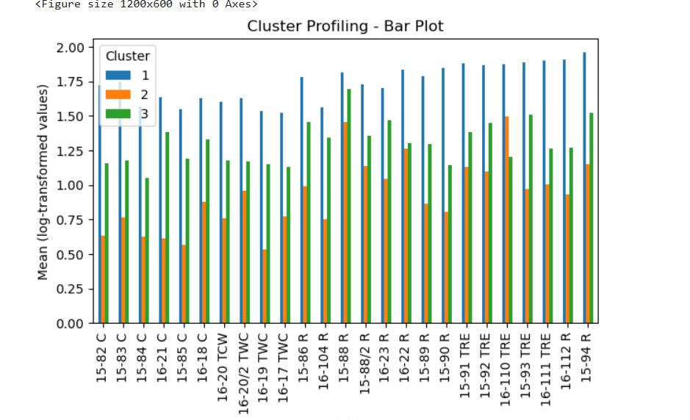
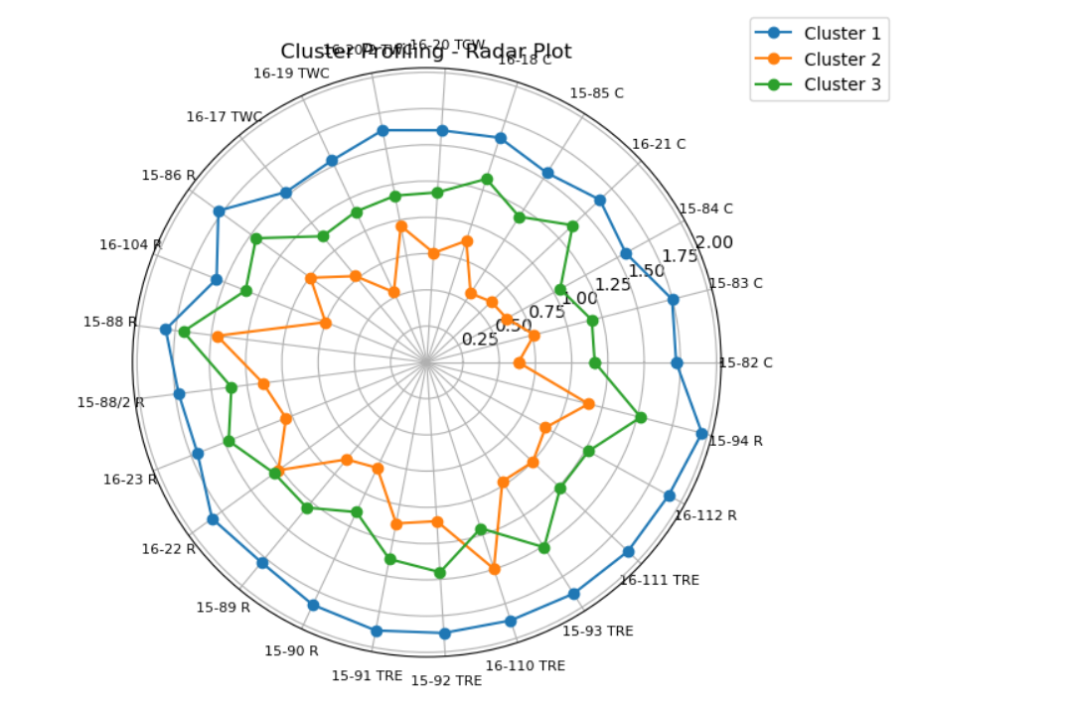
Profiling of Fen
Cluster 1 – High Values / Enriched Group (Blue)
Highest values across most elements.
Largest radar shape and tallest bars: strong, enriched signal.
Indicates high elemental abundance and less fractionation.
Represents samples from an enriched or primitive source
Cluster 2 – Low Values / Depleted Group (Orange)
Lowest values in both radar and bar plots.
Radar stays near center: weak, depleted signal.
Indicates low elemental abundance and strong fractionation.
Represents samples with depleted or altered signatures.
Cluster 3 – Moderate Values / Intermediate Group (Green)
Falls between Clusters 1 and 2.
Shows intermediate signal intensity.
Indicates partially enriched / partially depleted behavior.
Suggests a mixed or moderately fractionated source.

Slide 16
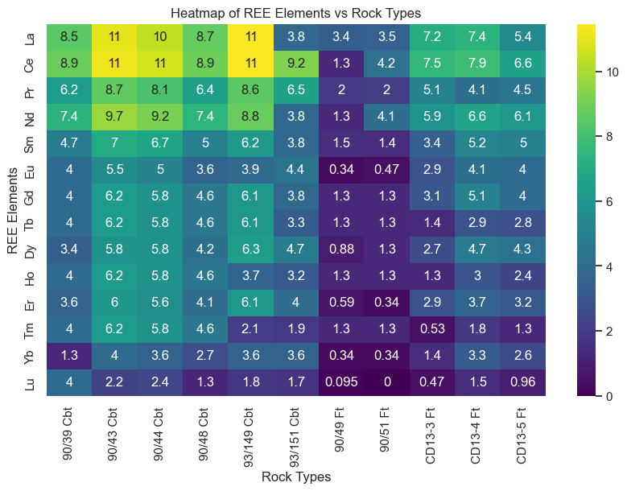
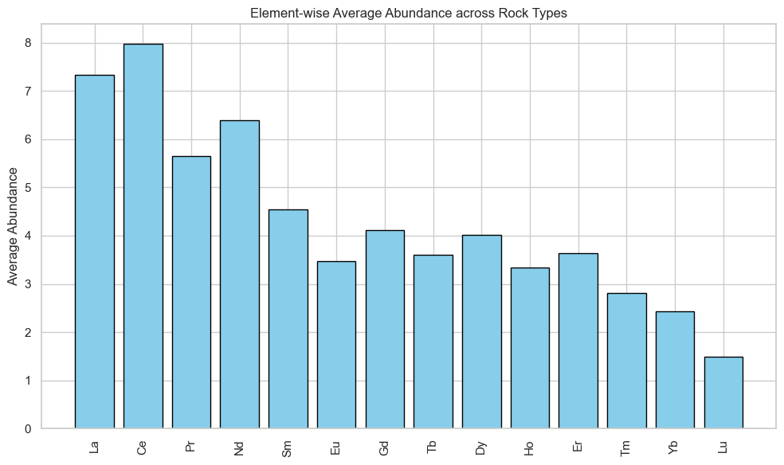
Heatmap and Average REE Abundance Pattern Across Rock Types
1) Bayan Obo
Strong LREE enrichment in Cbt samples (especially 90/43, 90/44, 90/48).
MREEs show moderate levels following the LREE trend.
HREEs are lowest, particularly in Ft samples (90/49, 90/51).
Clear grouping: Cbt = high REE, CD13 Ft = moderate, 90/49 & 90/51 Ft = highly depleted.
Sample 93/151 (Cbt) shows unusually low REE values compared to other carbonatites.
La and Ce have the highest average abundances, showing strong LREE enrichment.
They display high mean values and strong positive correlations with other REEs.
La and Ce are the most suitable target variables for regression modeling due to their robustness and geochemical significance.

Slide 17
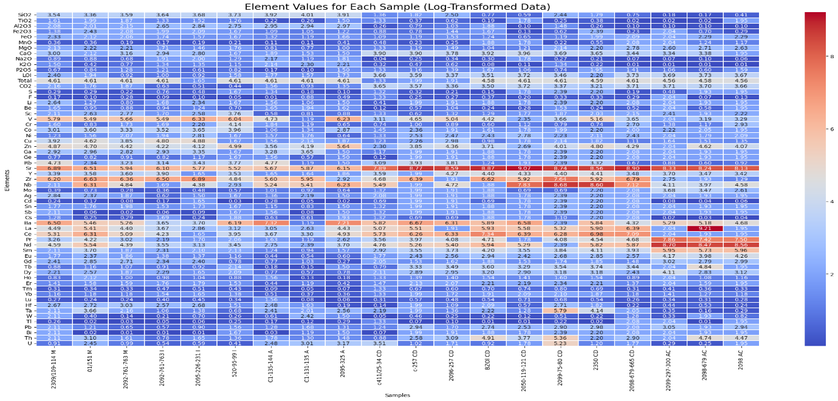
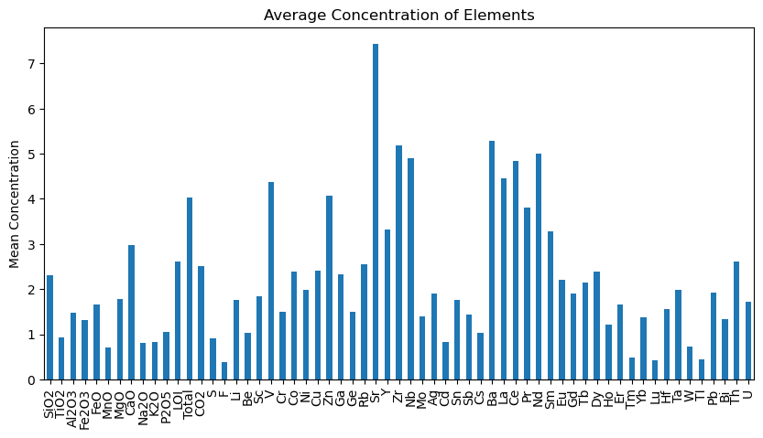
2) Belaya Zima
Red = enriched, blue = depleted element values.
2099-297-300 (AC) and 2098-679-665 (CD) are highly enriched.
2098 (AC) and C1-131-135 (A) are strongly depleted.
REEs vary strongly, while major oxides vary moderately.
Major elements are moderate; REEs (La, Ce, Nd, Y, Yb) are highly enriched.
Sb, Cd, Bi, Tl appear in very low amounts.
La is selected for its strong variation indicating LREE enrichment, while CaO effectively distinguishes Ca-rich carbonatites from silicate-rich rocks.

Slide 18
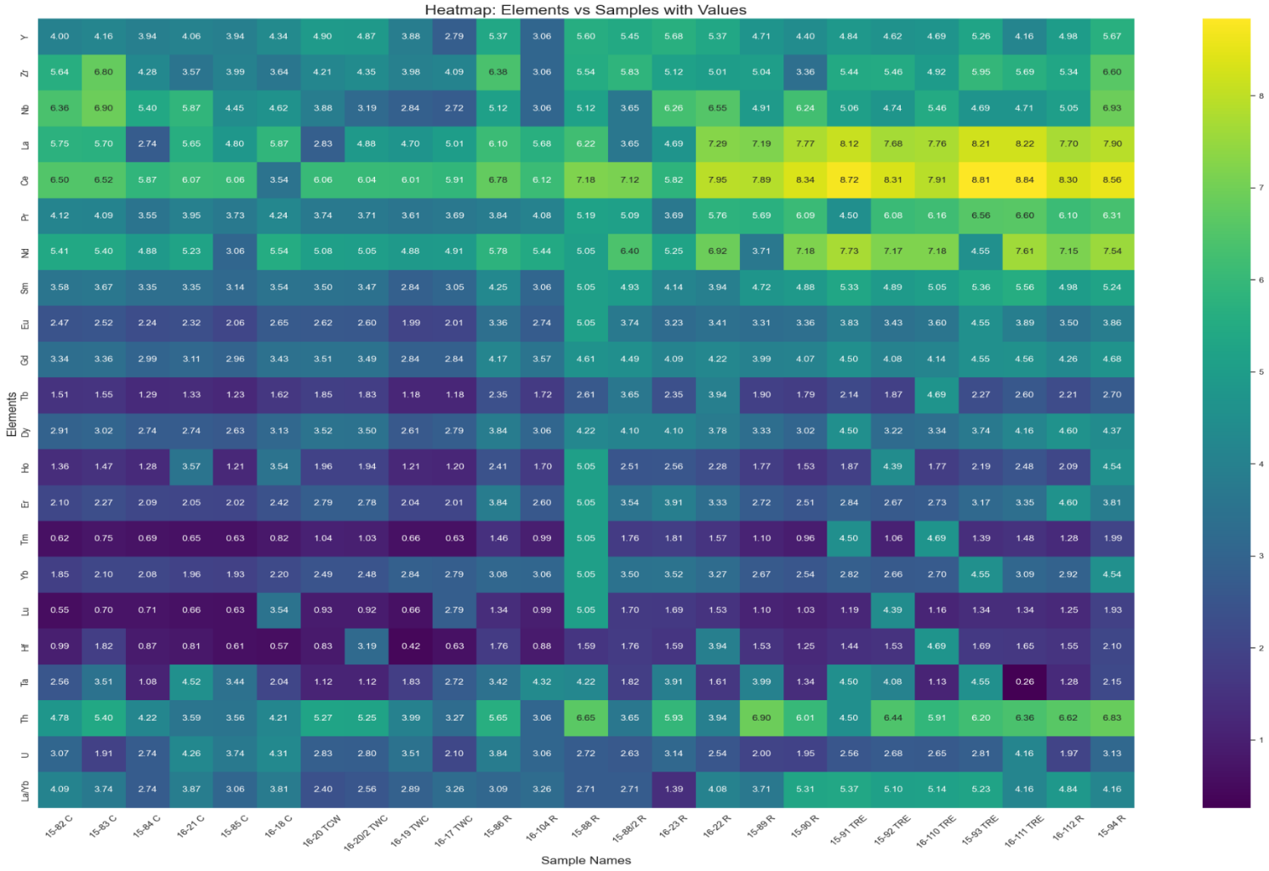
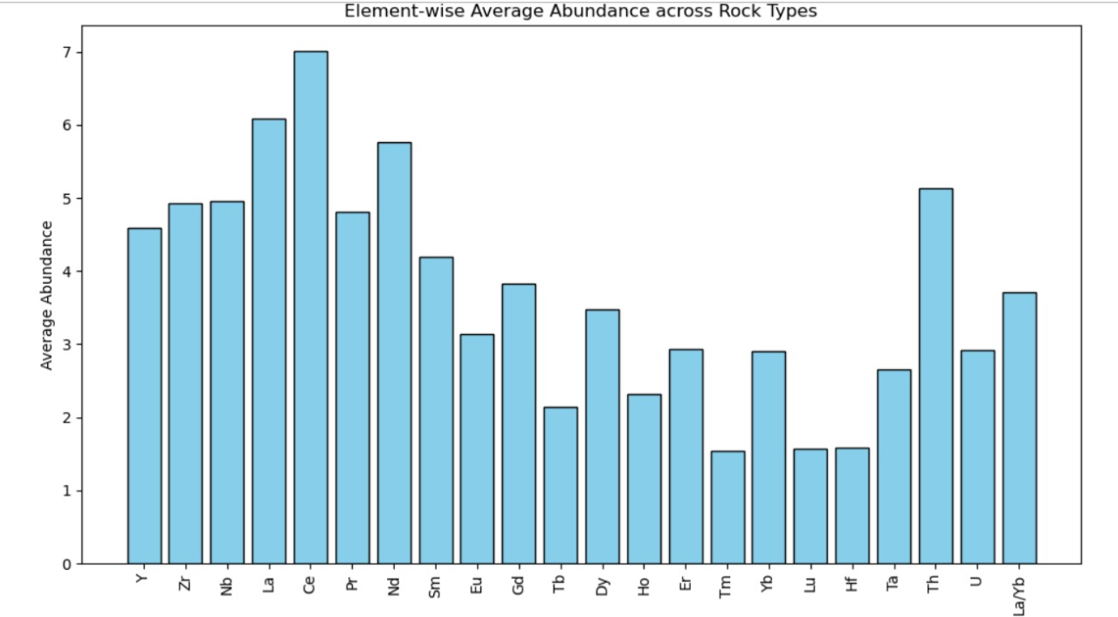
3) Fen
Strong LREE enrichment and HREE depletion → fractionated REE pattern.
Mid-REEs (Ce–Gd) most enriched → coherent REE behavior.
HFSE (Zr–Hf, Nb–Ta) moderately enriched → magmatic origin, minimal alteration.
HREEs consistently low → evolved magmatic conditions.
15-92 RE and 16-104 RE show highest enrichment.
La and Ce have the highest average abundances, showing strong LREE enrichment.
They display high mean values and strong positive correlations with other REEs.
La and Ce are the most suitable target variables for regression modeling due to their robustness and geochemical significance.

Slide 19
Regression: Elastic Net For Bayan Obo
La (R² = 0.94)
Strong positive: Sm, Tb → LREE–MREE enrichment
Moderate positive: Ce, Ho, Er, Lu → smooth REE pattern
Negative: Yb → mild HREE depletion
La Model
Ce (R² = 0.75)
Strong positive: La–Pr–Nd → classic LREE coherence
Positive MREE: Gd, Dy → smooth LREE→MREE trend
Strong negative: Eu → clear Eu anomaly
Negative: Tm, Lu → mild HREE depletion
Ce Model
La & Ce Together (R² = 0.71)
Both La & Ce increase with MREE–HREEs: Pr → Er
No strong effects: Eu, Yb, Lu → weak fractionation control
Consistent positive coefficients across REEs
La & Ce Combine
      La, Ce, and the combined model are mainly controlled by the same REEs: Pr, Nd, Sm, Gd, Dy, Ho, and Er.

Slide 20
Regression: Elastic Net For Belaya Zima
R² = 0.78 → Strong predictability
Positive drivers: Zr, Tb, MgO, W, S, Total REE, Sn, CaO, Pr
Negative drivers: Be, Cr, Er, Y, Ni, SiO₂, Ti, Rb
HREE controls: Very weak (Er only minor)
La Model
R² = –1.05 → Extremely poor predictability
Weak positive drivers: Cd, Gd, Ce, Ho, Yb, Ni, Tm, CO₂, La
Negative drivers: Be, Cr, Na₂O, Al₂O₃
HREE role: Very small (Yb, Tm)
CaO Model
R² = 0.26 → Only weak–moderate joint predictability
Positive contributors: CO₂, Cu, Sr, Y, Zr, Ce, Gd, Tb, MgO, S, Ba, Pr, W
Negative contributors: SiO₂, Al₂O₃, Total, Be, Cr, Zn, TiO₂, Ni, Cd, Pb, Th,Er
HREE: Minimal effect in both cases (Er weak; others negligible)
La & CaO Combine
La is strongly governed by LREE–MREE enrichment, CaO shows no real REE control, and combined modeling confirms that REEs systematically influence La but not CaO.

Slide 21
Regression: Elastic Net For Fen
La(R² = 0.885)
Positive (Strong → Moderate)
Pr, La/Yb, Ta, Th, Hf, U, Ce, Nd, Dy, Er, Yb, Gd
Negative (Weak)
Y, Zr, Tb, Ho, Sm, Eu, Tm, Lu (near-zero → negligible)
La Model
Ce(R² = 0.854)
Positive (Strong → Moderate)
Sm, Pr, La, Zr, Nd, Yb, Ta, Gd, La/Yb
Negative (Moderate → Weak) Lu, U, Nb, Er, Ho, Tm, Dy, Eu, Tb, Hf, Th (mostly near-zero)
Ce Model
La & Ce Together R² = 0.875)
Positive (Shared for La & Ce)
Pr, Nd, Sm, Gd, Dy, Hf, Ta, Th, U, Yb, La/Yb
Negative (Shared for La & Ce)
Y, Zr, Nb, Ho, Lu, Er, Tm (mostly small to negligible)
La & Ce Combine
La, Ce, and the multi-task model are controlled by a common set of REEs—Pr, Nd, Sm, Gd, Dy, Hf, Ta, Th, and U—indicating a smooth and coherent LREE–MREE pattern with only weak HREE influence.

Slide 22
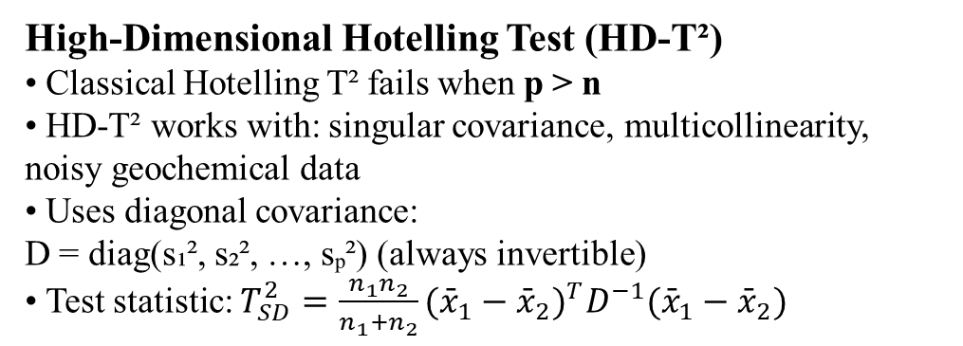
Analysis of Variance – Bayan Obo
1. Why Classical ANOVA Fails (n < p Problem)
• Dataset: p = 14 elements, n = 11 samples → p > n
• Covariance matrix becomes singular → F-statistic not valid
• Variance-equality tests fail (Levene/Bartlett)
Classical ANOVA cannot be used
2. What to Use Instead (High-Dimensional Tests)
• Use HD-ANOVA methods designed for p > n:
– Chen & Qin (2010) test
– Srivastava & Fujikoshi (2006)
– Regularized MANOVA
• These do not require covariance inversion
High-Dimensional Hotelling Test (HD-T²)
• Classical Hotelling T² fails when p > n
• HD-T² works with: singular covariance, multicollinearity, noisy geochemical data
• Uses diagonal covariance:
D = diag(s₁², s₂², …, sₚ²) (always invertible)
• Test statistic: $T_{SD}^{2}=\frac{n_{1}n_{2}}{n_{1}+n_{2}}({\overset{ˉ}{x}}_{1}−{\overset{ˉ}{x}}_{2})^{T}D^{−1}({\overset{ˉ}{x}}_{1}−{\overset{ˉ}{x}}_{2})$
T²_HD statistic : 154.7965925048067
F_HD statistic : 11.056899464629051
df1 = 14
df2 = 12.786044254805576
p-value = 5.667306909884484e-05 (0.0000567)
Interpretation
• p-value = 5.67×10⁻⁵ : Cbt and Ft have significantly different REE compositions.
• Less than 0.006% chance they come from the same REE population.
Hypothesis:
H₀: Carbonatites (Cbt) and Fenites (Ft) have the same mean REE composition.
H₁: Carbonatites and Fenites have different REE compositions.

Slide 23
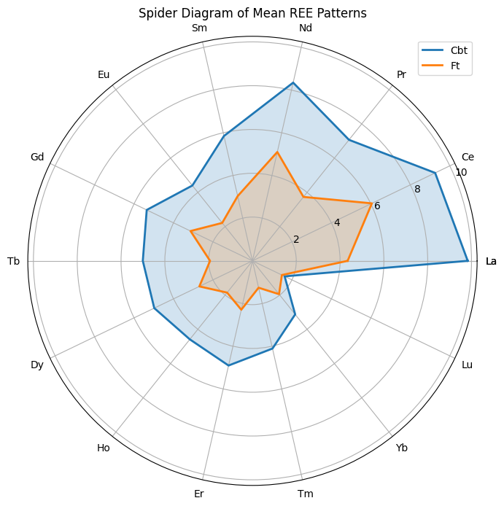
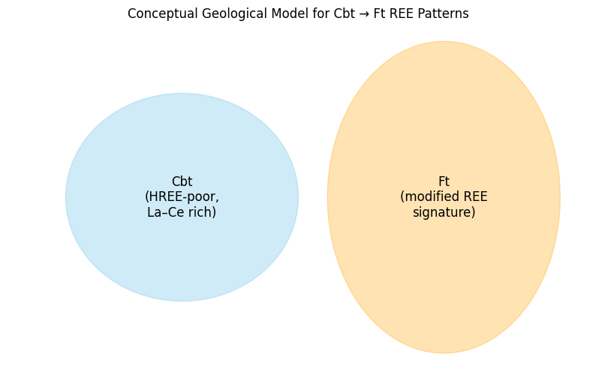
REE Pattern Interpretation
• Carbonatites (Cbt): Strong LREE enrichment and very low HREE → signature of REE-rich mantle melts.
• Fenites (Ft): Lower, variable REE levels
→ metasomatic modification by carbonatite-derived fluids.
• Comparison: Fenites are not diluted carbonatites; they represent a different geochemical process.
• Implication: Supports a two-stage REE evolution at Bayan Obo
Carbonatitic LREE enrichment
Fenite metasomatic overprint.
Belaya zima Data set contains many REEs, oxides, and trace elements, which makes it high-dimensional.
ANOVA is designed to test one variable at a time, but:
Data have too many highly correlated variables (La, Ce, Pr, Nd, Sm, Gd, Dy, Ho, Er, many trace elements, many oxides).
High dimensionality creates strong multicollinearity among REEs.
ANOVA cannot handle multiple inter-dependent chemical variables at once.

Slide 24
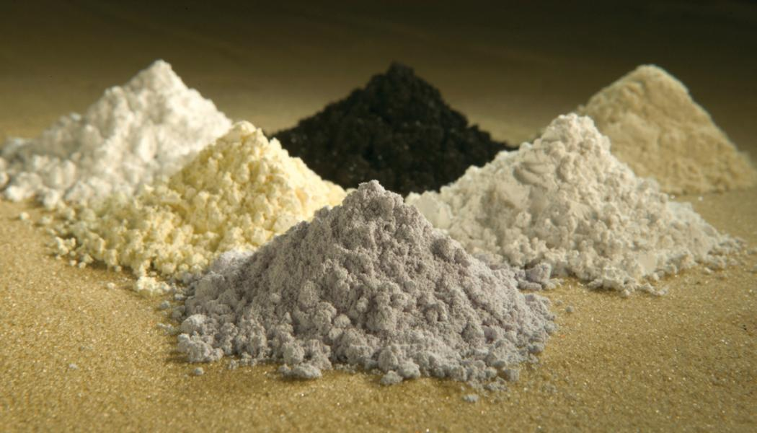
Analysis of Variance – Fen
Purpose: To test whether REE (or element) concentrations differ between rock groups (Carbonatite (C), Transitional Carbonatite (TWC), Rødbergite (R), Transitional Rødbergite (TRE))
Hypothesis:
H₀: All group means are equal
H₁: At least one group mean is different
F-statistic = 2.8923
P-value = 0.0000
Result: Significant difference between groups (reject H0)
Interpretation
p-value ≈ 0.0000, which is less than the typical significance level α = 0.05.
Decision: Reject the null hypothesis (H₀).
Conclusion: There is a statistically significant difference between the means of at least some of the groups in your dataset.

Slide 25

Conclusion
1) Bayan Obo shows the clearest geochemical separation, with carbonatites and fenites forming fully distinct REE populations, confirming a two-stage magmatic–hydrothermal evolution.
2) Belaya Zima is the most heterogeneous, with extreme variability and the strongest skewness/kurtosis, reflecting multiple carbonatite types and complex enrichment mechanisms.
3) Fen shows the most coherent magmatic signature, with smooth LREE enrichment, predictable REE patterns, and strong multivariate regression performance.
4) Across all three regions, La and Ce emerge as the most reliable REE indicators, supported by clustering, heatmaps, and Elastic Net modeling.
5) LREE–MREE control dominates, while HREEs show weak and inconsistent contributions,
indicating widespread low-pressure melting, amphibole involvement, and limited garnet
retention.
6) Each region shows distinct enrichment mechanisms:
Bayan Obo: Magmatic + metasomatic overprint
Belaya Zima: Strongly heterogeneous multi-phase magmatism
Fen: Coherent magmatic enrichment with mild fractionation

Slide 26
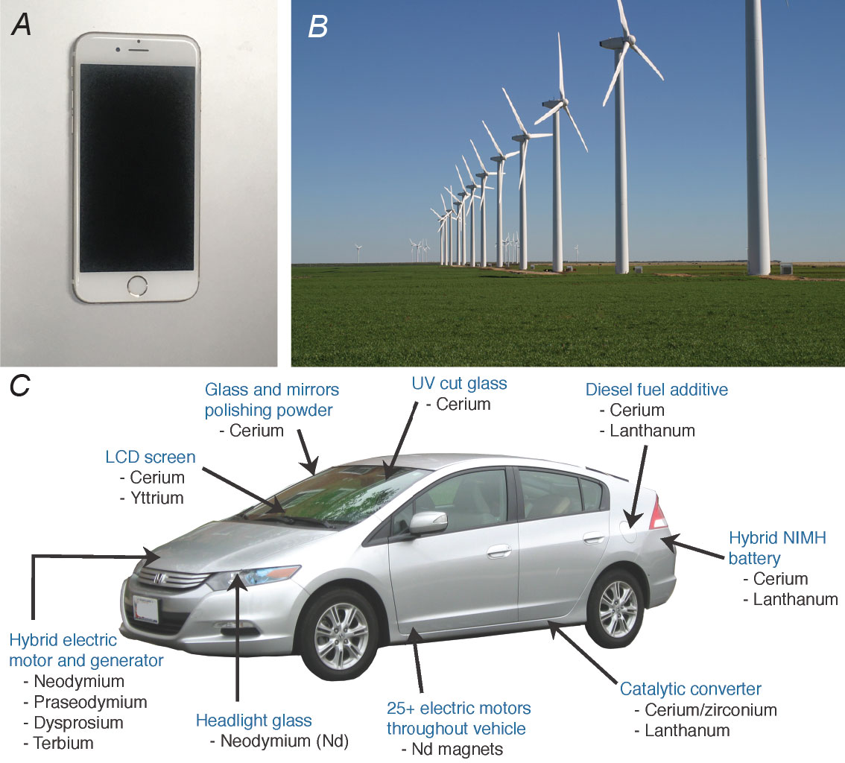
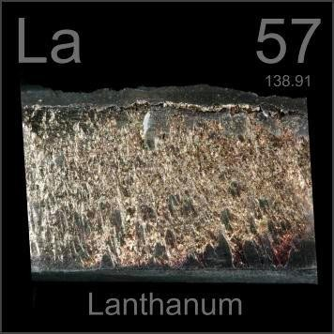
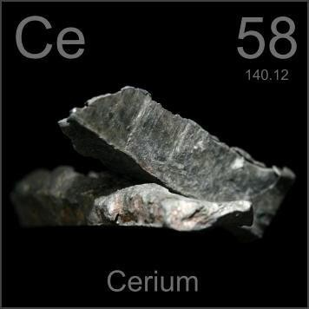
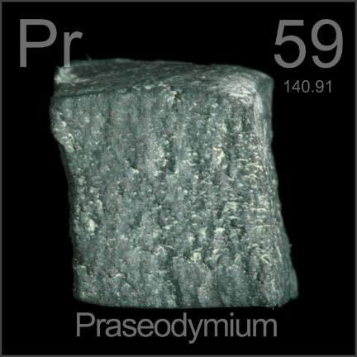
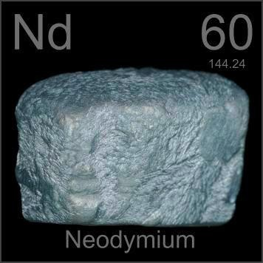
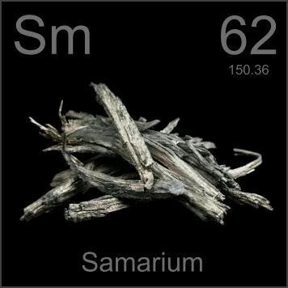
Importance in Green Technology
La & Ce: Electric vehicle (EV) batteries, polishing powders, catalysts.
Pr & Nd: High-strength Nd–Pr magnets for wind turbines, EV motors.
Sm: Sm–Co permanent magnets (high temperature stability).
Dy, Tb, Ho, Er, Tm, Lu, Y: Critical for high-performance magnets, lasers, phosphors, fiber optics, and hydrogen storage.

Slide 27

References
Articles:
“A Geochemical Study of an REE-rich Carbonatite Dyke at Bayan Obo, Inner Mongolia, Northern China.” (YANG Xueming1, ZHENG Yongfei1, YANG Xiaoyong1, ZHANG Peishan2 and M.J. LE BAS3)
“Trace-element composition of minerals and rocks in the Belaya Zima carbonatite complex (Russia): Implications for the mechanisms of magma evolution and carbonatite formation.” Anna G. Doroshkevich, Ilya V. Veksler, Reiner Klemd , Elena A. Khromova, Ivan A. Izbrodin
“The hydrothermal alteration of carbonatite in the Fen Complex, Norway: mineralogy, geochemistry, and implications for rare-earth element resource formation” by C. Marien, A. H. Dijkstra, and C. Wilkins, School of Geography, Earth and Environmental Sciences, Plymouth University, UK.
Applied Multivariate Statistical Analysis Book by Dean W. Wichern, Richard A. Johnson.
https://www.lindianresources.com.au/kangankunde-rare-earths
https://www.mining-technology.com/projects/kangankunde-rare-earths-project-malawi/
https://en.wikipedia.org/wiki/Geology_of_Malawi

Slide 28


