Slide 1
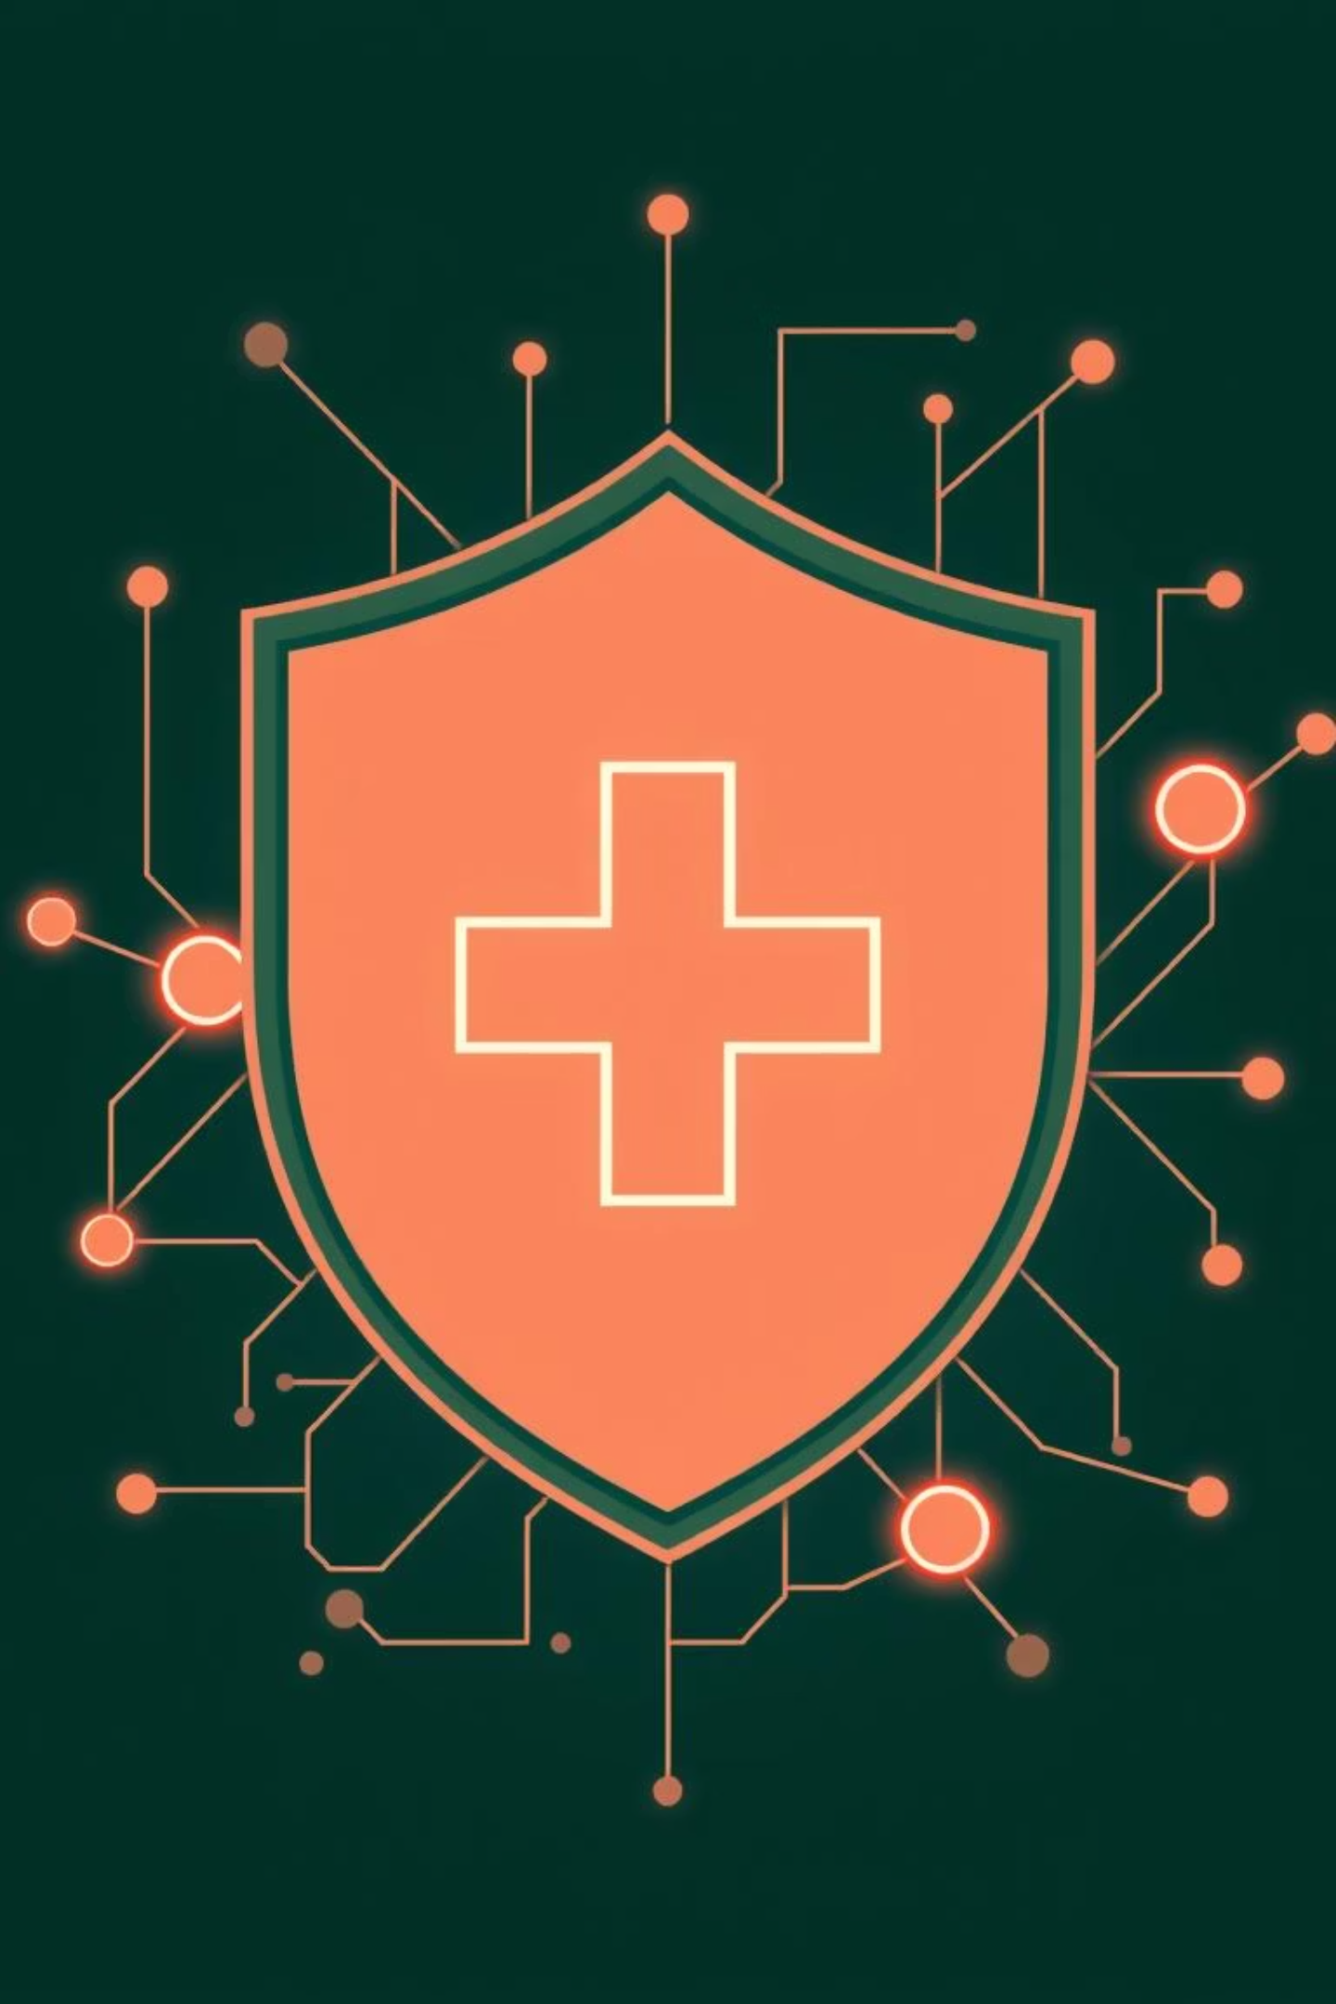
Lifeshield: Revolutionizing Healthcare Identity & Telehealth
Welcome to Lifeshield, where we're pioneering the future of secure, transparent, and efficient healthcare interactions. This presentation outlines our innovative approach to doctor and hospital verification using Non-Fungible Tokens (NFTs) and a cutting-edge Peer-to-Peer (P2P) video consultation topology.

Slide 2
Agenda
01
02
NFT-Based Verification
P2P Video Consultation
Secure and tamper-proof doctor/hospital credentials.
Low-latency, privacy-enhanced telehealth.
03
04
Benefits & Innovation
Vision & Impact
Key advantages and patentable aspects of our system.
Transforming healthcare identity and telehealth standards.

Slide 3

NFT Issuance for Doctor & Hospital Verification
Upon successful verification, our system mints a unique, non-transferable NFT for each doctor or hospital. This NFT serves as a digital badge of authenticity on the blockchain.
NFT Metadata Includes:
Hospital/Doctor Name
License Hash (encrypted)
Verification Date
Expiry Date
Optional: Decentralized Identifier (DID)

Slide 4
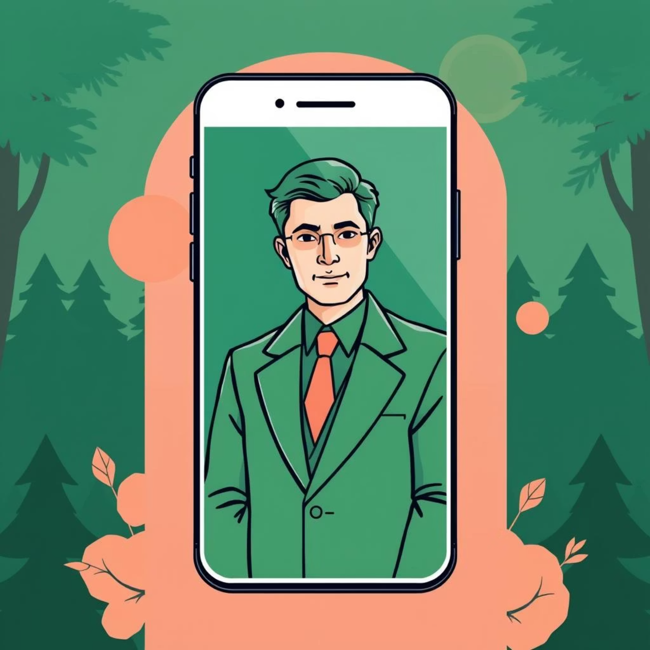
Transparent Verification for Patients
Parent/Patient View:
On a hospital or doctor's profile, parents see a prominent "Verified - Lifeshield NFT Badge".
They can scan a QR code or directly check the blockchain hash to independently verify authenticity, ensuring peace of mind.
Dynamic Updates:
If a license expires or is revoked, the associated NFT is auto-burned via a smart contract.
The badge instantly disappears from the profile, ensuring always up-to-date verification.

Slide 5
Core Benefits of NFT-Based Verification
Our NFT verification system offers unparalleled advantages:
Tamper-Proof
Privacy-Preserving
Blockchain technology ensures NFTs cannot be forged or altered, providing immutable proof of credentials.
Sensitive data like full license IDs is hashed, preventing public exposure while maintaining verifiable integrity.
Portable
Automated Updates
The verification badge can be reused across multiple platforms or for insurance verification, streamlining processes.
Smart contracts autonomously handle expiry and revocation, reducing manual oversight and potential errors.

Slide 6
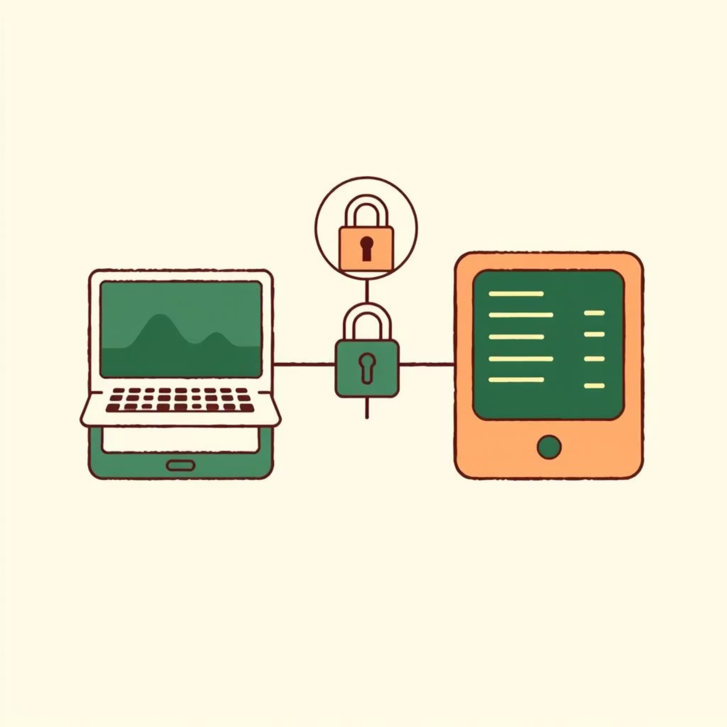
Revolutionizing Telehealth: P2P Video Consultations
Current telehealth platforms often rely on Selective Forwarding Units (SFUs), where all video streams pass through a central server. Lifeshield shifts to a pure P2P model for enhanced privacy and efficiency.
Current (SFU) Model:
Lifeshield's P2P Model:
Video streams relayed through central servers (e.g., Zego Cloud).
Direct doctor-patient connection via WebRTC + decentralized signaling.
Higher latency due to server hops.
Optional blockchain-based session token verification before call.
Server bandwidth costs.

Slide 7



Benefits of P2P Video Topology
Lower Latency
Reduced Server Costs
Enhanced Privacy
Direct connection eliminates server intermediaries, resulting in smoother, real-time communication.
No need to relay video streams through our servers, significantly cutting bandwidth expenses.
Video content never touches third-party servers, simplifying end-to-end encryption and boosting data security.

Slide 8
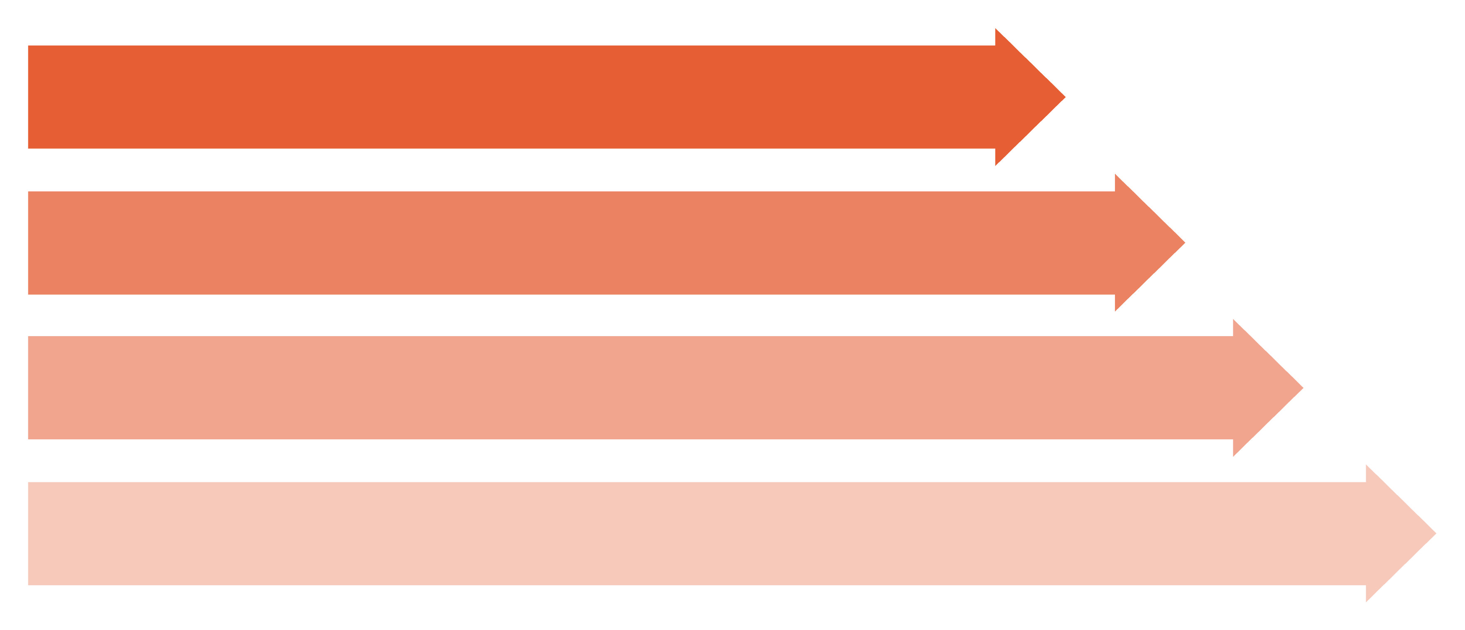
A Patentable Innovation: Decentralized Session Verification + P2P
Our unique combination of decentralized session verification via blockchain with a pure P2P video consultation topology represents a significant advancement in telehealth security and efficiency.
Start
User Initiates Call
Blockchain Verifies Token
P2P WebRTC Connection
"This integrated approach ensures both the identity of participants and the integrity of the session are cryptographically secured, without compromising on performance or privacy."

Slide 9
Lifeshield's Core Aims
1
Secure & Transparent Verification
2
Efficient & Private Telehealth
3
Novel & Patentable Mechanisms
To provide tamper-proof, privacy-preserving verification of doctors and hospitals using NFTs, giving parents and patients independent authenticity checks.
To deliver low-latency, secure, and privacy-enhanced video consultations through a pure P2P topology.
To combine NFT-based verification with decentralized P2P video, creating unique and defensible intellectual property.

Slide 10

Key Takeaways & Future Outlook
Outcome:
NFT-based verification badges replace centralized license storage for medical professionals.
P2P video consultations enhance privacy, reduce latency, and are blockchain-verifiable.
These mechanisms are unique and patentable due to the novel combination of NFT verification and decentralized P2P video topology.
Next Steps:
We are poised to pilot these innovations, aiming to set new industry standards for trust and efficiency in healthcare. Contact us to learn more about partnering with Lifeshield.

