Slide 1

Prediction of Mechanical Properties of Steel Using ML and Neural Networks
INDIAN INSTITUTE OF TECHNOLOGY JODHPUR
DEPARTMENT OF METALLURGICAL AND MATERIALS SCIENCE ENGINEERING
Design Credit Project
Faculty Supervisor : Dr. Nitin Kumar Sharma
INDIAN INSTITUTE OF TECHNOLOGY, JODHPUR DEPARTMENT OF METALLURGY AND MATERIALS SCIENCE ENGINEERING

Slide 2
Introduction
The Mechanical properties of engineering materials are those of the material that comes into action on applying forces.
Engineering Materials are substances employed as raw materials for construction or organized production for an engineering application.
Materials basically possess various qualities such as magnetism, thermal conductivity, heat capacity, stiffness, hardness, and thermal conductivity, among others.
Among various materials, the Mechanical properties of engineering materials tell the material's response against applied load.
Material selection is deciding which materials will be utilized for a certain application.
INDIAN INSTITUTE OF TECHNOLOGY, JODHPUR DEPARTMENT OF METALLURGY AND MATERIALS SCIENCE ENGINEERING

Slide 3
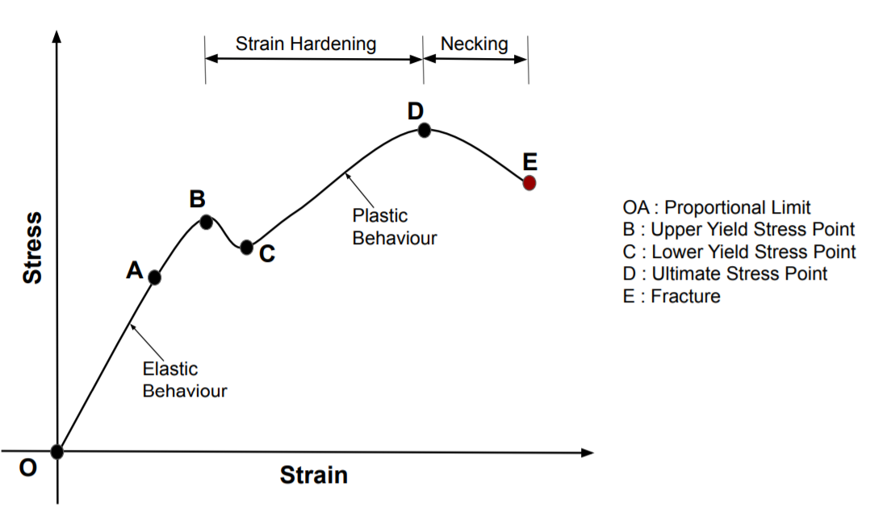
Introduction
The Mechanical properties of engineering materials are those that influence their mechanical strength and capacity for shaping into a desired shape.
Important Mechanical Properties of Engineering Materials
Strength
Hardness
Toughness
Brittleness
Ductility
Malleability
Source : https://www.smlease.com/wp-content/uploads/2019/10/Stress-Strain-Curve-For-Ductile-Materials.png
INDIAN INSTITUTE OF TECHNOLOGY, JODHPUR DEPARTMENT OF METALLURGY AND MATERIALS SCIENCE ENGINEERING

Slide 4
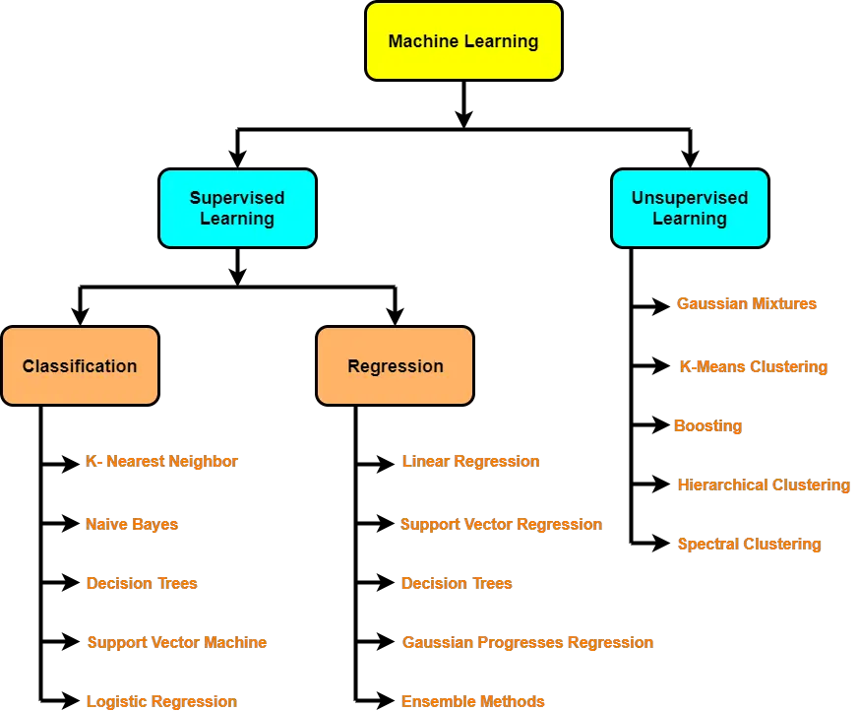
Intro to Machine Learning
INDIAN INSTITUTE OF TECHNOLOGY, JODHPUR DEPARTMENT OF METALLURGY AND MATERIALS SCIENCE ENGINEERING
Ref :https://www.gatevidyalay.com/wp-content/uploads/2019/12/Machine-Learning-Models.png
INDIAN INSTITUTE OF TECHNOLOGY, JODHPUR DEPARTMENT OF METALLURGY AND MATERIALS SCIENCE ENGINEERING

Slide 5
Basic steps to implement a ML model
Data Collection, Data Preparation
Correlation Parameters
Model Selection
Hyperparameter Tuning
Training with best parameters
Model Evaluation
Evaluation
INDIAN INSTITUTE OF TECHNOLOGY, JODHPUR DEPARTMENT OF METALLURGY AND MATERIALS SCIENCE ENGINEERING

Slide 6
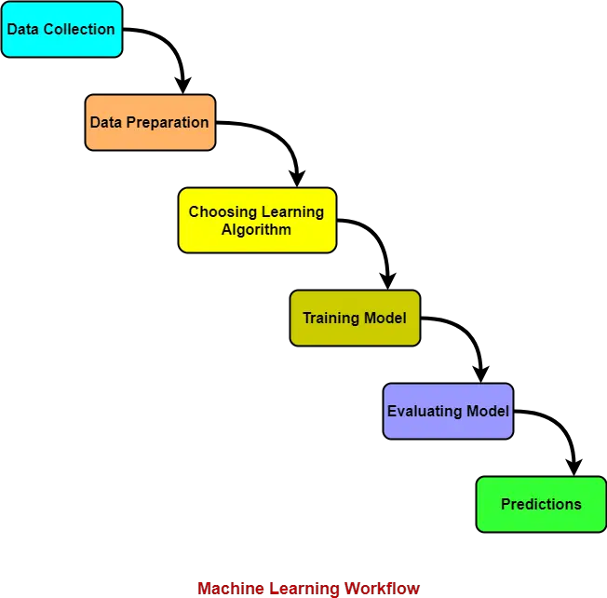
Basic Workflow of a ML Model
Source:https://www.gatevidyalay.com/wp-content/uploads/2019/12/Machine-Learning-Workflow.png
INDIAN INSTITUTE OF TECHNOLOGY, JODHPUR DEPARTMENT OF METALLURGY AND MATERIALS SCIENCE ENGINEERING

Slide 7
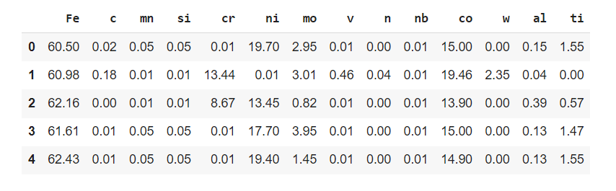
Data Interpretation | Feature Columns
Colab link : https://colab.research.google.com/drive/1TbWfqHDb-L7LWSYIWek6NlEjXkpuqF0V?usp=sharing
INDIAN INSTITUTE OF TECHNOLOGY, JODHPUR DEPARTMENT OF METALLURGY AND MATERIALS SCIENCE ENGINEERING

Slide 8
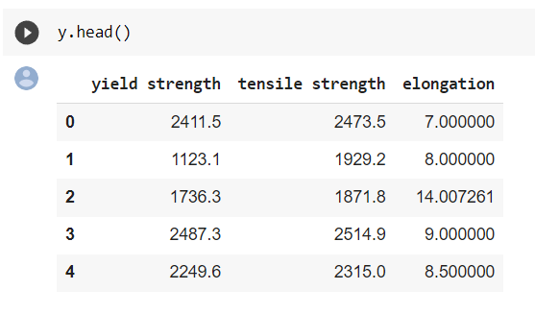
Data Interpretation | Target Columns
The obatined dataset can be accessed from the following link https://drive.google.com/file/d/1Ku1GHyWiwMFticOHoy8DT5uoFN4044qH/view?usp=sharing
INDIAN INSTITUTE OF TECHNOLOGY, JODHPUR DEPARTMENT OF METALLURGY AND MATERIALS SCIENCE ENGINEERING

Slide 9
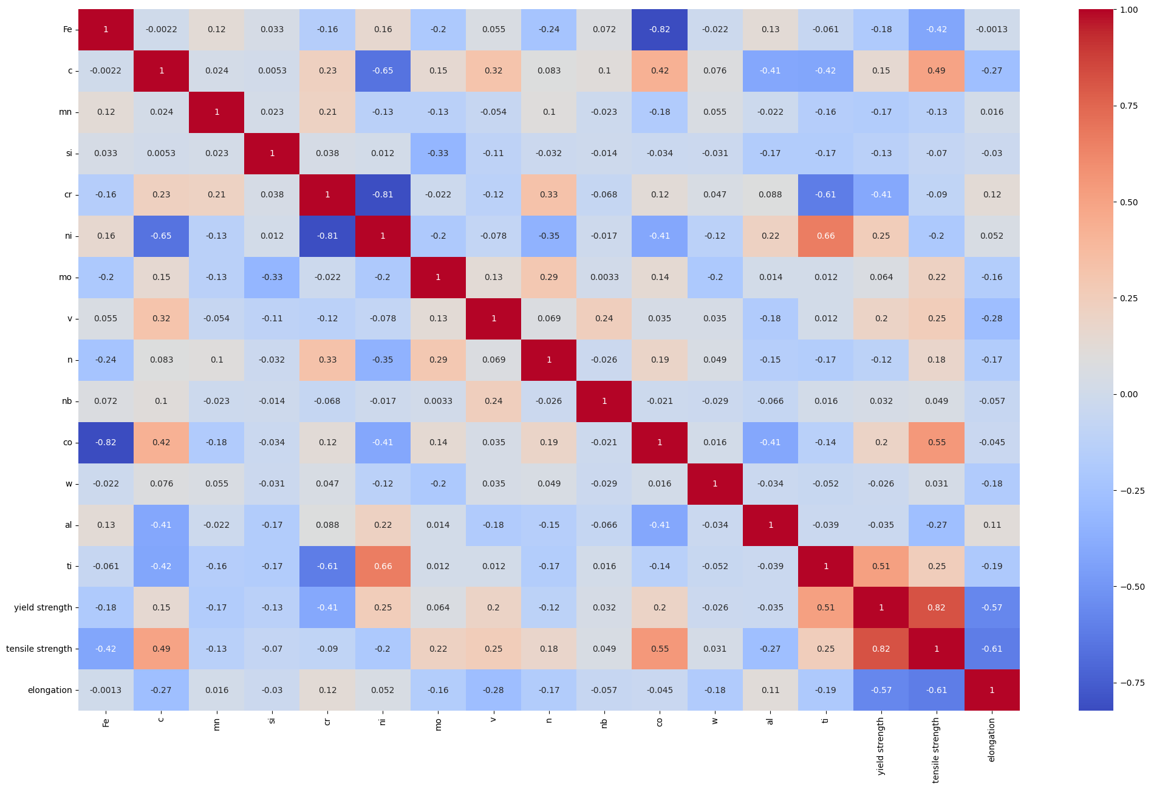
Correlation Matrix | Data Preprocessing
INDIAN INSTITUTE OF TECHNOLOGY, JODHPUR DEPARTMENT OF METALLURGY AND MATERIALS SCIENCE ENGINEERING

Slide 10
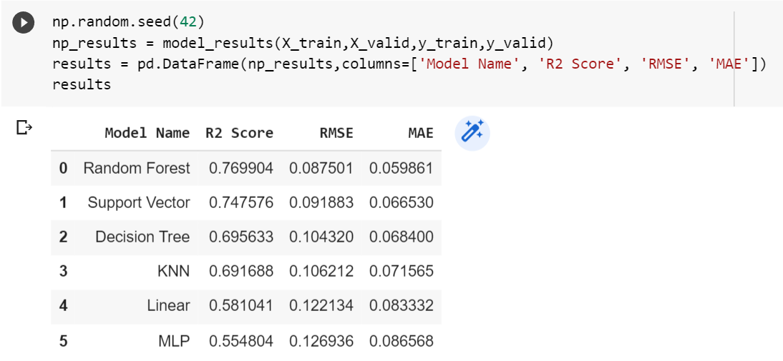
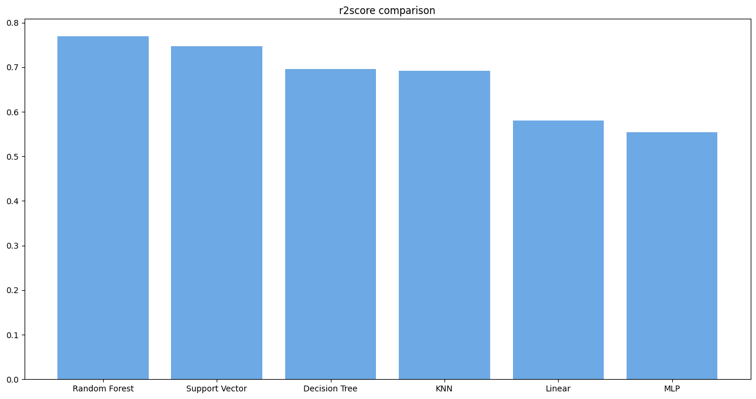
Selection of best suitable ML model
INDIAN INSTITUTE OF TECHNOLOGY, JODHPUR DEPARTMENT OF METALLURGY AND MATERIALS SCIENCE ENGINEERING

Slide 11
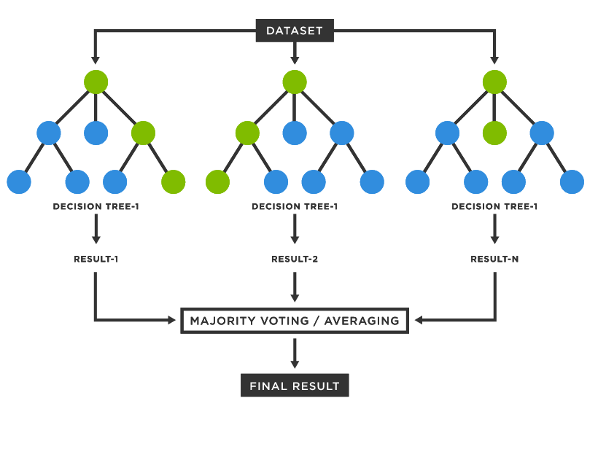
Random Forest Algorithm | ML Model
Supervised learning model used for both Classification and Regression.
Ref : https://www.tibco.com/sites/tibco/files/media_entity/2021-05/random-forest-diagram.svg
INDIAN INSTITUTE OF TECHNOLOGY, JODHPUR DEPARTMENT OF METALLURGY AND MATERIALS SCIENCE ENGINEERING

Slide 12
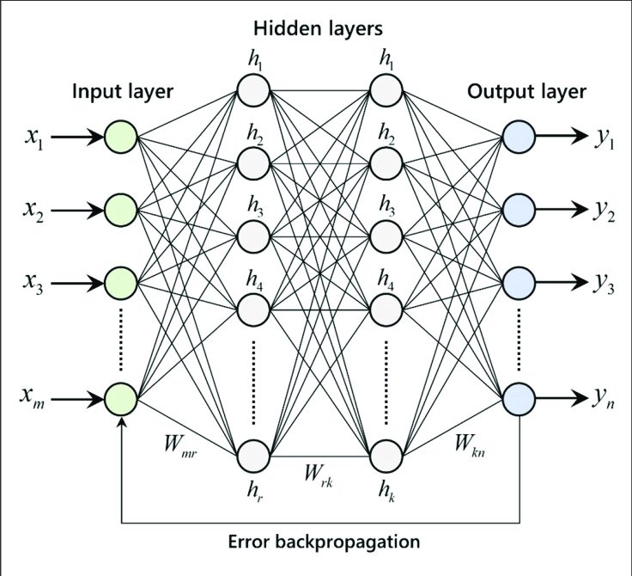
Regression Using Neural Networks | ML Model
Artificial Neural Networks are one of the deep learning algorithms that simulate the workings of neurons in the human brain, it consists of the Input layer, Hidden layers, Output layer.
Ref:https://www.analyticsvidhya.com/blog/2021/08/a-walk-through-of-regression-analysis-using-artificial-neural-networks-in-tensorflow/
INDIAN INSTITUTE OF TECHNOLOGY, JODHPUR DEPARTMENT OF METALLURGY AND MATERIALS SCIENCE ENGINEERING

Slide 13
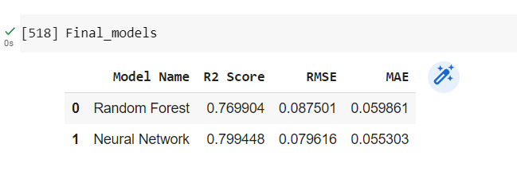
Random Forest Vs Neural Networks
SOOOOOOOOOOOOOOOOOOOOOOOOOOOOOOOO
So we shall use Neural Networks and hypertuning different parameters, improve the R2 Score.
INDIAN INSTITUTE OF TECHNOLOGY, JODHPUR DEPARTMENT OF METALLURGY AND MATERIALS SCIENCE ENGINEERING

Slide 14
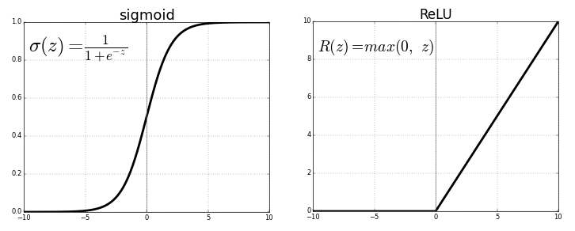
How to improve the model?
Activation function (tanh, Sigmoid, ReLU, Inverse ReLU)
Increasing the input data
Dropout layers
Regularization(L1 and L2)
Normalization
Ref : https://miro.medium.com/v2/resize:fit:1400/1*XxxiA0jJvPrHEJHD4z893g.png
INDIAN INSTITUTE OF TECHNOLOGY, JODHPUR DEPARTMENT OF METALLURGY AND MATERIALS SCIENCE ENGINEERING

Slide 15
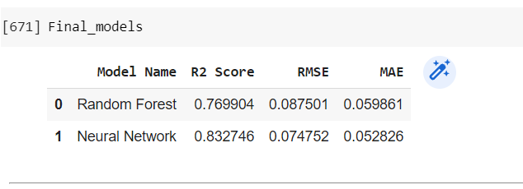
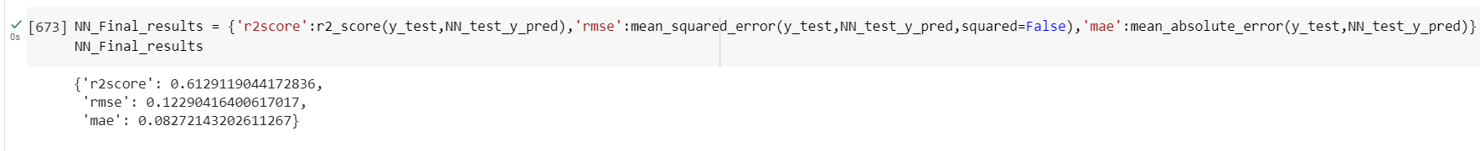
Results | Neural Networks
INDIAN INSTITUTE OF TECHNOLOGY, JODHPUR DEPARTMENT OF METALLURGY AND MATERIALS SCIENCE ENGINEERING

Slide 16
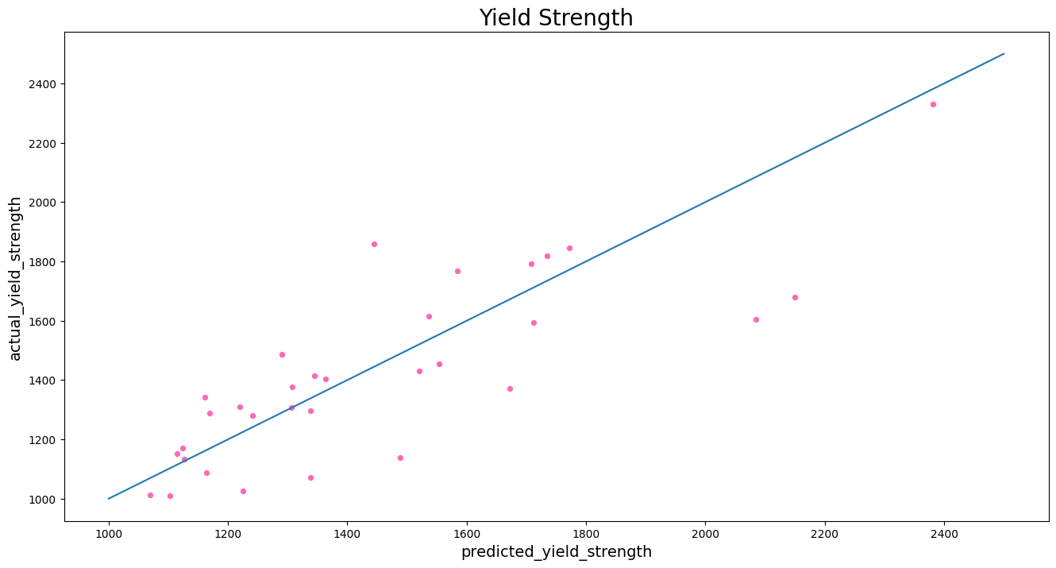
Results | Neural Networks
INDIAN INSTITUTE OF TECHNOLOGY, JODHPUR DEPARTMENT OF METALLURGY AND MATERIALS SCIENCE ENGINEERING

Slide 17
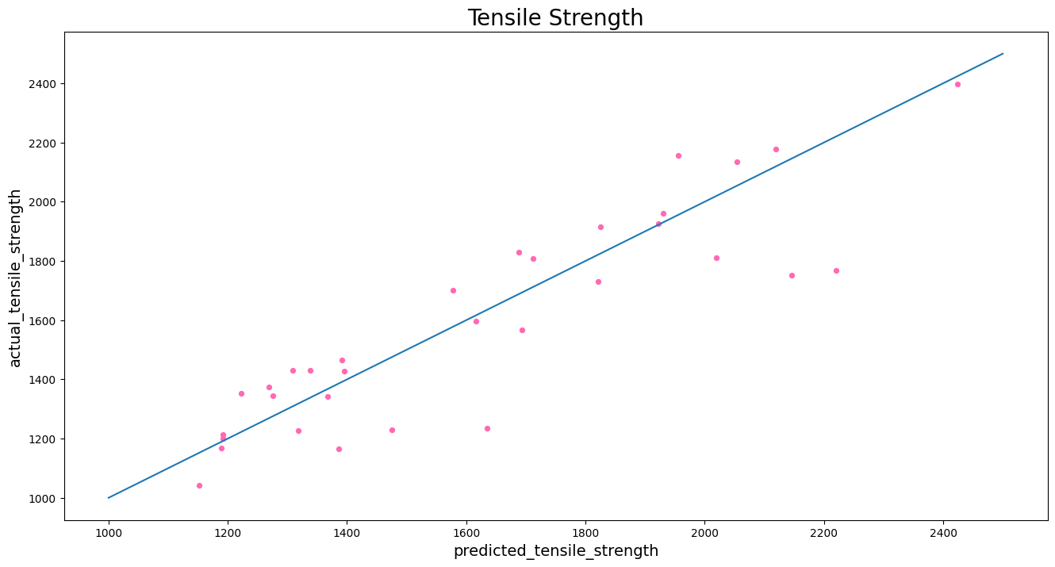
Results | Neural Networks
INDIAN INSTITUTE OF TECHNOLOGY, JODHPUR DEPARTMENT OF METALLURGY AND MATERIALS SCIENCE ENGINEERING

Slide 18
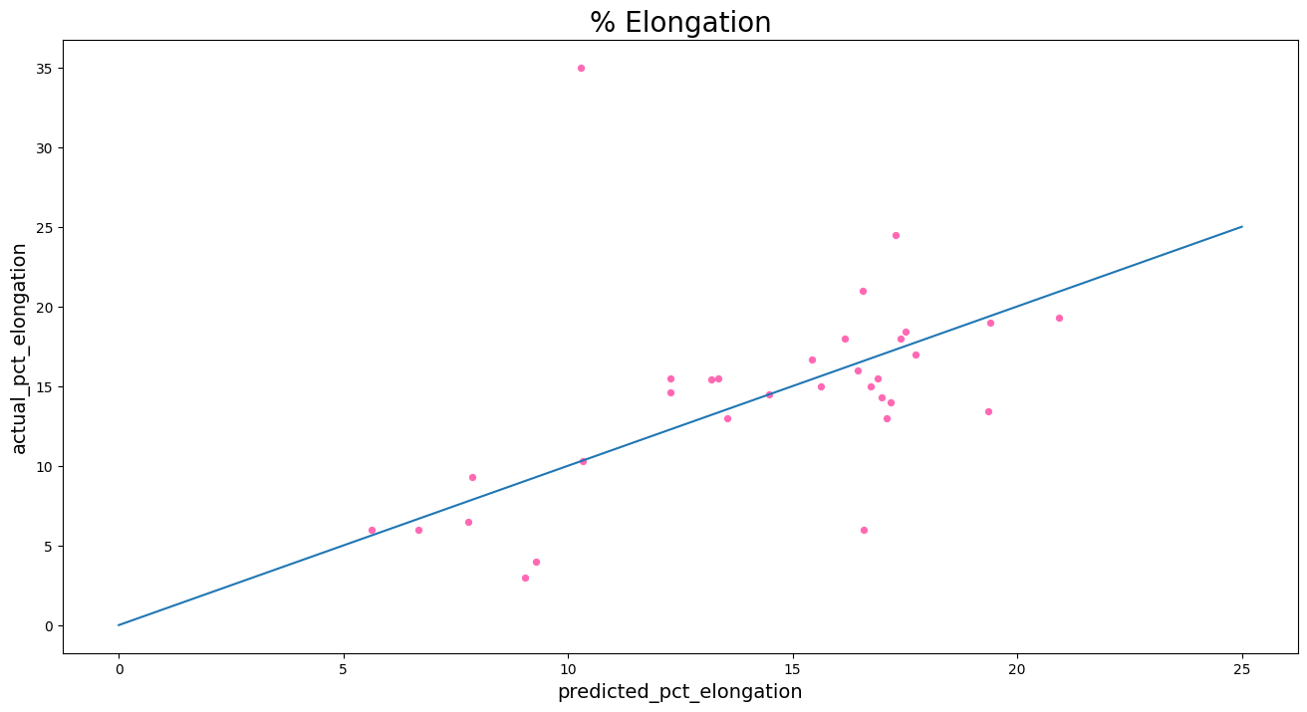
Results | Neural Networks
INDIAN INSTITUTE OF TECHNOLOGY, JODHPUR DEPARTMENT OF METALLURGY AND MATERIALS SCIENCE ENGINEERING

Slide 19

Presented By:
Chennamsetty Ushakiran(B20MT014)
Project Supervisor :
DR. NITIN KUMAR SHARMA
Project Mentor:
Navratan Panwar

