Slide 1
Project idea Course: Practical Bioinformatics for Biologists 2018 University of Groningen
Anne M. Veenstra-Skirl
Kiran Gurung

Slide 2
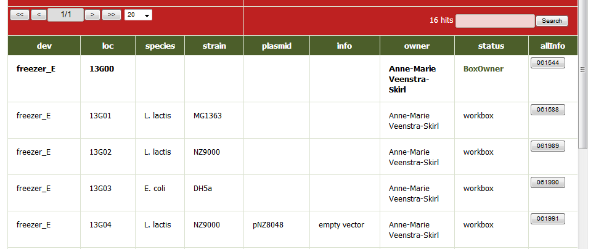
Problem: Limited search criteria; unrequired hits
Aim: To expand the search criteria

Slide 3
Project idea Course: Practical Bioinformatics for Biologists 2018 University of Groningen
Anne M. Veenstra-Skirl
Kiran Gurung

Slide 4
Outline of work flow
1. Input file
2. Provide parameters (refine the results)
3. Sorted text file

Slide 5
Tools
SQL File
&
Regular Expressions

