Slide 1
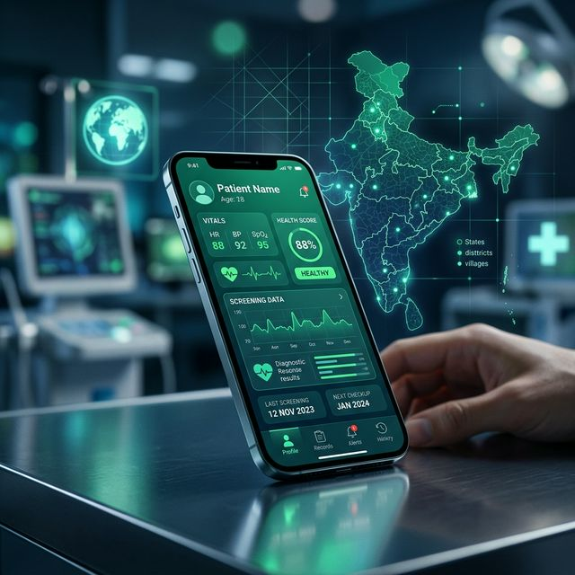
🌱JANRAKSHAK AI
"Predict Before It's Critical"
Hyper-Resilient, Offline-First Medical Intelligence for India's 1.2 Million ASHA Workers & 600M Rural Citizens
600M+
<100ms
Zero
3
Rural Target
AI Latency
Cloud Dependency
Indian Langs

Slide 2
🔴 The Problem: India's Rural Health Blackhole
600 million Indians live in the shadow of 'Late Detection'—where illness only meeting reality after it's too late.
1.4 Million
95% Access Gap
30+ KM Journey
Zero Signal
Preventable deaths annually due to delayed detection
ASHA workers still usage paper registers for critical vitals
Average distance to nearest ER-capable hospital
Villages with no stable 4G/5G remain digitally invisible
Current Workflow Error: Paper Register → No Risk Scoring → Delayed ER Routing → Fatality
Goal: Bypass the broken system and bring clinical-grade AI to a ₹6000 smartphone.

Slide 3
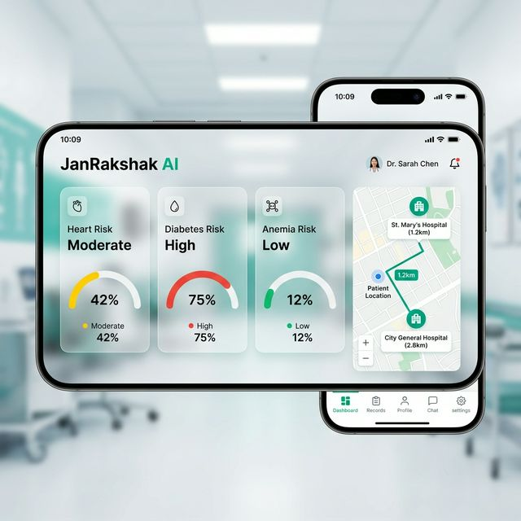
💡 Solution: JanRakshak AI — 'Pocket PHC'
Decentralizing healthcare through localized AI intelligence.
🧠 AI Risk Scoring
🤱 Maternal Care
Heart, Diabetes, and Anemia metrics analyzed under 100ms.
Automated High-Risk Pregnancy identification & protocol.
📴 Hyper-Resilience
🗺️ GPS Smart Route
Works 100% Offline; auto-syncs or sends Alerts via SMS.
Dynamic hospital mapping based on current patient location.
💬 Voice & Lang
💊 Medicine Engine
English, Hindi, Telugu voice feedback for illiterate patients.
Fuzzy-match search for 20+ diseases & 80+ home remedies.

Slide 4
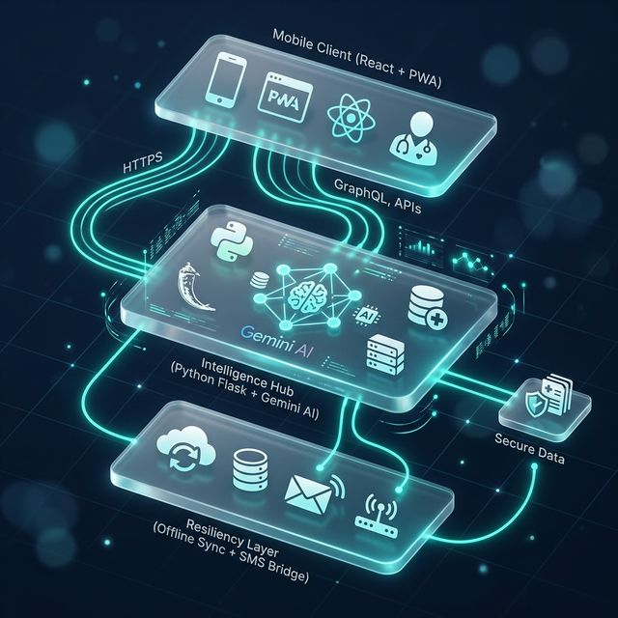
🏗️ Technical Depth: High-Performance PWA Architecture
Client
Zero-lag UI on ₹6000 Android phones.
React 18 + Vite
Server
Lightweight, secure, and easily scalable.
Python Flask API
Vision
Multimodal wound & fracture diagnosis.
Gemini 1.5 Flash
GIS
Offline routing using current GPS anchors.
Leaflet.js + OSM
i18n
0 libraries; instant Lang-switching (Hi/Te/En).
Custom Engine
Comm
Direct-to-dial emergency bypass logic.
tel: protocol

Slide 5
🚀 What Makes Us Truly Unique?
🌐 Multilingual AI Feedback
Beyond just text—AI reads reports aloud in Telugu/Hindi to bridge the literacy divide.
🌿 Hybrid Remedy Engine
Bridges 5000 years of Ayurveda with modern Medicine; 80+ remedies for mild symptom management.
📍 1-Tap SOS Triage
Automatically bypasses manual dialing; pressing 'CALL' instantly routes to 108 using native Web Protocols.
⚖️ Clinical Explainability
Every risk percentage includes a transparent health explanation, not just a black-box number.

Slide 6
🌍 Scaling Toward a Healthier India
SDG 3
SDG 10
National
Good Health & Well-being
Reduced Inequalities
Ayushman Bharat Alignment
Impact Roadmap
• Phase 1: Full ASHA digitisation across 3 States (Hindi/Telugu belt).
• Phase 2: Integration with ABHA IDs (Ayushman Bharat Digital Mission).
• Phase 3: Native hospital connectivity via National Health Authority APIs.

Slide 7
🌱 JanRakshak AI
"Predict Before It's Critical"
🚀 Step into the Future
Live Demo: http://localhost:5173
React 18 | Python Flask | Gemini AI
Built with ❤️ for Rural India by Team JanRakshak

