Slide 1
TCP/IP Protocol suite
A Coneptual Overview

Slide 2
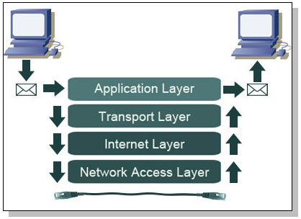
Communication on the Network

Slide 3
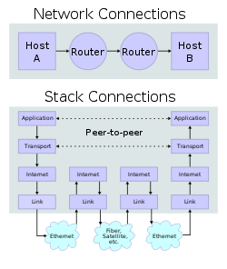

Slide 4
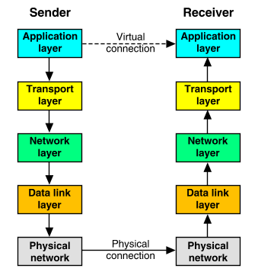
Stack of protocols

Slide 5
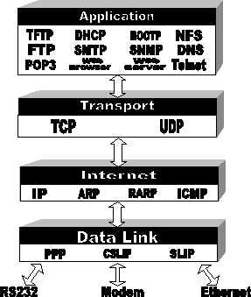
More protocols of TCP/IP Suite

Slide 6
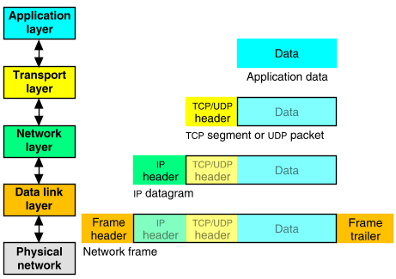
Encapsulation with Headers

Slide 7
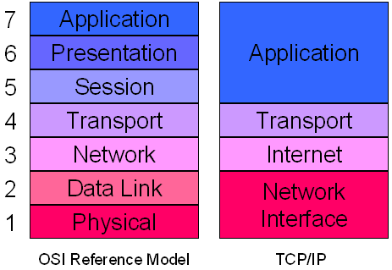
OSI Layers & TCP/IP Suite

Slide 8
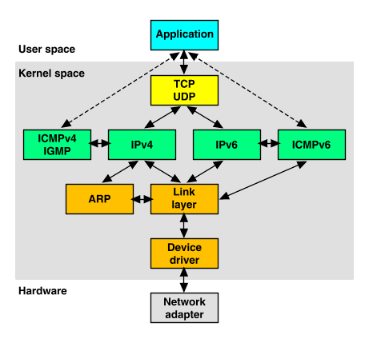
Some Protocols of TCP/IP

Slide 9
Network File System
Pioneered by SUN Micro Systems
Sharing of files/resources on the network
Allows mounting a partition over network
Based on Application Level Protocol NFS

Slide 10
Network Information System
Stand alone UNIX system has local :
  User database - /etc/passwd
  Group database - /etc/group
  Every user a separate home directory
An NIS system
  Database of user and groups shared on the network
  Provides a home dir on one of the UNIX machines
  One home dir is made available to logins of the user on remote Machines.
  Logins on multiples machines will use a single home dir on one machine

Slide 11
Domain Name System
Maps Hostnames to IP addresses
  www.symphony.com --> 84.19.33.1
Responsibility Distributed amoung nodes of hierarchicy of a tree(s)
Central Authority of the root of the tree rests with IAB, Internet Architecture Board
IANA, Internet Assigned Numberes Authority

Slide 12
Domain Name System
A DNS server for each high level domains
  .com, .org, .edu, .in, .jp, and .edu
The server for .com would have the servers of various ibm.com symphony.com as children
The server of ibm.com would have the servers of in.ibm.com, us.ibm.com and jp.ibm.com

Slide 13
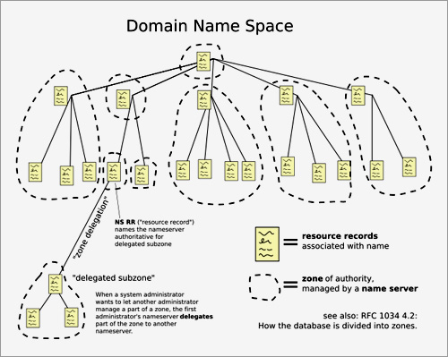
Domain Name System

Slide 14
Dynamic Host Configuration Protocol
Used to assign IP addresses to hosts newly connected to the network
A DHCP server administors the addresses
Assigns addresses as part of the client booting
Protocol is BOOTP
/etc/services has the ports for the BOOTP protocol

