Slide 1
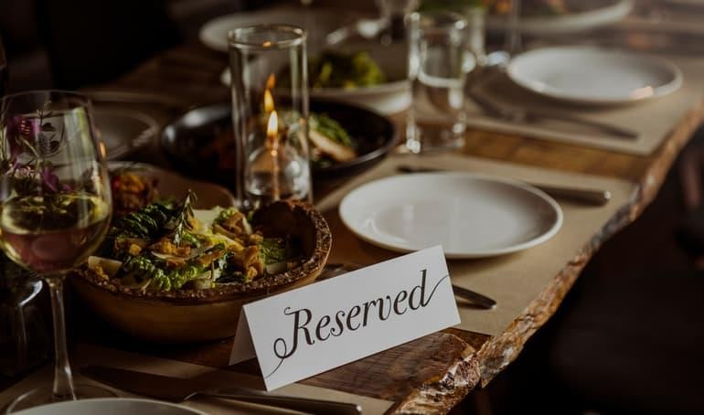
Restaurant Table Reservation System

Slide 2
Project Group Member-
Kiran Kedar NikitaBhalekar
Project guide by-
Prof.Pravin Adivarekar

Slide 3
Problem Statement
Restaurant is a kind of business that serves people all over world with readymade food. Currently this industry is going on with lot of flare the main problem with today’s Restaurant Management is the waiting problem. As sometimes so happens that sometimes their customers are more than hotel’s capacity so the customer has to wait. So, it can become Tedious and time is wasted. And for the hotel to keep all the reservation in the register were not easy as it was time consuming and the hotel was not able to keep record. Restaurant manage their business by manual especially take customer reservation.

Slide 4
Introduction
Long wait time for tables can turn the customers away or can create revulsion towards the restaurant, many of people even argue that the restaurant makes them wait unnecessarily. “Restaurant Table Reservation System” give a proper solution to the problem by allowing them to pre-book the table online. While it is appropriate to give customer a chance to look at the menu and decide their order, but it is not ideal if they feel like they are being ignored when the staff is too busy to attend them. This creates a dislike towards the restaurant. Our proposed application will reduce the load of the staff to attend them by taking order online at the time of booking. A reservation is a promise between the diner and the restaurant.Sometime customer shows up late for their table and the restaurant cancel their reservation, the customer has to wait for another table to available even after they have reserved. “Restaurant Table Reservation System” will inform the restaurant if there is a change or delaying the reservation from the customer side.

Slide 5
Objective
The key objective of current project was to allow the management administration and employees of a restaurant to grip the customers to place their orders and to find free tables according to their required number of seats. Restaurant table reservation system app will enable the user to access and manage the arrangements of table and food. The general objective of Restaurant table reservation system was to build up a reservation system for table reservation to assist workers with solving basic issues with their manual reservation system for example utilization of time, cash and vulnerability. And for the customer to Pre-Book the table

Slide 6
Scope
The scope of this project is to build an application for reserving tables for restaurants. Through restaurant reservation system online, users can be allowed to take reservations quickly and easily. The proposed system also provides additional optional features for customer to reserve which food to eat from home and reserve table through the application by just paying a booking amount to save their valuable time. It will not only help the customer but also help the restaurant to manage and serves customer easily. The manager doesn't have to maintain a guest book anymore. The manager can see who is coming and at what time. In that they are aware about which tables have been booked. The system will also notify the customer if there is a delay for their reservation by the restaurant, it will help the customer to re-schedule their reservation. The sole objective of the proposed system is to eliminate the wait time of the customer, enhance the customer eating experience and manage the large number of customers by the restaurant. Restaurant table reservation system is an android application That can affectively improve their restaurant table reservation system in order to provide direct access of every user to the management. This application can assist to avoid holding up time spend at the restaurant.

Slide 7
Literature Review
1.https://ieeexplore.ieee.org/abstract/document/5513147-An Automated FoodOrdering System using Interactive User Interface approach was created to improve the current food ordering system. A computer screen will be placed on each table for customers to make their order. Order will be sent to the server in the kitchen. Food will be delivered to customers using a robot controlled via wireless transmitter.
2.https://ieeexplore.ieee.org/document/7058749-To manage the crowd and eliminate the problem of waiting time, we have designed and proposed an application for the customer to pre-book the table at specific time. The proposed system also provides additional optional features for customer to order food from their home through the application by just paying a booking amount to save their valuable time. To satisfy and enhance the experience of the customer we have predict time using intelligent algorithm for managing table for customers. It will not only help the customer but also help the restaurant to manage and serves customer easily.

Slide 8
3.https://ieeexplore.ieee.org/document/5288330-This paper presents an integration of wireless communication technologies and web services technologies to realize a wireless food ordering system. In this system, it implements wired and wireless data access to the servers and food ordering functions through both desktop PCs and mobile devices such as PDAs over a wired/wireless integrated local area network. To sure the security of the system, the secure web service architecture and some security strategies to ensure mobile communication security are discussed. Web services-based wireless applications on mobile devices provide a means of convenience, improving efficiency and accuracy for restaurants by saving time, reducing human errors, etc.

Slide 9
Benefits for environment
As the project mentioned above is mainly an app so it does not require any work in written format on paper. So, which is very beneficial for environment as all data is saved in the app so there will be no need of paper which means less usage of paper. So, there will be less cutting of trees. As this project requires less energy so the consumption of electricity is reduced

Slide 10
Benefits for society
Rights are reserved at customer’s fingertips.
During festive seasons, tables get booked shortly, in such cases clients can make advance booking for utilization of ordering framework.
It saves client's time looking out for restaurants.
It saves business assets and costs.

Slide 11
Application
The Restaurant Table Reservation is used to people have different mindset, sometimes they don’t want to miss their favourite restaurant on their very special day or occasion so they like to book a table for the decided number of people. It significantly time saving and gives one a sense of relaxation.Sometimes we have an important meeting or a business gathering, which we want to keep in any exclusive and peaceful ambiance so we book for a suitable restaurant and make the arrangements according to the event. This controls flow of information for owner and Manager and enhance better table management which results an overall improved Management of the Restaurant.

Slide 12
PROPOSED SYSTEM
In proposed ordering system we provide facility customers to reserve tables for dining, and can also get details of hall availability for reservation of party and celebrations. At the same time this online reservation system will provide the restaurant owner to manage their services including food. Currently proposed system will be fast and easy to use and involves the application of five modules which are the reservation, the order takeaway, your order gallery ,search, profile and contact us. This system will managed by three main android applications, first one would be available for general customers for viewing and booking of table and halls. Second would be used by the admin to update the manage the services with in the restaurant premises.and third would be update seat aailability and manages staff,cutomers information.

Slide 13
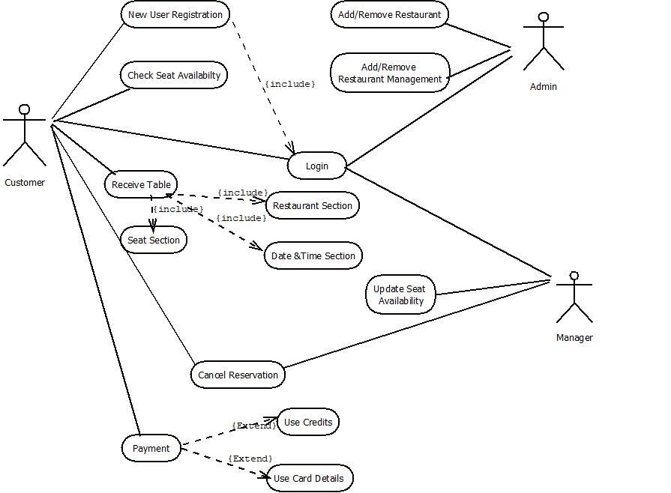
UseCase Diagram

Slide 14
Technology stack
Software Requirement :
WindowsXP,windows7 Android studio
Microsoft SQL server for backend
Hardware Requirement :
Android phone with kitkat and higher

Slide 15
Features
Smart pay
24 hours booking
Notification
Help section and blog
Ability to add menu
Ability to cancel reservations due to some reasons

Slide 16
Conclusion
The project has concluded that if a customer is willing to visit the restaurant and he finds no table is available for the dinner/lunch then he/she has to wait long for the table availability. With the help of this app user can choice the table’s location according to their need and willing

