Slide 1
WEL-COME

Slide 2


NAAC B++ Accredited & ISO 9001:2015 Certified Institute
SANT GAJANAN MAHARAJ COLLEGE OF ENGINEERING, MAHAGAON
Site- Chinchewadi, Tal – Gadhinglaj, Dist – Kolhapur 416502
DEPARTMENT OF COMPUTER SCIENCE & ENGINEERING
MINI PROJECT TOPIC : LUDO GAME

Slide 3
Student Name | Seat no.
Mr. Nikam Kiran Gungaji | 2893
Mr. Patil Aditya Vijay | 2870
Mr. Patnekar Vivek Sandeep | 2903
Mr. Patil Akhilesh Ajit | 2861
Mr. Kumbhar Prathmesh Ramdas | 2836
Under the Guidance of
Prof. Mrs. P.G. Sanmane

Slide 4
INDEX
Problem statement
Introduction
Software & Hardware Requirements
Flow Chart
Block Diagram
Implementation
Results
Advantages
Disadvantages
Conclusion
References

Slide 5
PROBLEM STATEMENTS
The problem at hand is to design and implement a digital version of the Ludo game that meets the following requirement :
Game board
Game logic
User interface
Game progression

Slide 6
INTRODUCTION
In this project, the basic Ludo that is present in the real world is computerized.
Special areas of the Ludo board are typically coloured yellow, green, blue, red. Each player is given a color and possesses four tokens(coins) of one color in their game.
The board is normally square with a cross-shaped game track, with each arm of the cross consisting of three columns with six squares per each column.
The middle column consists of five colored squares which represent the player’s respective home column.

Slide 7
REQUIREMENTS
SOFTWARE REQUIREMENTS
Language used : C Language Software : dev C++ with including graphics( graphics.h ). Operating system : windows 10
HARDWARE REQUIREMENTS
System : AMD RAM : 2GB(min) Processor : Intel i5 Memory : 128 GB SSD(min)

Slide 8
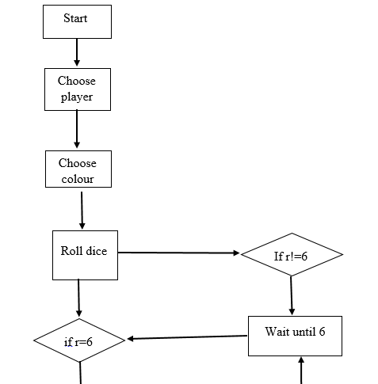
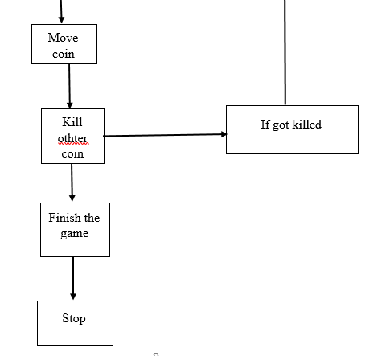
FLOW CHART
other

Slide 9
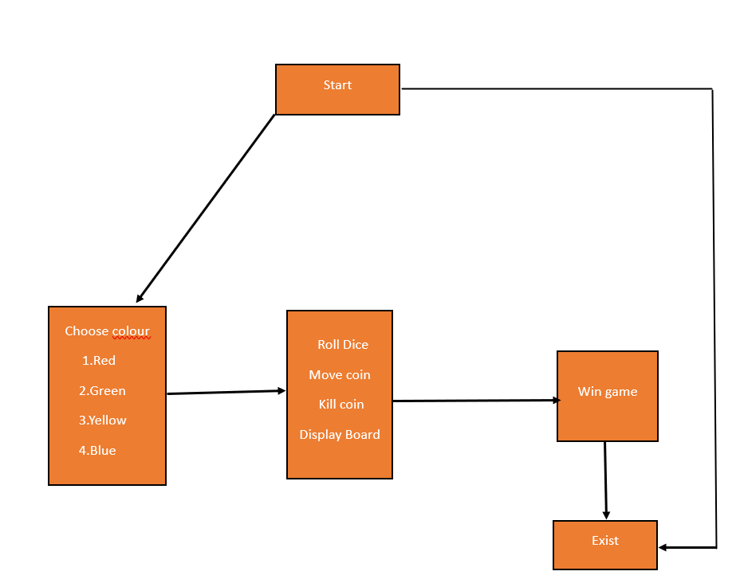
BLOCK DIAGRAM

Slide 10
IMPLEMENTATION
we have use some loops like for loop, while loop and switch case in our project.
We use file handling to store the rules of the ludo game.
We Have use graphics in our program to show the ludo board.
Some logic and functions that we used to implement in our project.
Void rd()
Void display_Board()
DATA STRUCTURE :
1. Array

Slide 11
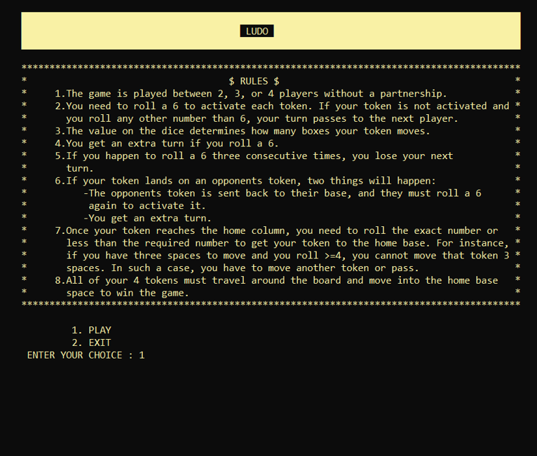
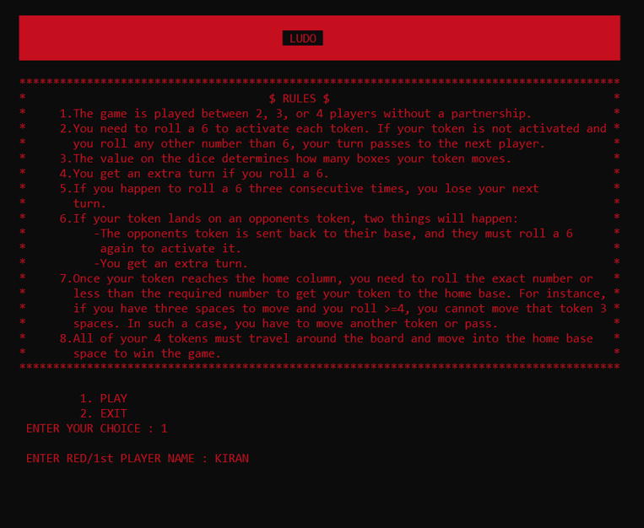
RESULTS

Slide 12
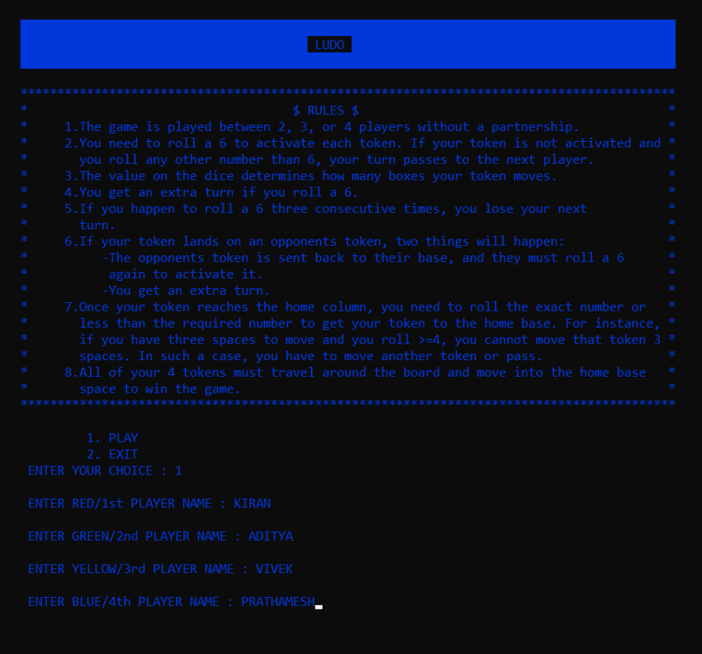
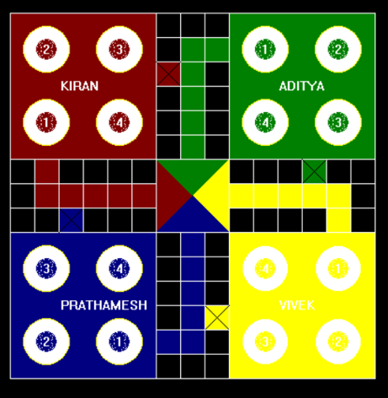

Slide 13
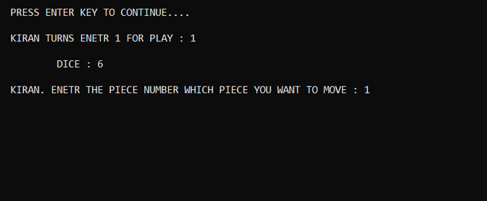
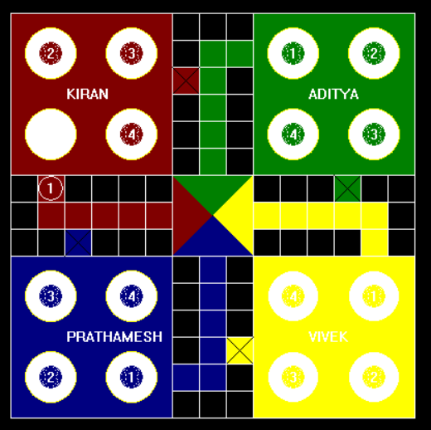
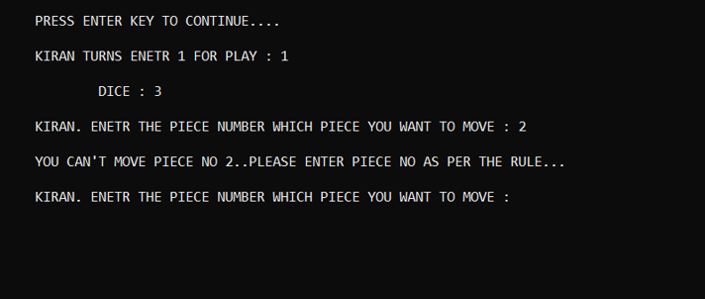

Slide 14
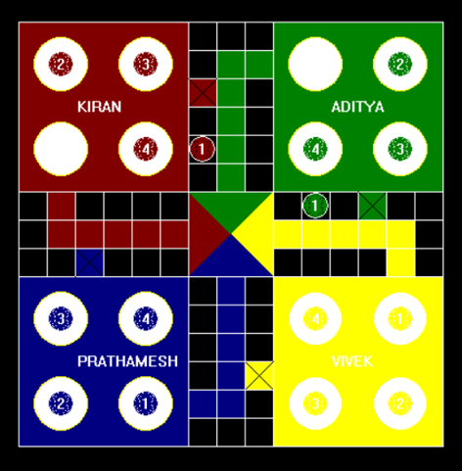
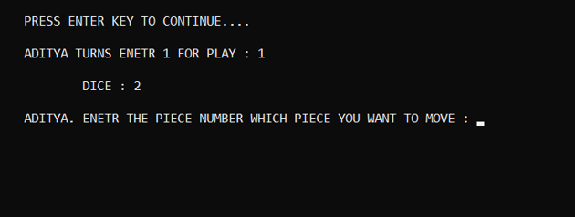

Slide 15
ADVANTAGES
Increased competitiveness.
Skill development.
Progress tracking.
Social interaction.
Extended game play.
Enhanced replayability.

Slide 16
DISADVANTAGES
Increased pressure and stress.
Frustration and disappointment.
Loss of simplicity and accessibility.

Slide 17
CONCLUSION
This project is one of the basic GUI applications of the C Programming. This game can be played and enjoyed by all the people who are very much interested.
All the players whoever they are, will become much attracted to the game as long as they are playing it. There will be no trouble playing the “ LUDO ”.

Slide 18
REFERENCES
WEB REFERENCES
https://youtube.com/playlist?list=PLiOa6ike4WAFOn9oStv0YI9QMcCVzv-AV
https://www.udemy.com/course/c-programming-for-beginners-programming-in-c/
BOOK REFERENCES
C the Complete Reference by Herbert Schild (Tata McGraw Hill) 4th Edition.
The C Programming Language- Brian W. Kernighan, Dennis Ritchie 2nd Edition.

Slide 19
ANY QUESTION ?

Slide 20
THANK YOU…

