Slide 1

Automated Testing for fixing Bugs in Android Applications
700644936
Hema Kiran Chegondi

Slide 2
CONTENTS
INTRODUCTION
WORKING
TEST RESULTS AND ANALYSIS
CONCLUSION
REFERENCES
FUTURE SCOPE

Slide 3
INTRODUCTION:
Wide usage of Android increased in last decade and replaced tasks which are done by desktops previously.
Due to this wide usage mobiles developed with big & wide screens and faster processes.
So, quality check of applications along with security issues.
To Overcome this problems strong need for testing automation tools

Slide 4
Android Bugs:
Android applications are composed of several type of java components(activities, services, broadcast receivers ,content providers).
Some of them are event-driven so, they will be having several open issues prone to new kind of bugs.
So, to overcome these kind of errors recursive testing and dynamic taint propogation is used.

Slide 5
Working:
Recursion testing:
Generally recursion testing is performed for testing the bugs that may occur in updated applications.
It takes care of the older version of application that which should not get disturbed due to the updated version.
EX: whatsapp, facebook etc
for which the older version of the applicatiions is not disturbed when the new feature is updated in the application.

Slide 6
Dynamic Taint propogation
This is the most common test for security testing, but there are two problems.
a) If the custom ROM runs in the smartphone, the running speed of ROM will be limited to the smartphone’s battery life and computing power.
b) If the program was running in emulator in PC, the efficiency will be very poor because of the manual operation for the triggering action during the running time.

Slide 7
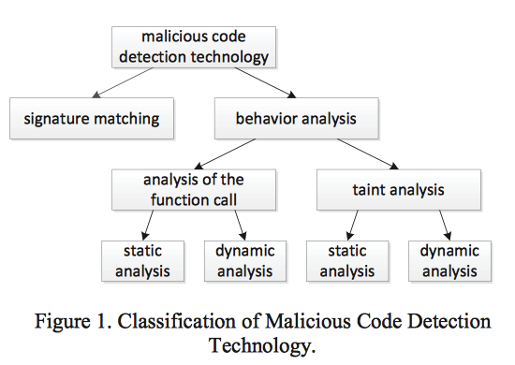
According to the study of malicious code in the application,
the paper gives a classification, The figure below puts forward a research method named dynamic taint analysis and had accomplished the design and implementation of TaintDroid.
TaintDroid is a real-time detection system based on the analysis of dynamic information flow.

Slide 8
Current Study and Insufficiency
TaintDroid
The system modifies Android’s application framework, and it
supports four levels’ data tracking.
Variable level,
method level,
message level
file level.
TaintDroid, tags will be attached to the data that came from the privacy data sources and they will spread with the data in the system.

Slide 9
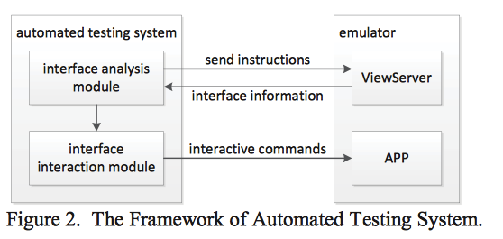
Some Automated Testing Tools
Monkey
MonkeyRunner
HierarchyViewer
In conclusion, the three tools provided by the Android SDK are not
effective for automated testing.
Implementation of Automated Testing System

Slide 10
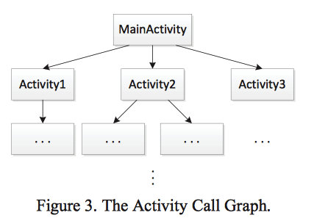
The Automated test system mainly includes two modules:
interface analysis and interface interaction.
Interface analysis
Activity is the basic interface of Android system, Generally every Android application
has a main interface as the entrance to the program, for example MainActivity which
is shown in the figure. The program can jump to other interfaces by triggering Controls
on the main interface. In the figure, the Activity such as Activity1, Activity2 and Activity3,

Slide 11
Interface Interaction
--There are two main types of call way for Activity in Android system.
One calls through triggering controls on the interface, and another
calls through radio message of the Android system.
--Considering the two cases, the interface interaction module first calls
the Activity which can be invoked, by triggering interface controls.
the interface interaction module will generate radio news to call,
according to the trigger condition stated by Activity, and then it
will analysis and trigger all the controls of the Activity.
the interface interaction module of automated interactive engine
will first the trigger the click and input events for text control, and
then trigger the click event for the button.

Slide 12
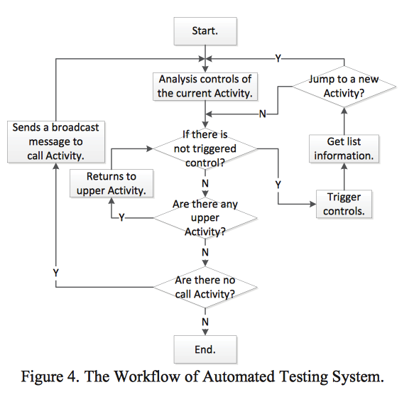

Slide 13
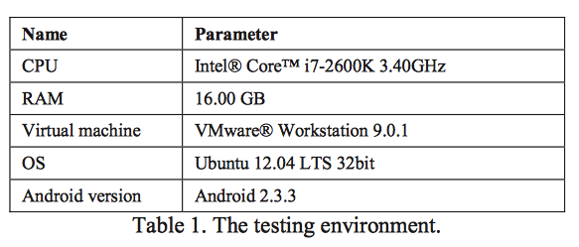
Testing
Testing Method
Testing purpose is to prove that automated testing system can complete
the operations of all the controls in the application.

Slide 14
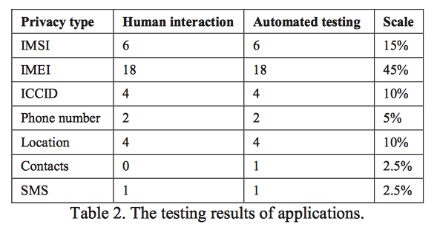
Testing Results and Analysis
Human interaction and Automated Testing values for testing application are observed in the below Table.

Slide 15
Testing Results and Analysis :
we can see that compared to human interaction and automated
testing system, the results are basically identical. The leak of contacts in an application has not been detected in human interaction, but in the automated testing system it has been found. The cause of this situation is that a button has not been triggered in human interaction.

Slide 16
Conclusion
This paper puts forward and implements the automated testing system, which is applied in the Android emulator and combined with dynamic taint propagation. It greatly improves the testing efficiency and coverage compared to previous way of human interaction. Not only to the current Android security research it provides the reference, but also can be reference by other mobile intelligent terminal OS.

Slide 17
REFERENCES:
X. Yuan and A. M. Memon. Generating event sequence-based test cases using gui runtime state feedback. IEEE Trans. on Software Engineering, 36:81–95, 2010.
IMPLEMENTATION OF AUTOMATED TESTING SYSTEM FOR ANDROID
APPLICATIONS BASED ON DYNAMIC TAINT PROPAGATION Zhu Kelong, Song Yubo, Chen Fei
Xun Yuan, Myra B. Cohen, Atif M. Memon, (2010) “GUI Interaction Testing: Incorporating Event Context”, IEEE Transactions on Software Engineering, vol. 99.
International Journal of Software Engineering & Applications (IJSEA), Vol.3, No.1, January 2012 DOI : 10.5121/ijsea.2012.3110 139 STUDY PAPER ON TEST CASE GENERATION FOR TESTING
M. Linares-Vasquez, C. Vendome, Q. Luo, and D. Poshyvanyk. How ´ developers detect and fix performance bottlenecks in android apps. In ICSME’15, pages 352–361, 2015

Slide 18
FUTURE SCOPE
As it is used to test Graphical user interface of mobile it can be also used in visual graphic test for movies making.
Can be used in video games with high graphical content (Ex: play stations)

Slide 19

Dr. Fei Cao
Thank You

