Slide 1
Windows shortcuts
W+alt+R – Recrd
W+G – Rcrdfiles
w+d - hide the windows

Slide 2
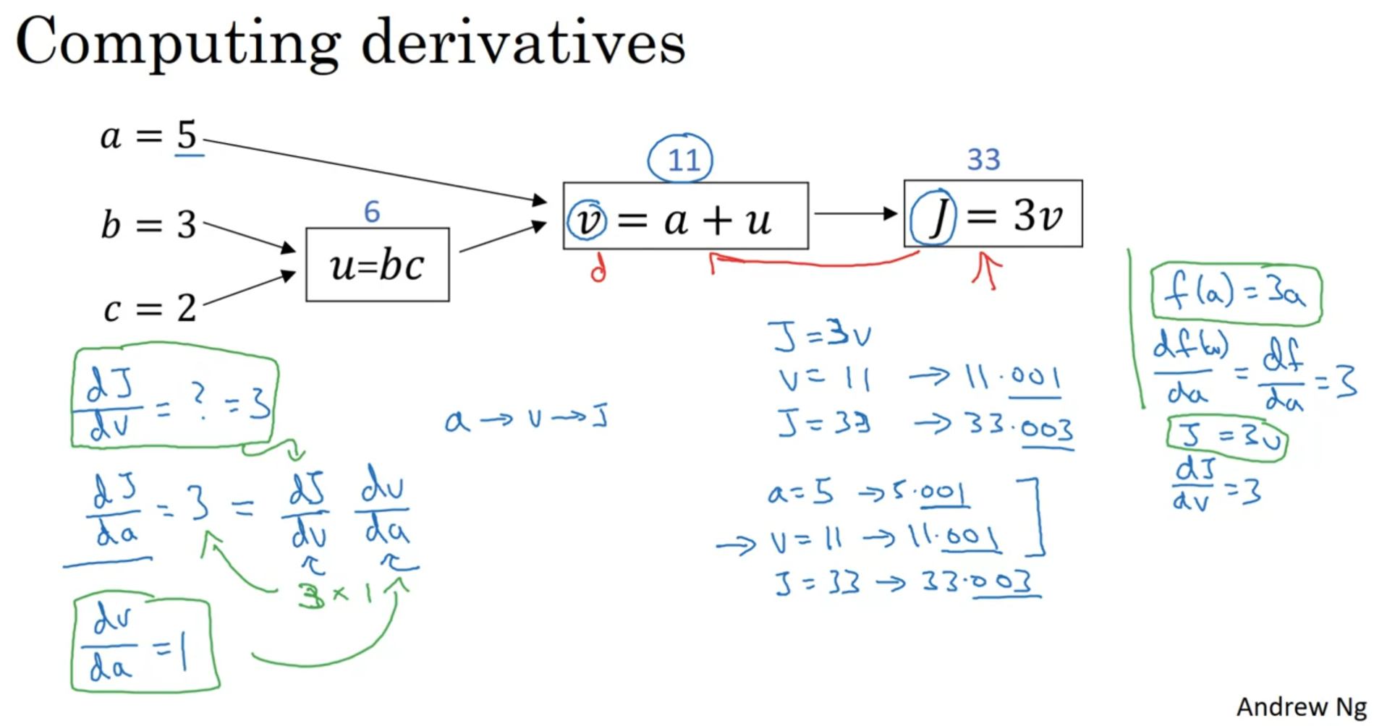

Slide 3
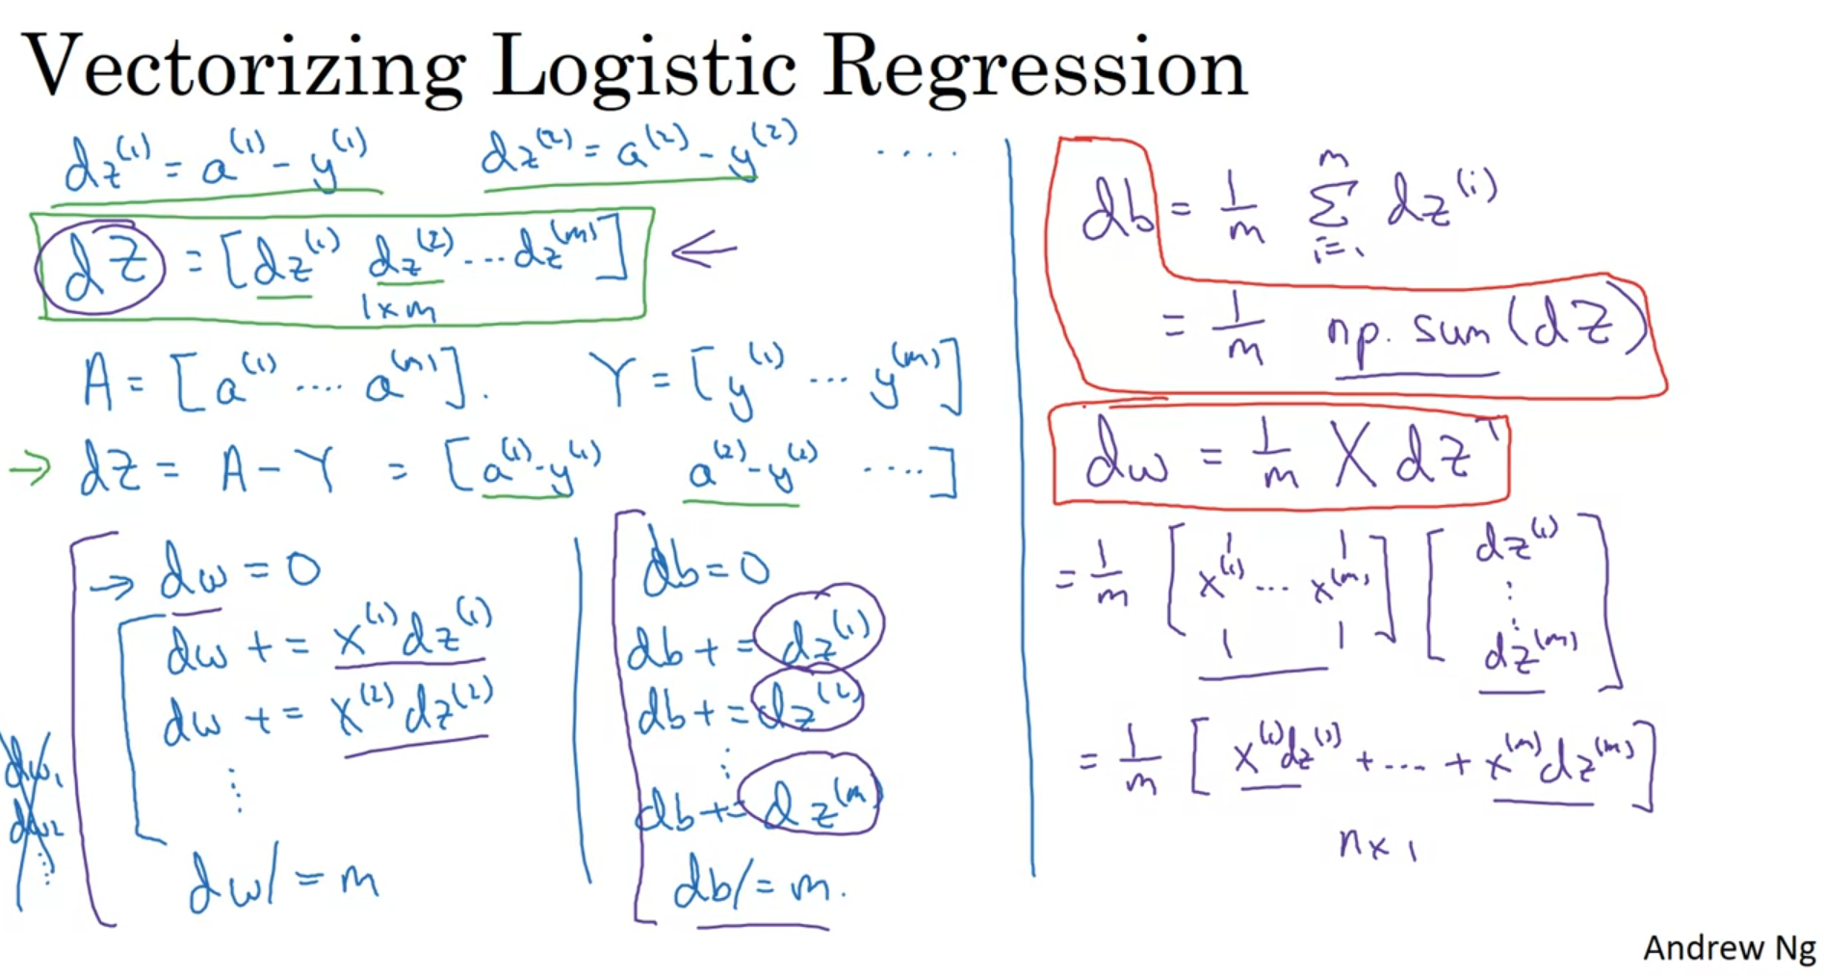

Slide 4
Key points
Cost function
Loss function
Vectorization

