Slide 1
Windows shortcuts
W+alt+R – Recrd
W+G – Rcrdfiles
w+d - hide the windows

Slide 2
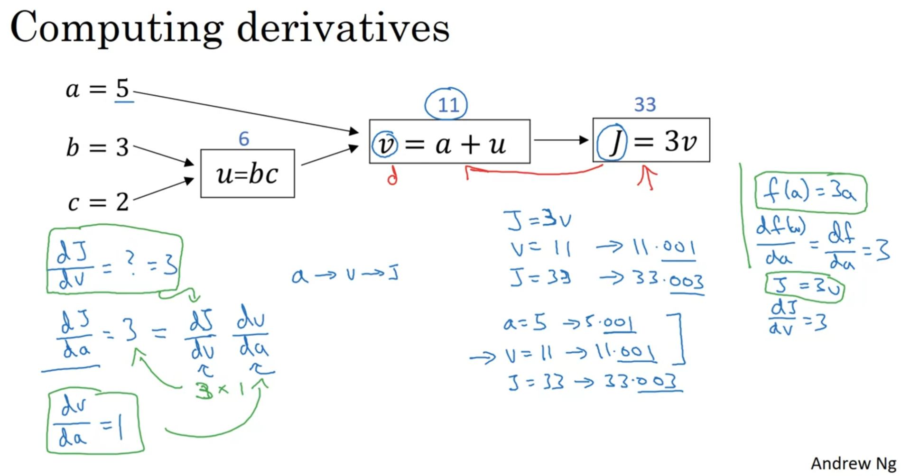

Slide 3
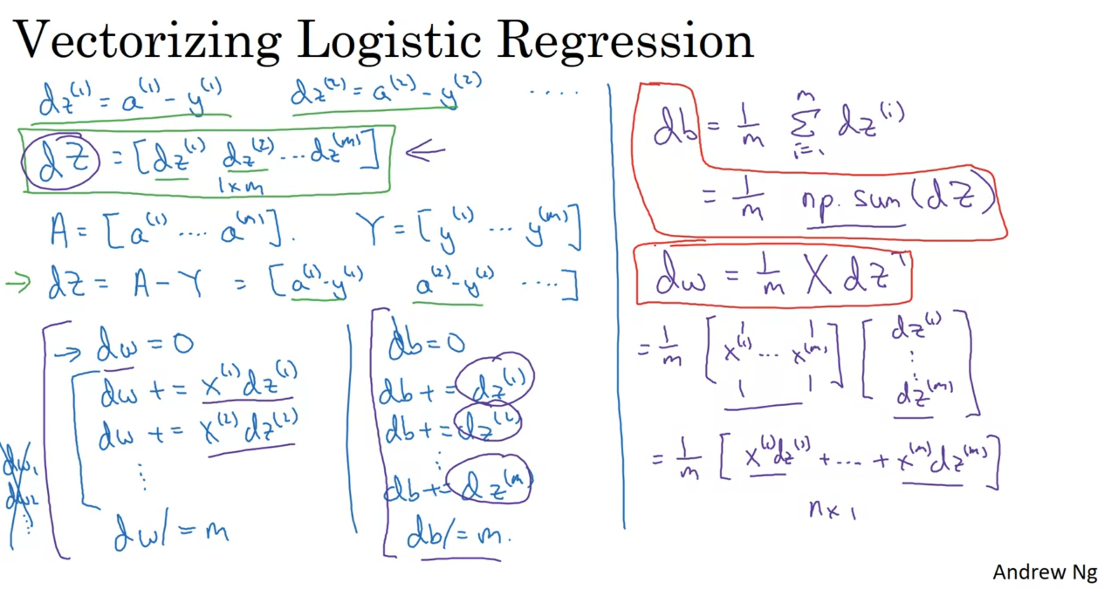

Slide 4
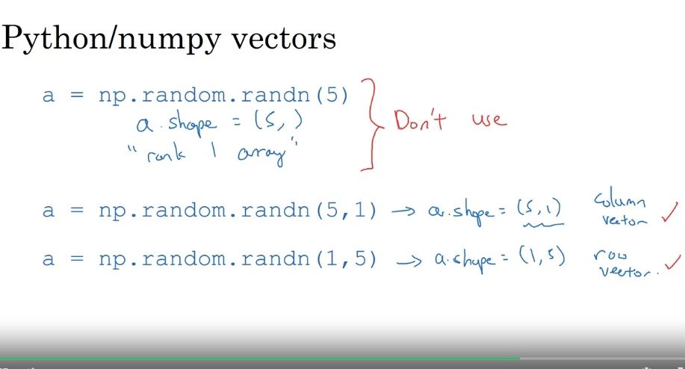

Slide 5
Implementation of function using the numpy
What you need to remember:
np.exp(x) works for any np.array x and applies the exponential function to every coordinate
the sigmoid function and its gradient
image2vector is commonly used in deep learning
np.reshape is widely used. In the future, you'll see that keeping your matrix/vector dimensions straight will go toward eliminating a lot of bugs.
numpy has efficient built-in functions
broadcasting is extremely useful
Vectorization
What to remember:Vectorization is very important in deep learning. It provides computational efficiency and clarity.
You have reviewed the L1 and L2 loss.
You are familiar with many numpy functions such as np.sum, np.dot, np.multiply, np.maximum, etc...

Slide 6
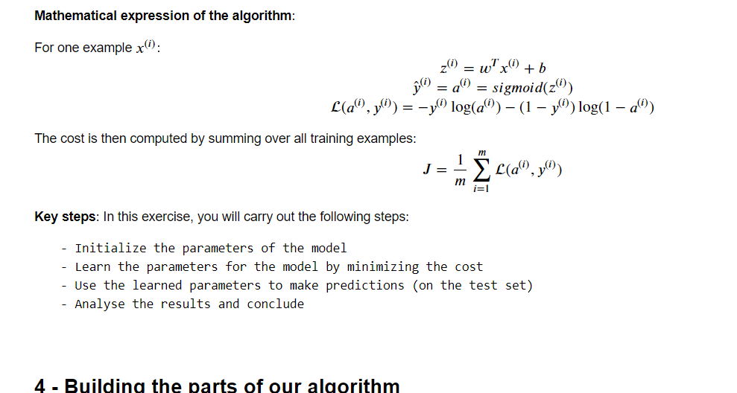
What you need to remember:
Common steps for pre-processing a new dataset are:
Figure out the dimensions and shapes of the problem (m_train, m_test, num_px, ...)
Reshape the datasets such that each example is now a vector of size (num_px * num_px * 3, 1)
"Standardize" the data

Slide 7
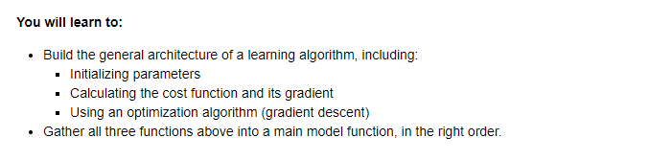

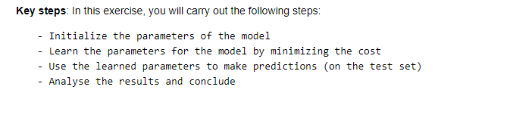
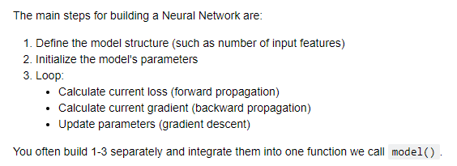
Logistic Regression with a Neural Network mindset

Slide 8
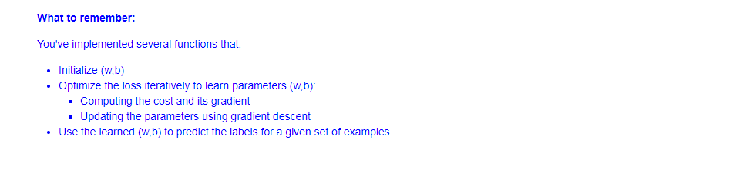


Slide 9
Key points
Cost function
Loss function
Vectorization

